Slide 1
Carbocation Rearrangement
Ayesha Shamim
Pharm.D
M.phil

Slide 2
Contents
Definition
Introduction
Classification
Mechanism
Example

Slide 3
Definition
The movement of a carbocation from an unstable state to a more stable state through the use of various structural reorganizational "shifts" within the molecule.
Once the carbocation has shifted over to a different carbon, we can say that there is a structural isomer of the initial molecule.

Slide 4
Carbocation rearrangements are extremely common in organic chemistry reactions.
However, this phenomenon is not as simple as it sounds.

Slide 5
Introduction
A carbocation is molecule having a carbon atom bearing three bonds and a positive formal charge. Carbocations are generally unstable because they do not have eight electrons to satisfy the octet rule.

Slide 6
Carbocation Classification
Methyl carbocation.
Primary carbocation
Secondary carbocation
Tertiary carbocation

Slide 7
Methyl carbocation.
A carbocation in which the open valence shell carbon is not bonded to any carbon groups is termed a methyl carbocation.
Primary carbocation
A primary carbocation is one in which there is one carbon group attached to the carbon bearing the positive charge.
It is designated as 1º carbocation.

Slide 8
Secondary Carbocation
A secondary carbocation is one in which there are two carbons attached to the carbon bearing the positive charge.
It is designated as 2º carbocation.
Tertiary Carbocation
A tertiary carbocation is one in which there are three carbons attached to the carbon bearing the positive charge.
It is designated as 3º carbocation.

Slide 9
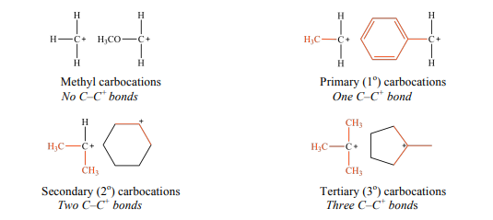

Slide 10
Exercise 1: Label each carbocation as primary, secondary, or tertiary.

Slide 11
Allyl carbocation
When the carbon bearing the positive charge is immediately adjacent to a carbon-carbon double bond, the carbocation is termed an allylic carbocation. The simplest case (all R = H) is called the allyl carbocation.

Slide 12
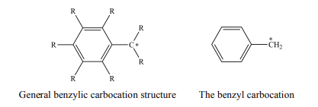
Benzyl carbocation
When the carbon bearing the positive charge is immediately adjacent to a benzene ring, the carbocation is termed a benzylic carbocation. The simplest case is called the benzyl carbocation.

Slide 13
Vinyl carbocation
When the carbon bearing the positive charge is part of an alkene, the carbocation is termed a vinylic carbocation. The simplest case is called the vinyl carbocation.
Note that the carbon bearing the positive charge has two attachments and thus adopts sp hybridization and linear geometry.

Slide 14
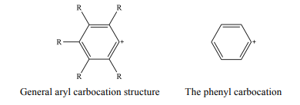
Aryl carbocation
When the carbon bearing the positive charge is part of a benzene ring, the carbocation is termed an aryl carbocation. The simplest case is called the phenyl carbocation.

Slide 15
Thank You

