Slide 1
Topic: $χ^{2}$ test

Slide 2
Chi Squared Test
A chi squared test follows a chi square distribution. This test is generally used for three purpose which are as follows:
1. Chi square test for independence
The Chi Square statistic is commonly used for testing relationships between categorical variables. The null hypothesis of the Chi-Square test is that no relationship exists on the categorical variables in the population; they are independent.
2. Chi square test for goodness of fit
Chi-squared tests often refers to tests for which the distribution of the test statistic approaches the χ² distribution asymptotically, meaning that the sampling distribution (if the null hypothesis is true) of the test statistic approximates a chi-squared distribution more and more closely as sample sizes increase.

Slide 3
3. Chi square test for variance
The chi-square test for variance is a non-parametric statistical procedure with a chi-square-distributed test statistic that is used for determining whether the variance of a variable obtained from a particular sample has the same size as the known population variance of the same variables. In order to determine the population variance, it is necessary to examine the entire population. It is often sufficient to obtain the population variance based on a representative sample. When conducting the chi-square test, the variable being tested can have any level on a scale.

Slide 4
Chi Squared Test Procedure
Formulating Hypothesis: We frame the null and alternative hypothesis. Three different forms of null and alternative hypothesis are possible which are:
$H_{0}: σ^{2}={σ^{2}}_{0} and H_{1}:σ^{2}≠{σ^{2}}_{0}$
$H_{0}:σ^{2}≤{σ^{2}}_{0} and H_{1}:σ^{2}>{σ^{2}}_{0}$
$H_{0}:σ^{2}≥{σ^{2}}_{0} and H_{1}:σ^{2}<{σ^{2}}_{0}$
2. Level of significance α is decided that can be 1%, 5% and 10%
3. Test Statistics $χ^{2}=\frac{(n−1)s^{2}}{{σ^{2}}_{0}}$
whereby
n = the sample size
$s^{2}$ = the sample variance
${σ^{2}}_{0}$ = the population variance

Slide 5
4. Critical Region
It depends upon alternative hypothesis
If $H_{1}:σ^{2}≠{σ^{2}}_{0}$ than $χ^{2}>{χ^{2}}_{1−α/2(n−1)}$ and $χ^{2}<{χ^{2}}_{α/2(n−1)}$
If $H_{1}:σ^{2}>{σ^{2}}_{0}$ than $χ^{2}>{χ^{2}}_{1−α (n−1)}$
If $H_{1}:σ^{2}<{σ^{2}}_{0}$ than $χ^{2}<{χ^{2}}_{α (n−1)}$
5. Calculation
Put all the information test statistics and get the results
6. Conclusion
If the calculated value of $χ^{2}$ falls in the critical region than we say that our null hypothesis is rejected under and the provided information and conclude that the population variance is not equal to the specific value we assumed.

Slide 6
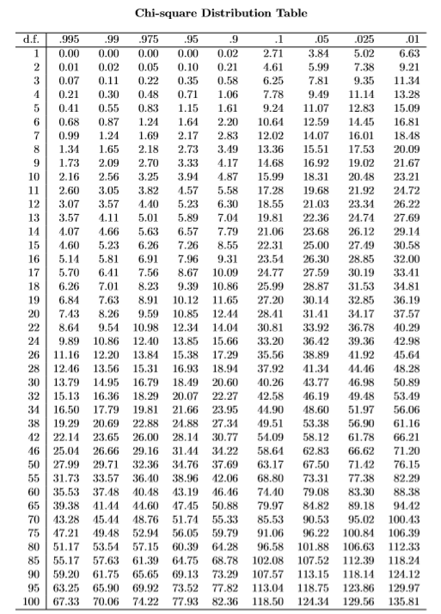

Slide 7
Questions
Q 1: A test was performed for the gear data set. The observed variance for the 20 measurements of gear diameter is 0.00003969 (the standard deviation is 0.0063). Test the null hypothesis that the true variance is greater 0.01. Using 0.05 level of significance.
Solution
Null Hypothesis: $σ^{2}≤0.01$ Alternative Hypothesis: $σ^{2}>0.01$
Level of Significance: α = 0 . 05
Test Statistics: $χ^{2}=\frac{(n−1)s^{2}}{{σ^{2}}_{0}}$
Critical Region:
$χ^{2}>{χ^{2}}_{1−α (n−1)}$
From chi square table the value of ${χ^{2}}_{1−α (n−1)}$ are as follows
${{χ^{2}>χ}^{2}}_{1−0.05 (20−1)}$
${{χ^{2}>χ}^{2}}_{0.95 \left(19\right)}=10.12$
0.0754 > 10.12

Slide 8
5. Calculation:
Here n = 20, $s^{2}$ = 0.00003969 and ${σ^{2}}_{0}$ = 0.01
Put this information in test statistics
$$χ^{2}=\frac{\left(20−1\right)0.00003969 }{0.01}=0.07541$$
6. Conclusion: As the calculated value is very smaller than the critical value we therefore do not reject Ho and conclude that the true variance is not greater but less than equals to 0.01.

