Slide 1
Principles of Design
The principles of design are the rules a designer must follow to create an effective and attractive composition. The fundamental principles of design are Emphasis, Balance and Alignment, Contrast, Repetition, Proportion, Movement and White Space.

Slide 2
Design differs from art in that it has to have a purpose. Visually, this functionality is interpreted by making sure an image has a center of attention, a point of focus. Maybe you’re thinking, ‘But wait! I thought design was all about creativity?’ If you’re an entrepreneur or designer who’s just starting out, you might be tempted to go wild and combine the first five typefaces and colors that catch your eye, believing you’re creating something fresh and new. You will probably find yourself with a design that is muddled, unfinished, or well, just plain ugly.

Slide 3
1. Emphasis
Say you’re creating a poster for a concert. You should ask yourself: what is the first piece of information my audience needs to know? Is it the band? Or the concert venue? What about the day and the cost of attending?
Make a mental outline. Let your brain organize the information and then lay out your design in a way that communicates that order. If the band’s name is the most essential information, place it in the center or make it the biggest element on the poster. Or you could put it in the strongest, boldest type

Slide 4
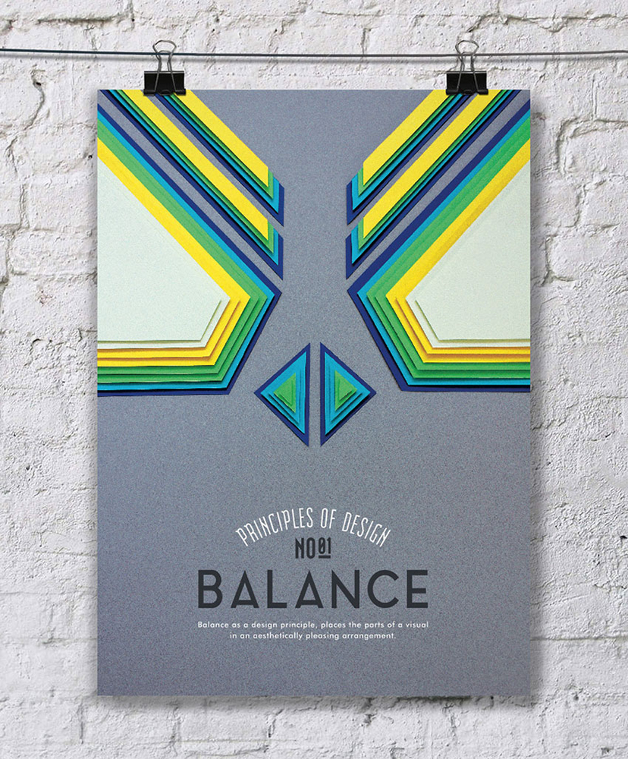
Balance and alignment
Never forget that every element you place on a page has a weight. The weight can come from color, size, or texture. Just like you wouldn’t put all your furniture in one corner of a room, you can’t crowd all your heavy elements in one area of your composition. Without balance, your audience will feel as if their eye is sliding off the page.

Slide 5
3. Contrast
Contrast is what people mean when they say a design “pops.” It comes away from the page and sticks in your memory. Contrast creates space and difference between elements in your design. Your background needs to be significantly different from the color of your elements so they work harmoniously together and are readable.

Slide 6
4. Repetition
If you limit yourself to two strong typefaces or three strong colors, you’ll soon find you’ll have to repeat some things. That’s ok! It’s often said that repetition unifies and strengthens a design. If only one thing on your band poster is in blue italic sans-serif, it can read like an error. If three things are in blue italic sans-serif, you’ve created a motif and are back in control of your design.

Slide 7
. Proportion
Proportion is the visual size and weight of elements in a composition and how they relate to each other. It often helps to approach your design in sections, instead of as a whole.

Slide 8
6. Movement
Going back to our concert poster. If you decided the band was the most important piece of information on the page and the venue was the second, how would you communicate that with your audience?
Movement is controlling the elements in a composition so that the eye is led to move from one to the next and the information is properly communicated to your audience.

Slide 9
White space
All of the other elements deal with what you add to your design. White space (or negative space) is the only one that specifically deals with what you don’t add. White space is exactly that—the empty page around the elements in your composition.
For beginning designers it can be a perilous zone. Often simply giving a composition more room to breathe can upgrade it from mediocre to successful.

Slide 10
How to use the principles of design
A design doesn’t have to strictly follow these rules to be “good.” Some absolutely mind-blowing designs ignore one or more of the principles of design in order to create an eye-catching and effective work.
Consider the cover of “The Bed Moved” by Rebecca Schiff, designed by Janet Hansen. This was one of the most lauded book covers of 2016.

