Slide 1
Effects of elevated carbon dioxide on plants

Slide 2
Effects of elevated carbon dioxide on plants
Co₂ is essential to Plant growth. Rising CO₂ concentration in the atmosphere can have both positive and negative consequences.
Increased co2 is expected to have positive physiological effects by increasing rate of photosynthesis.(carbon dioxide fertilization)
Currently, the amount of co2 in the atmosphere is 380 parts per million and oxygen is 210000 ppm.
Plant physiological and biochemical responses to elevated co2 known as the co2 fertilization effect have been studied in plants with different photosynthetic pathways, mostly in C3 species but also in C4.

Slide 3
Effects of rising atmospheric concentrations of carbon dioxide on plants
Atmospheric concentrations of carbon dioxide have been steadily rising 315 ppm in 1959 to 385ppm( keeling et al.,2009)
Rising concentrations are also likely to have profound direct effects on the growth, physiology and chemistry of plants independent of any effects on climate.
Our knowledge of plants response to future co2 concentrations rests on the results of experiments that have experimentally increased co2 and then compared the performance of the experimental plants with those grown under current ambient co2 conditions.

Slide 4
Change in climate

Slide 5
Seven sources of CO₂ from fossil fuel combustion
The seven sources of CO₂ from fossil fuel combustion are ( with % contributions for 2000-2004):
Solid fuels (e.g., coal): 35%
Liquid fuels (e.g., gasoline, fuel oil) : 36%
Gaseous fuel (e.g., natural gas ) : 20%
Flaring gas industrially and at wells : <1%
Cement production : 3%
Nonfuel hydrocarbons : <1%
The “international bunkers’’ of shipping and air transport not included in national inventories : 4%

Slide 6
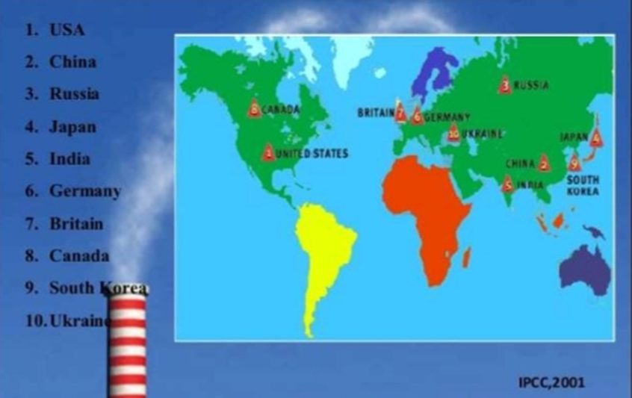
Top Ten CO₂ Producing Nations

Slide 7
Physiological effects of plants due to elevated CO₂
Behavior of stomata
Effects on the leaf
Effects on photosynthesis and photorespiration
Water use and water use efficiency
Changes in rooting pattern
Effects of CO₂ on nitrogen content
Germination
Decrease in crop duration
Effects on seed yields
Consequences on quality of food and forage

Slide 8
Effect of stomata
Elevated concentrations of CO₂ – partial stomata closure.
Reductions stomatal conductance in crops would translate into reductions of <10% in evapotranspiration, partly because of increases in temperature and decreases in humidity in the air around the crop leaves.
Due narrowing the stomata has additional benefit that a lesser amount of pollutants in the air will make it through the narrower openings.

Slide 9
Effects on the leaf
Growing plants at elevated concentration leads to increased leaf area , leaf area index, leaf area duration and leaf thickness as indicated by decreased specific leaf area (SLA) (Bowes 1993 ; Bray and Reid 2002), which is partly related to the accumulation of non-structural carbohydrates (Lambers et al. 1998).
accumulation starch increased at a rate of about 6 g/kg dry matter/hour.
Elevated CO2 causes plants to produce more number of mesophyll cells and chloroplasts.

Slide 10
Effects on photosynthesis & photorespiration
Photosynthetic capacity per unit leaf area is increased under CO2 enrichment.
The CO2 fertilization effect begins with enhanced photosynthetic CO2 fixation.
Non-structural carbohydrates tend to accumulate in leaves and other plant organs as starch , soluble carbohydrates or polyfructosans, depending on species.
This may be because the CO2 enriched plants do not have an adequate sink( inadequate growth capacity) , or lack capacity to load phloem and translocate soluble carbohydrates.
Hence Improvement of photoassimilate utilization should be one goal of designing cultivars for the future

Slide 11
Photograph of representative plant
Photograph of representative plant that we carefully removed from each of our three experimental units. The mid and high CO₂ plants appear to have nearly identical root systems, while the root system of the low CO₂ plant is not much smaller. In terms of above ground growth however there are considerably larger differences. The low CO₂ plant is much smaller than the otherd and the pant from the high CO₂ unit is significantly larger than the plant from the mid CO₂ unit.

Slide 12
Water use efficiency
Water use efficiency is the ratio of the net gain in dry matter over a given period, divided by the water loss( from the vegetation alone or from soil and vegetation together) over the same period.
Stomatal conductance decreases with increasing CO2 concentration which can cause a reduction of both leaf and whole canopy transpiration.
WUE increased with increasing CO2 due to the decline in ET.

Slide 13
Effect on Nitrogen content
Plants with nitrogen fixing symbionts (e.g., beans alfalfa) , under favorable environmental conditions for both symbionts and plants, tend to benefit more
For most plants, growth under elevated CO2 can alter the internal balance between carbon and nitrogen.
The content of non-structural carbohydrates generally increases under high CO2 while the concentrations of mineral nutrients and proteins are reduced
Decrease in tissue nitrogen is likely due to several factors :
Dilution of nitrogen from increased carbohydrates concentrations.
Decreased uptake of minerals from the soil , as stomatal conductance decreases and plants take up less water
Decreases in the rate of assimilation of nitrate into organic compounds.

Slide 14
Changes in rooting pattern
High carbon gain might increase root length, diameter and number and stimulate lateral root production in plants grown under elevated CO₂, a shift in biomass allocation from leaves to roots can occur under CO₂ enrichment.
Longer stems and extended large roots wit altered branching patterns.
Root/shoot ratios often increase under elevated CO₂ levels favoring root crops and also contribute to soil organic matter build-up

Slide 15
Decrease in crop duration
Duration of crop growth cycles are above all , related to temperature. An increase in temperature will speed up development.
Sylvan wittwer, quoted above , states that under most circumstances the availability of CO2 is the factor which limits growth. Thus with a higher level of CO2 in the air plants can grow faster with a higher temperature.

Slide 16
Germination
Increased CO2 concentrations will decrease the rate of germination.

Slide 17
Effects on seed yields
Reproductive biomass growth and vegetative biomass growth are usually increased by elevated CO₂
However, the harvest index , or ratio of seed yields to above –ground biomass yield is typically lower under elevated CO₂ conditions, which may also be evidence of the lack of capacity to utilize completely the more abundant photoassimilate.
C3 plants exhibit an increased production averaging about 30% at doubled (770ppm) CO₂ concentrations ; both biomass and seed production show an increase in almost all experiments under controlled conditions.
Plant growth and yield of soybean were increased by 45% with 120ppm CO₂

Slide 18
Quality of food and forage
Protein concentration in plant tissues are closely tied to plants nitrogen status.
Apart from an overall decrease in N and protein concentrations , as shown under elevated C0₂ , the nutritional value and the quality of the edible products of most food and forage crops are largely unknown
For wheat , barley and rice the reduction in grain protein ranged from 10% to 15 % of the value of ambient CO₂(315-400ppm )
Overall decrease for most macronutrients and micronutrients such as Fe, Zn, Mn and Cu under high CO₂ , with nutrient concentrations more affected in straw than in grains, although the responses to elevated CO₂ were species and cultivar dependent.
Quality of forage crops decrease due to higher C:N ratio.

Slide 19
Effects of CO₂ on C3 and C4 plants
Experiments concerning crop performance at elevated CO2 concentrations in general show a positive but variable increase in productivity for annual crops
C3 plants exhibit an increased production averaging about30Z% at doubled (700ppm) CO2 compared to C4 plants
49% for C3 cereals ,
20% for C4 cereals and
15% for CAM plants
the extended and occurrence of physiological adaptations of the photosynthetic apparatus , particularly pf perennial plants , to long term exposure to high CO2 concentrations – which is more directly relevant to long term climate change are still unreported.

Slide 20
Graph showing effect on photosynthesis

Slide 21
Adaptations /mitigation actions could include the following :
Selection of plants that can better utilize carbohydrates and produce less structural matter and more reproductive capacity under CO₂ enrichment.
Search for germplasms that are adapted to higher day and night temperatures , incorporate those traits into desirable crop production cultivars to improve flowering and seed set.
Change planting dates and other managements procedures to optimize yields under new climatic conditions.
Shift to species that have more stable production under higher temperatures or drought.
determine whether more favorable N:C ratios van be attained in forage cultivars adapted to elevated CO₂
Where needed , and where possible , develop irrigation systems for crops .

Slide 22
7. Micro-algae can fix carbon dioxide from different sources which can be categorized as :
C02 from the atmosphere.
CO2 from industrial exhaust gases(e.g., flue gas and flaring gas )
Fixed CO2 in the form of soluble carbohydrates (e.g. , NaHCO3 and Na2CO3).
Can be grown in closed systems , which could result in savings of precious freshwater resources

Slide 23
Summary and conclusions
Elevated CO2 increases the size and dry weight of most C3 plants and plant components.
The harvest index tends to decrease with increasing CO2 concentration and temperature.
Selection of plants that could partition more photoassimilates to reproductive growth should be a goal for future research.
C4 plants include most tropical and sub-tropical grasses and several important crops, including maize , sugar cane , sorghum, and the millets. There has therefore been considerably more research on the responses to elevated CO2 in C3 and CAM plants.
Rising CO2 over the century is likely to affect both agricultural production and food quality.

Slide 24
Thank you
Thank you

