Slide 1
Riboflavin
2

Slide 2
Introduction About Riboflavin…..
3
After isolation of thiamin (vitamin B1) as the “vitamin B” factor that prevented beriberi and polyneuritis, riboflavin (vitamin B2) was the first growth factor to be characterized from the remaining B-complex vitamins. Riboflavin in the form of flavin mononucleotide (FMN) and flavin adenine dinucleotide (FAD) functions as a coenzyme in diverse enzymatic reactions.
The vitamin is required in the metabolism of all plants and animals, and every plant and animal cell contains the vitamin.

Slide 3
HISTORY
4
The historical aspects of riboflavin were reviewed by McCollum (1957), Wagner-Jauregg (1972), Sharman (1977), Scott et al. (1982), and Loosli (1991). In 1915, it was known that a water-soluble factor or factors promoted growth and prevented beriberi in rats.
In 1920, it was found that heating feedstuffs (e.g., yeast) destroyed the beriberi preventive effect more readily than the growth-promoting effect. Therefore, it was determined that this water-soluble B vitamin contained two essential factors, one of which was more stable to heat than the other. The less stable factor was labeled vitamin F (B1 or thiamin) and the heat stable factor vitamin G (B2 or riboflavin).
The biological importance of certain yellow pigments became apparent in 1932, when Warburg and Christain (Germany) isolated an oxidative enzyme (“old yellow enzyme”) from yeast that was yellow with green fluorescence.
In 1933, Kuhn (Germany) isolated a yellow pigment from egg white that showed green fluorescence and had oxidative properties. Kuhn suggested that this growth factor for rats be given the name Flavin. Therefore, the terms ovoflavin from eggs, lactoflavin from milk, hepatoflavin from liver, and uroflavin from urine were used. Pure crystalline flavin compounds were found to contain ribose, and thus, the name riboflavin became popular.

Slide 4
History…….
5
In 1934–1935, riboflavin was synthesized by two groups—Kuhn’s in Germany
and Karrer’s in Switzerland.
At the same time, Györgi in Germany proved that the biological activity of the synthetic form was the same as that of the natural vitamin.
The synthesis of FMN was accomplished in 1936 by Kuhn and Rudy. In 1938, Warburg discovered FAD as the coenzyme of D-amino acid oxidase. Other flavin-dependent enzymes were discovered thereafter at a rapid rate.

Slide 5
Chemical Structure & Importance
6
Riboflavin consists of a dimethylisoalloxazine nucleus combined with the alcohol of ribose as a side chain. All flavins are isoalloxazines, which are 10-substituted derivatives of alloxazine, the parent tricyclic ring system, with nitrogens in positions 1, 3, 5, and 10. Riboflavin exists in three forms: as the free riboflavin and as the coenzyme derivatives FMN (also called riboflavin 5-phosphate) and FAD in Table 7.1.
The coenzyme derivatives are synthesized sequentially from riboflavin. In the first step, catalyzed by flavokinase, riboflavin reacts with adenosine triphosphate (ATP) to form FMN; then FMN combines with a second molecule of ATP to form FAD in a reaction catalyzed by the enzyme FAD pyrophosphorylase.
Riboflavin is an odorless, bitter orange-yellow compound that melts at about 280oC. Its empirical formula is C17H20N4O6, with an elemental analysis of carbon 54.25%, hydrogen 5.36%, and nitrogen 14.89%.
Riboflavin is only slightly soluble in water but readily soluble in dilute basic or strong acidic solutions. It is quite stable to heat in neutral and acid, but not alkaline solutions; very little is lost in cooking. Aqueous solutions are unstable to visible and ultraviolet light, and instability is increased by heat and alkalinity. When dry, it is not affected appreciably by light, but in solution, it is quickly destroyed.

Slide 6
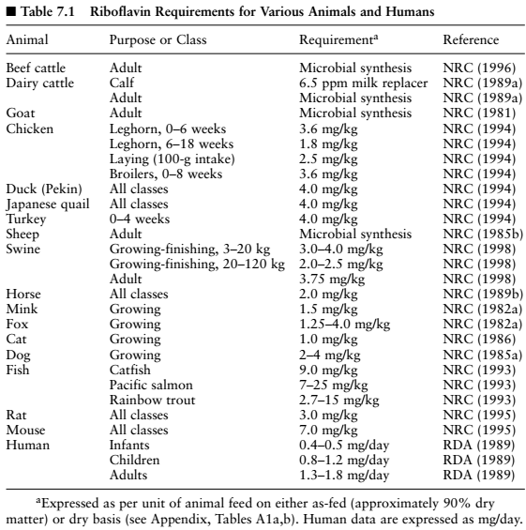
7

Slide 7
Chemical Structure & Imp……
8
Loss in milk during pasteurization and exposure to light is 10 to 20%. Much larger losses (50 to 70%) can occur if bottled milk is left standing in bright sunlight for more than 2 hours. Poultry mashes left exposed to direct sunlight for several days and frequently stirred are subject to some loss.
Many flavins which differ structurally and functionally from riboflavin, FMN, and FAD—have been discovered, with physiological roles often unknown.
The phenothiazine's (e.g., chlorpromazine, used in the treatment of schizophrenia) and the tricyclic antidepressant drugs (e.g., imipramine) are structural analogues of riboflavin and inhibit flavokinase. In experimental animals, administration of these drugs at doses equivalent to those used clinically results in increased urinary excretion of riboflavin, with reduced tissue concentrations of FMN and FAD, despite feeding diets providing more riboflavin than is needed to meet requirements.

Slide 8
Analytical Procedures
9
Analytical methods for riboflavin determination in feeds and bio- logical tissues employ fluorometric or microbiological assays. The first assays measured the biological response in the rat and the chicken, but riboflavin can be assayed more readily by chemical or microbiological methods, so animal assays have given way to these.
Growth and production of lactic acid by Lactobacillus casei are dependent on presence of riboflavin in the medium. Turbidity from the growth of the bacteria can be read in a colorimeter after 16 to 24 hours of incubation at 37oC.
Riboflavin rarely occurs free in nature, so natural products usually must be treated with acid or enzymes to liberate the riboflavin.
If FMN or FAD are to be measured, special non hydrolytic extraction procedures are required.
Unique properties of riboflavin allowing for successful fluorometric analysis include the following
(1) Riboflavin gives off an intense greenish fluorescence, with intensity proportional to the concentration.
(2) it is stable to heat and acid, allowing release from proteins.
(3) it is stable to oxidizing agents (e.g., potassium permanganate) needed to destroy other fluorescing materials.

Slide 9
Analytical Procedures……...
10
Because riboflavin is readily destroyed by blue or violet light, operations must be done in dim light or in amber or red glassware. Also, at a pH of greater than 7.0 dilute solutions may be destroyed by alkali even on clean glassware.
A high-performance liquid chromatographic (HPLC) methodology has been developed to determine riboflavin in plant (Fernando and Mur- phy, 1990)
And Animal (Li et al., 1993) sources that compares with fluorometric procedures.
Using HPLC, it is possible to simultaneously determine the three principal forms of the vitamin, riboflavin, FMN, and FAD in foods (Russell and Vanderslice, 1991).

Slide 10
Metabolism
11
Digestion, Absorption, and Transport

Slide 11
Contin………..
12
Riboflavin is found in feeds as FAD, FMN, and free riboflavin. Riboflavin covalently bound to protein is released by proteolysis digestion. Phosphorylated forms (FAD, FMN) of the riboflavin are hydrolyzed by phosphatases in the upper gastrointestinal tract to free the vitamin for absorption.
Free riboflavin enters mucosal cells of the small intestine after apparently being absorbed in all parts of the small intestine. In a comparison between jejunal and ileal cells from guinea pigs, cells from both portions of the small intestine transported riboflavin almost equally (Hegazy and Schwenk, 1983).
Cells from deficient animals have a greater maximal absorption uptake of riboflavin (Rose et al., 1986). At low concentrations, riboflavin absorption is an active Na+-dependent carrier-mediated process (Hegazy and Schwenk, 1983). However, Said et al. (1993a,b) suggest that the carrier-mediated system in the rabbit is Na+- and pH-in- dependent in nature and transports the substrate rather by an electroneutral process.
At high concentrations, riboflavin is absorbed by passive diffusion, proportional to concentration (Middleton, 1990).

Slide 12
Contin………..
13
In mucosal cells, much of the riboflavin is phosphorylated to FMN by flavokinase.
Riboflavin enters the blood as both FMN and the free vitamin.
In tissues, most of the FMN is then converted to the other coenzyme FAD by FAD-pyrophosphorylase.
Transport of flavin by blood plasma is known to involve both loose association with albumin and tight associations with some globulins (McCormick, 1990).
A genetically controlled riboflavin-binding protein is present in serum and eggs. There is a hereditary recessive disorder in chickens renal riboflavin uriain which the riboflavin-binding protein is absent (White, 1996). Eggs become riboflavin deficient, and embryos generally do not survive beyond the fourteenth day of incubation (Clagett, 1971). Also, if riboflavin-binding protein is in excess, it can diminish riboflavin availability to the chicken embryo (Lee and White, 1996).
Much of the control of riboflavin utilization is at the level of flavo- coenzyme formation. Hormonal control affects riboflavin metabolism, and specific binding proteins can be greatly increased by estrogen ad- ministration (Rivlin, 1984). Thyroid hormones enhance conversion of riboflavin into its coenzyme derivatives and hypothyroidism decreases it.

Slide 13
Tissue Distribution, Storage, and Excretion
14

Slide 14
Contin…….
15
Animals do not appear to have the ability to store appreciable amounts of riboflavin; the liver, kidney, and heart have the richest concentrations.
Liver, the major site of storage, contains about one-third of the total body flavins. A significant amount of free riboflavin exists in retinal tissue, but its function is unclear. Free riboflavin constitutes less than 5% of the stored flavins, with 70 to 90% in the form of FAD.
In- takes of riboflavin above current needs are rapidly excreted in urine, primarily as free riboflavin. The kidney excretes both riboflavin and FMN, the latter being dephosphorylated in the bladder. Minor quantities of absorbed riboflavin are excreted in feces, bile, and sweat.

Slide 15
Functions
16

Slide 16
Contin……
17
Riboflavin is required as part of many enzymes essential to utilization of carbohydrates, fat, and protein. More than 100 enzymes are known to bind FAD or FMN in animal and microbial systems.
Riboflavin and related natural flavins participate in numerous and diverse reactions, perhaps more than for any other vitamin-coenzyme group.
FMN and FAD, which contain riboflavin, function as prosthetic groups that combine with specific proteins to form active enzymes called flavo- proteins. Most flavoproteins contain the FAD form, and a few contain FMN. Riboflavin in these coenzyme forms acts as an intermediary in the transfer of electrons in biological oxidation-reduction reactions. The enzymes that function aerobically are called oxidases, and those that function anaerobically are called dehydrogenases.
The general function is in oxidation of substrate and generation of energy (ATP). By involvement in the hydrogen transport system, flavoproteins function by accepting and passing on hydrogen, undergoing alternate oxidation and reduction.

Slide 17
Contin……
18
Collectively, the flavoproteins show great versatility in accepting and transferring one or two electrons with a range of potentials. Many flavo- proteins contain a metal (e.g., iron, molybdenum, copper, zinc), and the combination of flavin and metal ion is often involved in the adjustments of these enzymes in transfers between single- and double-electron donors. Xanthine oxidase contains the metals molybdenum and iron. It converts hypoxanthine to xanthine and the latter to uric acid. It also re- acts with aldehydes to form acids, including the conversion of retinal (vitamin A aldehyde) to retinoic acid.
Riboflavin functions in flavoprotein-enzyme systems to help regulate cellular metabolism, and is also specifically involved in metabolism of carbohydrates. Riboflavin is also an essential factor in amino acid metabolism as part of amino acid oxidases. These oxidize α-amino acids to corresponding amino acids that decompose to give ammonia and α-keto acid.

Slide 18
REQUIREMENTS
19
Riboflavin requirements vary with heredity, growth, environment, age, activity, health, other dietary components, and synthesis by host.
The majority of species have a requirement between 1 and 4 mg/kg of diet (dry basis). Where sufficient data are available, studies indicate that riboflavin requirements decline with animal maturity and increase for reproductive activity.
Chicks receiving diets only partially deficient in riboflavin may recover spontaneously, indicating that requirement rapidly decreased with age (Scott et al., 1982). However, Dey- him et al. (1992) reported that 3.6 ppm dietary riboflavin for growing broilers was satisfactory through 4 weeks, but that benefits were obtained by exceeding the 3.6 ppm recommendation through 8 weeks. Several studies have indicated that the riboflavin requirement for prevention of leg paralysis is higher than that for growth (Ruiz and Harms, 1988).

Slide 19
NATURAL SOURCES
20
Riboflavin is synthesized by green plants, yeasts, fungi, and some bacteria.
Rapidly growing, green, leafy vegetables and forages, particularly alfalfa, are a good source, with the vitamin richest in the leaves. Ce- reals and their by-products have a rather low content, in contrast to their supply of thiamin. Oil meals are fair sources.
While grains and protein meals contain some riboflavin, they should not be relied on as the sole source of the vitamin. Riboflavin concentrates obtained from whey and distiller’s soluble are important commercial sources, particularly for animal feeds.
Although fruits and vegetables are moderately good sources of this vitamin, they are not consumed in sufficient quantities to meet daily requirements (Cooperman and Lopez, 1991) . Riboflavin concentration in various foods and foodstuffs is shown in Table 7.2. .
Riboflavin is more bioavailable from animal products than plant sources. Flavin complexes in plants are more stable to digestion and thus less digestible than animal sources (Combs, 1992).

Slide 20
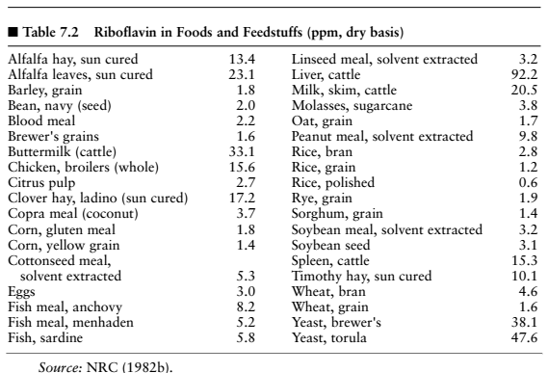
21

Slide 21
Contin….
22
For human diets milk, eggs, liver, heart, kidney, and muscle meat are rich sources. Riboflavin content of milk, such as that of cows and goats, is many times higher than content in their feed because of rumen synthesis.
Human milk contains about 0.5 mg riboflavin/L, while cow’s milk is three times higher (e.g., 1.7 mg/L).
For humans in the United States, it has been estimated that milk and milk products contribute al- most one-half of dietary riboflavin in the diet, with meat, eggs, and legumes contributing about 25%. Fruits, vegetables, and cereal grains contribute about 10% each (Hunt, 1975).
Riboflavin is one of the more stable vitamins, but it can be easily destroyed by ultraviolet rays or sunlight. Appreciable amounts may be lost upon exposure to light; up to one-half the riboflavin content is lost in cooking eggs and pork chops in light and most of the vitamin in milk stored in clear glass or plastic bottles. However, processes like pasteurization, evaporation, and condensation have little effect on riboflavin content of milk. Sun-drying of fruits and vegetables is likely to lead to substantial losses of vitamin activity.

Slide 22
Deficiency
23
Riboflavin deficiency also results in a decrease in the conversion of the vitamin B6 coenzyme pyridoxal phosphate to the main vitamin B6 urinary excretory product of 4-pyridoxic acid (Kodentsova et al., 1993).
Riboflavin deficiency had an effect on iron metabolism, with less iron absorbed and an increased rate of iron loss due to an accelerated rate of small intestinal epithelial turnover (Powers et al., 1991, 1993).
In Gambian men, riboflavin deficiency reduced iron utilization with hemoglobin levels increased after riboflavin supplementation (Fairweather- Tait et al., 1992).

Slide 23
Effects of Deficiency
24
Animals and humans are unable to synthesize riboflavin within tissues; therefore, requirements are met principally by dietary sources, with some intestinal microbial synthesis. Since riboflavin plays many essential roles in the release of food energy and the assimilation of nutrients, it is understandable why deficiency is reflected in a wide variety of signs that vary among species.
. However, it is not possible to relate signs to specific biochemical roles that have been established. A decreased growth rate and lowered feed efficiency are common signs in all species affected. Typical clinical signs often involve the eyes, the skin, and the nervous system. Riboflavin deficiency would not be expected in young nursing animals, as milk is a rich source of the vitamin.

Slide 24
Ruminants
25
Riboflavin is not required in the diet of adult ruminants because ruminal microorganisms synthesize this vitamin in adequate amounts. Apparently no response to supplemental riboflavin has been reported in animals with a functional rumen. Confirmation of net synthesis in the rumen can be obtained from work such as that of McElroy and Goss (1940), in which secretion of riboflavin in milk was shown to be equivalent to approximately 10 times dietary intake.
A dairy cow producing 21 kg milk per day loses about 36 mg of riboflavin in milk alone, much more than the amount consumed in the diet. Beef cattle and other lactating ruminants that have a much lower loss of riboflavin due to lowered milk production are even less likely to be deficient in the vitamin.
Riboflavin deficiencies have been demonstrated in young ruminants whose rumen flora is not yet established. Failure to provide riboflavin results in redness of the buccal mucosa, lesions in the corners of the mouth, loss of hair, and excessive tear and saliva production (Radostits and Bell, 1970). Less specific signs are anorexia, diarrhea, and reduced growth.

Slide 25
Swine
26
Typical swine diets based largely on grains are often borderline to deficient in riboflavin. Signs of riboflavin deficiency in the young growing pig include anorexia, slow growth (Fig. 7.3), rough hair coat, dermatitis, alopecia, abnormal stiffness, unsteady gait, scours, ulcerative colitis, inflammation of anal mucosa, vomiting, cataracts, light sensitivity, and eye lens opacities (Cunha, 1977; NRC, 1998).
Reduced feed in- take was demonstrated in gilts given a lactation diet containing 1.3 mg/kg of riboflavin. These gilts consumed 30% less feed than gilts receiving 2.3 to 5.3 mg/kg of riboflavin (Frank et al., 1988). Typical clinical signs often involve the eye, the skin, and the nervous system. In severe riboflavin deficiency of pigs, researchers have observed increased blood neutrophil granulocytes, decreased immune response, discolored liver and kidney tissue, fatty liver, collapsed follicles, degenerating ova, and degenerating myelin of the sciatic and brachial nerves (NRC, 1998).
In riboflavin-deficient swine, reproduction is impaired (Fig. 7.4). Cunha (1977) summarized the clinical signs for gilts fed a riboflavin-deficient diet during reproduction and lactation as follows: (1) erratic or, at times, complete loss of appetite; (2) poor gains; (3) parturition 4 to 16 days premature; (4) one case of death of fetus in advanced stage with resorption in evidence; (5) all pigs either dead at birth or within 48 hours thereafter; (6) enlarged front legs in some pigs due to gelatinous edema in the connective tissue and generalized edema in many others; and (7) two hairless litters.

Slide 26
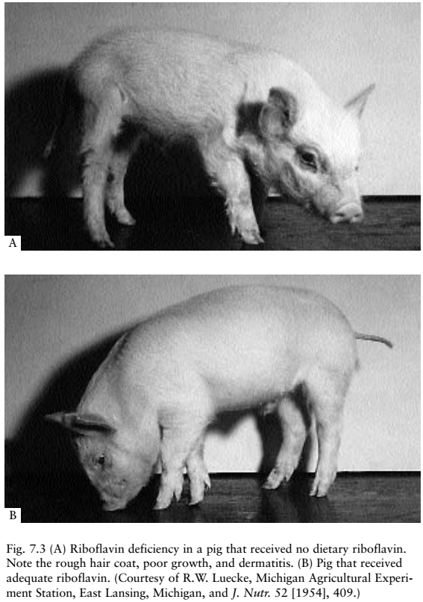
27

Slide 27
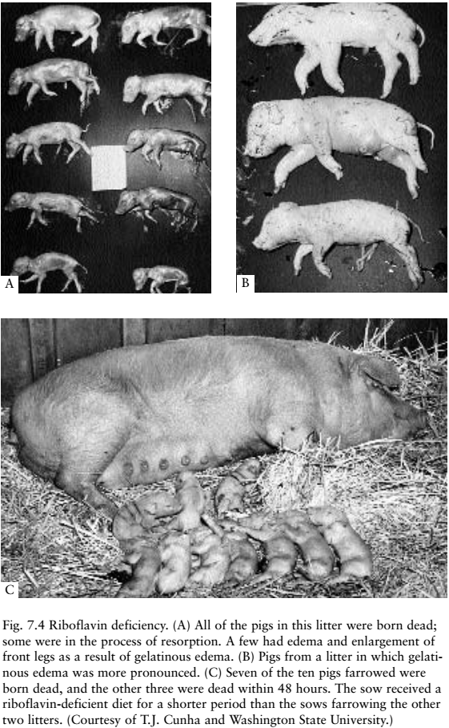
28

Slide 28
Poultry
29
Only a few of the feedstuffs fed to poultry contain enough riboflavin to meet the requirements of young growing poultry. The most critical requirements for riboflavin are those exhibited by the young chick and the breeder hen. The characteristic sign of riboflavin deficiency in the chick is “curled-toe” paralysis. However, it does not develop when there is ab- solute deficiency, or when the deficiency is very marked, because the chicks die before it appears.
Chicks are first noted to be walking on their hocks with their toes curled inward. Deficient chicks do not move about except when forced to do so, and their toes are curled inward (Fig. 7.5) both when walking and when resting on their hocks (Scott et al., 1982). Legs become paralyzed, but the birds may otherwise appear normal.
Changes in the sciatic nerve produces curled-toe paralysis in growing chicks. There is a marked enlargement of sciatic and brachial nerve sheaths, with the sciatic nerve reaching a diameter four to six times normal size.
Signs of riboflavin deficiency in the poult and duckling differ from those in the chick. In the poult, dermatitis appears in about 8 days; the vent becomes encrusted, inflamed, and excoriated; growth is retarded or completely stopped by about the seventeenth day; and deaths begin to occur about the twenty-first day. In the duckling, clinical signs include diarrhea and cessation of growth.

Slide 29
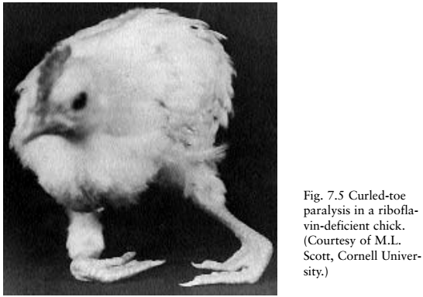
30

Slide 30
Contin….
31
In laying poultry, hatchability of incubated eggs is first reduced, and subsequently, egg production is decreased, roughly in proportion to degree of deficiency. Embryonic mortality typically has two peaks, and of- ten a third peak.
These are, respectively, on the fourth and twentieth days and on the fourteenth day of incubation. Embryos that fail to hatch from eggs of hens receiving low-riboflavin diets are dwarfed and exhibit pronounced micromelia; some embryos are edematous.
The down fails to emerge properly, resulting in a typical abnormality termed “clubbed” down, which is most common in neck areas and around the vent. The nervous systems of these embryos show degenerative changes much like those described for riboflavin-deficient chicks. When dietary riboflavin provided to breeder hens was decreased from 9.7 to 1.7 mg/kg, embryo mortality increased to 83.3% and hatchability to 3.1%; decreasing riboflavin from 9.7 to 7.0, or 4.4 mg/kg had no effect on these variables (Flores-Garcia and Scholtyssek, 1992).
Chicks fed a diet only marginally deficient in riboflavin often re- cover spontaneously. The condition is curable in the early stages, but in its acute stage, it is irreversible (NRC, 1994). There is increasing evidence that vigor and livability of the baby chick are directly tied to amount of riboflavin in the hen’s diet (Anonymous, 1969).

Slide 31
Horses
32
It is generally felt that riboflavin synthesis in the cecum and colon provides some of the horse’s requirement. When Carroll et al. (1949) fed a diet containing 0.4 mg of riboflavin per kilogram of dry matter, riboflavin concentrations (mg/kg of ingesta dry matter) in the various intestinal sections were as follows: duodenum, 3.8; ileum, 1.1; cecum, 7.0; anterior large colon, 9.2; and anterior small colon, 12.2. Horses fed low- riboflavin diets demonstrated anorexia, sporadic but severe weight loss, general weakness, and poor growth (Pearson et al., 1944).

Slide 32
Cats and Dogs
33
Riboflavin-deficient dogs exhibit low growth rates, anemia, and corneal lesions (NRC, 1985a). The animals collapse, become comatose, and die. During the deficiency state, dermatitis develops on the chest, abdomen, inner thigh, axilla, and scrotum. In the final stages of the deficiency disease, muscular weakness develops and progresses within a few days to ataxia, followed by collapse, coma, and death (Hoffmann- La Roche, 2000). Cats deficient in the vitamin develop cataracts, fatty livers, testicular hypoplasia, and alopecia with epidermal atrophy (NRC, 1986). Riboflavin deficiency manifests itself in cats after 4 to 8 weeks with anorexia, weight loss, and death. Anorexia resulting in weight loss and death is the principal deficiency sign in cats (Gershoff et al., 1959). Chronic riboflavin deficiency in cats results in hair loss extending to the chest and feet, cataracts, and alopecia with epidermal atrophy.

Slide 33
Fish
34
Signs of riboflavin deficiency in fish are species specific (NRC, 1993). The only common signs are anorexia and poor growth. The first sign of riboflavin deficiency observed in salmonids (Halver, 1957; Stef- fens, 1970) appeared in the eyes and included photophobia, cataracts, corneal vascularization, and hemorrhages. Lack of coordinated swimming and dark skin color were also reported for riboflavin-deficient chi- nook salmon (Halver, 1957) and rainbow trout (Steffens, 1970). Additional signs of riboflavin deficiency in trout include slow growth, anorexia, inefficient conversion of feed, and opaque lens and cornea (NRC, 1993).
Channel catfish fed riboflavin-deficient diets developed deficiency signs including anorexia, poor growth, short-body dwarfism, and cataracts. Common carp exhibited nervousness, photophobia, and hemorrhages, with the initial deficiency signs of anorexia and nervousness. Signs of deficiency in Japanese eels were poor growth, anorexia, hemorrhage in fins and abdomen, photophobia, and lethargy (NRC, 1993).

Slide 34
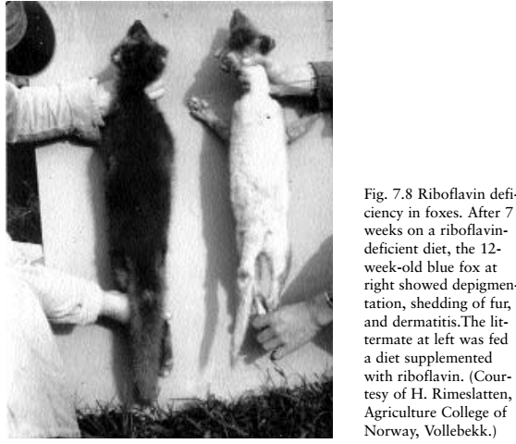
FOXES AND MINK
35
Riboflavin deficiency in foxes results in decreased growth rate, signs of muscular weakness, chronic spasms, coma, opacity of the cornea, and decreased pigment production in the fur (Fig. 7.8). Foxes on a riboflavin-deficient diet show signs similar to those seen in riboflavin-deficient dogs. Mink on a riboflavin-deficient diet exhibit anorexia, weight loss, extreme weakness, and poor breeding results (NRC, 1982a).

Slide 35
Humans
36
Riboflavin deficiency signs have been observed in humans consuming nutritionally poor diets and under experimental conditions. As in animals, riboflavin deficiency is believed to retard growth in humans, al- though no growth experiments have been undertaken. Clinically, riboflavin deficiency in humans is usually observed in conjunction with deficiencies of other B vitamins.
Clinical features of riboflavin deficiency include seborrheic dermatitis around the nose and mouth; soreness and burning of the lips, mouth, and tongue; photophobia; burning and itching of the eyes; superficial vascularization of the cornea; cheilosis; angular stomatitis; glossitis; anemia; and neuropathy (Fig. 7.10) (Rivlin, 1984).
Clinical signs of glossitis begin with flattening, followed by disappearance of the tongue filiform papilla. The fungiform papillae become enlarged, the tongue color changes to a beefy red, the tongue is sore, and loss of taste sensation develops (Cooperman and Lopez, 1991). Dermatitis due to riboflavin deficiency begins most often in the nasolabial fold and is scaly and oily. Similar lesions may also appear around the eyes and on the ears.

Slide 36
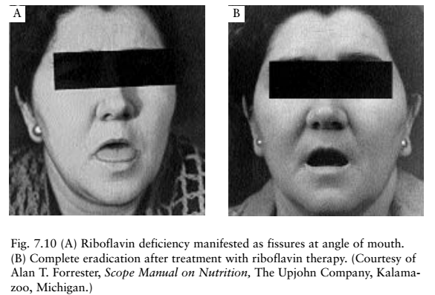
37

Slide 37
Contin…..
38
Dermatitis of the scrotum or vulva is frequently present (Marks, 1975). Corneal vascularization due to riboflavin deficiency always occurs in the entire circumference of the cornea and is nearly always bilateral. Corneal vascularization may be a result of the oxygen requirement of the corneal epithelium. Cells of the cornea have no hemoglobin supply but maintain integrity by intracellular oxidative processes that depend on riboflavin activity. Tears are a rich source of riboflavin. Foy and Mbaya (1977) stated that in vitamin A deficiency the tear ducts are blocked with keratin, and vascularization of the cornea follows from lack of tears. Thus, such patients should be given both vitamin A and riboflavin.
One of the first systemic experimental studies in humans resulted in cheilosis in 10 of 18 women consuming a low-riboflavin diet during a 94- to 130-day period (Sebrell and Butler, 1938). Cheilosis began with pallor of the lips in the angles of the mouth, followed by maceration. Within a few days, superficial transverse fissures appeared in the angles of the mouth.

Slide 38
Assessment of Status
39
Several methods have been used to assess nutritional status of riboflavin. These include clinical signs, blood and urine levels of the vita- min, and measurement of enzymatic coenzyme activity. The most certain way of identifying a riboflavin deficiency seems to be to cause a remission of the clinical signs in question by feeding riboflavin alone. Measuring riboflavin excretion in the urine is of some value, with the limitation that daily output of riboflavin is usually an estimate of dietary intake. Riboflavin red blood cell content appears to be a better measure on the basis of human studies. For the laying hen, riboflavin concentration in egg albumen is an excellent status indicator of the vitamin(Squires and Naber, 1993). The estimated minimum critical egg albumen riboflavin concentrations needed to support maximum reproductive function are between 1.9 and 2.9 ppm.
The most rapid and dramatic biochemical method of determining riboflavin status is loss of erythrocyte glutathione reductase (EGR) activity, an FAD-containing enzyme. The ratio of EGR activity in erythrocytes with and without added FAD is considered the activity coefficient. Experimental studies including those with livestock, laboratory animals, humans, and even fish have shown that EGR activity is a very sensitive and specific indicator of riboflavin deficiency (Frank et al., 1988; Boisvert et al., 1993; Pettigrew et al., 1996).

Slide 39
SUPPLEMENTATION
40
Riboflavin is one of the vitamins most likely to be deficient for both non ruminant animals and humans. Before their rumens are developed, young ruminants (up to 2 months of age), if early weaned or dependent on milk replacer, have a dietary need for riboflavin. Cereal grains, though poor sources of riboflavin, are important for people in many developing countries where cereals constitute the major dietary component. Often, individuals in developing countries do not have the economic resources to consume the major dietary sources of riboflavin of meat, milk, and dairy products.
Supplementation and education programs for humans need to be implemented in developing countries to ensure adequate riboflavin in- take. Growing children and pregnant-lactating mothers are groups at risk of deficiency. In India, children who received 5 mg of riboflavin daily for 1 year had elevated EGR levels, improved hand steadiness, and reduced incidence of glossitis (Prasad et al., 1990). Additional risk groups for whom supplemental riboflavin is required are people who exercise, alcoholics, diabetics, drug users, patients with chronic heart disease, patients on diuretics or undergoing hemodialysis, preterm in- fants, and people with other disease conditions (see Requirements).

Slide 40
Contin….
41
Riboflavin is commercially available as a crystalline compound produced by chemical synthesis or fermentation. Most of the commercially available riboflavin is made by bacterial synthesis, a cheap and convenient way to produce crystalline riboflavin. It is available to the feed, food, and pharmaceutical industries as a high-potency U.S. Pharmacopeia (USP) or feed-grade powder, spray-dried powders, and dry dilutions. The water-soluble, riboflavin 5-phosphate salt is available for liquid oral and parenteral pharmaceuticals. High-potency USP or feed-grade powders are electrostatic, hygroscopic, and dusty; thus they do not flow freely, and they show poor distribution in feeds. In contrast, dilution of riboflavin as a spray-dried powder or dry dilution product, or including it in a premix, reduces its electrostacity and hygroscopicity for better flowability and distribution in feeds (Adams, 1978). Diluted riboflavin is added to feeds to increase its mixing properties.
Riboflavin is remarkably stable during heat processing (see Chemical Structure, Properties, and Antagonists; Natural Resources). How- ever, considerable loss may occur if foods are exposed to light during cooking, and some losses occur in feed administered to animals out of doors. Only the portion of the feed exposed to light would be destroyed; therefore, this may be of little significance as only the top of concentrate mixtures in automatic feeders would be affected. In dry form, riboflavin is extremely resistant to oxidation even when heated in air for long periods.

Slide 41
TOXICITY
42
A large body of evidence has accumulated indicating that treatment with riboflavin in excess of nutritional requirements has very little toxicity for experimental animals or for humans (Rivlin, 1978). Most data from rats suggest that dietary levels between 10 and 20 times the requirement (possibly 100 times) can be tolerated safely (NRC, 1987). When massive amounts of riboflavin are administered orally, only a small fraction of the dose is absorbed; the remainder is excreted in the feces. Toxicity is lacking probably because the transport system necessary for the absorption of riboflavin across the gastrointestinal mucosa becomes saturated, limiting riboflavin absorption (Christensen, 1973).
Also, capacity of the tissues to store riboflavin and its coenzyme deriva- tives appears to be limited when excessive amounts are administered. No case of riboflavin toxicity in humans has been reported, and oral doses per kilogram of body weight of 340 mg for mice, 10 g for rats, and 2 g for dogs produced no toxic effects (Cooperman and Lopez, 1991).

Slide 42
Contin…
43
Riboflavin is somewhat more toxic when administered parentally. Only when doses of 600 mg/kg body weight were administered in traperitoneally to rats were ill effects evident (Unna and Greslin, 1942). Then anuria developed, and at autopsy, crystals were apparent in the collecting tubules and renal pelvis. Rainbow trout, like other animals, were insensitive to excess dietary riboflavin, as levels of 600 mg/kg of diet produced no undesirable effect on growth (Hughes, 1984).

Slide 43
44

