Slide 1
FARM BUSINESS ANALYSIS (NET WORTH STATEMENT, INCOME STATEMENT AND PROFITABILITY ANALYSIS)
By Hanzala Zulfiqar

Slide 3
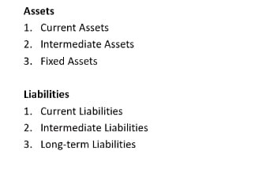
Net Worth Statement or Balance Sheet

Slide 4
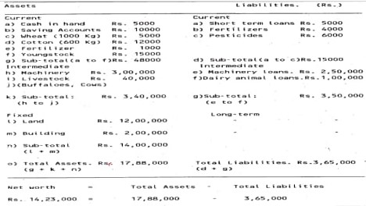

Slide 14
