Slide 1
Book: Learning PHP, MySQL, JavaScript, and CSS By Robin Nixon
SECOND EDITION

Slide 2
CHAPTER 1
Introduction to Dynamic Web Content

Slide 3
Introduction of Web
Tim Berners-Lee (a CERN fellow, (the European Laboratory for Particle Physics) devised a method of navigating between them using a hyperlinking framework, which came to be known as the Hyper Text Transfer Protocol, or HTTP.
He also created a markup language called HTML, or Hyper Text Markup Language.
To bring these together, he wrote the first web browser and web server.

Slide 4
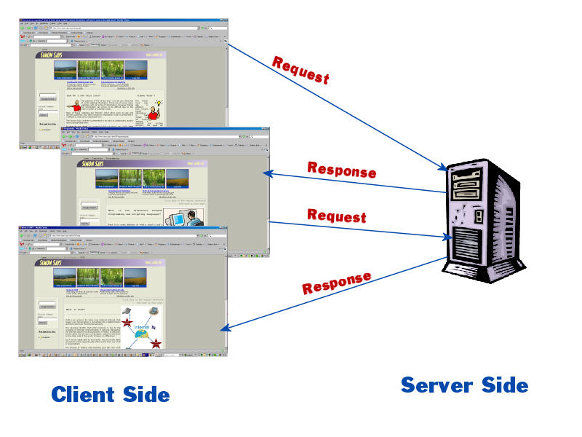
Clients and Servers
The Web is a client/server application: Web browsers are clients which send requests to Web servers, which send responses back.

Slide 5
Fetching Pages over the Internet
Architecturally, the Internet consists of a collection of layers, each one providing services for the one above it:
The Internet Layer gets packets to their destinations;
The Transport Layer sends streams of data;
The Application Layer provides high-level services to applications such as Web browsers.

Slide 6
Uniform Resource Locators (URLs)
Without a universal addressing mechanism, it would be impossible to navigate to a site, and page linking would not be feasible
Uniform Resource Locators (URLs) are used to identify Web pages — basically a URL is a web address
URLs have 3 components:
A Prefix (usually http:// )
A Hostname: (such as www.cityu.edu.hk)
A Path: (such as /scm/index.htm)

Slide 7
Uniform Resource Locators (URLs)
Example:
http://www.cityu.edu.hk/scm/index.htm
Path
Identifies a file within a hierarchical directory structure on the server
Host name
Identifies a particular computer somewhere on the Internet
Prefix
The transfer protocol required to request data from the server

Slide 8
HTTP
HTTP makes use of TCP to open connections between clients and servers and to pass the requests and responses between them.
When a user clicks a link or types a web address:
A TCP connection is opened between browser and server
Then requests and responses are sent back and forth using HTTP
HTTP is a stateless protocol, meaning each request for data is dealt with in isolation; once the server sends the response, it forgets everything about the original request.

Slide 9
Uniform Resource Locators (URLs)
Example:
http://www.cityu.edu.hk/scm/index.htm
Path
Identifies a file within a hierarchical directory structure on the server
Host name
Identifies a particular computer somewhere on the Internet
Prefix
The transfer protocol required to request data from the server

Slide 10
IP Addresses and DNS
Every computer connected to the Internet must have a unique IP address, no matter whether it’s a client or a server (or both)
An IP address is just a number that identifies a host on the Internet. Example:
212.171.218.34 or 144.214.5.218
The Domain Name System (DNS) is a database that matches IP addresses to host names

Slide 11
Domain Names
And the Domain Name System (DNS) translates host names into IP addresses, which are then used by TCP to establish connections between HTTP clients and servers.
Domain names are administered in such a way that they are guaranteed to be unique.
Domain names are organized in a hierarchical structure….

Slide 12
Top Level Domains
Top Level Domain (TLD)
Mostly country domains: .uk, .pk, .hk, etc.
www.cityu.edu.hk
www.cityu.hk
www.apple.com
Generic Top Level Domain (gTLD)
.com .org .net .info .name .tv

Slide 13
Second Level Domains
www.cityu.edu.hk
www.cityu.hk
www.apple.com
The actual name of the organisation or service.
Can contain letters (a to z), numbers (0 to 9), dashes ( - )

Slide 14
Third Level, or Sub Domains
www.cityu.edu.hk
sweb.cityu.edu.hk
www.apple.com
store.apple.com
seminars.apple.com
Strings of characters that designate different services, or hosts within the second level domain.
E.G. “www” for the core or main website, “sweb” for SCM’s(supply chain management) sub-network within CityU.

Slide 15
Registering Domain Names
Registered with the HKDNR in Hong Kong
www.hkdnr.hk
www.cityu.edu.hk
www.cityu.hk
www.apple.com
Registered with any global registration service
networksolutions.com register.com directNIC.com
etc.
Chinese character domain names now also available

Slide 16
Registering Domain Names
Registering a domain name can either be done directly with a registration service, such as HKDNR, or through a website hosting service.
Either way, you have to pay a fee for domain registration that is separate from any site hosting fees you may pay.
gTLD domains (.com, .org, .net): US$12 - 15 per year
Country domains in Hong Kong:
.com.hk, .org.hk, .net.hk: HK$200 per year
.hk: HK$250 per year

Slide 17
Linking Domain Names and IP Addresses
A domain name, once registered, needs to be associated with a fixed IP address of a web server on the Internet. When you register and setup a new domain name, you need to enter details of at least 2 nameservers.
These nameservers are special internet servers that implement a name service protocol.
They may be provided by a web hosting service, or a domain registration service.
They link a domain name to the specific IP address assigned for a website. Examples:
ns0.directnic.com ns1.directnic.com
Note: Most commercial hosting services provide a form of virtual hosting, placing many websites on a single server, so special software is used to route domains names to assigned IP address.

Slide 18
Domain Names… not just websites
Once your domain name is assigned a specific IP host you can:
Set up and run a website (www.cityu.edu.hk)
Set up e-mail accounts (nick.foxall@cityu.edu.hk)
Set up file transfer capabilties (ftp.cityu.edu.hk)

Slide 19
Paths
http://www.cityu.edu.hk/scm/index.htm
Path
Identifies a file within a hierarchical directory structure on the server
Host name
Identifies a particular computer somewhere on the Internet
Prefix
The transfer protocol required to request data from the server

Slide 20
Home Page Naming
Web servers will automatically serve up pages file-named
index.html index.htm default.htm default.html
…as long as ONE page by those filenames resides in the root directory of your site.
If you want to use a page by another name as the home page of the site, you will have to configure the server software to point to that page.

Slide 21
The Request/Response Procedure for average web page
1. You enter http://server.com into your browser’s address bar.
2. Your browser looks up the IP address for server.com.
3. Your browser issues a request for the home page at server.com.
4. The request crosses the Internet and arrives at the server.com web server.
5. The web server, having received the request, looks for the web page on its hard disk.
6. The server retrieves the web page and returns it to the browser.
7. Your browser displays the web page.

Slide 22
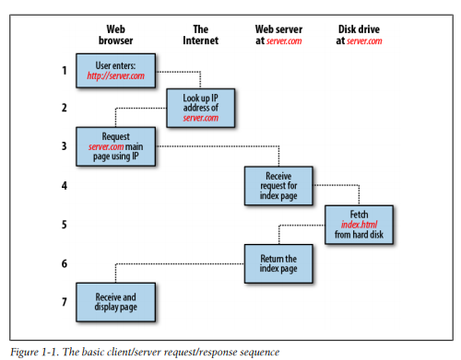

Slide 23
The Request/Response Procedure for dynamic webpages
You enter http://server.com into your browser’s address bar.
Your browser looks up the IP address for server.com.
Your browser issues a request to that address for the web server’s home page.
The request crosses the Internet and arrives at the server.com web server.
The web server, having received the request, fetches the home page from its hard disk.

Slide 24
With the home page now in memory, the web server notices that it is a file incorporating PHP scripting and passes the page to the PHP interpreter.
The PHP interpreter executes the PHP code.
Some of the PHP contains MySQL statements, which the PHP interpreter now passes to the MySQL database engine
The MySQL database returns the results of the statements back to the PHP interpreter.
The PHP interpreter returns the results of the executed PHP code, along with the results from the MySQL database, to the web server.
The web server returns the page to the requesting client, which displays it.

Slide 25
