Slide 52
Biodiversity Of Pakistan
Pakistan's native flora reflects its varied climatic zones,
which range from arid and semi-arid to temperate and tropical.

Slide 53
Geography of Pakistan
Pakistan lies in Southern Asia,
bordering the Arabian Sea,
between India on the east and
Iran and Afghanistan on the
west and China in the north
total: 803,940 sq km
land: 778,720 sq km
(Cultivated, Rangeland, Protected areas)
water: 25,220 sq km

Slide 54
Gilgit and Baltistan are located between 34.60-37.40 N and 740–77.50 E with total area of 45224 sq. km
North Pakistan(Gilgit-Baltistan) are rich in biodiversity as they are situated at the junction of three mountain ranges (Shinwari et al., 2011).
Approximately 6000 species of higher plants in Pakistan (Stewart, 1972).
Nearly 600 plant species identified as having medicinal value (Shinwari, 1996)

Slide 55
Climate change
Climatic changes are vertically influenced due to high mountain ranges
Organisms are adapted to their environments and have explicit tolerance ranges to different temperature and other abiotic conditions
If conditions change beyond an organism’s tolerance, the organism must move to a more suitable location or face extinction

Slide 56
In mountain ecosystems, all sectors of the population are affected by the harsh weather and environmental conditions prevailing at high altitude,
compounded by active erosion problems that result in land degradation
Constrain their ability to live in a mountain environment

Slide 57
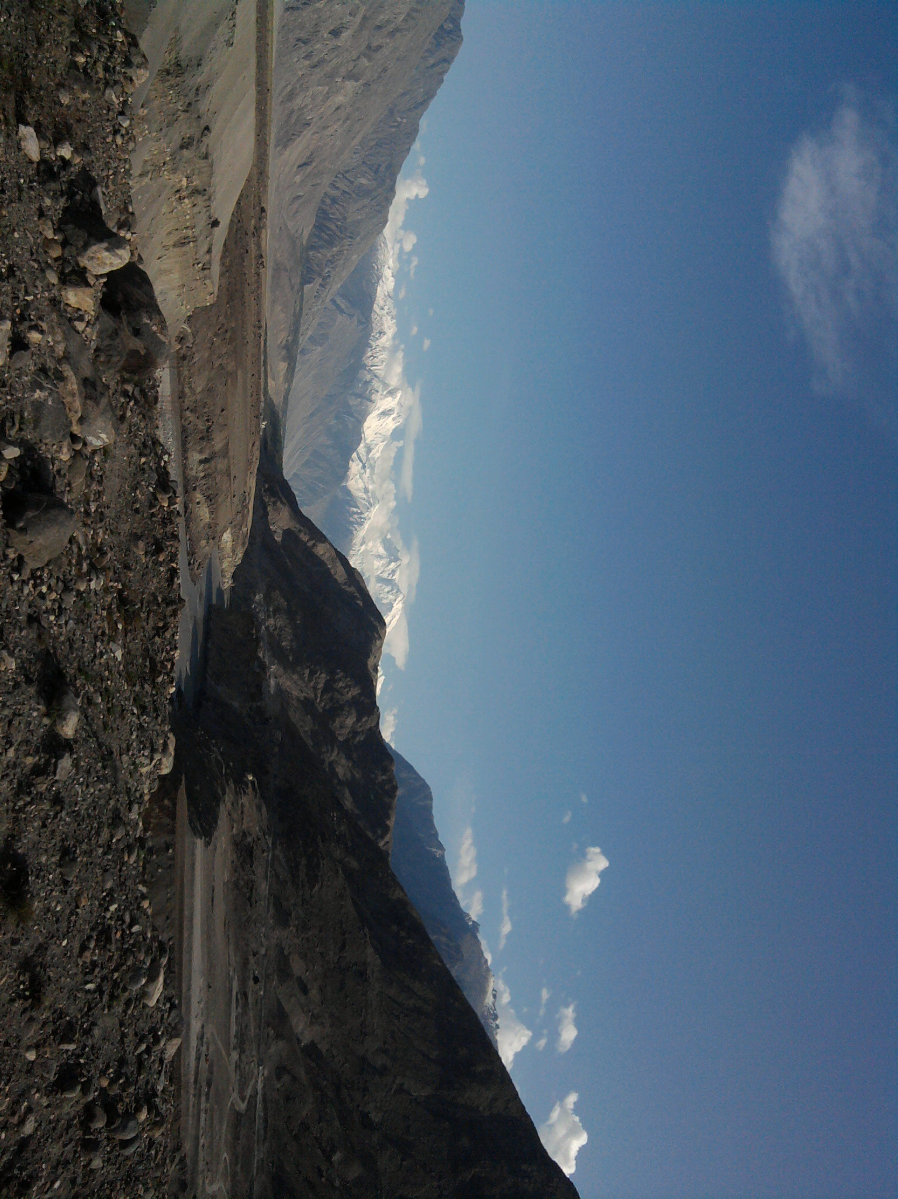
Conversion point of three great mountain ranges
The Himalaya, The Karakoram and The Hindokush mountains

Slide 58
Flora of Pakistan
6000 native species of flowering plants reported in Flora of Pakistan found wildly in different phytogeographical regions
The flora of Pakistan includes no endemic families, and only three endemic genera (Douepia in Brassicaceae, Stewartiella in Apiaceae, and Decalepidanthus in Boraginaceae).

Slide 59
Almost 80% of Pakistan’s endemic flowering plants confined to the north and western mountains (Ali & Qaiser, 1986).
Of these species, the active constituents of approximately 500 species are known from research conducted in Pakistan or elsewhere (Williams & Ahmad, 1999).
Species in prevailing at high altitude mountains and in fragmented habitats, such as in Gilgit-Baltistan, are particularly vulnerable to climate change

Slide 60
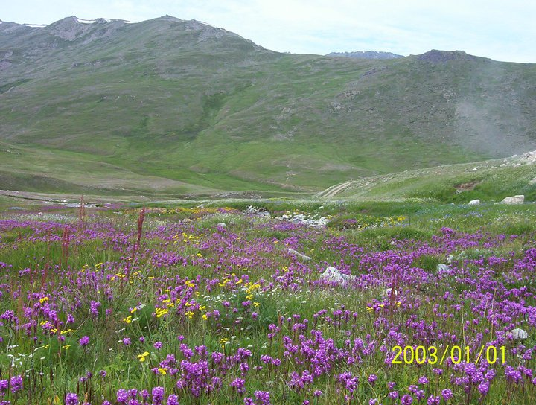
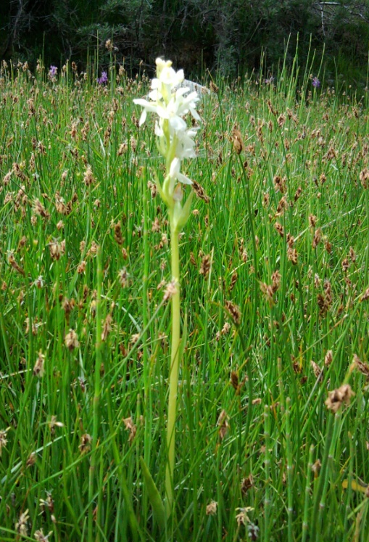
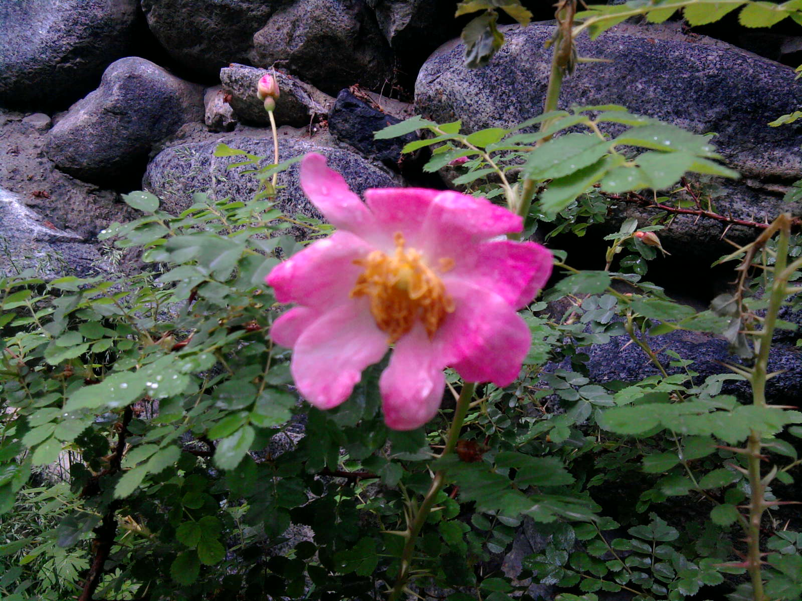
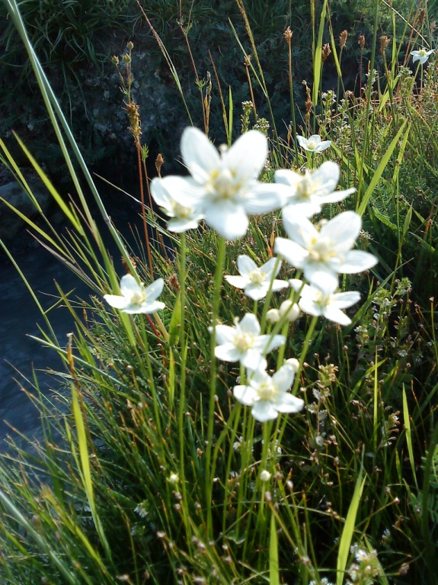
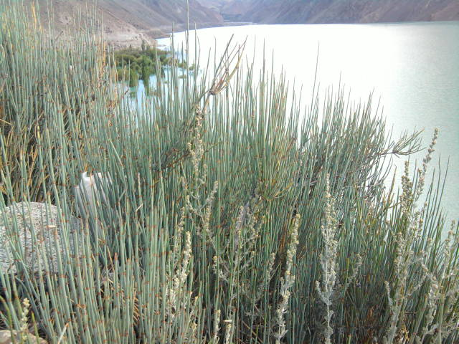
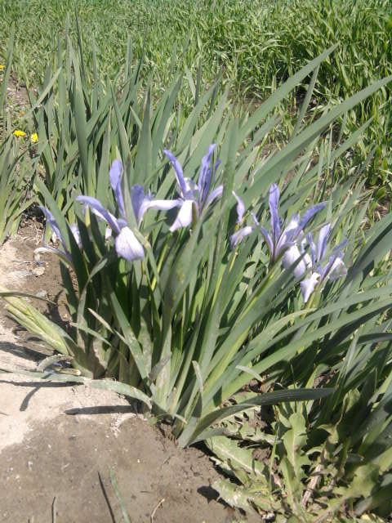
Overview of Biodiversity Medicinal herbs and wild plants

Slide 61
Major Agro-ecological Zones of Pakistan
Zones | Characteristics
Zone I | Indus Delta
Zone II | Southern Irrigated Plain
Zone III | Sandy Deserts
Zone IV | Nothern Plains
Zone V | Flood Plains and Bar Uplands.

Slide 62
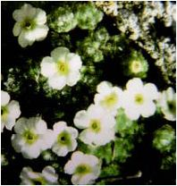
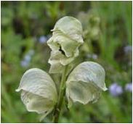
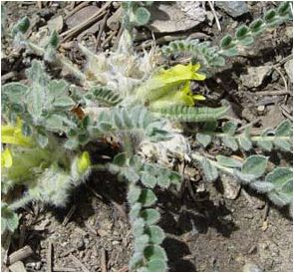
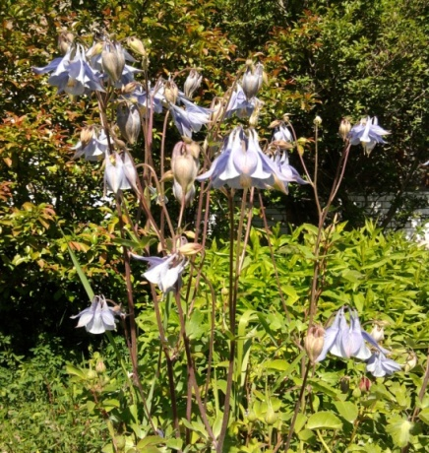
Endemic plants
Androsace russellii
Aconitum violaceum
Astragalus gilgitensis
Aquilegia pubiflora

Slide 63
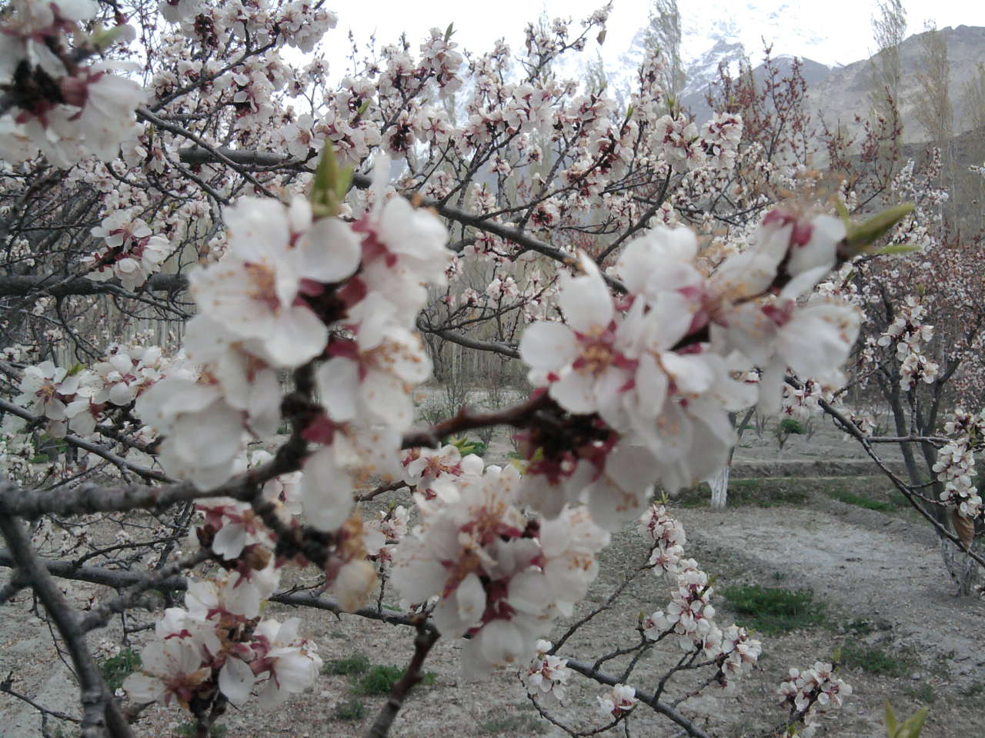
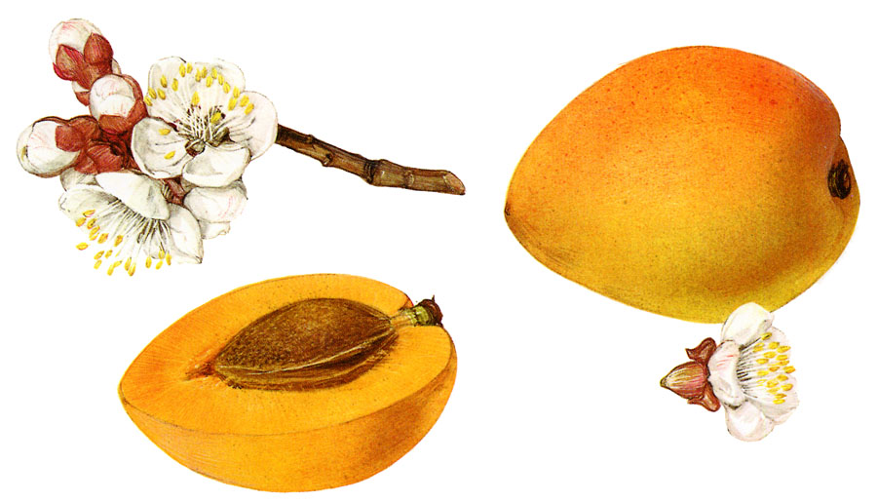
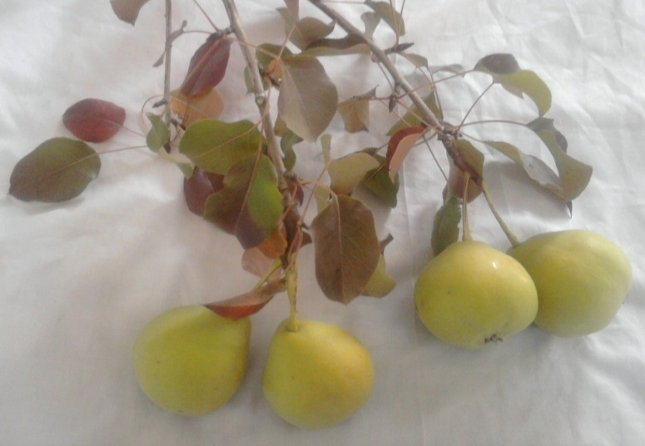
Overview of Biodiversity Fruit plants
Prunus armeniaca
Pyrus communis

Slide 64
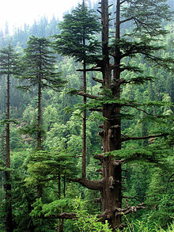
Northern highlands and valleys
Pakistan has conifer forests in most of the northern and north-western highlands. These occur from 1,000 to 4,000 m altitudes.
Swat, Upper Dir, Lower Dir,
Malakand, Mansehra and Abbottabad districts of Khyber Pakhtunkhwa (formerly North-West Frontier Province) are the main areas covered with coniferous forests.

Slide 65
Conti…
Pindrow fir (Abies pindrow) and Morinda spruce (Picea smithiana) occupy the highest altitudes,
deodar (Cedrus deodara) and
blue pine (Pinus Wallichiana),
the intermediate heights,
and chir pine (Pinus roxburghii), occupy the lower areas

Slide 66
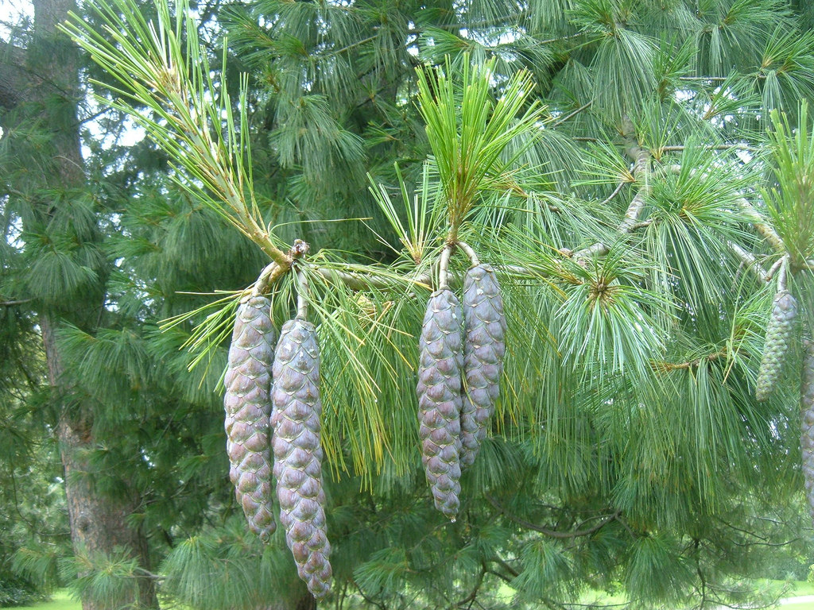

Slide 67
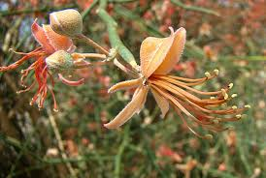
Eastern plains and deserts
In most of Punjab and Sindh, the Indus plains have many fluvial landforms that support various natural biomes including tropical and
subtropical dry and moist broadleaf forestry as well as tropical and xeric shrublands (deserts of Thal in Punjab, Tharparkar in Sindh) and kair (Capparis aphylla) which provide firewood.

Slide 68
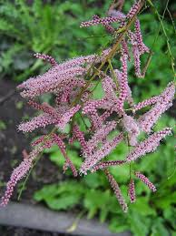
Conti…
The riparain woodlands grow in narrow belts along the banks of River Indus and its tributaries.
Main tree varieties are of sheesham and babul and main shrub varieties are reed beds and tamarisk (Tamarax dioica) bushes.

Slide 69
Wetlands and coastal regions
In the south of Sindh are Indus River Delta in west and Great Rann of Kutch in east.
The largest saltwater wetland in Pakistan is the Indus River Delta.
Unlike many other river deltas, it consists of clay soil and is very swampy.

Slide 70
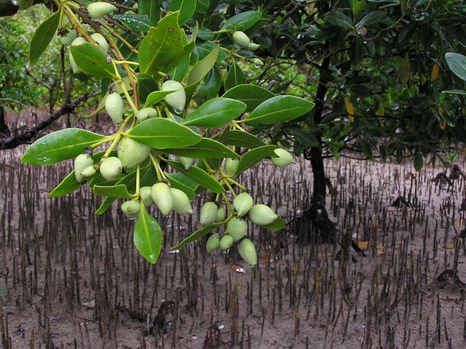
Conti…
The Great Rann of Kutch below the Thar Desert is not as swampy and exhibits shrubland vegetation of rather dry thorny shrubs as well as marsh grasses of Apluda and Cenchrus.
Other saltwater wetlands are located on the coast of Balochistan such as at Sonmiani and Jiwani. These and Indus River Delta support mangrove forestry, mainly of species Avicennia marina.

Slide 71
Conti…
Many of these endemic species are found in the mountain regions of northern Pakistan, particularly in the Chitral and Kashmir districts, and in northern Baluchistan.
However, these regions are particularly poorly known and likely to be sources of considerable numbers of new and possibly endemic species (Chaudhri 1977, Frodin 1984).

Slide 72
Conservation status
Conservation status of various endangered species in the area was determined according to recent (2011) IUCN
Critically Endangered (CR),
Endangered (EN), and
Vulnerable (VU).
Criteria according to IUCN
80% decline = CR
50% decline = EN
20% decline = VU

Slide 73
Conservation status of fifty-three (53) medicinal and other plant species was evaluated during the studies in (Mansehra KPK).
Among 53 species 20 Endangered, 16 species Critically Endangered and 16 species were found Vulnerable

Slide 74
Endangered Species of KPK Lesser Himalaya
Podophyllum emodii
Valeriana wallichii

Slide 75
Endangered Species cont.. Pyrus paschia Pistacia integramia

Slide 76
List of Medicinal plants
S.No | Botanical Name | Local Name | Family
01 | Acacia modesta | Phulai | Mimosaceae
02 | Acacia nilotica | Kikar | Mimosaceae
03 | Ajuga bracteosa | Kori booti | Lamiaceae/Labiateae
04 | Albizia lebbeck | Siris, Sirin | Mimosaceae
05 | Acorus calamus | WarchBb-- − | Araceae
06 | Aconitum heterophyllum | Patris | Ranunculaceae
07 | Achillea millefolium | Birangesif | Asteraceae
08 | Anagallis arvensis | - | Primulaceae
09 | Aloe barbadensis | Kanvar | Liliaceae

Slide 77
S.No | Botanical Name | Local Name | Family
10 | Argemone mexicana | Sian kanta | Papvaraceae
11 | Abutilon indicum | Kangi | Malvaceae
12 | Althaea officinalis | Gul-e-Khera | Malvaceae
13 | Asparagus racemosus | Shahghandal | Liliaceae
14 | Asphodelus tenuifolius | Piazi | Liliaceae
15 | Aesculus indica | Bankhor | Hippocastanaceae
16 | Artemisia vulgaris | Duck | Asteraceae/ Compositae
17 | Arisaema flavum | Surganda /Sanp | Araceae
18 | Atropa acuminata | Cheela Lubur | Solanaceae

Slide 78
Endangered Flora
Botanical Name | EN | CEN | VU
Abelia triflora | +
Acer caesium |  | +
Achillea millefolium | +
Actaea spicata | +
Andranchne cordifolia |  |  | +
Anemone falconeri |  |  | +
Anemone obtusiloba | +
Anemone tetrasepala |  | +
Anemone vitifolia | +

Slide 79
Botanical Name | EN | CEN | VU
Ainsliaea aptera |  | +
Aristolochia punjabensis |  |  | +
Atropa acuminata |  |  | +
Betula utilis |  | +
Botrychium lunaria |  | +
Celtis australis |  |  | +
Colchicum luteum |  |  | +
Corydalis govaniana | +
Corydalis stewartii | +

Slide 80
Botanical Name | EN | CEN | VU
Cotoneaster microphyllus |  | +
Corylus colurna | +
Fraxinus excelsior |  | +
Gentianoides kurroo |  |  | +
Geranium wallichianum |  |  | +
Hermium lanceum |  | +
Ilex excelsa | +
Impatiens scabrida | +
Incarvillea emodi |  |  | +

Slide 81
Botanical Name | EN | CEN | VU
Lavetera kashmirana | +
Liparis rostrata | +
Mildella nitidula | +
Morchella esculenta (Mushroom) |  | +
Morina persica |  |  | +
Paeonia emodi |  |  | +
Pecteilis gigantea | +
Pedicularis elephantoides | +
Phagnalon niveum |  |  | +

Slide 82
Botanical Name | EN | CEN | VU
Podophyllum hexandrum | +
Potentilla sericophylla |  | +
Primula denticulata |  |  | +
Prunus cornuta |  | +
Pyrus pashia | +
Salix flabellaris | +
Saussurea albescens | +
Saussurea fastuosa | +
Skimmia laureola |  | +

Slide 84
Threatened or endangered Plant species
Nasir (1991) conservatively estimated that 580-650 plant species (c. 12% of the flora) are threatened or endangered,
The environmental impact of this huge human population and the very long history of human occupation of the Indus Valley (home to a highly developed urban civilization at least 5,000 years ago) present special challenges.

Slide 85
Issues
Urbanization and infrastructure development
Poverty and low literacy
Enhanced dependence on natural resources
Legal and administrative issues
Lacking co-ordination between institutions

Slide 86
Issues
Regional strategy in mountain areas is lacking
management gaps between institutions to mitigate climate change at local scale for Gilgit-Baltistan still lacking in basic research
snow reserves melting and water requirements for agricultural purposes

Slide 87
Threats
Habitat destruction
Deforsetation
Pollution
Species Introductions
Global Climate Change
Over Exploitation and grazing

Slide 88
Grazing : Threats to flora in mountain areas of Pakistan

Slide 89
Microorganisms play a role in conservation and restoration biology of higher organisms.
Need to understand the mechanism of microbial action, an inventory of diversity maintenance of reference culture and ways to exploit them beneficially
Floral biodiversity and microorganisms conservation have positive impact on climate change and sustainable national resource of any country.

Slide 90
Intellectual property rights of the communities concerned having indigenous traditional knowledge, must be protected.
Involve local communities in benefit sharing and cost of the programmes to be implemented.

Slide 91
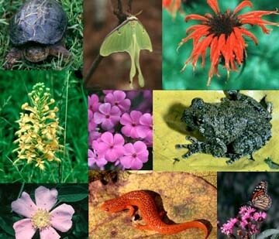
THREATS TO
BIODIVERSITY
Source: orgs.unca.edu/tulula/images/biodiversity.jpg

Slide 92
Factors determining degree of diversity/ Threats:
Habitat stress
Geographical isolation
Dominance by one species
Availability of ecological niches
Edge effect
Geological history

Slide 94
And at the base
Deforestation
Over-grazing
Desertification of Ecosystem
Source: www.mccullagh.org

Slide 95
HIPPO
H Habitat (Loss, Destruction, degradation, transformation, conversion)
I Invasive, Exotic, Alien, Foreign Species
P Popuplation
P pollution Soil, air, water, Noise, Thermal
O Over exploitation, Harvesting, Grazing,
Draf ting, Neting

Slide 96
Five mass extinctions
End Ordovician (~445 Ma)
Late Devonian (~365 Ma)
End Permian (~250 Ma)
End Triassic (~210 Ma)
End Cretaceous (65 Ma)

Slide 97
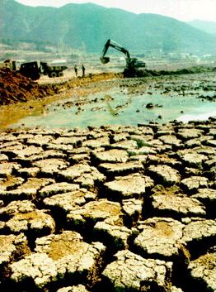
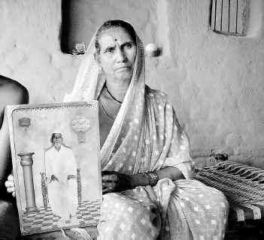
Why farmers commit Suicide
www.thehindubusinessline.com

Slide 98
Benefits/ Economic Role of Biodiversity .
Food: Crop Biodiversity or agrobiodiversity.
Goods: Various things like timber,paper,medicines.
Recreation: Wildlife tourism, trekking nature photography,birdwatching.

Slide 99
Scientific Role of Biodiversity
Genetic resources:Biotechnology and genetic enginnering use the genes of organisms to make new crops and medicines.
Each species can give scientist some clue as to how life evolved and will continue to evolve.

Slide 100
Causes of Biodiversity losses
At least 40 per cent of the world’s economy and 80 percent of the needs of the poor are derived from biological resources.
In addition, the richer the diversity of life, the greater the opportunity for medical discoveries, economic development, and adaptive responses to such new challenges as climate change.
Habitat loss and degradation.
Habitat fragmentation.

Slide 101
Habitat and Degradation
Destruction of biodiversity rich areas like tropical forests.
Destruction of coral reefs and Wetlands.
Ploughing of grasslands.
Aquatic ecosystem is threatened.
Pollution of freshwater streams, lakes, and marine habitats.

Slide 102
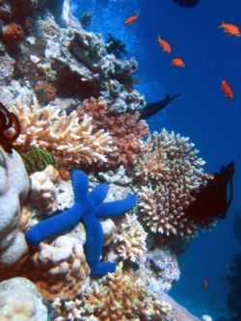
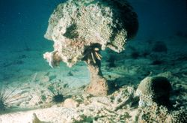
Threats to Reefs
10% of the coral reefs around the world are already dead. Coral bleaching is another manifestation of the problem and is showing up in reefs across the planet.
source:www.oceansalive.org

Slide 103
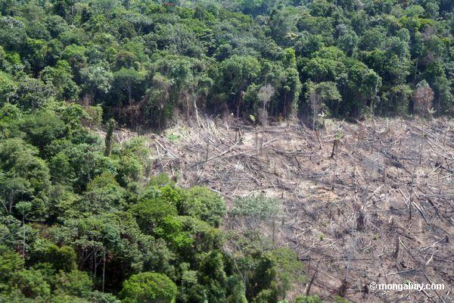
Threatened Tropical Forests
A world imperiled- forces behind the forest losses
source:www.mongabay.com

Slide 104
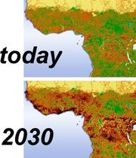
Habitat fragmentation
Emergence
of discontinuities in
organism’s preferred
environment.
Fragmentation and
destruction of
Great Ape habitat
in Central Africa.

Slide 105
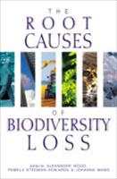
The Root Causes of Biodiversity Loss
This book provides detailed studies on the evolving consensus on biodiversity loss
A framework for analyzing the root causes of biodiversity loss
The underlying causes of biodiversity loss
Addressing the root causes of biodiversity loss….

Slide 106
Other causes of decline
Pollution of wetlands.
Over-exploitation of resources.
Construction of large dams.
Commercial hunting and poaching.

Slide 107
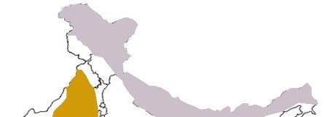
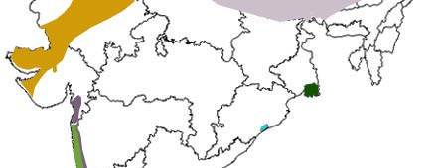
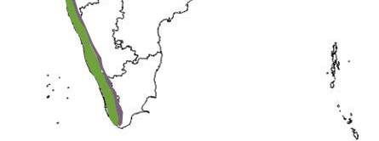
BIODIVERSITY IN SUB-CONTINENT
Himalayas - This majestic range of mountains is the home of a diverse range of flora and fauna. Eastern Himalayas is one of the two biodiversity hotspots in India.
Chilika - This wetland area is protected under the Ramsar convention.
Sunder bans - The largest mangrove forest in India.
Western Ghats - One of the two biodiversity hotspots in India.
Thar desert - The climate and vegetation in this area
is a contrast to the Himalayan region.
Source: earthtrends.wri.org

Slide 108
Comparative statement of recorded number of animal species in Sub-continent and the World
Taxa | Species | World | Percentage of Sub-continent to the world
Protista | 2577 | 31259 | 8.24
Mollusca | 5070 | 66535 | 7.62
Arthropoda | 68389 | 987949 | 6.9
Other Invertebrates | 8329 | 87121 | 9.56
Protochordata | 119 | 2106 | 5.65
Pisces | 2546 | 21723 | 11.72
Amphibia | 209 | 5150 | 4.06
Reptilia | 456 | 5817 | 7.84
Aves | 1232 | 9026 | 13.66
Mamalia | 390 | 4629 | 8.42
Source: MoEF 2002.

Slide 109
IS THE BIODIVERSITY OF SUB-CONTINENT UNDER THREAT?
10% of plant species are under threat.
More than 150 medicinal plants have disappeared in recent decades.
About 10% of flowering plants,20% of mammals and 5% of the birds are threatened.
What ahead ???

Slide 110
Impact of loss of Biodiversity
Increased vulnerability of species extinction
Ecological imbalance
Reduced sources of food, structural materials, medicinal and genetic resources
Cost increase to the society

