Slide 1
SEVEN C’s IN BUSINESS COMMUNICATION
.

Slide 2
SEVEN C’s IN BUSINESS COMMUNICATION
Correctness
Conciseness
Clarity
Completeness
Concreteness
Consideration

Slide 3
CORRECTNESS
Use the correct level of language
Incorrect: We thank you in anticipation of this courtesy and assure you that it will be a pleasure to serve you in similar manners.
Correct: I will appreciate your helping us. Let me know when I can return the favour.
Include only accurate facts and figures
Maintain acceptable writing mechanics

Slide 4
CONCISENESS
Omitting trite expressions
Trite: In accordance with your request of recent date, we are enclosing here with our cashier’s cheque in the amount of Rs 20,000, representing a withdrawal of said saving A/c. No. 3595.
Improved: According to your request of April 25, cheque of Rs. 20,000 is enclosed.
Avoid unnecessary repetition.
Wordy: I have your letter of October 14 and wish to say that we will be glad to give you a refund for shirt you purchased here last week.
Improved: You can avail refund for the shirt you purchased last week
Include relevant facts

Slide 5
CLARITY
Choose words that are short, familiar and conversational
Construct effective sentences and paragraphs
Achieve appropriate readability
Include examples, illustrations etc.

Slide 6
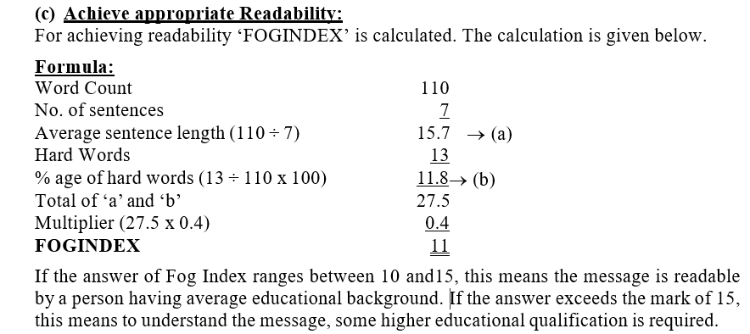
CLARITY

Slide 7
COMPLETENESS
Answer all questions asked
Give something extra. When desirable
Check for five W’s (Who, What, When, Where and Why)

Slide 8
CONCRETENESS
Use specific facts and figures
General: These brakes stop car within short distance.
Specific: The hydraulic pressure brakes stop a car with a distance of two feet as soon as they are applied.
Put action in the verb
Noun: They held meeting in the office.
Verb: They met in the office.
Choose vivid image building words
This is a very good computer.
The P-IV 800 MHz, 20GB HD, 64MB RAM, 500 MB CACHE, Intel genuine processor, in ATX casing is a computer of new millennium.

Slide 9
CONSIDERATION
You attitude
I - Attitude: We allow 5% discount on Cash Payment.
You - Attitude: You can enjoy 5% discount on Cash Payment.
Show readers interest
Apply integrity in the message
Emphasize the positive
Negative: We do not refund if the refund item is soiled and unsalable.
Positive: We do refund if the returned item is clean and saleable.

Slide 10
COURTESY
Be tactful
Tactless: Your letter is not complete I cannot understand it.
Tactful: If I understand your letter correctly, you want to say that…….
Omit expressions that can irritate
You have failed
You have no choice
Answer/mail promptly
Grant and apologize

