Slide 1
Shopify Drop Shipping

Slide 2
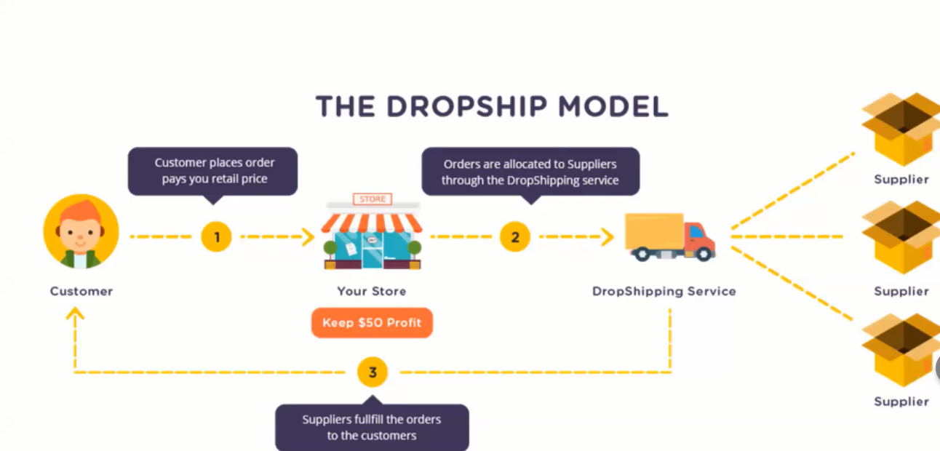

Slide 3
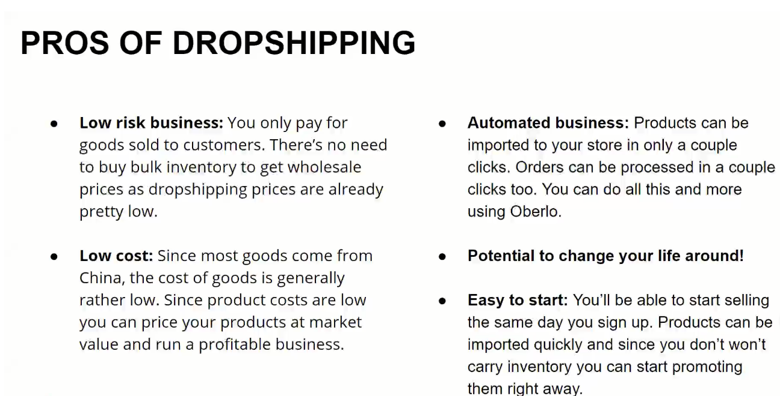
Notes:
PayPal, stripe ,2-checkout .

Slide 5
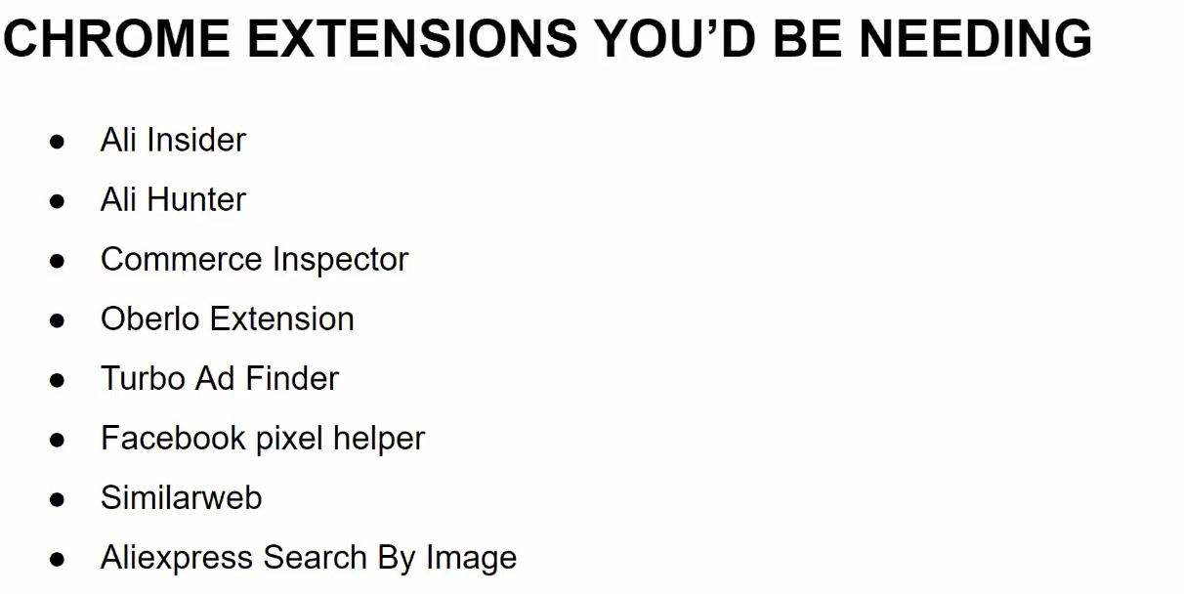

Slide 6
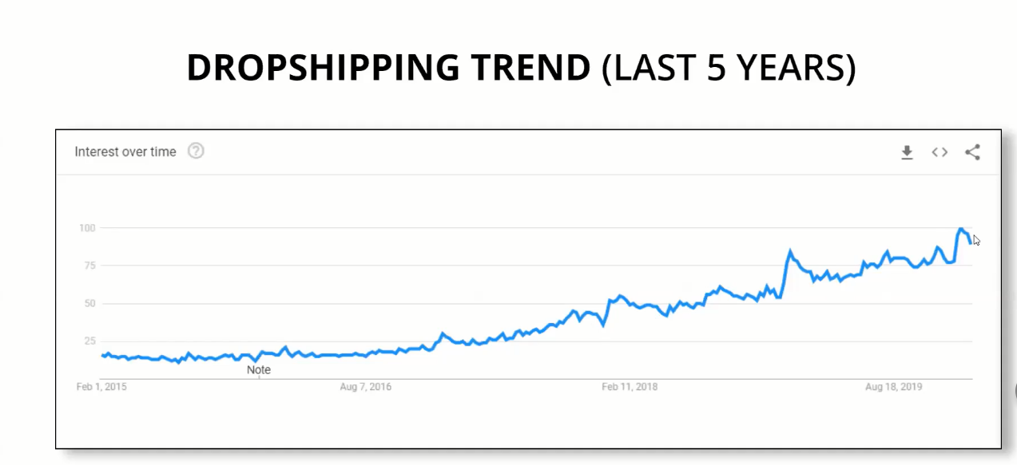

Slide 12
