Slide 1
DAS
Importance of Livestock
Introduction to Animal Husbandry
2020
Notes:
Experimental—deceleration, disability, supine, mice
Theory—mites, honeybees, identity, probit
Lifespan—primates, etc
Human—self reinforcing, wasp, NBA
Thank
Background
Invasive/Greece/Hawaii
CDFA Medfly panel
Aging research
LBAM
Workshop
Zalom et al
Retreat/Workshop
LMAM see that little changes
New day in science/policy

Slide 2
Agriculture and Livestock
I I
The agriculture sector has four sub-sectors including:
Crops
Livestock
Fisheries
Forestry
The Livestock sector contributes 58.3 percent in the agriculture recorded a positive growth of 4.1 percent in 2014-15 against 2.8 percent growth during the same period last year

Slide 3
Domestication
The process of taming an animal and keeping it as a pet or on a farm
The goats were probably domesticated 8000-9000 years ago
There is fairly definite proof’ that cattle had been domesticated by about 3000.-4000 B.C
In past, domestication was centered mostly in the middle east countries

Slide 4
Categories of Live Stock
I I
1. Milch animals
Buffalo
i. Water buffalo ii. Swamp buffalo
Nili Ravi (Punjab), Kundi (Sind), Azi Kheli (KPK)
b. Cattle
Sahiwal (Punjab), Cholistani (Punjab), Red Sindi (Sind)
C. Goats
Dira Din Pannah, Beetal, Kamoori
2. Draught animals
Cattle breeds like Bhagnari. Dajal, Dhani and Rojhan etc
Buffaloes particularly in the rice growing tract
Horse, Camel, Donkeys, Mules etc

Slide 5
Conti…
I I
3. Meat and wool production
Different breeds of sheep at least 23 breeds are found in Pakistan
Different breeds of goats
Cattle/ Buffaloes
Camels
Poultry
4. Dual purpose animals
Tharparkar, Kankrej

Slide 6
What does the domestication of animals mean?
I I
To adapt animals for the use by humans
Animals taken from nature and raised under the care of humans

Slide 7
WHAT ARE THE COMMON FUNCTIONS OF LIVESTOCK IN TODAY’S SOCIETY?
I I

Slide 8
CONVERTING GRAIN AND ROUGHAGE INTO PRODUCTS
I I

Slide 9
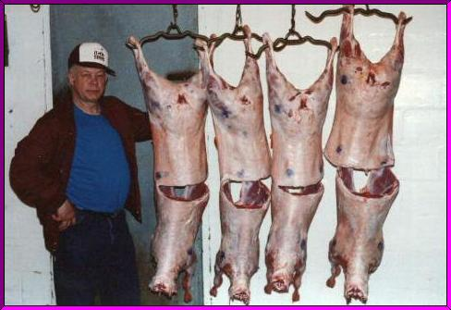
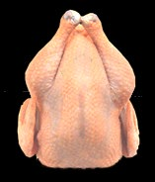
I I
To Provide a Steady Food Supply

Slide 10
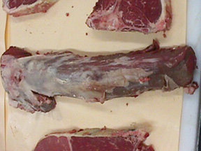
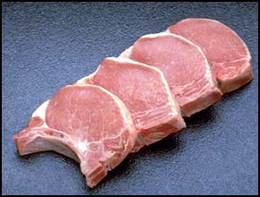
Conti…
I I

Slide 11
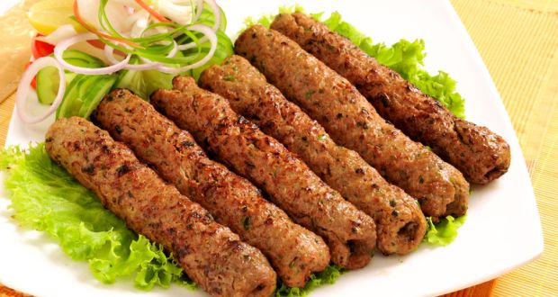
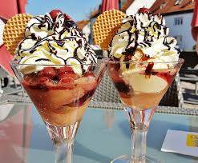
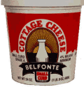
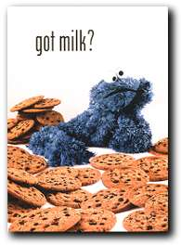
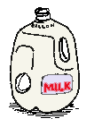
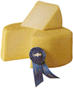
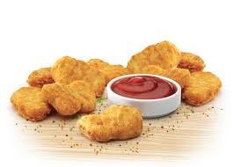
I I
PRODUCTS

Slide 12
To Provide Raw Materials for Clothing
I I

Slide 13
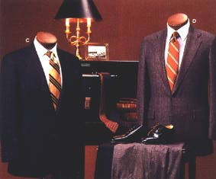
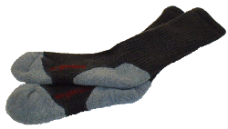
I I
Conti…

Slide 14
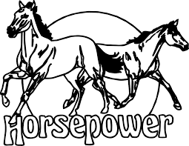
POWER; Motive power about 85 % for Agricultural operations and means of transportations
I I

Slide 15
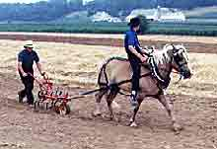
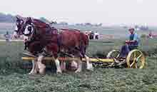
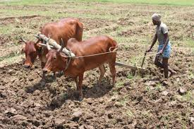
Agriculture Work
I I

Slide 16
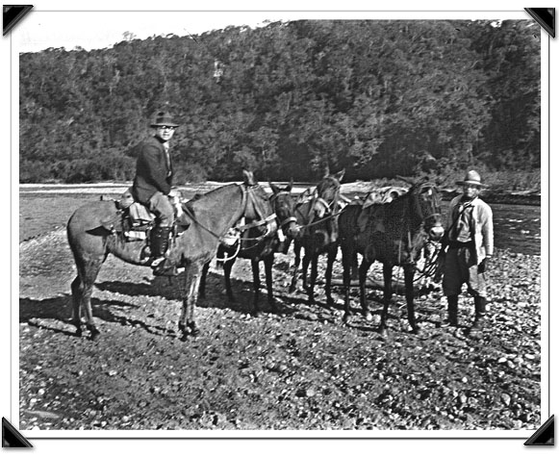
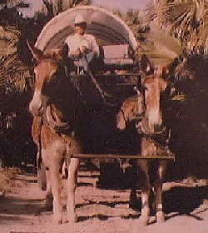
To Provide Transportation
I I

Slide 17
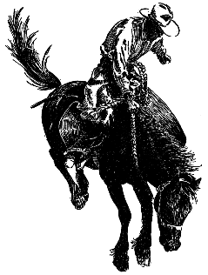
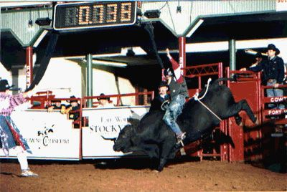
To Provide Pleasure and Recreation
I I

Slide 18
Conti…
I I

Slide 19
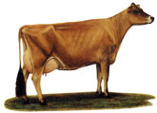
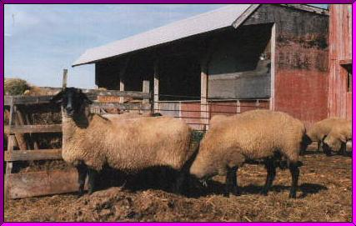
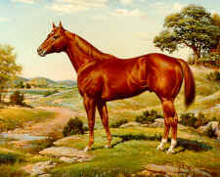
TO INCREASE DESIREABLE CHARACTERISTICS
I I

Slide 20
Conti…
I I
Meat: A good source of protein and energy
Dairy products: Milk is Processed into other dairy products, such as yogurt, cheese, butter, ice cream, Kulfi, butter oil, Lassi etc.
Fiber: Livestock produce a range of fiber/textiles, for example, sheep and goats produce wool and mohair
Hides and Skins: Cows, buffalo, camel deer, goat and sheep Hides/skins can be made into leather
Pharmaceutical Insulin- Pancreas, Cortisone.- Adrenaline, Rennet-calves stomach –Cheese making. Thrombi- Heparin- from blood and Lungs- Used for blood clotting

Slide 21
Conti…
I I
Fertilizer Manure: Manure is also used as a fuel for fires. Nitrogen 4.5 Kg / ton, Potassium: 3kg/ton, Phosphorus 0.8 and organic matter 230 kg / ton
Soil fertility and prevent soil erosion
Labor: Animals such as horses, donkey, and yaks can be used for mechanical energy
Prior to steam power, livestock were the only available source of non-human labor
They are still used for this purpose in many places of the world, including ploughing fields, transporting goods, and military functions

Slide 22
Conti…
I I
By Products: Fat- soap industry, Hooves, bones , hornes and teeth – button. DCP
The blood & bone of animals are also used as fertilizer
Land management: The grazing of livestock is sometimes used as a way to control weeds etc. For example, in areas prone to wild fires, goats and sheep are set to graze on dry scrub which removes combustible material and reduces the risk of fires

