Slide 2
Non-Citrus Tropical Fruits

Slide 3
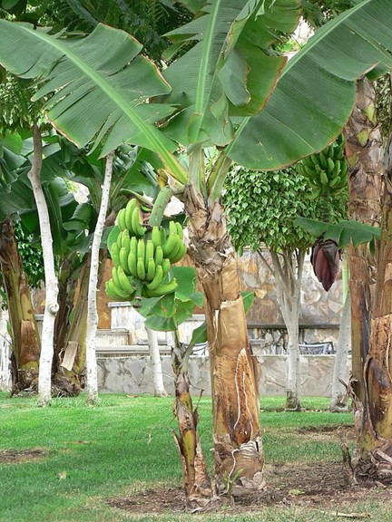
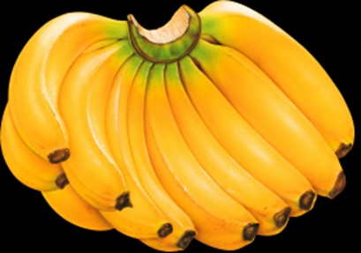
Non-Citrus Tropical Fruits: Banana
Banana, Musa paradisiaca subsp. sapientum, is one of the most important of all tropical fruits.
It has spread all over the tropical world from its original home in the humid tropics of Malaya or India.
Over 300 varieties of banana are known.
There are other species of banana, one of which, the dwarf banana, Musa nana, is occasionally exported.
Red bananas, Musa velutina, are quite common.
Musa cavendishii is a dwarf that is especially suited to home gardens.
They have a high content of carbohydrates with some fats and proteins.

Slide 4
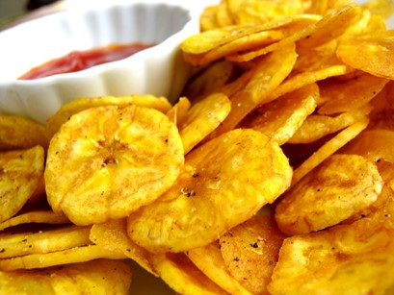
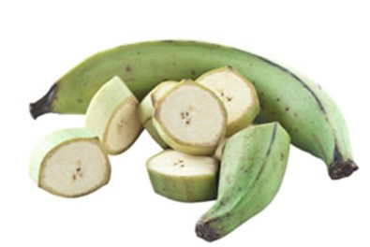
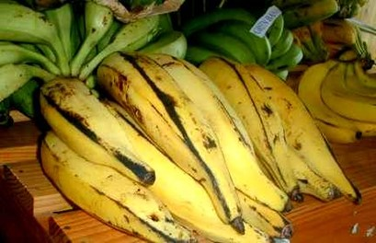
Plantain
Musa paradisiaca is a close relative of the banana and one of the great food plants of the tropics.
Indigenous to Southern Asia, it has furnished food for the inhabitants since ancient times.
Plantains are allowed to ripen and then are always consumed cooked, fried or made into flour and are very digestible.

Slide 5
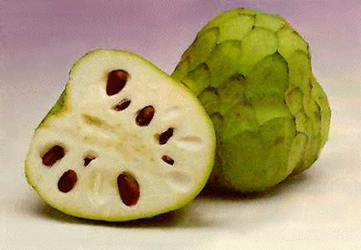
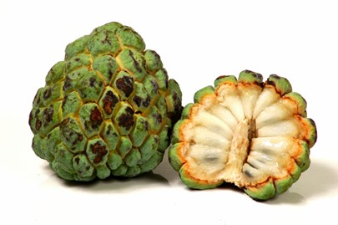
Custard Apples
Several tropical American fruits in the genus Annona have been called Custard Apples.
The family Annonaceae includes over 600 species most of which have edible fruits.
Annona cherimolia (Cherimoya) is a favorite dessert fruit.
It was known from ancient times in the Andes of Ecuador and Peru.
The delicious white or yellowish flesh is very aromatic with a soft and custard like consistency.
Annona squamosal (Sweetsop), also known as Sugar Apple, is indigenous in South America and the West Indies.
It has white custard like pulp and is the most highly prized of the group.

Slide 6
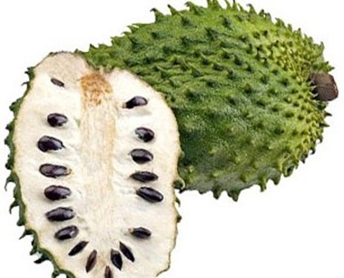
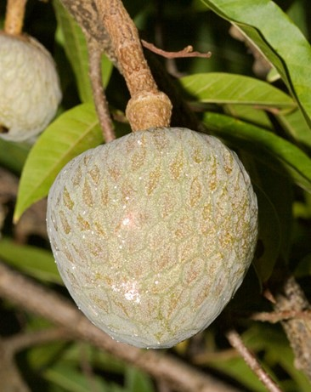
Annona muricata (Soursop), also known as Guanabana, is a small slender tree of the West Indies.
The white juicy flesh is very aromatic and is unrivaled for sherbets and drinks.
Annona reticulata (True Custard Apple), also known as Bullock’s Heart, is very common in the tropics.
The soft white or cream-colored sweetly aromatic pulp is somewhat glandular toward the rind and rather insipid and cloying.
It is indigenous in the West Indies.

Slide 7
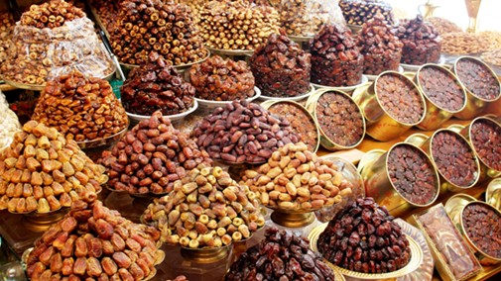
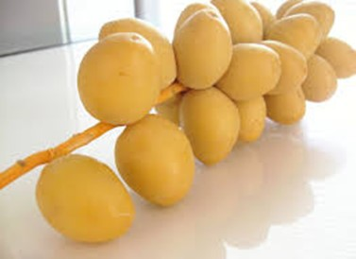
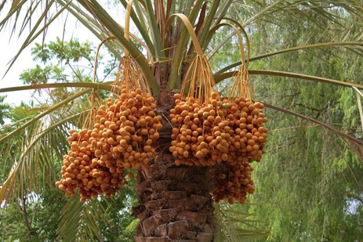
Dates
Phoenix dactylifera is an ancient crop that was known before 3,000 B.C.
Its origin has been thought to be either in Arabia or India, but it has been domesticated throughout Southwestern Asia and Northern Africa.
The fruit is a nearly round drupe or one-seeded berry. It is hard and green at first but later turns yellow or red.
Unripe fruits are consumed a month or more before harvest as a crunchy, sweet delicacy.
Fruits that are ripened on the tree command a higher price than those that are picked unripe and subjected to a steam ripening process.
Unlike most fruits they have a high food value, with 54 percent sugar and 7 percent protein as well as pectin and gums.

Slide 8
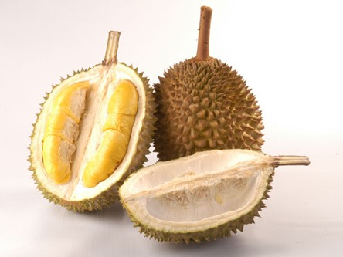
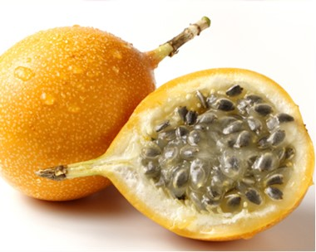
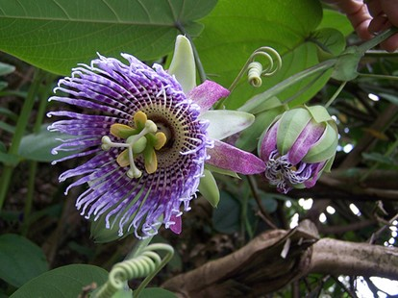
Durian
Durian, Duria zibethinus, is indigenous to Malaya and occurs locally in that area and west to Burma and south to the East Indies.
The custard like flesh has an exquisite flavor and is at the same time aromatic and sweet with a unique balsamic taste.
Granadillas are the edible fruits of several species of passion flower.
These are woody tendril-bearing vines with solitary showy flowers.
The Purple Granadilla, Passiflora edulis, is native to Brazil but has been cultivated worldwide.
Other common species are the Giant Granadilla, Passiflora quadrangularis, with greenish-yellow flowers that reach 10 in. in length; and the Sweet Granadilla, Passiflora ligularis.

Slide 9
Figs
The edible fig, Ficus carica, has been under cultivation since ancient times.
It is indigenous to Southern Arabia and had spread to the Mediterranean region in prehistoric times.
There are several different kinds of edible figs: Smyrna, Caprifigs, Common Figs and San Pedro Figs.
Figs are used fresh, dried, canned or preserved.
A large amount is used in baking and ground up for fig coffee.
Additional to their food value they have definite laxative properties and are important in medicine.

Slide 10
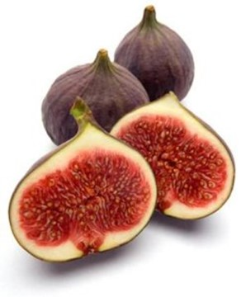
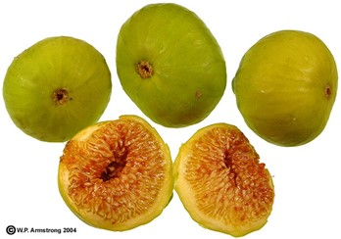
Common Figs: These have no staminate flowers and thus the fruits develop without pollination and have no seeds.
Two crops are produced annually.
Capri Figs: These are wild figs that grow naturally in the Mediterranean region and in Western Asia and are thought to represent the primitive type.
There is no commercial value for the fruit but cultivation is essential to the development of the Smyrna fig.
The life history of the Capri Fig is closely related with that of a small wasp, Blastophaga psenes, which affects pollination.

Slide 11
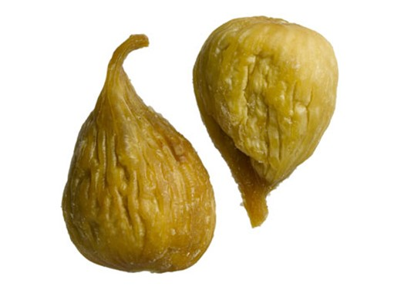
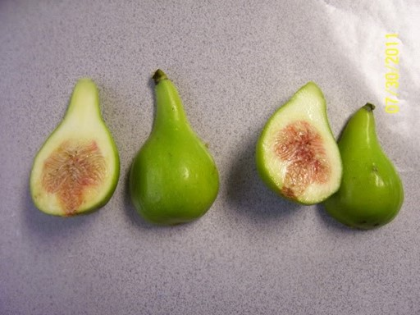
Smyrna Figs: There are no staminate flowers produced in Smyrna Figs, and thus these figs are completely dependent on cross-pollination from Capri Figs.
They are the most important commercial fig and are extensively grown in Asia Minor, Algeria, Greece and some sections of Portugal and California.
San Pedro Figs: These are grown in California with two crops annually.
The first develops without pollination, while the second fails to mature and falls from the tree, unless it is caprified.

Slide 12
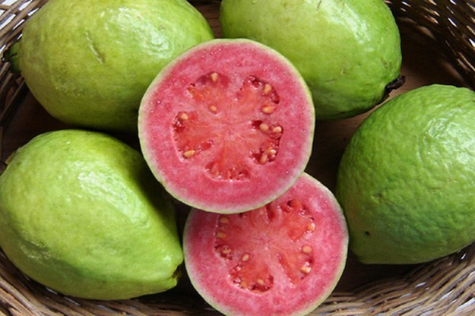
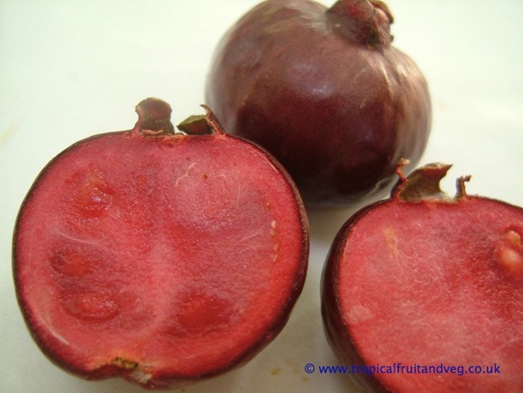
The family Myrtaceae, which includes guavas, probably has as many, if not more, species with edible fruits than any other family.
Guava, Psidium guajava, is native to tropical America where it has been cultivated for centuries.
The guava is very aromatic and is sweet and juicy and highly flavored with a fine balance between the content of acid, sugar and pectin. It is a rich source of Vitamins A, B. and C and of ascorbic acid.
Strawberry Guava, Psidium littorale, is native to Brazil and cultivated elsewhere. It has small red fruits with a very sweet juicy pulp.

Slide 13
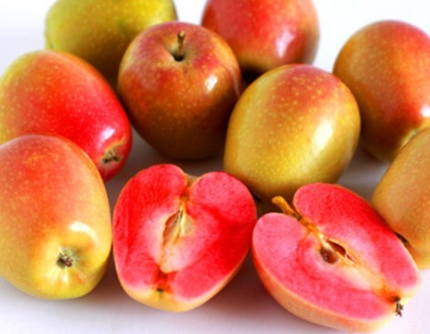
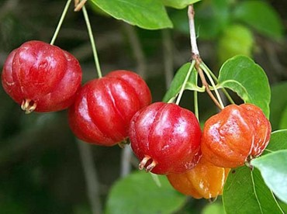
Besides guavas of which there are at least 155 species, there are the eugenias and syzgiums with almost 700 species.
The Rose Apple, Syzygium jambos, is indigenous to tropical Asia but has spread worldwide.
It is grown in Florida for its greenish-yellow fruits that are used in preserves and candy.
The Pitanga or Surinam Cherry, Eugenia uniflora, is grown in Florida and California for use as a fresh fruit and in jellies and sherbets.

Slide 14
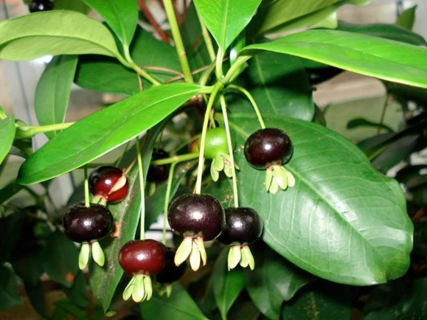
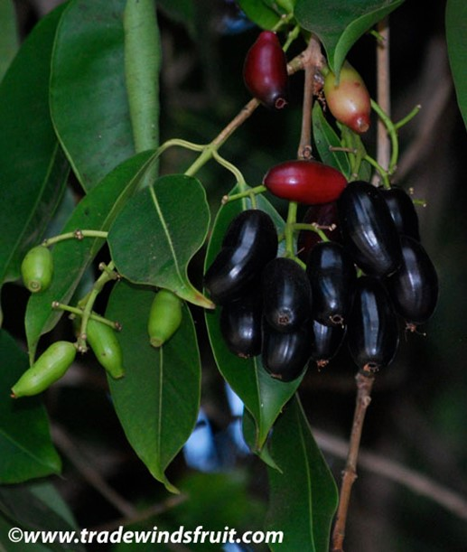
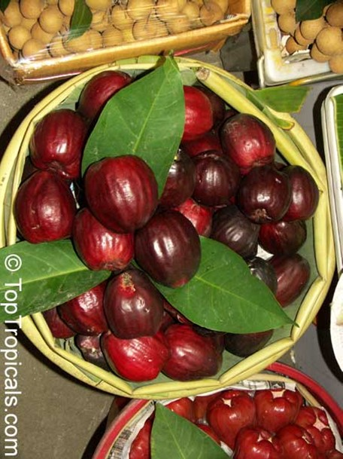
The Jambolan or Java Plum, Syzygium cumini, and the Chia or Mountain Apple,
Syzygium malaccensis, are all native to South Eastern Asia but may be found growing in other tropical countries.
The Grumichama, Eugenia dombeyi,

Slide 15
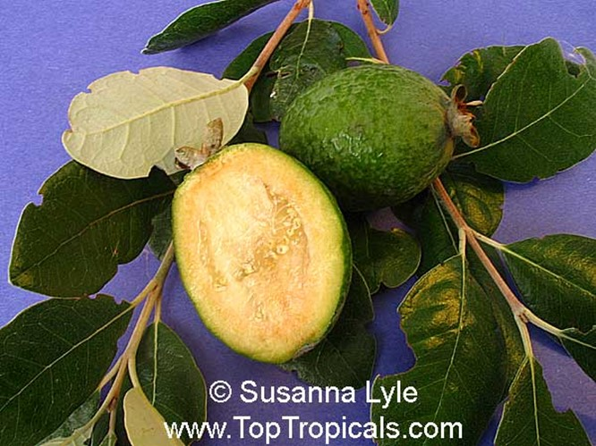
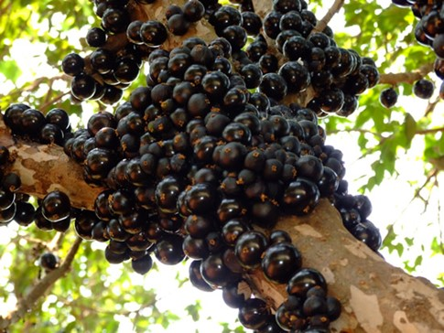
Other related species are the Feijoa, Feijoa sellowiana,
Jaboticaba, Myrciaria cauliflora. The Jaboticaba is a very beautiful tree native to Brazil.

Slide 16
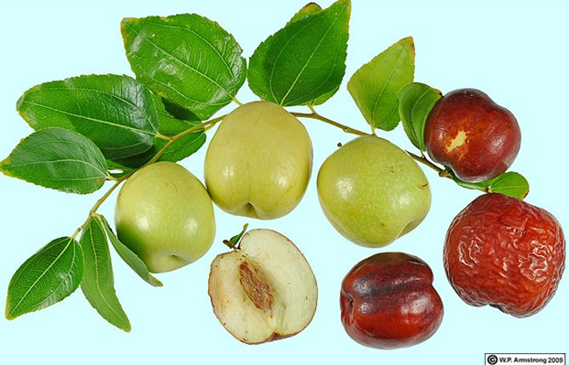
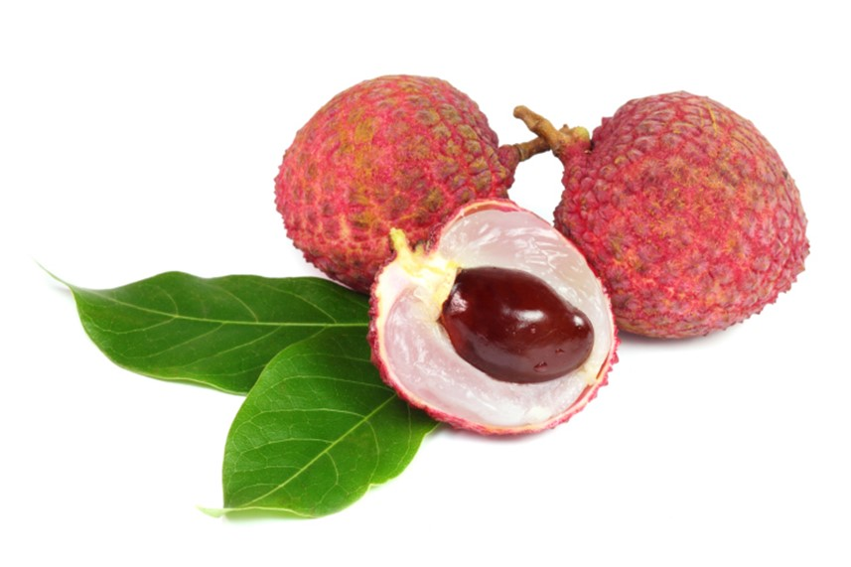
Jujube, Zizyphus jujuba, is indigenous to China and has been cultivated there since before 2,000 B.C.
It is one of the principal fruits consumed in China and is also grown elsewhere in the subtropics worldwide.
Lychee, Litchi chinensis, is indigenous to Cochin China and Thailand.
It has been an important fruit in Southeastern Asia since before 100 B.C.
The plant is now widely grown in the tropics and subtropics.

Slide 17
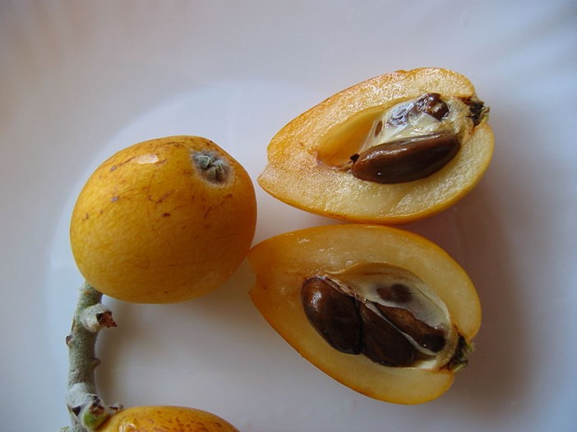
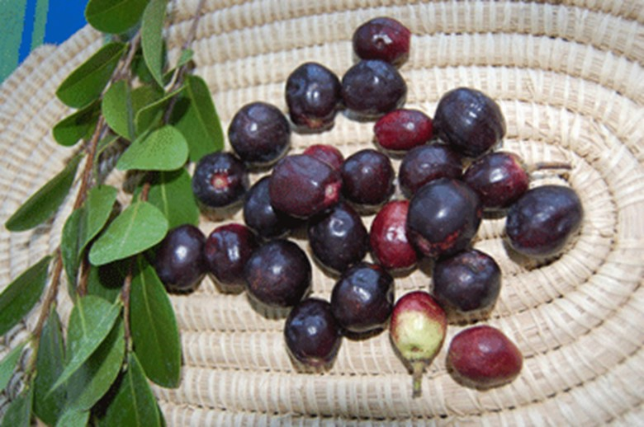
Loquat, Eriobotrya japonica, is one of the few tropical fruits that belong to the Rosaceae, a family which has such a large number of edible fruits in temperate regions.
The tree is native to China but is now grown in most tropical and subtropical areas.
Chrysobalanus icaco (Coco Plum) occurs on the sandy shores of southern Florida to the West Indies and Brazil.
it has plumlike fruits that make excellent conserves but which are too acid for consuming fresh.

