Slide 1
Type of Computer

Slide 2
Types
of
Computer
Analog
Digital
Hybrid
Super
Computer
Mainframe
Computer
Mini
Computer
Micro
Computer

Slide 3
Computers for Individual Use
Six primary types of Personal Computers (PCs)
Desktop computers
Workstations
Notebook computers
Tablet Computers
Handheld computers
Smart Phones
Notes:
a term that refers to any computer system that is designed for use by a single person.
Personal computers arc also called microcomputers because they are among the smallest computers created for people to use.

Slide 4
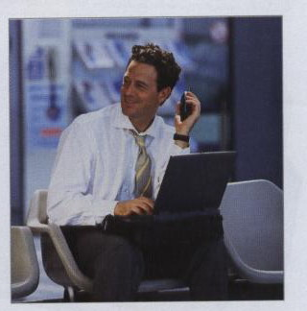
Computers for Individual Use
Although PCs are used by individuals,
they also can be connected together to create networks.
Notes:
Insider information
System units are commonly called cases. Many computer enthusiasts customize or ‘mod’ their cases with windows and lights. See www.casemodgod.com for examples of cases and products.
Sun Microsystems makes the most popular workstations on the planet. Sun’s systems are used in diverse applications such as medical imaging and CGI (computer generated image) animation.
Infact, networking has become one of the most important jobs of personal computers, and even tiny handheld computers can now be connected to networks.

Slide 5
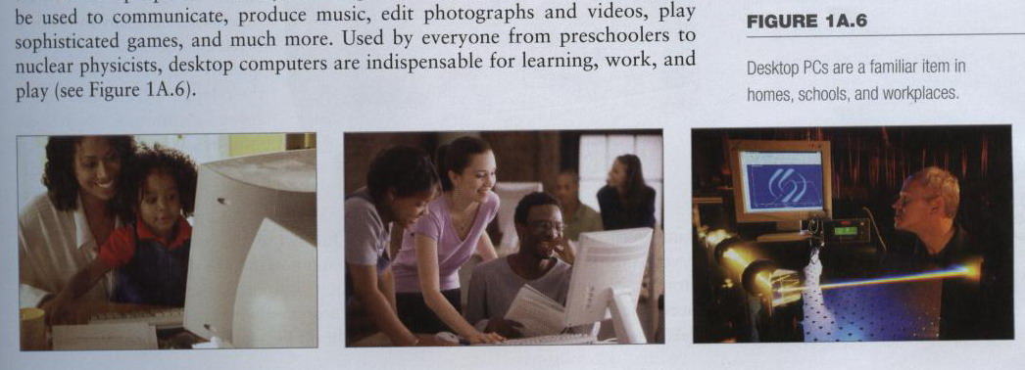
Desktop Computers
The most common type of computer
Sits on the desk or floor
Performs a variety of tasks
You see all around you in schools, home and offices
Notes:
Today's desktop computers are far more powerful than those of just a few years ago, and are used for an amazing array of tasks. Not only do these machines enable people to do their jobs with greater ease and efficiency, but they can be used to communicate, produce music, edit photographs and videos, play sophisticated games, and much more. Used by everyone from preschoolers to nuclear physicists, desktop computers arc indispensable for learning, work, and play (see Figure !A .6).

Slide 6
Desktop Computers
Different design types
Desktop Model
Tower model
Notes:
As its name implies, a desktop computer is a full-size computer that is too big to be carried around. The main component
of a desktop PC is the system unit, which is the case that houses the computer’s critical parts, such as its processing and storage
devices.
There are two common designs for desktop computers.
The more traditional desktop model features a horizontally oriented system unit, which usually lies flat on the top of the user’s desk. Many users place their monitor on top of the system unit (see Figure 1A.7).
Vertically oriented tower models have become the more popular style . of desktop system (see Figure V 1A.8). This design allows the user
to place the system unit next to or under the desk, if desired.

Slide 7
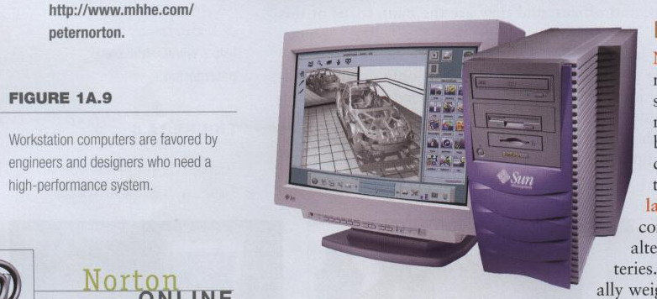
Workstations
Specialized single-user computers
Optimized for science or graphics
More powerful than a desktop
Notes:
A workstation is a specialized, single-user computer that typically has more power and features than a standard desktop PC (see Figure 1A.9).
These machines are popular among scientists, engineers, and animators who need a system with greater-than-average speed and the power to perform sophisticated tasks.
Workstations often have large, high-resolution monitors and accelerated graphics handling capabilities, making them suitable for advanced architectural or engineering design, modeling, animation, and video editing.

Slide 8
Notebook Computers
Small portable computers
Weighs between 3 and 8 pounds
About 8 ½ by 11 inches
Notes:
Discussion point
Have students contrast desktop and notebook computers. Focus on the pros and cons of each type of computer.
Notebook computers, as their name implies, approximate the shape of an 8.5-by-ll-inch notebook and easily fit inside a briefcase. Because people frequently set these devices on their lap, they are also called laptop computers.
Notebook computers can operate on alternating current or special batteries.
These amazing devices generally weigh less than 8 lbs, and some even weigh less than 3 lbs!
During use, the computer’s lid is raised to reveal a thin monitor and a keyboard.
When not in use, the device folds up for easy storage.
Notebooks arc fully functional microcomputers; the people who use them need the power of a full-size desktop computer wherever they go (see Figure I A.10). Because of their portability, notebook PCs fall into a category of devices called mobile computers—systems small
enough to be carried by their user.
Some notebook systems are designed to be plugged into a docking station, which may include a large monitor, a full-size keyboard and mouse, or other devices (see Figure 1A.11).
Docking stations also provide additional ports that enable the notebook computer to be connected to different devices or a network in the same manner as a desktop system.

Slide 9
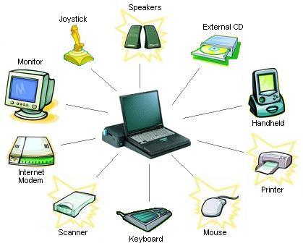
Notebook Computers
Docking station
provide additional ports that enable the notebook computer to be connected to different devices or a network in the same manner as a desktop system

Slide 10
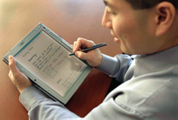
Tablet Computers
1st tablet was introduce in 1987 by Cambridge Research
Newest development in portable computers
Input is through a stylus or digital pen
Run specialized versions of office products
Some models have a fold-out keyboard
Some models can be connected to a keyboard and a full-size monitor
Notes:
Teaching tip
The tablet PC was designed to simulate a piece of paper. Users interact with the tablet as if it was an unlimited paper notebook.
For more information
See www.microsoft.com/windowsxp/tabletpc/evaluation/tours/default.mspx for an example of the Tablet PC in action.
Tablet PCs offer all the functionality of a notebook PC, but they are lighter and can accept input from a
special pen—called a stylus or a digital pen—that is used to tap or write directly on the screen.
Many tablet PCs also have a built-in microphone and special software that accepts input from the user's voice. A few models even have a fold-out keyboard, so they can be transformed into a standard notebook PC. Tablet PCs run specialized versions of standard programs and can be connected to a network.
Some models also can be connected to a keyboard and a full-size monitor.

Slide 11
Handheld PCs
Palm computer
1990, Very small computers
Personal Digital Assistants (PDA)
Note taking or contact management
Data can synchronize with a desktop
Notes:
Handheld personal computers are computing devices small enough to fit in your hand (see Figure 1 A. 13).
A popular type of handheld computer is the personal digital assistant (PDA). A PDA is no larger than a small appointment book and is normally used for special applications, such as taking notes, displaying telephone numbers and addresses, and keeping track of dates or agendas. Many PDAs can be connected to larger computers to exchange data.
Most PDAs come with a pen that lets the user write on the screen. Some handheld computers feature tiny built-in keyboards or microphones
that allow voice input.
Many PDAs let the user access the Internet through a wireless connection, and several models offer features such as cellular telephones,
cameras, music players, and global positioning systems.

Slide 12
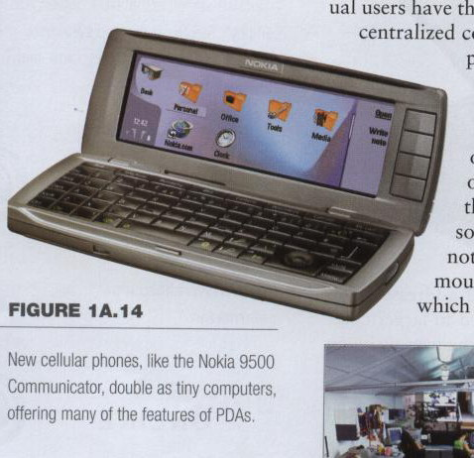
Smart Phones
Smart phones introduces in 1992 and was known as Simon Personal computer
In 1995, using the term Smart Phone
Hybrid of cell phone and PDA
Web surfing, e-mail access
Notes:
Some cellular phones double as miniature PCs (see Figure 1A.14). Because these phones offer advanced features not typically found in cellular phones, they are sometimes called smart phones.
These features can include Web and e-mail access, special software such as personal organizers, or special hardware such as digital cameras or music players. Some models even break in half to reveal a miniature keyboard.

Slide 13
Computers for Organizations
Some computers handle needs of many users at the same time.
These powerful systems are used by organizations such as businesses or schools
Commonly found at the heart of the organization network
Network servers
Mainframe computers
Minicomputers
Supercomputers

Slide 14
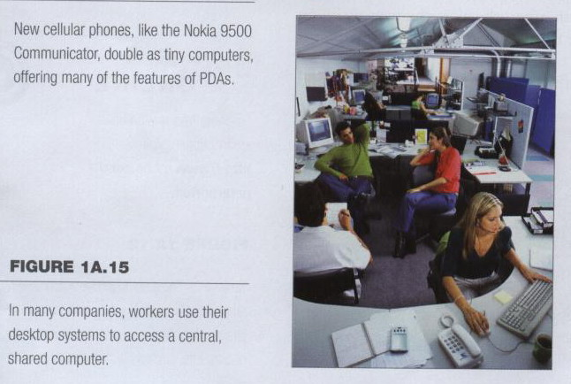
Network Servers
Network servers
Individual users have their own desktop computers, which are connected to one or more centralized computers, called network servers
Centralized computer
All other computers connect
Notes:
Today, most organizations’ networks are based on personal computers. Individual users have their own desktop computers, which are connected to one or more centralized computers, called network servers. A network server is usually a powerful personal computer with special software and equipment that enable it to function as the primary computer in the network.

Slide 15
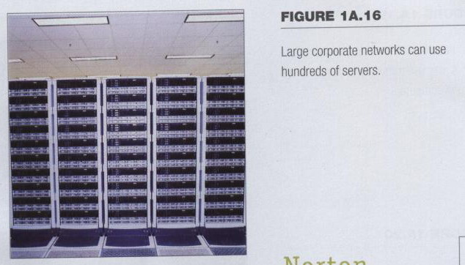
Network Servers
Provides access to network resources
Multiple servers are called server farms
supporting a certain set of users, handling printing tasks, enabling Internet communications, and so on.
Notes:
PC-based networks and servers offer companies a great deal of flexibility. For example, large organizations may have dozens
or hundreds of individual servers working together at the heart of their network (see Figure 1A.16).
When set up in such groups—sometimes called clusters or server farms—network servers may not even resemble standard PCs. For example, they may be mounted in large racks or reduced to small units called “ blades,“ which can he slid in and out of a case. In these large networks, different groups of servers may have different purposes, such as supporting a certain set of users, handling printing tasks, enabling Internet communications, and so on

Slide 16
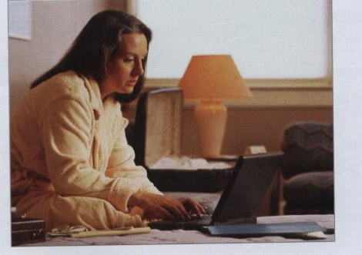
Network Servers
Users use the Internet as a means of connecting even if away from the offices.
Notes:
Depending on how the network is set up, users may be able to access the server in multiple ways. Of course, most users have a standard desktop PC on their desk that is permanently connected to the network.
Mobile users, however, may be able to connect a notebook PC or a handheld device to the network by wireless means. When they are away from the office, users may be able to use the Internet as a means of connecting to the company’s network servers (see Figure 1A.18)

Slide 17
Mainframes
Mainframe computers are used in large organizations such as insurance companies and banks, where many people frequently need to use the same data.
Used in large organizations
Handle thousands of users
Users access through a terminal
Notes:
Mainframe computers are used in large organizations such as insurance companies and banks, where many people frequently
need to use the same data. In a traditional mainframe environment, each user accesses the mainframe’s resources through a device called a terminal (see Figure 1A.19).
There are two kinds of terminals. A dumb terminal does not process or store data; it is simply an input/output (I/O ) device that functions as a window into a computer located somewhere else.
An intelligent terminal can perform some processing operations, but it usually does not have any storage. In some mainframe environments, however, workers can use a standard personal computer to access the mainframe

Slide 18
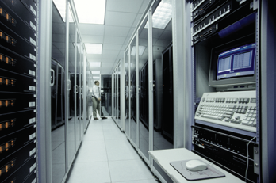
Mainframes
Large and powerful systems
The largest mainframes can handle the processing needs of thousands of users at any given moment.
Notes:
Mainframes are large, powerful systems (sec Figure 1 A.20). The largest mainframes can handle the processing needs of thousands of users at any given moment. But what these systems offer in power, they lack in flexibility. Most mainframe systems are designed to handle only a specific set of tasks. By limiting the number of tasks the system must perform, administrators preserve as much power as possible for
required operations.
You may have interacted with a mainframe system without even knowing it. For example, if you have ever visited an airline’s Web site to reserve a seat on a flight, you probably conducted a transaction with a mainframe computer.

Slide 19
Minicomputers
Called midrange computers
Power b/w mainframe and desktop
Handle hundreds of users
Used in smaller organizations
Users access through a terminal
Minicomputers can handle much more input and output than personal computers can
Notes:
The capabilities of a minicomputer are somewhere between those of mainframes and personal computers. For this reason, minicomputers are often called midrange computers.
Like mainframes, minicomputers can handle much more input and output than personal computers can. Although some ‘‘minis’’ arc designed for a single user, the most powerful minicomputers can serve the input and output needs of hundreds of users at a time. Users can access a central minicomputer through a
terminal or a standard PC

Slide 20
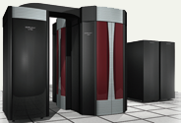
Supercomputers
The most powerful computers made for
Handle large and complex calculations
Process trillions of operations per second
Found in research organizations
Used for single operation
e.g., mapping of the human genome,
forecasting weather,
modeling complex processes like nuclear fission.
Notes:
Teaching tip
Students have a hard time understanding trillions of calculations. A simple explanation is to add 1 trillion random numbers together in a second. Contrast the speed of a super computer to the fastest desktop computer advertised during the week of class.
Supercomputers are the most powerful computers made, and physically they are some of the largest (see Figure I A.21). These systems can process huge amounts of data, and the fastest supercomputers can perform more than one trillion calculations per second.
Some supercomputers can house thousands of processors. Supercomputers are ideal for handling large and highly complex problems that require extreme calculating power. For example, supercomputers have long been used in the mapping of the human genome, forecasting weather, and modeling complex processes like nuclear fission.

Slide 21
End Note
The best way to predict the future is to invent it.

Slide 22
?

