Slide 1
Lecture 4
Strategy Analysis (SA)

Slide 2
Strategy analysis (SA)
Strategy analysis is used to refine existing plans, or build them if they do not yet exist.
It is a method that can be used at;
corporate,
business unit,
and business function levels
of an organization to define clear, brief
Strategic business plans,
Tactical business plans,
Operational business plans.
http://www.quickmba.com/strategy/levels/

Slide 3
Strategy analysis (SA)
Strategy analysis is used to:
Define business strategies, goals and issues .
Address identified threats and opportunities.
Establish technology requirements.
Define functional responsibility and accountability.

Slide 4
Strategy analysis (SA)
SA used to clearly define and express the needs of managers, at each level.
Plans documented at one level provide input to define plans at the next lower level.
At this level, problems or opportunities may be identified that need clarification or resolution, call these issues.
By examining these issues, SA helps us to identify strategies that address problems or opportunities.

Slide 5
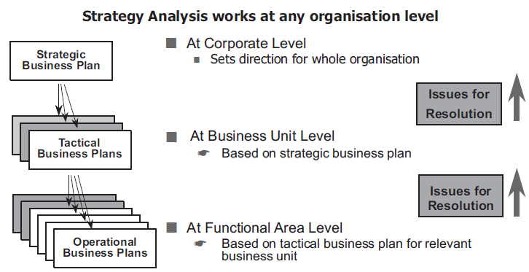
Strategy analysis (SA)
Notes:
Figure shows the hierarchical nature of these business plans

Slide 6
Participants of Strategy analysis
Managers who participate in strategy analysis are decision makers at all organizational levels,
It is their responsibility to ensure that business plans are well defined and clearly understood.
Participants of SA, use their organizational knowledge to develop business plans that incorporate that knowledge.

Slide 7
Why Strategy analysis?
For Example, Strategic plan of a hypothetical company, XYZ Corporation:
Documented as a mission statement and associated critical success factors.
To decide the directions that XYZ should take for the future and the goals and strategies to achieve that plan.

Slide 8
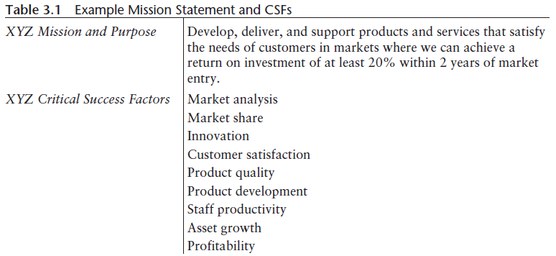
What is Strategy Analysis?
Fig 4.2 Mission statement and CSFs
A problem exists with the present CSFs:
They are not clearly stated.
Expressed in only one or two words, they are subject to misinterpretation.

Slide 9
The Quality of Planning Statements
To be effective, a strategic plan must be clear and unambiguous. We can test this as follows:
Does the XYZ strategic plan:
Provide sufficient guidance for XYZ?
State clearly what is to be done in XYZ?
Constitute an effective strategic plan for XYZ?
Each of these questions, when applied, leads to an answer of “no”.
The plan in its present form is confusing. Its quality is low.

