Slide 1
XML STANDARD FOR WEB SERVICES

Slide 2
WEB SERVICES
A web service is any piece of software that makes itself available over the internet and uses a standardized XML messaging system.
XML is used to encode all communications to a web service.
Web services are XML-based information exchange systems that use the Internet for direct application-to-application interaction. These systems can include programs, objects, messages, or documents.

Slide 3
WEB SERVICES
A Web Service is a network accessible interface to application functionality, built using standard Internet protocols.
A Web Service exposes functionality to a consumer
Over the Internet or intranet
A programmable URL
Functions you can call over the Internet

Slide 4
Components of a Web Service
A standard way for communication (SOAP)
A uniform data representation and exchange mechanism (XML)
A standard meta language to describe the services offered (WSDL)
A mechanism to register and locate WS based applications (UDDI)

Slide 5
The Web Service architecture

Slide 6
XML (EXtensible Markup Language)
XML stands for eXtensible Markup Language/
XML is a software- and hardware-independent tool for storing and transporting data.
XML is a markup language much like HTML
XML was designed to store and transport data
XML was designed to be self-descriptive
The XML language has no predefined tags.
Author can generate tags according to his XML script(like he can use tags of
<to> ,<from> where needed)

Slide 7
XML (EXtensible Markup Language)
XML is a simple tag-based language for describing information in a structured way.
Basic elements:
Tags
Attributes
Text

Slide 8
Basic Web Services Standards
SOAP 1.2 (Simple Object Access Protocol)
WSDL (Web Services Description Language) 1.1
UDDI (Universal, Description, Discovery, and Integration) 3.0.2

Slide 9
WSDL (Web Service Description Language)
It is an XML-based language for describing Web Services and how to access them.
It specifies the location of the service and the operations the services exposes.
A WSDL document is simply a set of definitions.
Fundamentally a client uses the WSDL to create the stub or to dynamically decode messages.

Slide 10
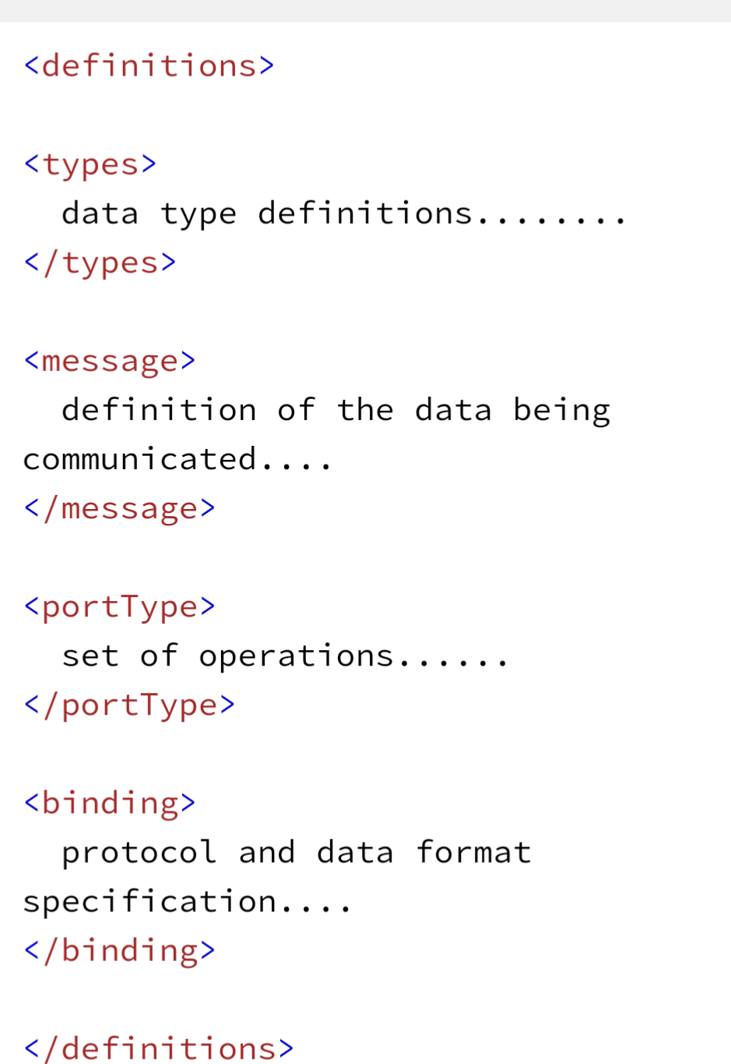
WSDL (Web Services Description Language)
The main structure of WSDL looks like this:

Slide 11
SOAP (Simple Object Access Protocol)
SOAP stands for Simple Object Access Protocol. It is an XML-based messaging protocol for exchanging information among computers. SOAP is an application of the XML specification.
SOAP is important for web applications to be able to communicate over the internet.
SOAP is a communication protocol designed to communicate via Internet.
SOAP can extend HTTP for XML messaging.
SOAP provides data transport for Web services.

Slide 12
CONTINUE
SOAP can exchange complete documents or call a remote procedure.
SOAP can be used for broadcasting a message.
SOAP is platform- and language-independent.
SOAP is the XML way of defining what information is sent and how.
SOAP enables client applications to easily connect to remote services and invoke remote methods.

Slide 13
UDDI (Universal Description, Discovery and Integration)
The Universal Description, Discovery, and Integration specs define a way to publish and discover information about Web services.
The UDDI business registration is an XML file that describes a business entity and its Web services
UDDI is a complimentary approach for searching based on a centralized repository.
The repository is an “electronic yellow pages” for firms that offer web services online. Besides the names of services and their WSDL descriptors, firms can add a description of their business, phone numbers, addresses...
UDDI repositories are offered by many agencies - e.g. IBM, Microsoft and HP.

Slide 14
Problem with WS Standards
Several organizations are involved in developing web services standards.
Each organization has different goals and different degrees of power and influence.
Also, there are many vendors who duplicate each other’s work.
An alliance of Microsoft and IBM
Others such as CA (Computer Associates), HP, and BEA
As a result, many standards have been created, they may overlap, and even conflict.

