Slide 1
The Component of the System Unit

Slide 2
Objectives Overview
Differentiate among various styles of system units on desktop computers, notebook computers, and mobile devices
Identify chips, adapter cards, and other components of a motherboard
Describe the control unit and arithmetic logic unit components of a processor, and explain the four steps in a machine cycle
Identify characteristics of various personal computer processors on the market today, and describe the ways processors are cooled
Define a bit and describe how a series of bits represents data
Explain how program instructions transfer in and out of memory
See Page 209
for Detailed Objectives

Slide 3
Objectives Overview
Differentiate among the various types of memory
Describe the purpose and types of expansion slots and adapter cards, and differentiate among slots for various removable flash memory devices
Differentiate between a port and a connector, and explain the differences among a USB port, FireWire port, Bluetooth port, SCSI port, eSATA port, IrDA port, serial port, and MIDI port
Describe the types of buses in a computer
Explain the purpose of a power supply and describe how it keeps cool
Understand how to clean a system unit on a computer or mobile device
See Page 209
for Detailed Objectives

Slide 4
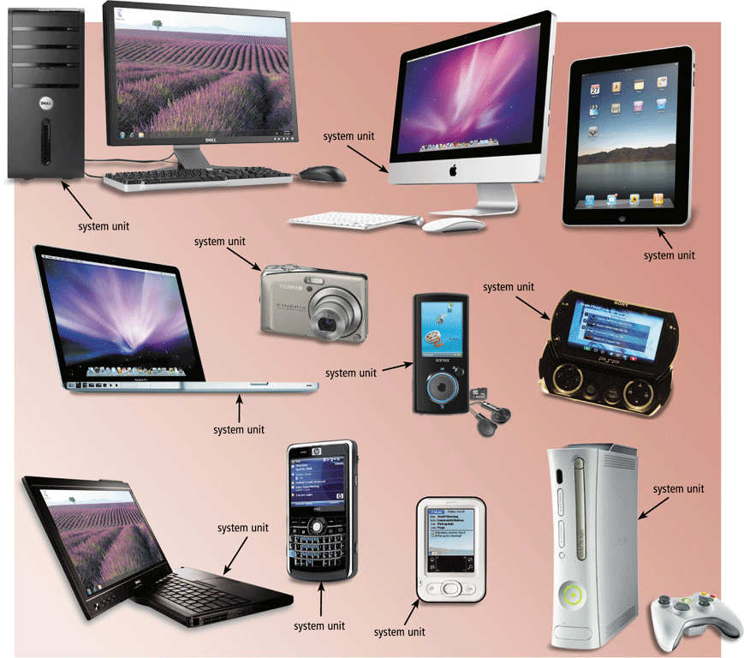
The System Unit
The system unit is a case that contains electronic components of the computer used to process data
Page 210
Figure 4-1

Slide 5
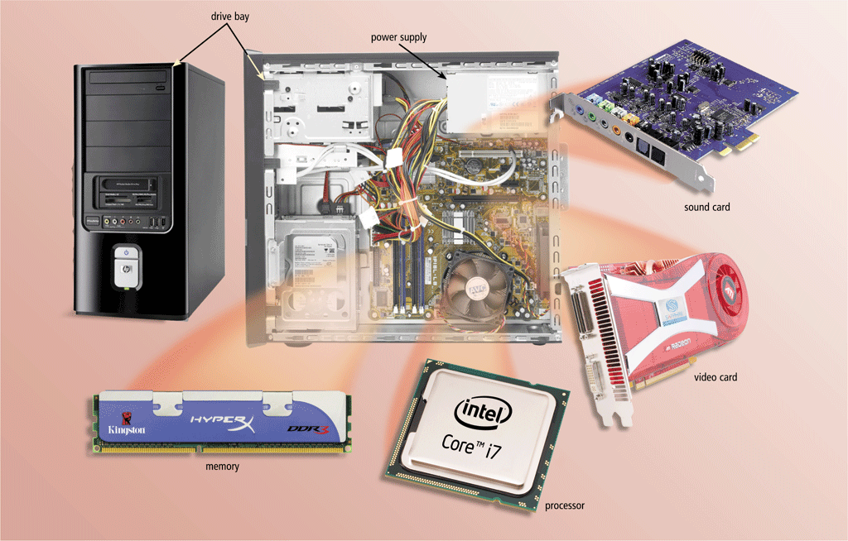
The System Unit
The inside of the system unit on a desktop personal computer includes:
Drive bay(s)
Power supply
Sound card
Video card
Processor
Memory
Page 211
Figure 4-2

Slide 6
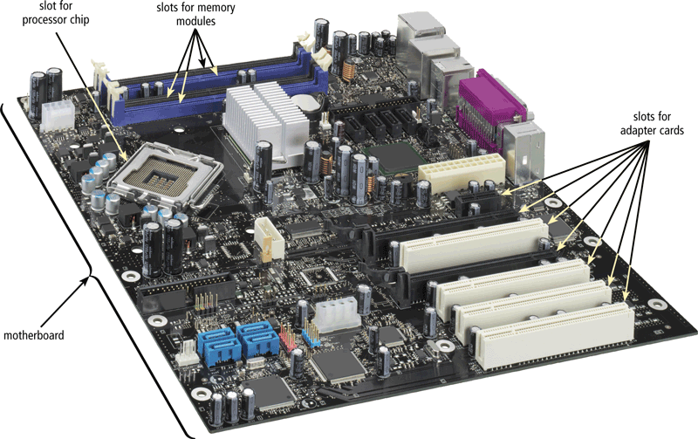
The System Unit
The motherboard is the main circuit board of the system unit
A computer chip contains integrated circuits
Page 212
Figure 4-3

Slide 7
Processor
The processor, also called the central processing unit (CPU), interprets(takes) and carries out the basic instructions that operate a computer
Contain a control unit and an arithmetic logic unit (ALU)
Multi-core processor
Dual-core processor
Quad-core processor
Page 213

Slide 8
Processor
Page 213
Figure 4-4

Slide 9
Processor
The control unit is the component of the processor that directs(guids or leads) and coordinates(manages) most of the operations in the computer
The arithmetic logic unit (ALU) performs arithmetic, comparison, and other operations
Page 214

Slide 10
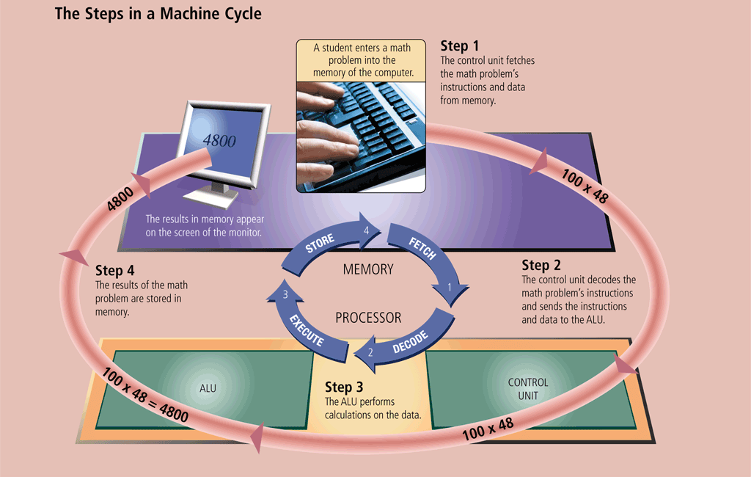
Processor
For every instruction, a processor repeats a set of four basic operations, which comprise a machine cycle
Page 215
Figure 4-5

Slide 11
Processor
Most current personal computers support pipelining
Processor begins fetching a second instruction before it completes the machine cycle for the first instruction
Pages 215 – 216
Figure 4-6

Slide 12
Processor
The processor contains registers, that temporarily hold data and instructions
The system clock controls the timing of all computer operations
The pace of the system clock is called the clock speed, and is measured in gigahertz (GHz)
Page 216

Slide 13
Processor
The leading manufacturers of personal computer processor chips are Intel and AMD
Pages 216 – 217
Figure 4-7

Slide 14
Data Representation
Analog signals are continuous and vary in strength and quality
Digital signals are in one of two states: on or off
Most computers are digital
The binary system uses two unique digits (0 and 1)
Bits and bytes
Page 221

Slide 15
Data Representation
A computer circuit represents the 0 or the 1 electronically by the presence or absence of an electrical charge
Eight bits grouped together as a unit are called a byte. A byte represents a single character in the computer
Page 221
Figures 4-12 – 4-13

Slide 16
Data Representation
ASCII (American Standard Code for Information Interchange) is the most widely used coding scheme to represent data
Page 221
Figure 4-14

Slide 17
Data Representation
Page 222
Figure 4-15

Slide 18
Memory
Memory consists of electronic components that store instructions waiting to be executed by the processor, data needed by those instructions, and the results of processing the data
Stores three basic categories of items:
The operating system and other system software
Application programs
Data being processed and the resulting information
Page 223

Slide 19
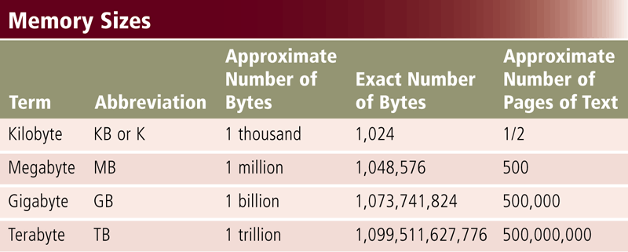
Memory
Each location in memory has an address
Memory size is measured in kilobytes (KB or K), megabytes (MB), gigabytes (GB), or terabytes (TB)
Page 223
Figure 4-17

Slide 20
Memory
The system unit contains two types of memory:
Volatile memory
Nonvolatile memory
Loses its contents when power is turned off
Does not lose contents when power is removed
Example includes RAM
Examples include ROM, flash memory, and CMOS
Pages 223 - 224

Slide 21
Memory
Page 224
Figure 4-18

Slide 22
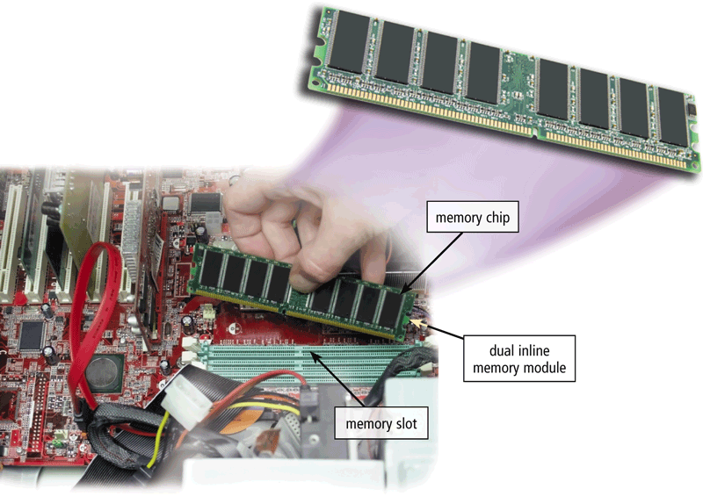
Memory
RAM chips usually reside on a memory module and are inserted into memory slots
Page 225
Figure 4-20

Slide 23
Memory
Read-only memory (ROM) refers to memory chips storing permanent data and instructions
Firmware
A PROM (programmable read-only memory) chip is a blank ROM chip that can be written to permanently
EEPROM can be erased
Page 228

Slide 24
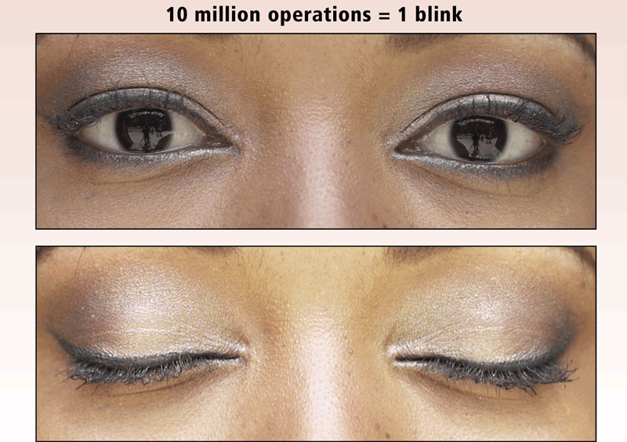
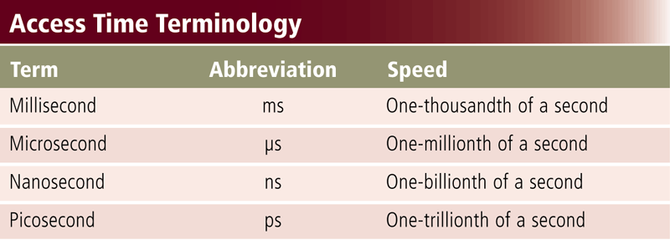
Memory
Access time is the amount of time it takes the processor to read from memory
Measured in nanoseconds
Page 229
Figures 4-24 – 4-25

Slide 25
Ports and Connectors
A port is the point at which a exterior attaches to or communicates with a system unit (sometimes referred to as a jack)
A connector joins a cable to a port
Page 232

Slide 26
Ports and Connectors
Page 232
Figure 4-29

Slide 27
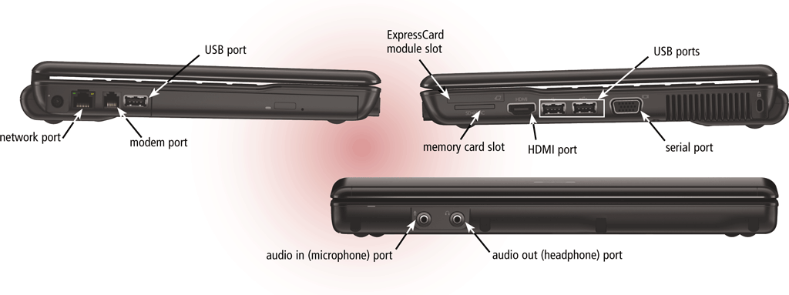
Ports and Connectors
On a notebook computer, the ports are on the back, front, and/or sides
Pages 232 - 233
Figure 4-30

Slide 28
Ports and Connectors
Page 233
Figure 4-31

Slide 29
Ports and Connectors
Page 234
Figure 4-32

Slide 30
Ports and Connectors
Other types of ports include:
Firewire port
Bluetooth port
SCSI port
eSATA port
IrDA port
Serial port
MIDI port
Pages 234 - 236

Slide 31
Buses
A bus allows the various devices both inside and attached to the system unit to communicate with each other
Data bus
Address bus
Word size is the number of bits the processor can interpret and execute at a given time
Page 237
Figure 4-36

Slide 32
Buses
Expansion slots connect to expansion buses
Common types of expansion buses include:
PCI bus
PCI Express bus
Accelerated Graphics Port
USB and FireWire bus
PC Card bus
Page 238

Slide 33
Bays
A bay is an opening inside the system unit in which you can install additional equipment
A drive bay typically holds disk drives
Page 238
Figure 4-37

Slide 34
Power Supply
The power supply converts the wall outlet AC power into DC power
Some external peripherals have an AC adapter, which is an external power supply
Page 239

Slide 35
Putting It All Together
Home
Intel Core i5 or Intel Core 2 i3 or AMD Athlon II or AMD Sempron
Minimum RAM: 2 GB
Small Office/ Home Office
Intel Core i7 or Intel Core i7 Extreme or AMD Phenom II or AMD Athlon II
Minimum RAM: 4 GB
Mobile
Intel Core i7 Extreme or Intel Core i7 or AMD Phenom II or AMD Turion II
Minimum RAM: 2 GB
Page 239
Figure 4-38

Slide 36
Putting It All Together
Power
Intel Xeon or Intel Itanium or AMD Opteron
Minimum RAM: 8 GB
Enterprise
Intel Core i7 or Intel Core i7 Extreme or AMD Phenom II or AMD Athlon II
Minimum RAM: 4 GB
Page 239
Figure 4-38

Slide 37
Keeping Your Computer or Mobile Device Clean
Clean your computer or mobile device once or twice a year
Turn off and unplug your computer or mobile device before cleaning it
Use compressed air to blow away dust
Use an antistatic wipe to clean the exterior of the case and a cleaning solution and soft cloth to clean the screen
Page 240

Slide 38
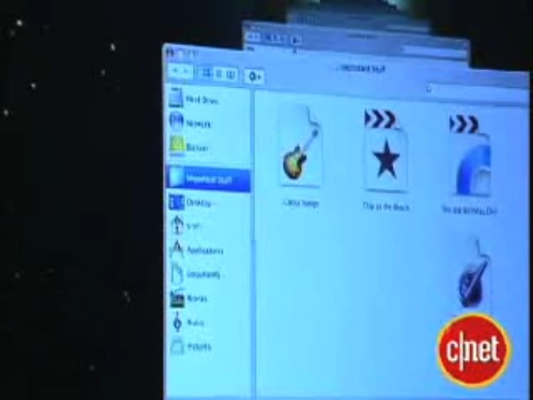
Video: The Leopard with a Time Machine
CLICK TO START

Slide 39
Summary
Components of the system unit
How memory stores data, instructions, and information
Sequence of operations that occur when a computer executes an instruction
Comparison of various personal computer processors on the market today
How to clean the exterior and interior of a system unit
Page 241

Slide 40
Chapter 4 Complete

