Slide 1
Normal physical changes in Sleep in Older Adults
FAIZAAMJAD

Slide 2
Stages of Sleep
Non Rapid Eye Movement (NREM)
Rapid Eye Movement (REM)
NREM consists of 4 stages
Stage 1: Very light sleep
Stage 2: Light sleep
Stage 3: Deeper sleep
Stage 4: Very deep sleep, most restorative
Stage 5: REM sleep, when we dream
Notes:
The stages of sleep were first described in 1937 by Alfred Lee Loomis, an American also known for significant work in developing the radar. Loomis and his coworkers used EEG recordings to classify 5 different levels of sleep that they referred to using the letters A to E.
When Dement and Kleitman discovered that REM sleep was a distinct state in 1953, it led them to reclassify the stages of sleep, separating REM from the other four stages of non-REM and giving us the model we use today.
Read more: http://www.end-your-sleep-deprivation.com/stages-of-sleep.html#ixzz29pZwU1W8

Slide 5
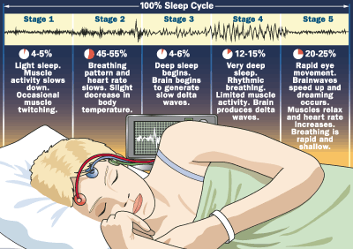

Slide 6
Sleep patterns
A normal night of sleep usually begins with NREM sleep
the first REM period occurs after 80 minutes after falling asleep may last 3-4 mint
REM TENDS TO OCCUR 5 TIME A NIGHT
NREM and REM then alternate throughout the night
Sleep progresses from stage 1 to 4 ; back through 3 and 2 before entering REM
stages 1 -> 2 -> 3 -> 4 -> 3 -> 2 -> REM.

Slide 7
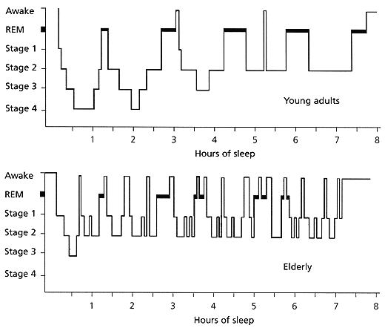
Changes in Sleep with Aging
Sleep is cyclical
The ability to stay a sleep changes most markedly with aging

Slide 8
Normal sleep
Sleep latency : period of time needed to fall a sleep
Sleep duration: 6-9 hour is normal
Position change :20-40 /night is normal
Night awakening :1-2 , increase with age
Circadian rhythm : The daily cycle of sleep and wakefulness

Slide 9
Circadian rhythm
Biological event occuring at 24 hour interval such as
Sleep /wake cycle
Body temp fluctuation
Harmone secretory cell
Generally link to the dark and light cycle

Slide 10
Age-related changes in sleep
Alteration in sleep pattern include decreased sleep efficiency-
time asleep divided by time in bed
Normal to decreased total sleep time
Increase sleep latency time to fall a sleep
Earlier bed time and earlier morning awakening
More arousals during the night
More day time napping

Slide 11
Selected Medical Conditions that Disrupt Sleep
Pain: arthritis, cancer, neuropathy
Cardiac and Vascular: angina, CHF
Pulmonary: COPD, secretions, bronchospasm,
Gastrointestinal: , ulcer pain, hunger
Endocrine: hypo/hyperthyroidism, diabetes
Genitourinary: nocturia, incontinence

Slide 12
Sleep problem
Insomnia difficulty initiating or maintaining sleep
Sleep apnea temporary absence of breathing during sleep
Obstructive sleep apnea due to obstruction in throat during sleep
Central sleep apnea delay in signal from brain to breath
Narcolepsy excessive day time sleepiness and pathological REM sleep
Repetitive knee flexion and foot dorsiflexion restless leg syndrome

Slide 13
Sleep problem
Circadian rhythm disorder mismatch between the sleep schedule and normal pattern
Somnambulism sleepwalking
Night terror arousal and agitation during slow wave sleep ( sweating tachycardia)
Nightmares bad dream occurring during REM sleep
Sleep enuresis bed wetting
Bruxism teeth grinding

Slide 14
Age related sleep disorders insomnia
Complaints of poor sleep quality
Day time symptoms of drowsiness
Mid sleep awakening
Early morning awakening
Non restorative sleep
Irritability
Problems with concentration

Slide 15
Type of insomnia
Transient : less than 04 week or less
intermittent insomnia : period of 4 weeks to up to 6 months.
Chronic: almost every night for more than six months.

Slide 16
Assessment data
Sleep history sleep pattern
Sleep diary
Physical examination
Behavioral : mood alteration , confusion
Physical :dark circle under the eyes ,increase BP , Pulse rate , respiratory rate
Diagnostic test
Conducted in sleep lab , home monitoring

Slide 17
The Sleep Interview
Is there a complaint of poor sleep or unsatisfactory sleep? (daytime consequences?)
Is there a complaint of excessive daytime sleepiness?
Sleep Schedule and Nap
Amount and timing of daily light exposure
Daily exercise

Slide 18
Non-drug treatments
Stimulus control
Sleep restriction
Relaxation training
Sleep hygiene

Slide 19
How to keep track of your sleep
Daily sleep diary or sleep log
Bedtime
Falling asleep time
Nighttime awakenings
Time to get back to sleep
Waking up time
Getting out of bed time
Naps

Slide 20
Stimulus Control - You can do this on your own
Go to bed only when sleepy
Use the bed only for sleeping
If unable to sleep, move to another room
Return to bed only when sleepy
Repeat the above as often as necessary
Get up at the same time every morning
Do not nap

Slide 21
Sleep Restriction - best if done with a professional
Cut bedtime to the actual amount of time you spend asleep
No additional sleep is allowed outside these hours
Record on your daily sleep log the actual amount of sleep obtained
Compute sleep efficiency (total time asleep divided by total time in bed)

Slide 22
Relaxation training
More effective than no treatment, but not as effective as sleep restriction
More useful with younger compared with older adults
Engage in any activities that you find relaxing shortly before bed or while in bed
Can include listening to a relaxation tape, soothing music, muscle relaxation exercises, a pleasant image

Slide 23
Relaxation training
Time Required: 20 minutes a day
Sit
Close your eyes
Breathe in
Breathe out
Repeat
Practice daily
What You Need:
Place to sit
20 uninterrupted minutes

Slide 24
Healthy sleep habits (sleep hygiene)
Avoid alcohol, nicotine, caffeine, chocolate
For several hours before bedtime
Cut down on non-sleeping time in bed
Bed only for sleep
Avoid trying to sleep
Avoid a visible bedroom clock with a lighted dial
Don’t let yourself repeatedly check the time!
Can turn the clock around or put it under the bed

Slide 25
More healthy sleep habits
Expose yourself to bright light at the right time
Morning:
Night
Establish a regular sleep schedule
Get up at the same time 7 days a week
Go to bed at the same time each night
Exercise every day - exercise improves sleep!
Deal with your worries before bedtime
Plan for the next day before bedtime
Set a worry time earlier in the evening

Slide 26
More healthy sleep habits
Adjust the bedroom environment
Sleep is better in a cool room, around 65 F.
Darker is better
If you get up during the night to use the bathroom, use minimum light
Make sure your bed and pillow are comfortable

Slide 27
Supplements:
Many supplements claim to help with insomnia. The two most popular are melatonin and valerian.
Melatonin: This hormone is naturally produced by your body and stimulated by exposure to sunlight. Studies have not shown that melatonin is effective in treating insomnia. However, many people claim that taking melatonin helps them to fall asleep.
Valerian: This is an herb that is reportedly effective in helping people fall asleep. (tea, pills extracts) and is unregulated. Dose and quality can vary widely from one product to another

Slide 28
Exercise to Improve Your Sleep
Producing a drastic change in body temperature.
When you exercise, there is a significant increase in your body's temperature. After a few hours, the body temperature drops back down. This change in temperature can make it easier for to fall asleep and stay asleep.
An increase in adrenaline. When you exercise adrenaline is increased which increases the heart rate and metabolism. This naturally fatigues the body making it easier to fall asleep.
Vigorous use of the legs muscles. When the leg muscles are used vigorously, it acts as a natural tranquilizer, making it much easier to fall sleep.

