Slide 1
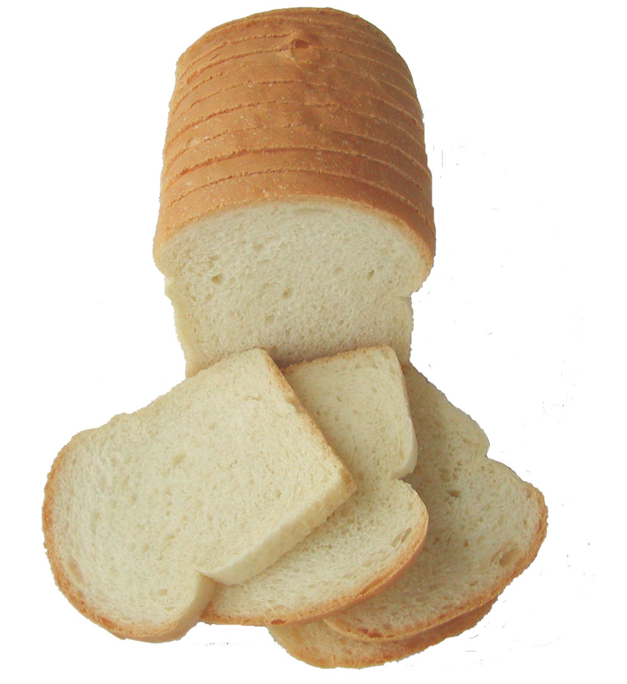
Baking Cooking foods in ovens by surrounding dry heat.
Objective of baking
To convert unpalatable dough into light, porous and digestible flavored dough.
Flavor of bread is due to alcohol production.
Alcohol is produced by alcoholic fermentation.

Slide 2
Factors effecting baking
Baking depends on:-
TEMPERATURE
After final proofing baking is done at 240 ⁰C.
Temperature should be maintained continuously at 240 ⁰C.
BAKING TIME
Dough is baked for 30 mins.

Slide 3
Reactions During Baking
GELATINIZATION:-
Starch + water → Gel
Baking causes starch present in dough to gelatinize.
Gelatinization occurs at 55-59⁰C.
Starch particles swells 5 times to their original
size.
Gelatinization cause thickening, which plays a major role in creating the texture of the finished crumb.
Without gelatinization, bread will be hard and tough.

Slide 4
Continued……
Moisture evaporation:-
Water evaporates during baking and it can easily be noticed by the weight of finished product.
Water evaporation causes a flaky texture.
A properly cooked loaf will be lighter in weight after baking.

Slide 5
Continued……
Fats melt:-
Fats melt and liquefy in the oven, which allows them to be absorbed.
Loss of fat also makes the bread less delicious.

Slide 6
Continued……
Sugars Caramelize:-
Heat melts sugar and turns it brown in a process called caramelization.
The higher the heat, the faster the caramelization takes place.
This is not always a good thing, because the crust shouldn't brown before the interior is cooked.

Slide 7
Continued……
Proteins Solidify:-
During baking, dough proteins changes from soft to firm.
This change creates the structure of bread.
Heat causes the chains of amino acids to tighten, altering the overall structure of the protein.

Slide 8
Continued……
Oven Spring:-
The first noticeable change during baking is the expansion of gasses.
A loaf puff up quickly, within a few minutes. This effect is known as “oven spring.”
In yeast breads, CO₂ expands through the fermentation process.
In quick breads, CO₂ expands too, but it is created by chemical leaveners (baking soda or baking powder).

Slide 9
Effect Of Temperature On Baking
Loaf Size:-
If loaf size is large, we have to reduce the temperature to avoid burning of bread.
If loaf size small, we have to regulate temperature accordingly.

Slide 10
Continued………
Presence of sugars:-
If formula contains too much sugar, we have to reduce the temperature to avoid excessive color.
If there is low sugar, we have to increase the temperature to get proper color.

Slide 11
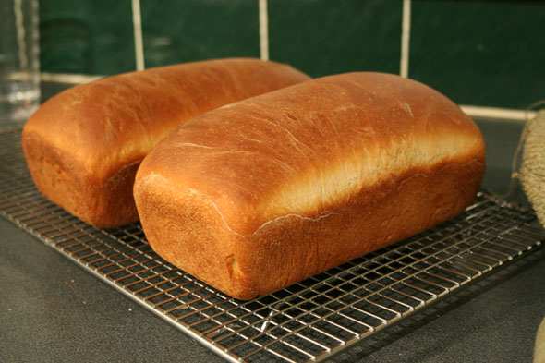
Indication of baked product
Pan walls are no more sticky.
Right amount of moisture
is lost.
All enzymatic and fermentation
activities are over.
The loaf hold its shape.

Slide 12
Properly Baked Bread

