Slide 2
Introduction
Micro-Bodies
Specialized form of peroxisome
Present in plant cells (Germinating seeds)
Not found in animal cells except some lower animals (Nematodes )
Contain the enzymes of the Glyoxylate Cycle

Slide 3
Enzymes
Citrate synthase, isocitrate lyase, malate synthase etc
They contain all the enzymes necessary for fatty acid oxidation in Glyoxylate Cycle and Gluconeogenesis.

Slide 4
Discovery
R.W Breidenbach and H. Beevers In 1961.
Microbodies of the fat-storing cells of germinating seeds contain enzymes.
Enzyme were found in the organelle other than mitochondria (Glyoxysomes).

Slide 5
Role Of Glyoxysomes In Glyoxylate Cycle
Main Aim:
Convert acetyl CoA into succinate for the synthesis of carbohydrates.
Fatty acid → Carbohydrates
In Microorganisms in the absence of glucose this cycle allows cells to utilize carbon compounds as a carbon source.

Slide 6
Absent in lipid-poor seed such as the pea

Slide 7
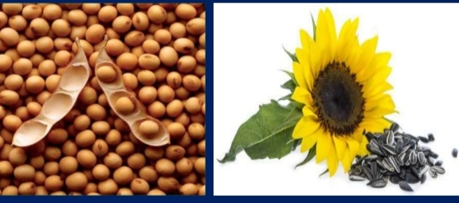
Role In Glyoxylate Cyclic
Present in plants e.g (Oil rich seeds) Soya beans, Castor beans, Sunflower beans.

Slide 8
Role In Glyoxylate Cyclic
Present at the time of Germination (Plant seedling)
Removed in living plants when they become able to produce their own food from photosynthesis
Energy comes from the stored fatty acids
Fatty acid → Carbohydrates
Glyoxysomes undergo catabolism & anabolism of lipids
Catabolism carried by the enzymes present in glyoxysomes (Glyoxylate Cycle)
Contain material to begin formation of new plants Form epicotyl & hypocotyl

Slide 9
Glyoxylate Cycle

Slide 10
Role In Glyoxylate Cyclic

Slide 11
Enzymes involve in Glyoxylate Cycle
The glyoxylate cycle utilizes five enzymes that are following:
Citrate synthase
Aconitase
Isocitrate lyase
Malate synthase
Malate dehydrogenase

Slide 12
Steps Involved In Glyoxylate Cycle
Citric acid is dehydrated to produce Cisaconitic Acid in the presence of Aconitase

Slide 13
Role Of Glyoxylate Cycle In Pathogenic Fungi
Main enzymes Isocitrate Lyase and malate synthase are increased upon contact with the human host. Mutant of particular fungi that lacked Isocitrate Lyase are less virulant. Glyoxylate Cycle is a significant factor for the pathogenesis of these microbes.

Slide 14
Role Of Glyoxylate Cycle In Gluconeo-genesis
Fatty acid from lipids are used as an energy source.
Fatty acid is converted into acetate molecule by beta oxidation.
Acetate +active thiol group (coenzyme A) > TCA cycle > CO2
This pathway allows cells to obtain energy from fats.

Slide 15
GOLGI APPARATUS

Slide 16
What is Golgi Apparatus ?
Also known as Golgi complex, Golgi body or Golgi.
Membrane bound organelles, which are sac-like.
Found in cytoplasm of most eukaryotic cells and
absent in prokaryotes, Mammalian RBCs and sperm cells of bryophytes.
Ranges from one to several within a cell.
In plant cells several small Golgi complex – dictyosomes.
It is responsible for transporting, modifying and packaging proteins and lipids into vesicles.

Slide 17
Structure of Golgi Apparatus
Is made up of several stack of parallel, flattened sac or cisternae.
Many peripheral tubules and vesicles.

Slide 18
CISTERNAE
Golgi apppartaus is made up of approx 4- 8 cisternae .
Usually equally spaced in stark separated from each other by thin layer of intercisternal cytoplasm .
Golgi complex has a distinct polarity ,the two poles are cis and transface responsible for receiving and shipping departments.
Forming (cis)face-convex side of stack,Maturing(trans) faceconcave side of stack.
Secretory material 𝑓𝑟𝑜𝑚 smooth endoplasmic
reticulum 𝑣𝑖𝑎 transport vesicles 𝑟𝑒𝑎𝑐ℎ𝑒𝑠 golgi complex.

Slide 19
CISTERNAE

Slide 20
Tubules & vesicles :
Tubules: - small, round tubules formed from the periphery of the cisternae .
And few get enlarged at the end to form vesicles.
Vesicles:-lie near the end and concave surface of the golgi complex
Types of vesicles:-smooth vesicles and coated vesicles
Golgi matrix:-all golgi elements filled with a fluid.

Slide 21
Modification in CGN AND TGN

Slide 22
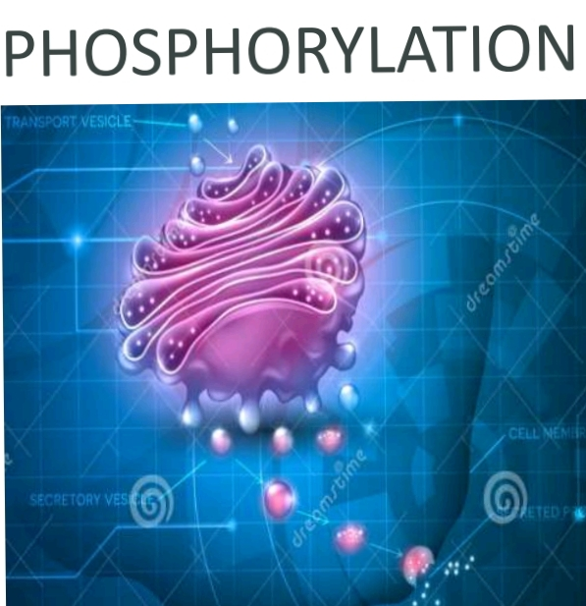
FUNCTIONS
SECRETION
SYNTHESIS
SULFATION
APOPTOSIS
PHOSPHORYLATION

Slide 23
Transport from the Golgi apparatus
Transport from golgi takes place by two pathways.
1. Constitutive secretory pathway
2. Regulated secretory pathway

Slide 24
GOLGI APPARATUS

Slide 25
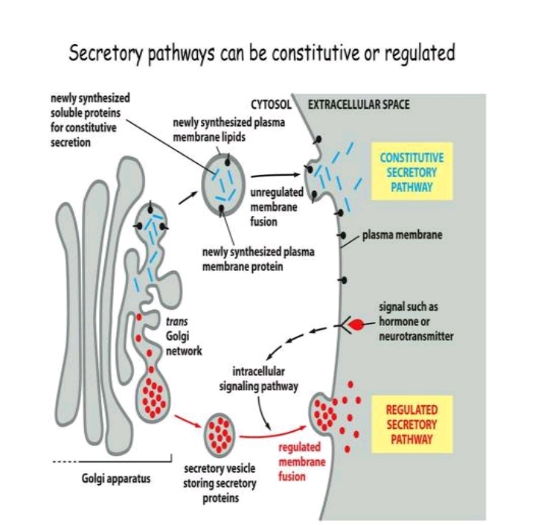
a. Constitutive secretory pathway
Proteins are secreted from a cell continuously, regardless of external signals or factors.
Proteins are stored in vesicles in the Golgi and move directly to the cell surface and fuse with the PM and release the soluble proteins

Slide 26
b. Regulated secretory pathway:
A distinct regulated secretory pathway in which specific proteins are secreted in response to environmental signals. Proteins are sorted in trans Golgi network and packed into secretory vesicles.
These secretory vesicles are usually larger than other transport vesicles.
And stored until specific signals are received , then fuses with plasma membrane to release the proteins.

Slide 27
b. Regulated secretory pathway:

Slide 28
PEROXISOMES

Slide 29
STRUCTURE
Small vesicles found around the cell.
They have a single celled membrane that contains digestive enzymes.
They have the thickest membrane of all organelles.
A lipid bilayer surrounds it.

Slide 30
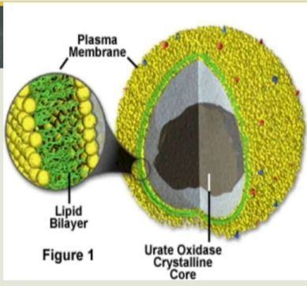
STRUCTURE
Contains a urate oxylase crystalline core.
Contains more than 50 enzymes
They self-replicate by enlarging and then dividing

Slide 31
CONTRAST BETWEEN PEROXISOMES AND OTHER ORGANELLES
Like vacuoles, peroxisomes digest and store material.
Like lysosomes, peroxisomes have similar structure.
Unlike lysosomes, peroxisomes require oxygen to work.
Like mitochondria and choroplast, proteins from the peroxisomes are translated to the cytoplasm
Unlike mitochondria and choroplast, peroxisomes do not contain genetic material.

Slide 32
FUNCTION OF PEROXISOMES
AIDS IN THE OXIDATION OF TOXIC MOLECULES
CONTRIBUTES TO THE BIOSYNTHESIS OF PLASMOLOGENS WHICH ARE AN ABUNDANT CLASS OF PHOSPHOLIPIDS IN MYELIN
RECYCLES CARBON DURING PHOTORESPIRATION IN PLANT CELLS

Slide 33
FUNCTIONS CONT’D
BREAK DOWN FATTY ACIDS AND AMINO ACIDS TO BE USED FOR THE FORMATION OF MEMBRANES AND FUEL FOR RESPIRATION
AIDS IN THE FORMATION AND BREAKDOWN OF REACTIVE OXYGEN SPECIES
PRODUCES BILE ACIDS NEEDED FOR ABSORPTION OF FATS AND LIPIDSOLUBLE VITAMINS

Slide 34
IMPORTANCE OF PEROXISOMES IN CELLS
PEROXISOMES ARE IMPORTANT TO THE CELL SINCE THEY PROVIDE A MAJOR SOURCE OF METABOLIC ENERGY

Slide 35
ENZYMES IN PEROXISOMES
THE ENZYMES IN PEROXISOMES ARE :
1) CATALASE
DESTROYS EXCESS HYDROGEN PEROXIDE IN OXIDATION REACTIONS
2) D- AMINO ACID OXIDASE
OXIDISES D-AMINO ACIDS TO IMINO ACIDS (AMMONIA & HYDROGEN PEROXIDE)
3) URIC ACID OXIDASE
CATALYZES THE OXIDATION OF URIC ACID TO SOLUBLE ALLANTOIN IN PLANTS

Slide 36
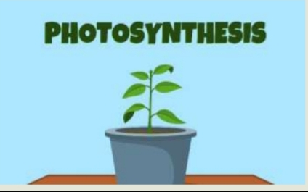
PEROXISOME ROLE IN PHOTOSYNTHESIS
Takes part in photorespiration where carbon is recovered.
Glycolate, a chemical which is received by the peroxisomes.
Glycolate is turned to another enzyme called glycine and sent to the mitochondria

Slide 37
PHOTOSYNTHESIS
In the mitochondria it turned into serine and passed back to the peroxisome. •In the peroxisome is then turned to glycerate and sent to the chloroplast. •No energy is gained.

Slide 38
Pathway of photorespiration

