Slide 1
Question:
Hellet al compared three method of determining serum amylase values in patients with pancreatitis. The result are shown below. We wish to know whether these data indicate a difference among the three methods given α=0.05

Slide 2
Question no# 1

Slide 3
Methods Of Determination
specimen | A | B | C
1 | 4000 | 3210 | 6120
2 | 1600 | 1040 | 2410
3 | 1600 | 647 | 2210
4 | 1200 | 570 | 2060
5 | 840 | 445 | 1400
6 | 352 | 156 | 2499
7 | 224 | 155 | 224
8 | 200 | 99 | 208
9 | 184 | 70 | 227

Slide 4
1. Hypothesis Testing: Ho: MA=MB=MC H1: At least one equality is violated 2. Level Of Significance: 𝛼 = 0.05

Slide 5
Test Statistic: Where b=9 & k=3 After assigning ranks
Methods Of Determination
Specimen | A | B | C
1 | 2 | 1 | 3
2 | 2 | 1 | 3
3 | 2 | 1 | 3
4 | 2 | 1 | 3
5 | 2 | 1 | 3
6 | 3 | 1 | 2
7 | 2.5 | 1 | 2.5
8 | 2 | 1 | 3
9 | 2 | 1 | 3
Total | 19.5 | 9 | 25.5

Slide 6
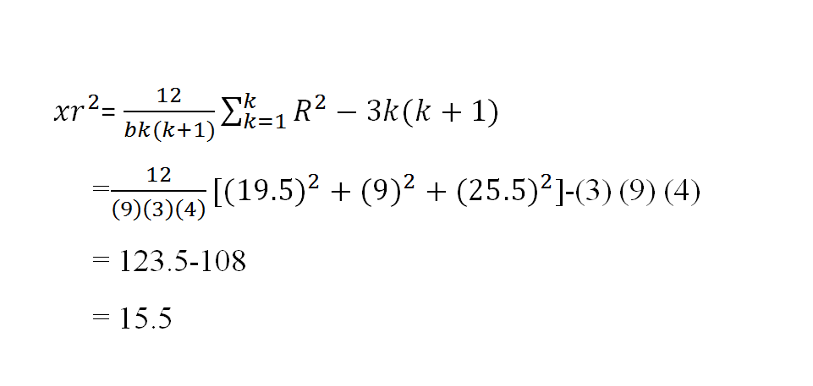
b

Slide 7
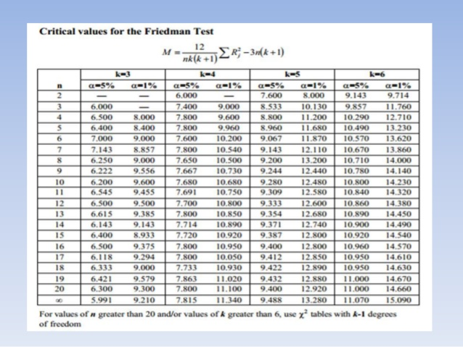

Slide 8
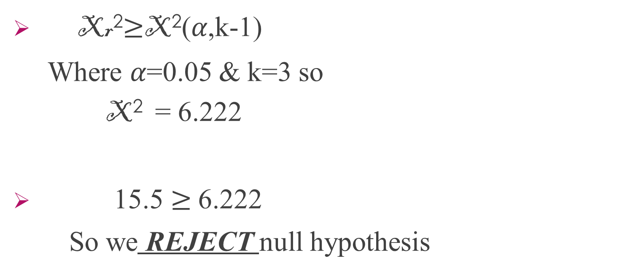
Decision:
Xr²$≥$X²(𝛼,k-1)
Where 𝛼=0.05 & k=3 so
X² = 6.222
15.5 $≥$6.222
So we REJECT null hypothesis

Slide 9
Conclusion:
Enough evidence to support the claim that the three methods do not yield identical results

