Slide 1
Chapter 12: Other Quality Attributes

Slide 2
Chapter Outline
Other Important Quality Attributes
Other Categories of Quality Attributes
Software Quality Attributes and System Quality Attributes
Using Standard Lists of Quality Attributes
Dealing with “X-ability”
Summary

Slide 3
Other Important Quality Attributes
Variability: is a special form of modifiability. It refers to the ability of a system and its supporting artifacts requirements, test plans, and configuration specifications to support the production of a set of variants that differ from each other in a preplanned fashion.
The goal of variability in a software product line is to make it easy to build and maintain products in the product line over a period of time.
Portability: is also a special form of modifiability. Portability refers to the ease with which software that built to run on one platform can be changed to run on a different platform.

Slide 4
Other Important Quality Attributes
Development Distributability: is the quality of designing the software to support distributed software development.
Teams working on modules that communicate with each other may need to negotiate the interfaces of those modules. When a module is used by many other modules, each developed by a different team, communication and negotiation become more complex and burdensome.
Similar considerations apply for the data model.
Scenarios for development Distributability will deal with the compatibility of the communication structures and data model of the system being developed and the coordination mechanisms of the organizations doing the development.

Slide 5
Other Important Quality Attributes
Scalability: Two kinds of scalability are horizontal scalability and vertical scalability.
Horizontal scalability (scaling out) refers to adding more resources to logical units such as adding another server to a cluster.
Vertical scalability (scaling up) refers to adding more resources to a physical unit such as adding more memory to a computer.
In cloud environments, horizontal scalability is called elasticity.

Slide 6
Other Important Quality Attributes
Deployability: is concerned with how an executable arrives at a host platform and how it is invoked.
Deployment scenarios will deal with the type of update, the form of the update, the resulting integration into an existing system, the efficiency of executing the process, and the associated risk.

Slide 7
Other Important Quality Attributes
Mobility: deals with the problems of movement and affordances of a platform (e.g. size, type of display, type of input devices, availability and volume of bandwidth, and battery life).
Issues in mobility include battery management, reconnecting after a period of disconnection, and the number of different user interfaces necessary to support multiple platforms.
Scenarios will deal with specifying the desired effects of mobility or the various affordances. Scenarios may also deal with variability, where the same software is deployed on multiple (perhaps radically different) platforms.

Slide 8
Other Important Quality Attributes
Monitorability: deals with the ability of the operations staff to monitor the system while it is executing.
Items such as queue lengths, average transaction processing time, and the health of various components should be visible to the operations staff so that they can take corrective action in case of potential problems. Scenarios will deal with a potential problem and its visibility to the operator, and potential corrective action.

Slide 9
Other Important Quality Attributes
Safety:
In 2009 an employee of the Shushenskaya hydroelectric power station in Siberia sent commands over a network to remotely, and accidentally, activate an unused turbine. The offline turbine created a “water hammer” that flooded and then destroyed the plant and killed dozens of workers.
Software safety is about the software’s ability to avoid entering states that cause or lead to damage, injury, or loss of life, and to recover and limit the damage when it does enter into bad states.
The architectural concerns with safety are almost identical with those for availability (i.e. preventing, detecting, and recovering from failures).

Slide 10
Other Categories of Quality Attributes
Conceptual Integrity: refers to consistency in the design of the architecture. It contributes to the understandability of the architecture. Conceptual integrity demands that the same thing is done in the same way through the architecture.
Marketability: Some systems are marketed by their architectures, and these architectures sometimes carry a meaning all their own, independent of what other quality attributes they bring to the system (e.g. service-oriented or cloud-based).

Slide 11
Other Categories of Quality Attributes
Quality in Use: qualities that pertain to the use of the system by various stakeholders. For example
Effectiveness: a measure whether the system is correct
Efficiency: the effort and time required to develop a system
Freedom from risk: degree to which a product or system affects economic status, human life, health, or the environment .

Slide 12
Software Quality Attributes and System Quality Attributes
Physical systems, such as aircraft or automobiles or kitchen appliances, that rely on software embedded within are designed to meet a whole other quality attributes: weight, size, electric consumption, power output, pollution output, weather resistance, battery life, and on.
Sometimes the software architecture can have a surprising effect on the system’s quality attributes. For example, software that makes inefficient use of computing resources might require additional memory, a faster processor, a bigger battery, or even an additional processor
The software architecture can have a substantial effect on the system’s quality attributes.

Slide 13
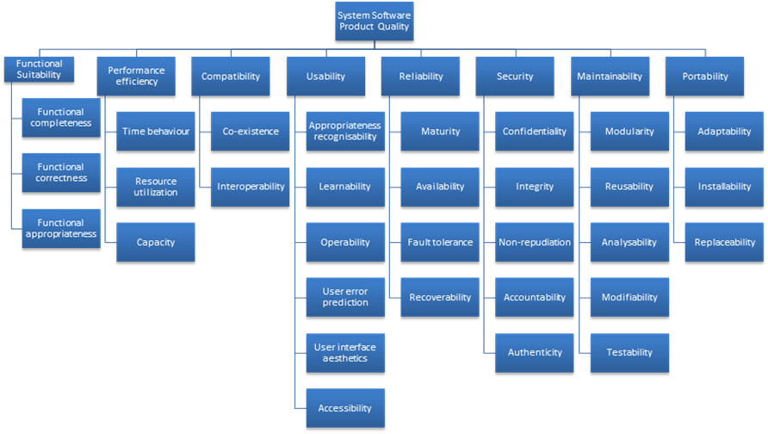
Standard Lists of Quality Attributes
ISO/IEC FCD 25010 Product Quality Standard

Slide 14
Standard Lists of Quality Attributes
The standard with the pause-and-take-a-breath title of “ISO/IEC FCD 25010: Systems and software engineering—Systems and software product Quality Requirements and Evaluation (SQuaRE)—System and software quality models,” is a good example.
The standard divides quality attributes into those supporting a “quality in use” model and those supporting a “product quality” model.
That division is a bit of a stretch in some places, but nevertheless begins a divide-and-conquer march through a breathtaking array of qualities.

Slide 15
Standard Lists of Quality Attributes
The standard lists the following quality attributes that deal with product quality:
Functional suitability. The degree to which a product or system provides functions that meet stated and implied needs when used under specified conditions
Performance efficiency. Performance relative to the amount of resources used under stated conditions
Compatibility. The degree to which a product, system, or component can exchange information with other products, systems, or components, and/or perform its required functions, while sharing the same hardware or software environment
Usability. The degree to which a product or system can be used by specified users to achieve specified goals with effectiveness, efficiency, and satisfaction in a specified context of use

Slide 16
Standard Lists of Quality Attributes
Reliability. The degree to which a system, product, or component performs specified functions under specified conditions for a specified period of time
Security. The degree to which a product or system protects information and data so that persons or other products or systems have the degree of data access appropriate to their types and levels of authorization
Maintainability. The degree of effectiveness and efficiency with which a product or system can be modified by the intended maintainers
Portability. The degree of effectiveness and efficiency with which a system, product, or component can be transferred from one hardware, software, or other operational or usage environment to another

Slide 17
Standard Lists of Quality Attributes
Advantages:
Can be helpful checklists to assist requirements gatherers in making sure that no important needs were overlooked.
Can serve as the basis for creating your own checklist that contains the quality attributes of concern in your domain, your industry, your organization, your products, …

Slide 18
Standard Lists of Quality Attributes
Disadvantages:
No list will ever be complete.
Lists often generate more controversy than understanding.
Lists often purport to be taxonomies. which are lists with the special property that every member can be assigned to exactly one place.
They force architects to pay attention to every quality attribute on the list, even if only to finally decide that the particular quality attribute is irrelevant to their system.

Slide 19
Standard Lists of Quality Attributes
Use standard lists of quality attributes to the extent that they are helpful as checklists, but don’t feel the need to slavishly adhere to their terminology.

Slide 20
Dealing with “X-ability”
Suppose you must deal with a quality attribute for which there is no compact body of knowledge, e.g. green computing.
What do you do?
Model the quality attribute
Assemble a set of tactics for the quality attribute
Construct design checklists

Slide 21
Capture Scenarios for the New Quality
Attribute The first thing to do is interview the stakeholders whose concerns have led to the need for this quality attribute.
For example, security is often decomposed into concerns such as confidentiality, integrity, availability, and others.
After that refinement, you can work with the stakeholders to craft a set of specific scenarios that characterize what is meant by that QA.
Once you have a set of specific scenarios, then you can work to generalize the collection.
Look at the set of stimuli you’ve collected, the set of responses, the set of response measures, and so on.
Use those to construct a general scenario by making each part of the general scenario a generalization of the specific instances you collected.

Slide 22
Assemble Design Approaches for the New Quality Attribute
After you have a set of guiding scenarios for the QA, you can assemble a set of design approaches for dealing with it. You can do this by
1. Revisiting a body of patterns you’re familiar with and asking yourself how each one affects the QA of interest.
2. Searching for designs that have had to deal with this QA. You can search on the name you’ve given the QA itself, but you can also search for the terms you chose when you refined the QA into subsidiary attribute characterizations (such as “confidentiality” for the QA of security).

Slide 23
Assemble Design Approaches for the New Quality Attribute
3. Finding experts in this area and interviewing them or simply writing and asking them for advice.
4. Using the general scenario to try to catalog a list of design approaches to produce the responses in the response category.
5. Using the general scenario to catalog a list of ways in which a problematic architecture would fail to produce the desired responses, and thinking of design approaches to head off those cases.

Slide 24
Model the New Quality Attribute
If you can build a conceptual model of the quality attribute, this can be helpful in creating a set of design approaches for it. By “model,” we don’t mean anything more than understanding the set of parameters to which the quality attribute is sensitive.
For example, a model of modifiability might tell us that modifiability is a function of how many places in a system have to be changed in response to a modification, and the interconnectedness of those places.
A model for performance might tell us that throughput is a function of transactional workload, the dependencies among the transactions, and the number of transactions that can be processed in parallel

Slide 25
Assemble a Set of Tactics for the New Quality Attribute
There are two sources that can be used to derive tactics for any quality attribute: models and experts.
Figure 12.2 shows a queuing model for performance. Such models are widely used to analyze the latency and throughput of various types of queuing systems, including manufacturing and service environments, as well as computer systems. Within this model, there are seven parameters that can affect the latency that the model predicts:
■ Arrival rate
■ Queuing discipline
■ Scheduling algorithm
■ Service time
■ Topology
■ Network bandwidth
■ Routing algorithm

Slide 26
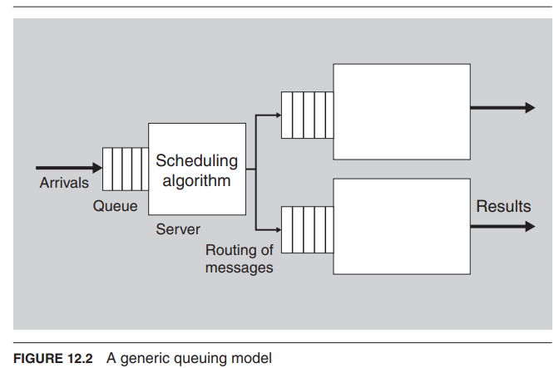

Slide 27
Assemble a Set of Tactics for the New Quality Attribute
The process of generating tactics based on a model is this:
■ Enumerate the parameters of the model
■ For each parameter, enumerate the architectural decisions that can affect this parameter

Slide 28
Assemble a Set of Tactics for the New Quality Attribute
Deriving tactics from models is fine as long as the quality attribute in question has a model.
Unfortunately, the number of such models is limited and is a subject of active research. There are no good architectural models for usability or security, for example. In the cases where we had no model to work from, we did four things to catalog the tactics:
1. We interviewed experts in the field, asking them what they do as architects to improve the quality attribute response.
2. We examined systems that were touted as having high usability (or testability, or whatever tactic we were focusing on).
3. We scoured the relevant design literature looking for common themes in design.
4. We examined documented architectural patterns to look for ways they achieved the quality attribute responses touted for them.

Slide 29
Construct Design Checklists for the New Quality Attribute
Finally, examine the seven categories of design decisions in Chapter 4 and ask yourself (or your experts) how to specialize your new quality of interest to these categories. In particular, think about reviewing a software architecture and trying to figure out how well it satisfies your new qualities in these seven categories.

