Slide 1
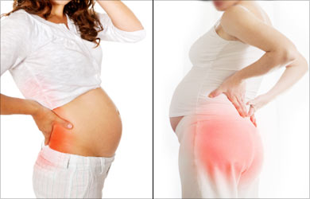
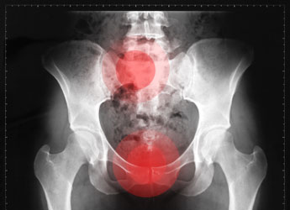
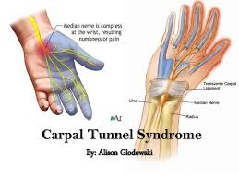
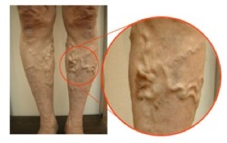
Pregnancy-Induced Pathology

Slide 2
Pregnancy-Induced Pathology
Diastasis Recti
Varicose Veins
Posture-Related Back Pain
Joint Laxity
Sacroiliac/Pelvic Girdle Pain
Nerve Compression Syndromes

Slide 3
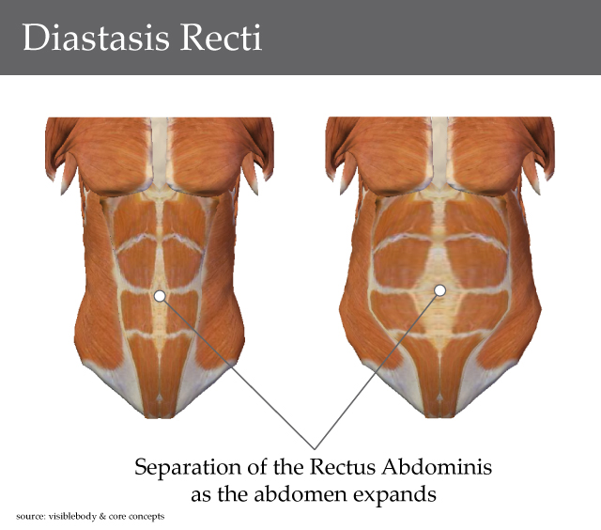
Diastasis Recti

Slide 4
THE ABDOMINAL MUSCLES

Slide 5
The anterior and lateral abdominal wall is formed by the abdominal muscles
The deepest of the group is the transversus abdominis muscle, which lies internally to the internal and external oblique muscles

Slide 6
Abdominal Layers

Slide 7
A-fascial layers
1- Superficial layer, referred to as the fatty layer, is a single layer with varying amounts of fat.
2-Deep fascial layer, known as the membranous layer, is more membranous and contains elastic fibers.

Slide 8
B-Anterolateral muscle group
Anterolateral muscle group of the abdomen consist of four pairs of muscles which include
1- External oblique muscle
2- Internal oblique muscle
3- Transversus abdominis
4- -Rectus abdominis

Slide 9
Rectus sheath
The rectus abdominis is entirely enclosed in a sheath formed by the aponeuroses of the muscles of the lateral walls of the abdomen.

Slide 10
Functions of the abdominal muscles
1- Protect the abdominal viscera and keep them in
their positions
2- Maintain a good erect posture
3- Stabilize pelvis during straight leg raising
4- Help in respiration and defecation
5- Concern with forward flexion of the trunk
6- Help expulsion of the fetus during second stage of labour.
7- Improving the function of the pelvic floor muscles

Slide 11
C- The aponeuroses
which are defined as flat sheets of densely collagen fibers usually consisting of several layers with few elastic fibers

Slide 12
D- The linea alba
which is the result of the fusion of the right and left aponeuroses of the three pairs of the anterolateral abdominal muscles in the midline from sternum to the pubis.

Slide 13
Diastasis Recti

Slide 14
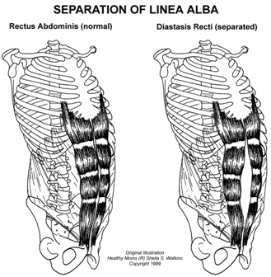
Definition
It is the separation of the rectus abdominis muscle which involve widening of the linea alba with gap greater than the normal distance between the rectus bellies (2 Cm or 2 fingers above umbilicus) palpated above, below or at the level of the umbilicus

Slide 15
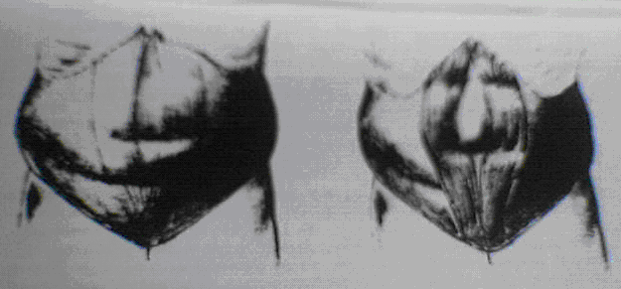

Slide 16
Etiology
Diastasis recti may occur in pregnancy as a result of hormonal effects on the connective tissue and the biomechanical changes of pregnancy; it may also develop during labor, especially with excessive breath-holding during the second stage.
It can occur above, below, or at the level of the umbilicus but appears to be less common below the umbilicus.
It appears to be less common in women with good abdominal tone before pregnancy.
Clinically, a diastasis may be found in women well past their childbearing years and also in men. Routine assessment for this condition is highly recommended and can easily be done in conjunction with abdominal strength testing.

Slide 17
Significance
diastasis recti may produce musculoskeletal complaints, such as low back pain, possibly as a result of decreased ability of the abdominal musculature and thoracolumbar fascia to stabilize the pelvis and lumbar spine.

Slide 18
Activity limitations.
Activity limitations can also occur, such as inability to perform independent supine-to-sitting transitions because of extreme loss of the mechanical alignment and function of the rectus muscle.

Slide 19
Decreased fetal protection
In severe separations, the remaining midline layers of abdominal wall tissue are skin, fascia, subcutaneous fat, and peritoneum.
The lack of muscular support provides less protection for the fetus.

Slide 20
Potential for herniation
Severe cases of diastasis recti may progress to herniation of the abdominal viscera through the separation at the linea alba.
This degree of separation requires surgical repair.

Slide 21
Examination for Diastasis Recti

Slide 22
Instruct patients to perform a self-test on or after the third postpartum day for optimal accuracy.
Until 3 days after delivery, the abdominal musculature has inadequate tone for valid test results.

Slide 23
Patient position and procedure
Hook-lying. Have the patient slowly raise her head and shoulders off the floor, reaching her hands toward the knees, until the spines of the scapulae leave the floor. Place the fingers of one hand horizontally across the midline of the abdomen at the umbilicus
If a separation exists, the fingers will sink into the gap between the rectus muscles, or a visible bulge between the rectus bellies may be appreciated. The number of fingers that can be placed between the muscle bellies is then documented. Because this condition can occur above, below, or at the level of the umbilicus, test for it at all three areas.

Slide 25
The palpation should assess the following
1- Width and length of any recti separation
2- Region of the greatest diastasis
3- Bulge of the abdomen on recti contraction
4- The women's ability to activate abdominal musculature
5- The endurance capacity of the abdominal musculature.

Slide 26
Predisposing factors
1-Child bearing especially when there was succession of pregnancies
2-Hernias, the simplest form of a ventral or epigasteric hernia is the region of the linea alba and represents diastasis recti.

Slide 27
4- Conditions that results in a persistent excessive increase in intra-abdominal pressure favors the development of a diastasis such as lifting or carrying heavy objects or chronic cough.
5- Sudden strain or fall may also be the starting point of a diastasis
6- Decrease in the tone of the tissues of the abdominal wall as a result of general weakness may also predispose to diastasis development

Slide 28
Incidence
Diastasis recti are not a condition limited to pregnant or postpartum women, it also can be seen in obese males, in patients with chronic lung disease, and in children (whose linea alba is wider than the adult)

Slide 29
Incidence
Second trimester
Childbearing period at full term 66%
Immediate post-partum 50%
Multiple gestation
↓Incidence in women with Good abdominal tone prior to pregnancy
Above umbilicus 37% - At umbilicus 52%- Below umbilicus 11%

Slide 30
INTERVENTIONS

Slide 31
Corrective Exercises for Diastasis Recti
corrective exercises (head lift or head lift with pelvic tilt) should be used until the separation is corrected to 2 cm (two finger widths) or less

Slide 32
Head Lift
Patient position and procedure:
Hook-lying with her hands crossed over midline at the level of the diastasis for support.
Have the woman exhale and lift only her head off the floor.
At the same time, her hands should gently approximate the rectus muscles toward midline
Then have the woman lower her head slowly and relax

Slide 33
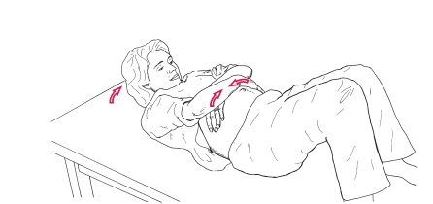

Slide 34
This exercise emphasizes the rectus abdominis muscle and minimizes the obliques.
Some women may not be able to successfully reach over their abdomens.
In this case, the use of a sheet wrapped around the trunk at the level of the separation can be used to provide support and approximation

Slide 35
Head Lift with Pelvic Tilt
Patient position and procedure: Hook-lying. The arms are crossed over the diastasis for support as before. Have the patient slowly lift only her head off the floor while approximating the rectus muscles and performing a posterior pelvic tilt, then slowly lower her head and relax.
All abdominal contractions should be performed with an exhalation so that intra-abdominal pressure is minimized.

Slide 36
Strengthening exercises

Slide 37
Core contraction - In a seated position, place both hands on abdominal muscles. Take small controlled breaths. Slowly contract the abdominal muscles, pulling them straight back towards the spine. Hold the contraction for 30 seconds, while maintaining the controlled breathing. Complete 10 repetitions.
Seated squeeze - Again in a seated position, place one hand above the belly button, and the other below the belly button. With controlled breaths, with a mid-way starting point, pull the abdominals back toward the spine, hold for 2 seconds and return to the mid-way point. Complete 100 repetitions.
Head lift - In a lying down position, knees bent at 90° angle, feet flat, slowly lift the head, chin toward your chest, (concentrate on isolation of the abdominals to prevent hip-flexors from being engaged), slowly contract abdominals toward floor, hold for two seconds, lower head to starting position for 2 seconds. Complete 10 repetitions.

Slide 38
Upright push-up - A standup pushup against the wall, with feet together arms-length away from wall, place hands flat against the wall, contract abdominal muscles toward spine, lean body towards wall, with elbows bent downward close to body, pull abdominal muscles in further, with controlled breathing. Release muscles as you push back to starting position. Complete 20 repetitions.
Squat against the wall - Also known as a seated squat, stand with back against the wall, feet out in front of body, slowly lower body to a seated position so knees are bent at a 90° angle, contracting abs toward spine as you raise body back to standing position. Optionally, this exercise can also be done using an exercise ball placed against the wall and your lower back. Complete 20 Repetitions.
Squat with squeeze - A variation to the "Squat against the wall" is to place a small resistance ball between the knees, and squeeze the ball as you lower your body to the seated position. Complete 20 repetitions.

Slide 39
Diastasis Recti Tape

Slide 40
Why use tape?
As a stimulus to assist function and strengthen muscles.
After application we see and feel the muscle activation and the space between the muscle decrease.
The child becomes ‘alert’ and is able to do more
with the tape on.
Adults can perform a given exercise with more ease.
The tape assists in sensory awareness.

Slide 41
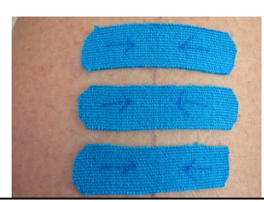
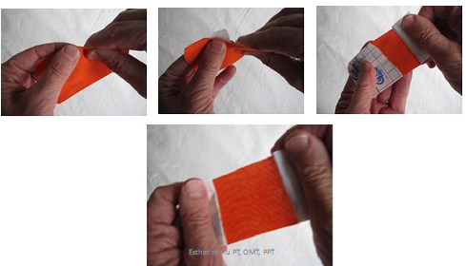
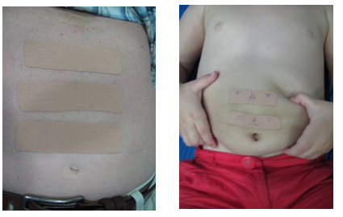
Ligament technique

Slide 43
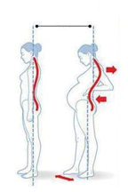
Posture-Related Back Pain

Slide 44
Posture-Related Back Pain
CAUSES
The postural changes of pregnancy, Increased ligamentous laxity, Hormonal influences,
decreased abdominal muscle function.
Characteristics
The symptoms of low back pain usually worsen with muscle fatigue from static postures .
As the day progresses; symptoms are usually relieved with rest or change of position.
Women who are physically fit generally have less back pain during pregnancy
50% to 80% of pregnant women
In the postpartum period, with prevalence in as many as 68% of women, for as long as 12 months after delivery.
Incidence
Interventions
Low back pain symptoms can be treated effectively with many traditional low back exercises, proper body mechanics, posture instructions, improvement in work techniques, along with superficial modality application.
The use of deep heating agents, electrical stimulation, and traction is generally contraindicated during pregnancy.

Slide 45
Therapeutic Interventions
Relaxation exercises
Muscle setting exercises
ROM exercise
Grade I , II mobilization
Training to good posture
Stretching exercises are contraindicated

Slide 46
Sacroiliac/Pelvic Girdle Pain

Slide 47
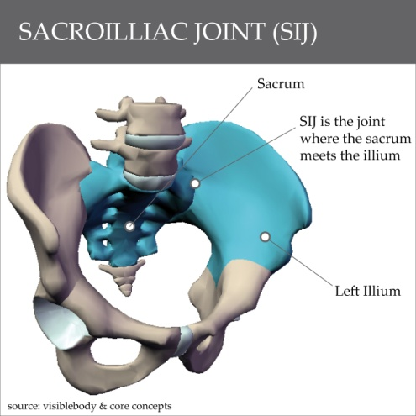
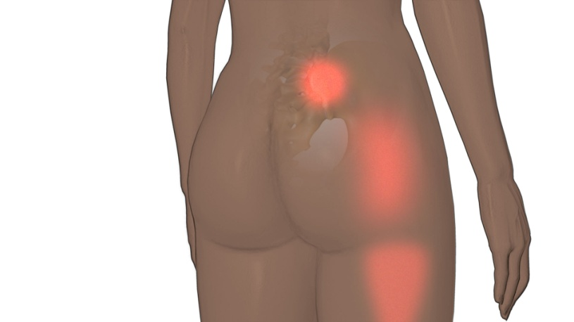
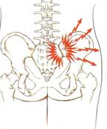
Sacroiliac/Pelvic Girdle Pain
Characteristics
Sacroiliac pain is localized to the posterior pelvis and is described as stabbing deep into the buttocks distal and lateral to L5/S1.

Slide 48
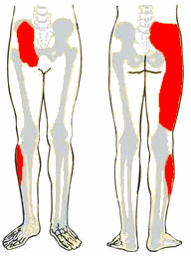
Sacroiliac/Pelvic Girdle Pain
Characteristics
Pain may radiate into the posterior thigh or knee but not into the foot.

Slide 49
Sacroiliac/Pelvic Girdle Pain
Symptoms
Symptoms include pain with prolonged sitting, standing or walking, climbing stairs, turning in bed, unilateral standing, or torsion activities.
Symptoms may not be relieved by rest and frequently worsen with activity.

Slide 50
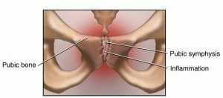
Sacroiliac/Pelvic Girdle Pain
Symptoms
Pubic symphysis dysfunction may occur alone or in combination with sacroiliac symptoms and includes significant tenderness to palpation at the symphysis, radiating pain into the groin and medial thigh, and pain with weight bearing

Slide 51
Sacroiliac/Pelvic Girdle Pain
interventions
Activity modification.
Exercise modification.
External stabilization..

Slide 52
Sacroiliac/Pelvic Girdle Pain
interventions
Activity modification.
Daily activities should be adapted to minimize asymmetrical forces acting on the trunk and pelvis.
For example, getting into a car is done by sitting down first, then pivoting both legs and the trunk into the car, keeping the knees together;
side-lying is made more symmetrical by placing a pillow between the knees and under the abdomen;
avoid full range of hip abduction.
Single-leg weight bearing, excessive abduction, and sitting on very soft surfaces should be avoided.
In addition, caution patients to avoid climbing more than one step at a time, swinging one leg out of bed at a time when getting up, or crossing the legs when sitting.

Slide 53
Sacroiliac/Pelvic Girdle Pain
interventions
Exercise modification.
Exercise must be modified so as not to aggravate the condition.
Avoid exercises that require single-leg weight bearing and excessive hip abduction or hyperextension.
Teach the patient to activate the pelvic floor and transverse abdominals when transitioning from one position to another and with any lifting in order to stabilize the pelvis.

Slide 54
Sacroiliac/Pelvic Girdle Pain
interventions
External stabilization
Use of external stabilization such as belts or corsets designed for use during pregnancy helps reduce posterior pelvic pain, especially when walking.

Slide 55
Varicose Veins

Slide 56
Varicose Veins
Varicosities are aggravated in pregnancy by the increased uterine weight, venous stasis in the legs, and increased venous distensibility.
Characteristics
Varicosities can present in the first trimester and are more prevalent with repeated pregnancies.
They can occur in the lower extremities, the rectum (hemorrhoids) Symptoms usually include heaviness or aching discomfort, especially with dependent leg positions;
Intensity may become severe as the pregnancy progresses.
In addition, pregnant women are more susceptible to deep vein thrombosis.

Slide 57
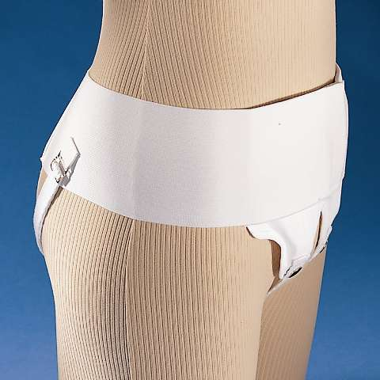
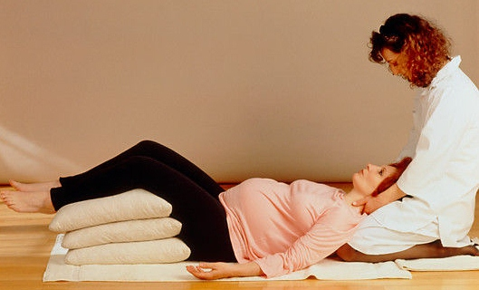
Interventions
Exercise modification. If there is discomfort, exercises may need to be modified so that minimal dependent positioning of the legs occurs.
External support. Elastic support stockings should be worn to provide an external pressure gradient against the distended veins, and the woman should be encouraged to perform lower extremity exercises and to elevate the lower extremities as often as possible.
Vulvar varicosities may benefit from use of a perineal pad or belt that provides counter-pressure and support to the tissues.

Slide 58
Joint Laxity
Significance
All joint structures are at increased risk of injury during pregnancy and during the immediate postpartum period. The tensile quality of the ligamentous support is decreased, and therefore injury can occur if women are not educated regarding joint protection. There is much controversy regarding the impact of postpartum hormone levels; however, elevated levels have been found 3 to 5 months after delivery.
Interventions
Exercise modification. Teach the woman safe exercises to perform during the childbearing year, including modification of exercises to decrease excessive joint stress
Aerobic exercise. Suggest non weight-bearing or less stressful aerobic activities such as swimming, walking, or biking, particularly for women who were relatively sedentary before pregnancy.

Slide 59
Nerve Compression Syndromes

Slide 60
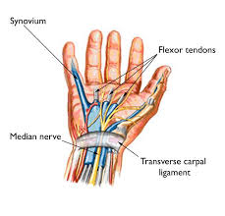

Slide 61
Impairments are
thoracic outlet syndrome (TOS) or carpal
tunnel syndrome (CTS)
CAUSES
postural changes in the neck and upper quarter
fluid retention
hormonal changes
or circulatory compromise.
Overall, women are three times as likely as men to experience carpal tunnel syndrome.
Occurrence in pregnancy can be as high as 41%.
Nerve compression syndromes (for example, of the lateral femoral cutaneous nerve) may also occur in the lower extremities because of the weight of the fetus, fluid retention, hormonal changes, or circulatory compromise.

Slide 62
Interventions
Typical protocols include postural correction exercises, manual techniques, ergonomic assessment, and modalities
Splints may be used in the treatment of carpal tunnel syndrome.
Carpal tunnel surgery in the pregnant population is rare, because symptoms generally resolve soon after delivery
(a longer course of the problem has been noted in women who breastfeed.)

