Slide 1
MICRONUTRIENTS AND THEIR DEFICIENCIES

Slide 33
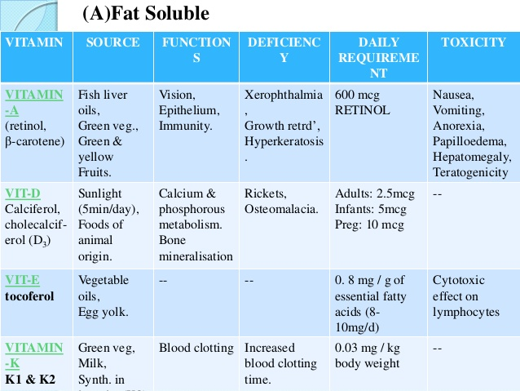

Slide 42
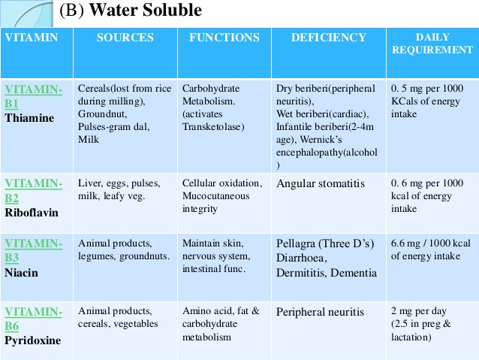

Slide 43
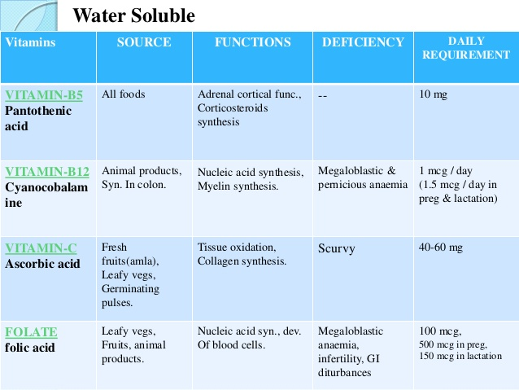

Slide 49
