Slide 1
Coronary arteries
The left coronary artery passes inferior to the left auricle and divides into the anterior interventricular and circumflex branches.
The anterior interventricular branch or left anterior descending (LAD) artery is in the anterior interventricular sulcus and supplies oxygenated blood to the walls of both ventricles.
The circumflex branch lies in the coronary sulcus and distributes oxygenated blood to the walls of the left ventricle and left atrium.

Slide 2
Coronary arteries
The right coronary artery supplies small branches (atrial branches) to the right atrium.
It continues inferior to the right auricle and ultimately divides into the posterior interventricular and marginal branches.
The posterior interventricular branch follows the posterior interventricular sulcus and supplies the walls of ventricles
The marginal branch beyond the coronary sulcus runs along the right margin of the heart

Slide 3
Coronary veins
Great cardiac vein in the anterior interventricular sulcus, which drains the areas of the heart supplied by the left coronary artery
Middle cardiac vein in the posterior interventricular sulcus, which drains the areas supplied by the posterior interventricular branch of the right coronary artery
Small cardiac vein in the coronary sulcus, which drains the right atrium and right ventricle
Anterior cardiac veins, which drain the right ventricle and open directly into the right atrium

Slide 4
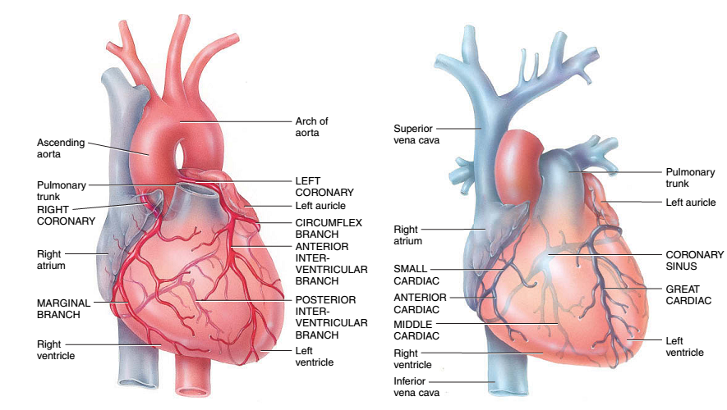
Coronary circulation

Slide 5
Cardiac Muscle Tissue and the Cardiac Conduction System
Histology
Shorter and less circular than skeletal muscle fibers
Branching gives “stair-step” appearance
Usually one centrally located nucleus
Ends of fibers connected by intercalated discs
Discs contain desmosomes (hold fibers together) and gap junctions (allow action potential conduction from one fiber to the next)
Mitochondria are larger and more numerous than skeletal muscle
Same arrangement of actin and myosin

Slide 6
Notes:
A sarcomere is the basic unit of muscle tissue in both cardiac and skeletal muscle. Sarcomeres appear under the microscope as striations, with alternating dark and light bands. ... Together, myosin and actin form myofibrils, the repeating molecular structure of sarcomeres.

Slide 7
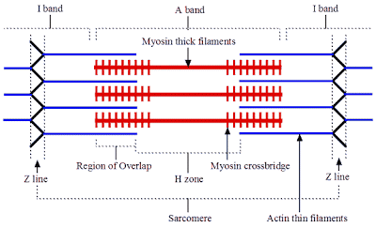

Slide 8
Autorhythmic Fibers
Specialized cardiac muscle fibers
Self-excitable
Repeatedly generate action potentials that trigger heart contractions
2 important functions
Act as pacemaker
Form conduction system

Slide 9
Conduction system
Begins in sinoatrial (SA) node in right atrial wall
Propagates through atria via gap junctions
Atria contact
Reaches atrioventricular (AV) node in interatrial septum
Enters atrioventricular (AV) bundle (Bundle of His)
Only site where action potentials can conduct from atria to ventricles due to fibrous skeleton
Enters right and left bundle branches which extends through interventricular septum toward apex
Finally, large diameter Purkinje fibers conduct action potential to remainder of ventricular myocardium
Ventricles contract

Slide 10
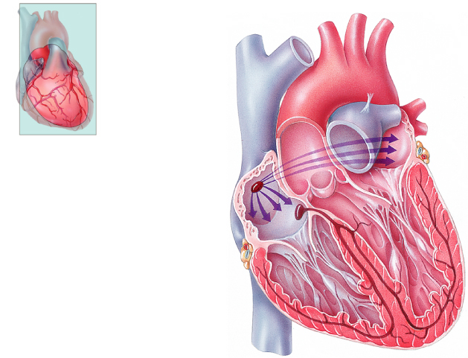
Frontal plane
Frontal plane
Frontal plane
Frontal plane
Frontal plane
Frontal plane
Left atrium
Left atrium
Left atrium
Left atrium
Left atrium
Left atrium
Right atrium
Right atrium
Right atrium
Right atrium
Right atrium
Right atrium
1
1
1
1
1
SINOATRIAL (SA) NODE
SINOATRIAL (SA) NODE
SINOATRIAL (SA) NODE
SINOATRIAL (SA) NODE
SINOATRIAL (SA) NODE
2
2
2
2
ATRIOVENTRICULAR
(AV) NODE
ATRIOVENTRICULAR
(AV) NODE
ATRIOVENTRICULAR
(AV) NODE
ATRIOVENTRICULAR
(AV) NODE
3
3
3
ATRIOVENTRICULAR (AV)
BUNDLE (BUNDLE OF HIS)
ATRIOVENTRICULAR (AV)
BUNDLE (BUNDLE OF HIS)
ATRIOVENTRICULAR (AV)
BUNDLE (BUNDLE OF HIS)
Left ventricle
Left ventricle
Left ventricle
Left ventricle
Left ventricle
4
Left ventricle
4
RIGHT AND LEFT
BUNDLE BRANCHES
RIGHT AND LEFT
BUNDLE BRANCHES
Right ventricle
Right ventricle
Right ventricle
Right ventricle
Right ventricle
Right ventricle
5
PURKINJE FIBERS
Anterior view of frontal section
Anterior view of frontal section
Anterior view of frontal section
Anterior view of frontal section
Anterior view of frontal section
Anterior view of frontal section
Notes:
Discovered in 1893 by Swiss-born cardiologist and anatomist Wilhelm His Jr., the bundle of His ... These specialized muscle fibers in the heart were named after the Swiss cardiologist Wilhelm His Jr., who discovered them in 1893.

Slide 11
Conduction System
SA node acts as natural pacemaker
Faster than other autorhythmic fibers
Initiates 100 times per second
Nerve impulses from autonomic nervous system (ANS) and hormones modify timing and strength of each heartbeat
Do not establish fundamental rhythm
Notes:
The SA node is the heart's natural pacemaker. The SA node consists of a cluster of cells that are situated in the upper part of the wall of the right atrium (the right upper chamber of the heart). The electrical impulses are generated there. The SA node is also called the sinus node.

