Slide 1
TEACHING AIDS
” “We remember 20% of what we HEAR
We remember 30% of what we SEE
We remember 50% of what we SEE & HEAR
We remember 90% of what we SAY & DO”
“I hear, I forget
I see, I remember
I do, I understand

Slide 3
TEACHING AIDS
Teaching aids are the tools that teachers use them in the classroom such as flash cards,maps,cassette and blackboard.
A teaching aid is a tool used by teachers to help learners improve reading and other skills, illustrate or reinforce a skill, fact, or idea, and relieve anxiety, fears, or boredom, since many teaching aids are like games.

Slide 4
Categories of Teaching Aids
3 categories
1) Audio Aids
2) Visual Aid
3) Audio – Visual Aid
A-V aid imply, “anything by means of which learning process may be encouraged or carried on through the sense of hearing or the sense of sight.”

Slide 5
CLASSIFICATION OF AUDIO VISUAL AIDS
PROJECTED & NON PROJECTED AIDS
NON PROJECTED
GRAPHIC- picture, charts, maps, graphs, puppets, flash cards, posters
PROJECTED
SILENT- slides, film strips, OHP
DIPLAY BOARDS- BB, bulletin board,
flannel board,
magnetic board, specimens
3- D AIDS- globes, models, objects, field trip
AUDIO AIDS- radio,
taperecorder,
language laboratory
ACTIVITY AIDS- CAI, demonstrations,
dramatics,
experiments,
programmed instruction
SOUND- films

Slide 7
EDGAR DALE’S CLASSIFICATION OF AUDIO VISUAL AIDS

Slide 8
NEED & IMPORTANCE
Clarity
Attention & interest
Best motivators
Use of maximum senses
Saving time & effort
Fixing and recalling the knowledge
Meeting the individual differences
Encouraging activities
Introductory variety
Development of scientific attitude
Direct experiences
Promotion of international understanding

Slide 9
PRINCIPLES OF SELECTION & EFFECTIVENESS IN USE
PRINCIPLE OF SELECTION
Educational value
Realization of objectives
Pupil centeredness
Interest and motivation
Simplicity
Relevancy and suitability
Accuracy
Encouragement
Well preparedness
Avoiding too many aids
Means to an end
Integration
availability of resources- size of classroom, finance, facilities, experienced teachers

Slide 10
PRINCIPLE OF USE
preparation- awareness, teacher's preparation, students participation
Proper presentation- handling, checking, timely presentation, avoiding distraction
Protection and preservation
Action
Follow up
Evaluation

Slide 11
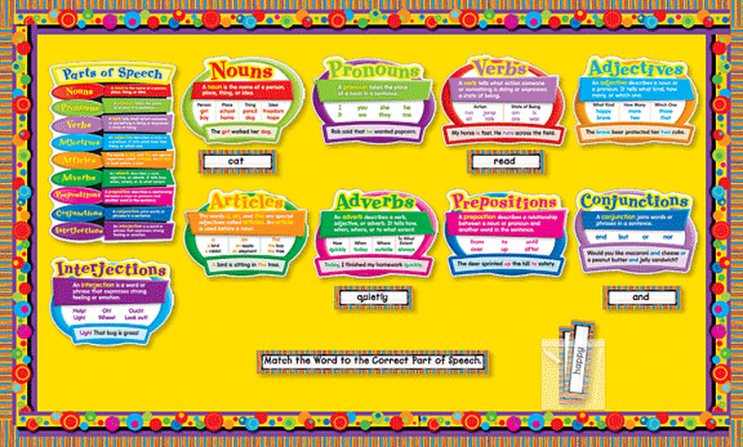
CHARTS

Slide 13
CHART
A chart is a useful way to present and display information or instructions, especially in a classroom or other educational situation. It can range in size from a large wall chart to a single piece of paper.
Acc to Edgar Dale , “a chart is a visual symbol summarising or comparing or contrasting or performing other helpful services in explaning subject matter”

Slide 14
TYPES OF CHARTS
Picture chart
Time chart
Tree chart
Table chart
Graphic chart
Flow chart
Pie chart

Slide 15
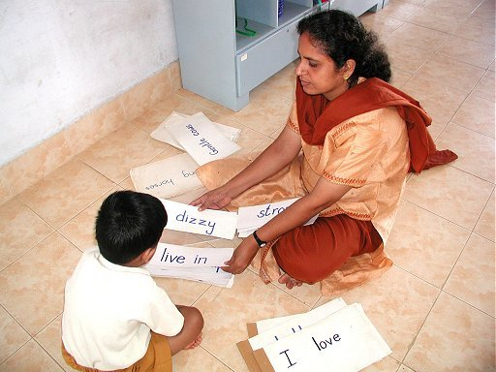
FLASH CARDS

Slide 17
FLASH CARDS
Flash cards are useful for drilling new letters, words, and other information. They are normally used in a classroom, but can also be used more informally.
A flash card is part of a set of cards on which are written items to be studied. They are “flashed” (shown quickly) one by one to a learner to elicit a quick response.

Slide 18
Flash cards are sets of cards printed with information to be studied, such as
definitions
formulas
letters
multiplication tables
prefixes
words.
If there is an answer or solution to what appears on the front of the card, it is printed on the back so that the person showing the cards can see if the learner's answer is correct

Slide 19
FLIP CHARTS

Slide 21
FLIP CHARTS
Flip charts are useful in teaching situations where you need to teach a number of people at a time. They are used when books are unavailable, scarce, or too expensive for individuals to have their own copy when other media such as overheads and slides are not available, and where group learning is most culturally appropriate.
A flip chart is a collection of large pages which are bound together at the top. The pages are “flipped” or brought up and to the back as they are used.
A flip chart is bound together at the top in such a way that the pages can be easily turned and lie flat.

Slide 22
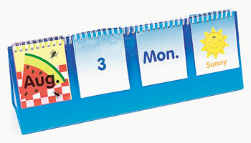
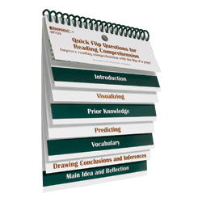
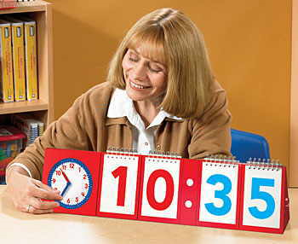
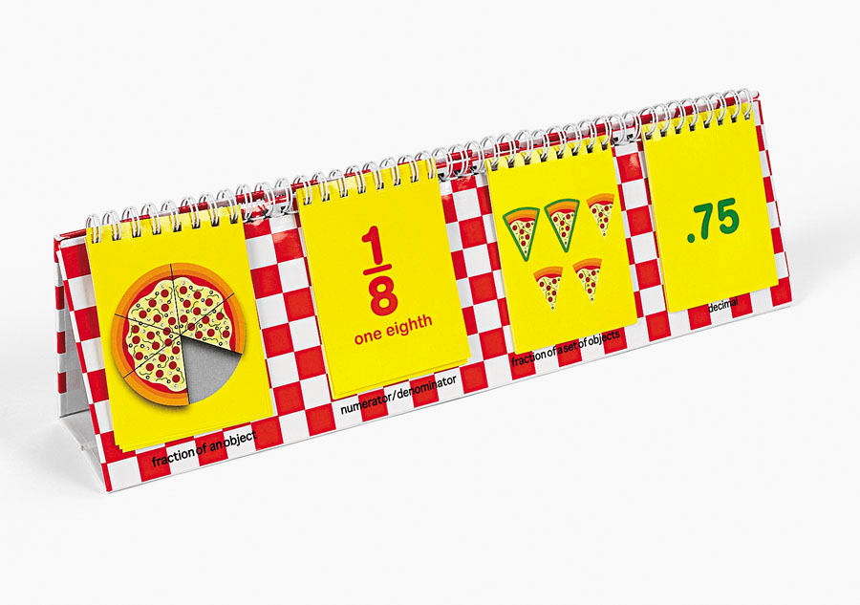
FLIP CARDS

Slide 23
FLANNEL BOARD

Slide 24
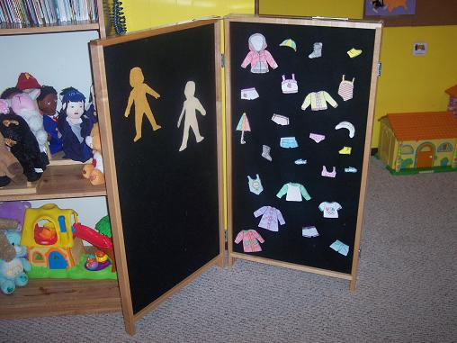

Slide 25
FLANNEL BOARD
It consists of a piece of flannel or felt made from wool, stretched tightly over a strong backing of plywood. Pictures, cards and similar material can be made stick on it.

Slide 27
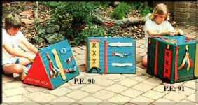
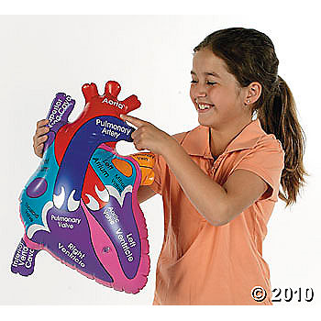
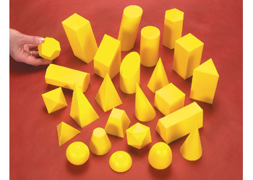
MODELS

Slide 28
MODEL
Models are replicas or copies of real objects with suitable change in size, complexity, timing, safety and cost factors.
CLASSIFICATION-
Simplified
Scale
Working
Cross-sectional
Mock-ups

Slide 29
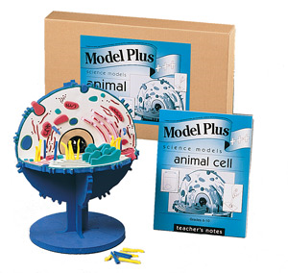

Slide 31
GLOBE a globe is a spherical model of earth

Slide 32
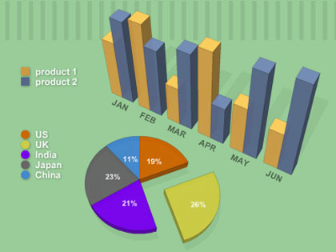
GRAPHS

Slide 33
GRAPHS
Flat pictures which employ dots, lines or pictures to visualize numerical and statistical data to show statistics or relationships.
Graphs are by nature a summarizing device.
Effective tools for comparisons and contrast.

Slide 34
KINDS
Line
Bar
Pictorial
Circle or pie
Flannel

Slide 35
CARTOONS

Slide 36
CARTOONS
A cartoon is an interpretive picture, usually a drawing, intended to convey a message or point of view about things, events or situation; may make free use of exaggeration and symbolism.

Slide 37
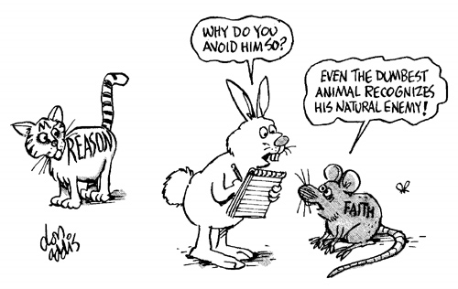

Slide 38
PUPPETS

Slide 39
SLIDES( TRANSPARENCIES)
Any positive transparency mounted individually for use in a projector or viewing transmitted light.

Slide 40
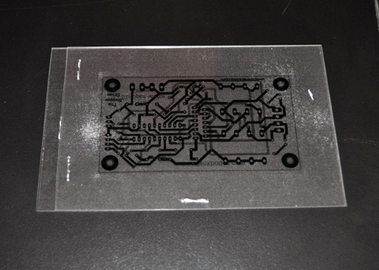

Slide 41
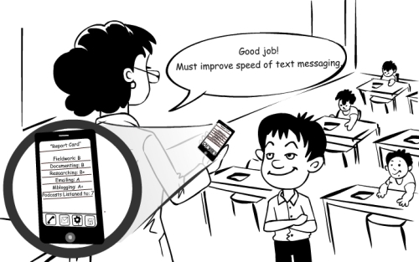
MOBILE TECHNOLOGY

Slide 42
Internet and Wi Fi
Touch screen
Games and quizzes
Mobile applications
Any time & anywhere

Slide 43
The value of mobile learning
It is important to bring new technology into the classroom.
Devices used are more lightweight than books and PCs.
Mobile learning can be used to diversify the types of learning activities students (or a blended learning approach).
Mobile learning supports the learning process rather than being integral to it.
Mobile learning can be a useful add-on tool for students with special needs. However, for SMS and MMS this might be dependent on the students’ specific disabilities or difficulties involved.
Mobile learning can be used as a ‘hook’ to re-engage disaffected youth.

Slide 44
Benefits
Relatively inexpensive opportunities, as the cost of mobile devices are significantly less than PCs and laptops
Multimedia content delivery and creation options
Continuous and situated learning support
Decrease in training costs
Potentially a more rewarding learning experience

Slide 45
Technical challenges include
Connectivity and battery life
Screen size and key size
Meeting required bandwidth for nonstop/fast streaming
Number of file/asset formats supported by a specific device
Content security or copyright issue from authoring group
Multiple standards, multiple screen sizes, multiple operating systems
Limited memory
Risk of sudden obsolescence

Slide 46
Social and educational challenges include
Accessibility and cost barriers for end users
How to assess learning outside the classroom
Content's security or pirating issues
Frequent changes in device models/technologies/functionality etc.
Developing an appropriate theory of learning for the mobile age
Design of technology to support a lifetime of learning
No restriction on learning timetable
Personal and private information and content
No demographic boundary
Disruption of students' personal and academic lives
Access to and use of the technology in developing countries
Risk of distraction

Slide 47
INTERACTIVE WHITE BOARD

Slide 48
an interactive whiteboard is a large display that connects to a computer and a projector
use of graphics and other visuals to represent information

Slide 49
Uses
Running software that is loaded onto the connected PC, such as a web browsers or other software used in the classroom.
Capturing and saving notes written on a whiteboard to the connected PC
Controlling the PC from the white board using click and drag, markup which annotates a program or presentation
Using OCR software to translate cursive writing on a graphics tablet into text
Using an Audience Response System so that presenters can poll a classroom audience or conduct quizzes, capturing feedback onto the whiteboard
Multimedia lessons and presentations including audio and video
Collaborative problem solving
Showcasing student projects and presentations
Virtual field trips
Recorded lessons that can be used by substitute teachers

