Slide 1
Light as an ecological factor

Slide 2
Light
Light plays an important role in the species composition and development of vegetation.
On an average approximately only 2-3 per cent of this solar energy is used in Primary Productivity.

Slide 3
Light as an ecological factor
The word light usually refers to visible light, and is responsible for the sense of sight.
The main source of light on Earth is the Sun.
Light is part of the electromagnetic spectrum, which ranges from radio waves to gamma rays.
Electromagnetic radiation can also be described in terms of a stream of photons which are mass less particles each travelling with wave like properties at the speed of light.

Slide 4
CONT…
Light intensity shows special variations due to the factors like atmos­pheric water layer, particles dispersed in the air, etc. Further, the vegetation of an area may also affect the light intensity. In deep shade under trees, or under water, light becomes limiting below which photo-synthesis is not sufficient for effective growth.

Slide 5
Effect of Light on Plants:
Light plays a vital role directly or indirectly in regulating the growth (structure, form, size), metabolism, development and dis­tribution of plants.
The plants are influenced by light in the following ways:
1. Effect on Chlorophyll synthesis:
The synthesis of chloro­phyll in green plants can take place only in the presence of light. It is seen that if a chlorophillus plant is kept in pro­longed darkness, the chlorophyll amount practically disap­pears.

Slide 6
Effect of light on plants
2. Effect on number and Position of Chloroplasts:
Light has marked effect on the number and position of chloroplasts, the chlorophyll bearing organelle.
. The upper surface of leaves which receive maximum sunlight has the largest number of chloroplasts arranged in line with the direction of light.

Slide 7
Conti…
On the other hand, the leaves of the plants which shade chloroplasts are very few in number and arranged at right angles to the light rays, thus increasing the surface of absorption.

Slide 8
Effect of light on plants
3. Effect on Photosynthesis:
Photosynthesis is a process of conversion of solar energy (light) into chemical energy (in presence of chlorophyll) which is subsequently used for the preparation of carbohydrate from carbon dioxide and water.
It is clear that light is highly es­sential for photosynthesis.

Slide 9
Cont..
. The rate of photosynthesis is slower at lower intensity and it increases linearly with in­creasing light intensity upto a particular point, known as “Saturation point,” and after attaining this point, it remains constant.
Compensation intensity
The intensity of light at which the plants no longer carry on photosynthesis or when the photosynthesis balances respiration is called compensation intensity.

Slide 10
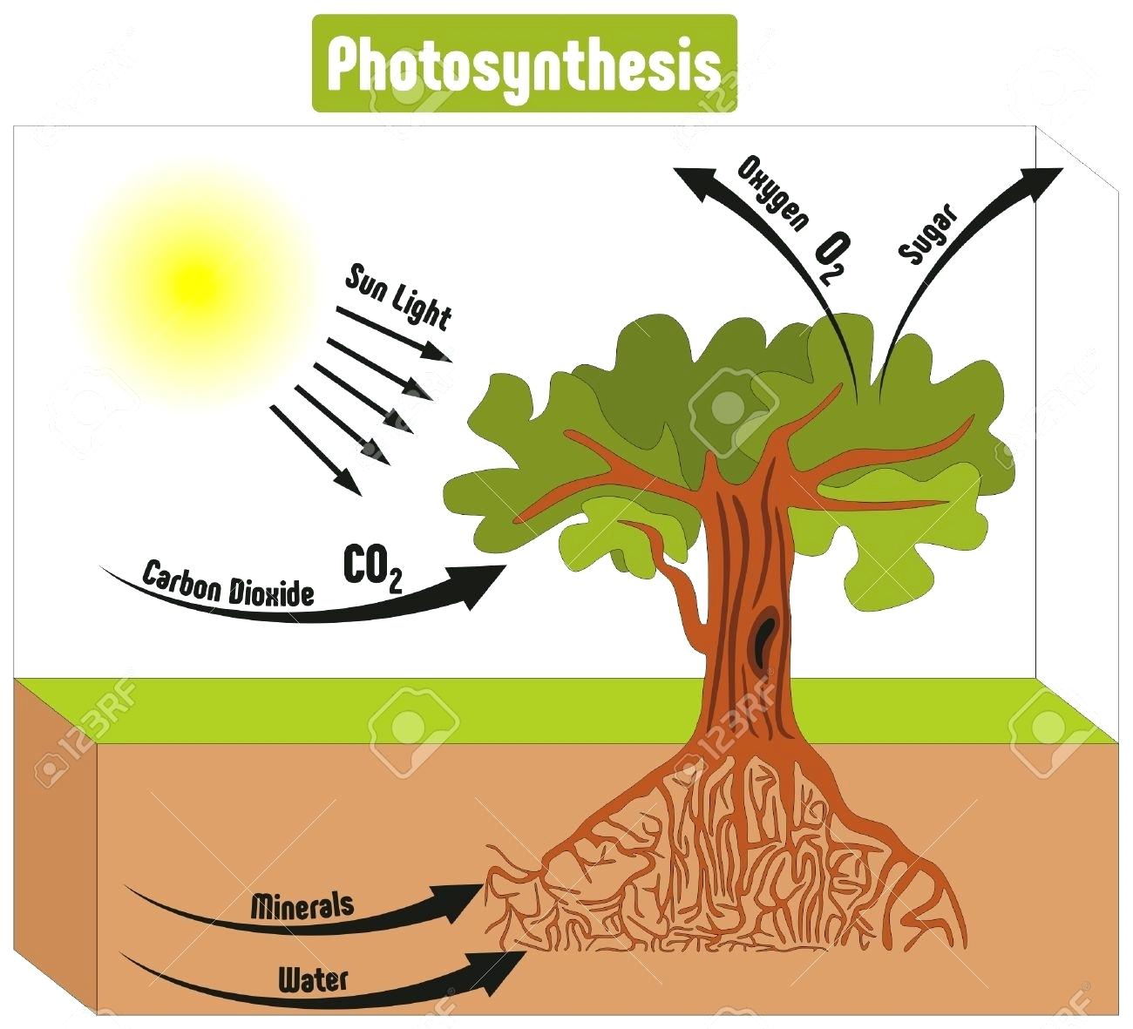

Slide 11
Effect of light on plants
4. Effect on Respiration:
In plants, respiration is a process of the oxidation of carbohydrate (produced in the photosyn­thesis) into carbon dioxide and water. According to Calvin (1958), the rate of respiration increases at higher light intensity and it decreases at lower light intensity.

Slide 12
Effect of light on plants
5. Effect on Transpiration:
The rise in atmospheric tempera­ture which may be due to the conversion of solar radiation into heat increases the rate of transpiration. The process of opening of stomata (which depends upon light) leading to loss of water from the aerial surface of plants is known as transpiration.

Slide 13
Effect of light on plants
6. Effect on Production of Hormone:
Light inhibits the synthe­sis of auxins or growth hormones in plants as a result of which the shape and size of the plants gets modified.

Slide 14
Effect of light on plants
7. Effect on development of Flowers, Fruits and Vegetative parts:
The intensity of light largely influences the growth and de­velopment of flowers, fruits and vegetative parts of plants.
Light of higher intensity favours development of flowers, fruits and seeds but light of lower intensity promotes the development of vegetative parts and causes delicacy.

Slide 15
Effect of light on plants
8. Effect on Formation of Anthocyanin Pigment:
Intense light helps in the formation of anthocyanin pigments in plants. The plants in Alpine regions have beautiful flowers contain­ing this pigment.

Slide 16
Effect of light on plants
9. Effect on Movement:
Phototropism
The effect on sunlight in modulating the movement of plants is called phototropism or heliotropism.

Slide 17
Effect of light on plants
Positive tropism
The elongation on stem towards light is known as posi­tive photo-
tropism .
Negative tropism
The movement of roots away from light is known as negative photo-tropism. The leaves grow transversely to light.

Slide 18
Effect of light on plants
10. Effect on Photoperiodism:
The response of plants to the relative length of the day (known as photo-period) is known as photoperiodism.

Slide 19
Cont…
According to the response of the plants to the length of the photo-period, the plants have been clas­sified into three groups:
(i) Long Day Plants (L.D.P.):
The plants which bloom when the light duration is more than 12 hours per day e.g. radish, potato, spinach, etc.

Slide 20
Cont..
(ii) Short Day Plants (S.D.P.):
The plants which bloom when the light duration is lesser than 12 hours per day e.g. cereals, tobacco, cosmos etc.
(iii) Day neutral Plants (D.N.P.):
The plants which show little response to the length of the day light e.g. cotton, bal­sam, tomato, etc.

Slide 21
Effect of light on plants
11. Effect on Seed Germination:
The germination of seeds is largely influenced by light. In most of the plants, the red light induces seed germination and in some plants blue light promotes the process.
In some cases, far-red light is seen to inhibit seed germination.

Slide 22
Effect of light on plants
12. Effect on Distribution of Plants:
The duration and intensity of light plays an important role in determining the distribu­tion of plants. Hence the vegetation of different geographi­cal regions are different from one another.

Slide 23
Effect of light on plants
13. Effect on Photo-morphogenesis:
The development of plants in seedling stage is controlled by light. The seedlings present in dark condition are non-green and highly elongated with poorly developed root system and no-foliage. However, an exposure of the dark grown seedling to light makes it normal.

Slide 24
Effect of light on plants
Effect on Stomatal opening
Basically opening and closing of stomata is regulated by light .It is also related with transpiration and absorption .

Slide 25
Quality of light
Normal plant growth requires white light or sunlight . Light quality refers to the color or wavelength reaching the plant's surface. If we take an example of a prism (or raindrops) can divide sunlight into respective colors of red, orange, yellow, green, blue, indigo and violet.
Red and blue have the greatest impact on plant growth.
Green light is least effective (the reflection of green light gives the green color to plants).

Slide 26
Blue light is primarily responsible for vegetative leaf growth. Red light, when combined with blue light, encourages flowering.

Slide 27
THANKS

