Slide 1
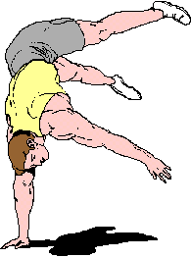
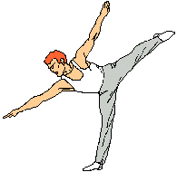
Fundamental and derived positions
Dr ATIF MALIK

Slide 2
INTRODUCTION
Posture Attitude assumed by the body
Sherrington stated that posture follows movement like a shadow. Every movement begins in posture and end in posture.
Starting position
The posture from which movement is initiated
Active or passive
Five fundamental positions
Derived position

Slide 3
Positions
1. Standing 2. Kneeling 3. Sitting 4. Lying 5. Hanging
Equilibrium and stability is maintained by
Isomeric muscle action
Postural reflexes
Voluntary control

Slide 4
For all these fundamental positions, steadiness or balance is maintain by balance of forces acting on the body and the muscular forces that are used up in Isometric form.
For all other derived positions, voluntary efforts of muscle be required.

Slide 5
Standing position
This is the most difficult of Fundamental position to maintain.
as the whole Body must be balanced and stabilized in correct alignment on a small base
By the co-ordination of many muscle groups.
Coordinated muscles work means what ??

Slide 7
standing
Heels are together and on the same line, the toes slightly apart does not exceed 45 degree
Knees are together and straight.

Slide 8
Standing
Hips are extended and laterally rotated slightly.
Pelvis is balance on femoral head.
Spine is stretched to its maximum length.
Vertex thrust upwards, ears are level and the eye look straight forward.
Shoulders are down and back.
Arms hang loosely to the sides, palm facing inward toward the body.

Slide 9
Muscle work maintain position
Muscle work reduces in good alignment
Increases by faulty alignment
Or by external force which disturb balance
Antigravity muscles works isometric ally how can one prove ??

Slide 10
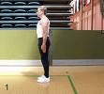
MUSCLE WORK
Intrinsic Muscle of feet to stabilize the feet and to prevent the curling of the toes to ground
Planter flexors of the ankle, working to balance the lower leg on the foot.
Dorsi flexors of the Ankle, working to counter balance the action of the planter flexor
Evertors works to counter balance invertors
Peroneus press ball of great toe on ground

Slide 11
Extensors of the knee may work slightly.
Extensor of the Hip, working to maintain hip extension and to balance the pelvis On the femoral heads
Extensor of spine, working to keep the trunk upright it increase curvature in cervical and lumber region
Flexors counter balance them
Flexor of the lumber spine, working to prevent over action of the extensor of this region
Maintain correct pelvic tilt
Support viscera

Slide 12
Pre-vertebral neck muscles, working to control excessive extension of neck and to straighten the cervical spine.
Flexors and Extensors of the Atlanto-occipital Joint working reciprocally to balance the head.
Elevators of mendible close the mouth
Retractors of the Scapulae, working to draw the Scapula backwards so glenoid cavity face laterally
Arms are relaxed Some time lateral rotators of the shoulder

Slide 13
Effects and Uses
Base of support is small and center of gravity is high.
Body is maintained by co ordinate work of many muscles.
Body is relatively less stable than other fundamental position.
Muscle work is minimum when perfect balance is maintained.
Thorax is free and abdominal viscera are well supported.

Slide 14
What is going on??
If on ankle or knee or foot???

Slide 15
What is this….?? Instability…..why and where

Slide 16
KNEELING POSITION
Body is supported on the knees that are slightly apart or together
The lower leg rests on the floor with the feet planter flexed.
The feet may be in the mid position over the edge of the plinth.

Slide 17
The rest of the body is held in standing.
The arms are by the sides of the body and the legs provide the base.

Slide 18
MUSCLE WORK
There is inter play between the flexors and the Extensor of the knee, to balance the femora vertically on the knees.
Quadriceps plays a key role in balancing the body.
Extensor of the hip and the flexors of the lumbar spine work more strongly to maintain the correct angle of pelvic tilt.
Muscle work of the rest of the body is same as that of standing

Slide 19
Effects and Uses
The COG is high but lower when compare to that of standing
The line of gravity is close to the edge of base, however, uncomfortable for most of the people.
The pelvis is fixed, because the origin and insertion of Rectus Femoris are further apart, so that the muscle is more on the stretch.
This is used as starting position for back movement, and to train control of hip joint and lower trunk in preparation for standing.

Slide 20
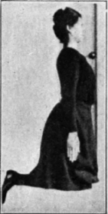
Because the muscles of the feet and leg do not take any share in maintaining the position, the effect of a movement done in this position will be more definite and purer than if done in standing position

Slide 21
SITTING
the position is taken on chair or stool.
It is preferable to leave 2 or 3 inches of space between the back of your knees and the edge of the seat.

Slide 22
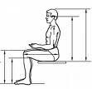
- SITTING
The height and width of seat must allow the thighs to be fully supported.
The hips and knees are flexed to right angle.
The knees are apart and feet rest on the floor.
Your weight should be evenly distributed on both buttocks chiefly on the tuberosities of the ischium.

Slide 23
MUSCLE WORK
There need be no muscle work to hold the position of the legs, as they are fully supported.
The flexors of the hips work to maintain a right angle at these joints and to prevent the tendency to slump
The working muscles for maintaining the position are principally the neck, back, and posterior shoulder muscles.

Slide 24
Effects And Uses
Comfortable, natural, and very stable position. for many non-weight bearing knee and foot exercises.
General steadiness in this position is considerably greater than in the previous positions, because
(a) The base is larger;
(b) The COG lies nearer the base;
(c) Gliding in hip, knee, and ankle joints has no disturbing influence.

Slide 25
Effects And Uses
The pelvis is also firmer, because it rests on the supporting surface.
The leg muscles work little, if at all, to maintain the position, so that movements are purer. For all these reasons the sitting fundamental position and its derived positions are much used in medical gymnastics

Slide 26
LYING
Position
Body is supine with the arms by the sides and the legs are straight
Body is completely supported. Low center of gravity and highest stable
MUSCLE WORK
As the whole body is completely relaxed on the floor there is very less muscle work.
If the body is relaxed on a hard surface, such as floor the head rolls to one side, the lumber spine is hollowed bcause of the tension of structures lying anterior to the hip joint and the latter fall into a position of lateral rotation

Slide 27
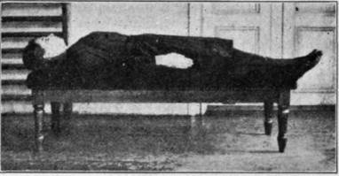
Head rotators of both sides work reciprocally to stabilize the position of the head.
Extensor of hips and flexor of lumbar spine work to combat the tendency to hollow the back.
Medial rotators of hips work to keep the leg in neutral position.

Slide 28
Effects and Uses
It is an easy position and as the trunk is relaxed and fixed by its own weight
Suitable position for many exercises
Spine is relieved from the burden of transmitting weight of head and shoulders
The position is unsuitable for those suffering from respiratory and cardiac conditions
Unsuitable for elderly because it hinders return of blood from head

Slide 29
HANGING
Body is suspended by grasping over a horizontal bar
Arms are straights and Shoulders are wide apart
Head held high and the scapulae are drawn down
Trunk and legs hang straight
Heels together and ankles are planter flexed.

Slide 30
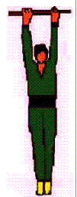
MUSCLE WORK
The flexor of the fingers work strongly to grasp the bar
All the muscles round the wrist work strongly to reduce the strain on the joints
The flexors of the Elbows work to reduce the strain on the joints.
The Adductors of the shoulder work strongly to lift the body on the arms
The Depressors, Retractors and Medial Rotators of the scapulae work strongly to fix the scapulae

Slide 31
MUSCLE WORK
The Pre-vertebral and posterior Neck Muscles Work reciprocally to maintain the position of neck and head
The Flexor of the Lumbar Spine and the Extensors of the hips work to correct the tendency to arch
The adductors of the Hips work to keep the legs together.
The Planterflexors work to point the toes to the floor.

Slide 32
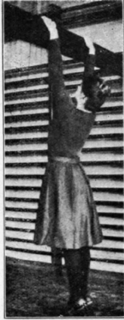
Effects and Uses
Only suitable for whom muscular strength and body weight is well balanced.
The weights of the shoulder is taken of by Spine
Weight of legs exerts traction up on the body
During hanging, if the chest is fixed in inspiration it may cause difficulty in breathing.

