Slide 1
Health and wellness
Healthy people 2010

Slide 2
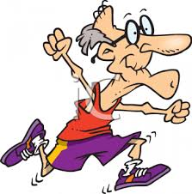
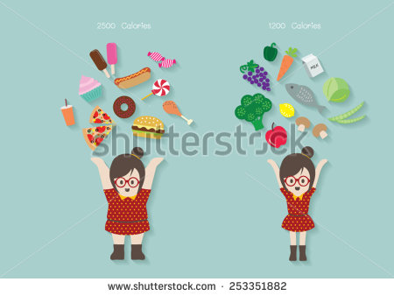
Healthy people 2010 is a federal health agenda developed to promote healthy lifestyles for American
Two main goals
To increase the quality and years of healthy life
To eliminate the health disparities among various populations
Notes:
Settings imp. Home. Workplace. Community. Gov. religious settings. Each setting provide risk and opportunities

Slide 3
1. Increase quality and years of healthy life
One primary goal of Healthy people is increase the life expectancy and improve the quality of life of all individuals
At the beginning of twentieth century average life expectancy was 47 years
Now it is 77 years varied with
1: Gender :::
Women outlive men by 6 years
Americans Caucasians
2:::Income relationship
10,000 25,000dollars
Notes:
IN AMERICA MALE LIVE LONGER THAN IN ASIA.

Slide 4
2: eliminate health disparities among various population
Gender
Race or ethnicity
Education
Income
Geographic location
Notes:
All contributing factors in health disparities.

Slide 5
2: eliminate health disparities among various population
GENDER:
Male
Shorter life span
Gender specific diseases
prostate cancer
Suffer leading causes of death,e.g Lung cancer,
Substance use disorder
Female
Longer than male
Expl
cervical spine prob
Depression, anxiety, Mood disorder
Somatoform disorders( physical symptoms appear as medical condition but lack measureable pathology.

Slide 6
Somatoform disorders
The somatoform disorders are a group of psychological disorders in which a patient experiences physical symptoms that are inconsistent with or cannot be fully explained by any underlying general medical or neurologic condition. Medically unexplained physical symptoms account for as many as 50% of new medical outpatient visits. Physical symptoms or painful complaints of unknown etiology are fairly common in pediatric populations. Many healthy young children express emotional distress in terms of physical pain, such as stomachaches or headaches, but these complaints are usually transient and do not effect the child's overall functioning. The somatoform disorders represent the severe end of a continuum of somatic symptoms.
Notes:
chronic disabling symptoms, such as seizures and paralysis
chronic disabling symptoms, such as seizures and paralysis
chronic disabling symptoms, such as seizures and paralysis

Slide 7
2: eliminate health disparities among various population
Geographic locations, race ethnicity
DEATH RATES:
Heart disease death rate ; cancer death rate ;
Prostrate cancer death rate
Breast cancer death rate>>>> in white & African -Americans than in Caucasian.
HIV > in African-american than white.
People in rural areas have more risk of injuries, heart diseases, cancer & diabetes.
Notes:
HUMAN IMMUNODEFICIENCY SYNDROME.

Slide 8
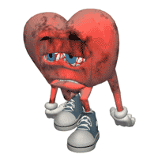
Geographic locations, race ethnicity
2: eliminate health disparities among various population
Factors are contribute health disparities:
excessive cv risk factors ie high bp, diabetes, obesity, physical inactivity and psychological stress.
Unfamiliarity with personal risk factors to atherosclerosis and heart disease
Cultural factors,,,,, desire to seek heath care
Economic factors
Psychological Stress, racism, frustration
Genetic predisposition to pathologies
Different for american and asians

Slide 9
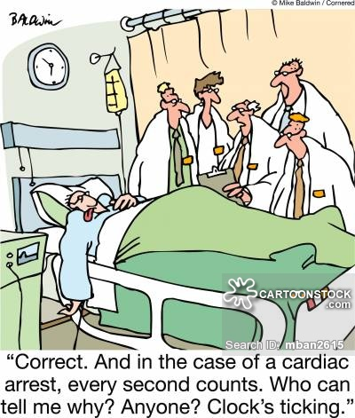
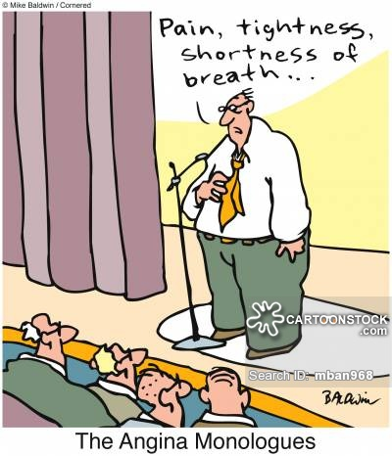
Income and education
2: eliminate health disparities among various population
Go hand by hand & relate to access to health care information , activities & programming.
Low income & low education:→
increased risk of heart diseases, diabetes, obesity, elevated blood levels, low birth weight. (having increased health disparities)
High income & high education:→make gains in their health
People >12 year education→ twice death rate than 13 & more yr education.

Slide 10
2: eliminate health disparities among various population
People with chronic disease or disabilities has more health disparities related to their low level physical activities. -→Suffer more anxiety, pain, sleeplessness, days of depression leading to diminished quality of life.
Recent research showed: mortality rate linked with childhood conditions including lower socioeconomic status, family living arrangements, mother work status, rural residence & parent nativity play key role in early mortality.

Slide 11
2: eliminate health disparities among various population
Strategies to deal with health disparities:
Health promotion , risk factor modification, culturally competent health care delivery, continued research on racial & ethnic variance in disease & injuries.
Income & education findings suggest that economic & education policies targeted children’s wellbeing are health policies with implicate effects that reach into adult life course.
As health care providers; physical therapist must acknowledge their role in promoting health education particularly disables children & adults.

Slide 12
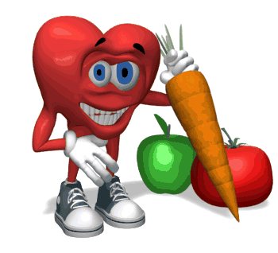
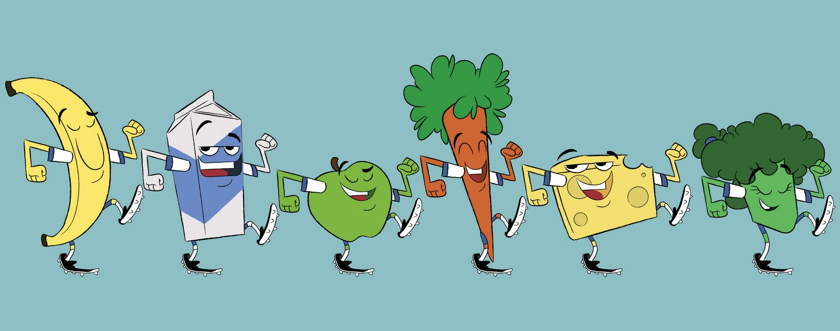
Objectives to improve health
Healthy people 2o1o _____467 objectives 28 areas…
Theses areas are
Access to quality health services
Arthritis
Osteoporosis
Chronic back condition
Cancer chronic kidney disease
Stroke
HIV
Maternal, infants and child health
Mental safety and mental health

Slide 13
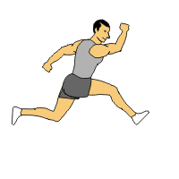
Goals directly related to physical therapy are
Increase the quality and years of healthy life
Inc. incidence of people reporting healthy days
Reporting active days
Reduce activity limitations
Reduce days of pains for arthritis,
osteoporosis, chronic back pains
Increased adaptation of daily
physical life
Increase leisure time
Exercise: Muscle fitness increase
Reduce incidence of death from cancer
Increase diagnosis & reduce incidence of type 2 diabetes

Slide 14
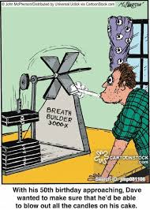
Dec. incidence of depression
Heart diseases, stroke, high bp
Dec incidence High cholesterole level
Eliminate health disparities
Dec personal stress levels n mental health problems
Reduce steroid use
Reduce accidents, destructive habits, pollution
Access to health information
People with good eating habits
Healthy weight and over weight

Slide 15
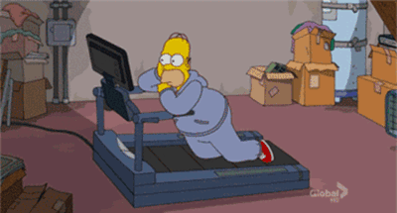
Leading Health Indicators
Are factors that provide info about the health n wellbeing of population
Not used individually but for whole population
10 leading health indicators are (POT MIRE-SIA)
Physical activity
Over weight and obesity
Tobacco use
substance abuse
Responsible sexual behavior
Mental health
Injury and violence
Environmental quality
Immunization
Access to health care

Slide 16
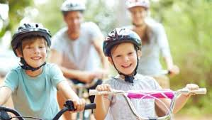
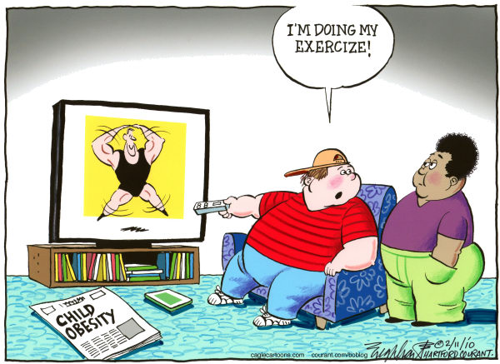
Health education resources
parents of young children
Healthy nutrition
Fitness activities for young children
Protecting young children from preventable injuries
Effective discipline for young children
Protection against childhood illness
Protection in childhood sports activities
Proper nutrition for physical activity
Reduce childhood obesity
Safety when swimming (including
protection against skin cancer)

Slide 17
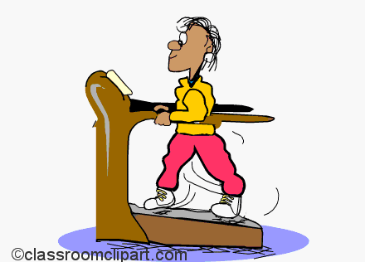
Children ages 8 to 12
Good nutrition
Fitness activities
Safety issues for children
Playing it safe(protection in sports activities)
Proper nutrition for physical activity
Getting in shape(managing childhood obesity)
Safety at the swimming pool/protection against skin cancer
Ergonomics for children(including wearing backpacks and playing at the computer)

Slide 18
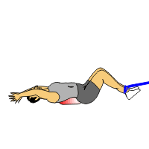
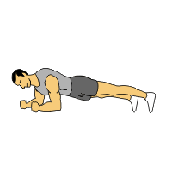
Adolescents
Good nutrition
Fitness activities
Principles of fitness training
Safety issues for athletes
Protection against infection
Proper nutrition for physical activity
Screening for fitness
Red flags for depression
Prevention and management of obesity
Pregnancy—healthy behaviors for a healthy baby
Pregnancy—ways to reduce back pain
Child development for teenage mothers/pregnant teenagers
Screening for poor posture (including scoliosis)
Changing your life to engage in healthy lifestyle habits
Screening for stress
Stress management
Ergonomics for the workplace (computer usres)
………………………………………(manual labor)

Slide 19
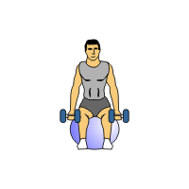
Young and middle aged adults
Good nutrition
Fitness activities
Principles of fitness training
Choosing the right shoes for fitness training
Proper nutrition for physical activity
Screening for fitness
Ergonomics for work place(manual therapy)
Red flags for depression
Prevention n management of obesity
Pregnancy ways to reduce back pain
Child development for new mothers
Healthy lifestyle habits
Screening for poor posture, diabetes, heart disease, stress,
Screening for fitness training
Stress management
Prevention of low back pain
Medications benefits n risks
Prevention of skin cancer

Slide 20
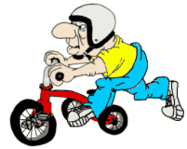
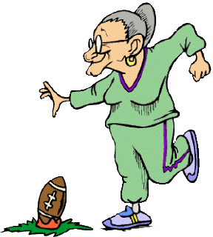
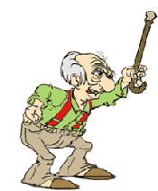
Older adults
Reducing risk of fall
Good nutrition
Physical activities for health n wellness
Fitness training for older adults
Choosing the right shoes for fitness training
Proper nutrition for physical activity
red flags for depression
How to maintain healthy bones
Ergonomics for computer use
Ergonomics for the home
Screening for stress
Stress management
medications

