Slide 2
Cotton crop

Slide 3
Agrometrology of cotton crop

Slide 4
Introduction
Genus Gossypium
Family Malvacea
Four cultivated species
Gossypium hirsutum ( American cotton)
G.aroboreum and herbaceous (desi cotton)
Among them G.herbacium and G.aroboreum (n=13 chrosome)are called Old world cotton
Cultivated in tropical and subtropical regions
The other two specie with n=26 chromosomes are grown in the New world

Slide 5
These are cultivated under area aer following
G.hirsutum(36%),G.aroboreum(17%),G.herbacium (10%) and G.hirsutum is less than 1.05%
The remaining 36% of the area is with hybrids Cotton is the most important vegeteble fiber cultivated in about 60 countries in the world such as, Russia,Pakistan,USA,China,etc

Slide 6
Crop botany

Slide 7
Cotton plant consist of roots,shoot,stem,
leaves and reproductive organs

Slide 8
Root system
Cotton plant has tap root system
Depth of primery root depends upon soil,climate and genotype
Maximum root depth varies from 150-300 cm under favorable conditions
Depletion of water in upper profile leads to penetration of roots and depth
It result in greater extraction of water from deeper profile

Slide 9
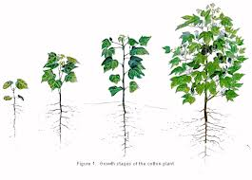

Slide 10
Shoot system
The main stem of cotton plant is monopodial with leaves and branches but no flowers
Usually tow auxiliary buds at each main stem node, the 2nd branching off the1st
Normally only one bud devolpe
At lower node, the1st bud remains vegetative and may devolpe into vegetative branch of monopodium

Slide 11
Usually the vegetative branches occur in definite zone near the base of plant
Fruiting branches occur further up the stem
Number of nodes from the base of main stalk to the first fruiting branches varies among cotton species and effected by cultural practices

Slide 12
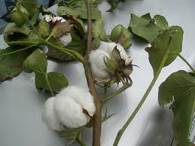

Slide 13
Fruiting structures
Squares are the flower bud that first appears on the plant when reproductive growth begins
The flower bud is enclosed by three bracts
Squares grow for about three weeks before a bloom appears
During this time numerous events are occurring within the flower bud structure.
The male and female parts of the flower undergo their development within the square and the fiber cells begin to differentiate just prior to bloom
The actual number of seeds within a boll is dependent on effective fertilization of the bloom

Slide 14
Blooms open at the culmination of the square period
The cells of the flower petals expand rapidly during the 24 hours preceding bloom, and the flower opens during the early to midmorning hours. During this time the male and female flower parts expand rapidly
The flower opens when the cotton reproductive system has reached maturity
The embryo sac is fully developed and ready for fertilization by the pollen from a mature anther at bloom
If the ovules are not fertilized properly, the plant sheds the young boll
The flower petals turn pink on the second day and later dry up and drop off the young boll

Slide 15
LOCALITY AND CLIMATE CONDITIONS
Major cotton growing provinces are Punjab and
Sindh
Cotton production require a frost free growing
period season of at least 180-200 days
Ample Sun light,favourable moisture regime, mild spring,warm moderately moist Summer and dry cool and prolong Autumn are most favorable conditions for cotton.

Slide 16
Soil
Cotton has wide range of soil adaptation
It can be grown on differrent types of soil except water logged and salt affected soil
Loam soil containing fair amount of organic matter is best
Since cotton has deep root system so shallow soils are not suitable for it
If the soil is saline,preferrably ridge cultivation should be adopted
Soil must be able to retain more irrigation as well as raw water for long time to make available to growing crop
Soil must provide adequate O₂ supply to growing roots

Slide 17
Temprature
Adequate soil temperature and moisture conditions
at planting are necessary to ensure proper seed
germination and crop emergence

Slide 18
Recommended soil temperature at seed depth should be above 18°C to ensure healthy uniform Stands
Cotton requires a minimum daily air temperature of 15°C for germination, 21°C–27°C for vegetative growth and 27°C–32°C during the
fruiting period
Current commercial cultivars generally need more than 150 days above 15°C to produce a crop
They become inactive at temperatures below
15°C and are killed by freezing temperatures

Slide 19
Economic importance of cotton in Pakistan
Pakistan is the fifth largest producer of cotton in the world.
the third largest exporter of raw cotton,
the fourth largest consumer of cotton, and the largest exporter of cotton yarn.
1.3 million farmers (out of a total of 5 million) cultivate cotton over 3 million hectares, covering 15 per cent of the cultivable area in the country

Slide 20
. Cotton and cotton products contribute about 10 per cent to GDP
cotton and cotton products contributes 55 per cent to the foreign exchange earnings of the country
Taken as a whole, between 30 and 40 per cent of the cotton ends up as domestic consumption of final products
The remaining is exported as raw cotton, yarn, cloth, and garments.

Slide 21
Cotton production supports Pakistan’s largest industrial sector.
It comprising some 400 textile mills,
7 million spindles,
And 27,000 looms in the mill sector (including 15,000 shuttleless looms), over 250,000 looms in the non-mill sector.

Slide 22
It also comprises 4,000 garment units,
650 dyeing and finishing units ,
nearly 1,000 ginneries,
300 oil expellers,
and 15,000 to 20,000 indigenous

Slide 23
Production technology of Cotton

Slide 24
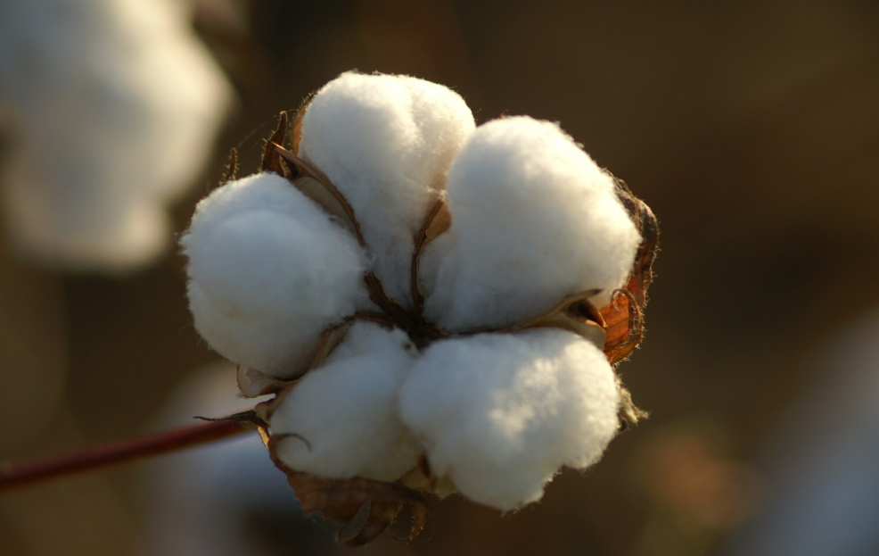
.seed bed preparation .varieties and their time of sowing .seed rate .plant population .method to check the germination rate .delinting of seed .seed treatment .sowing method .gap filling and thinning .irrigation .fertilizer application
Contents:

Slide 25
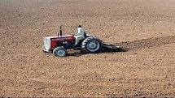
Seed bed preparation:
soil should have good drainage
Well ploughed
Breaking of hard pan
Deep ploughing & laser levelling
Rotavator and disc harrow

Slide 26
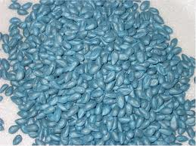
seed rate:
Seed should be certified,pure,healthy and free from diseases.
Having good germination rate.
Should be delinted and treated with fungicide.
Seed having germination rate 75% or more 6kg/acre after delinting.
Seed having germination rate 60% or more 8kg/acre after delinting.
Seed having germination rate 50% or more 10kg/acre after delinting

Slide 27
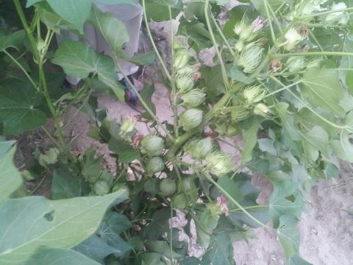
varieties and their time of sowing:
IR-3701……………5 apr-15may
Ali Akbar-703……..1 mar-15 apr
MG-6……………....1 apr-15 may
Sitara-008………… 1 mar-15 may
FH-113…………….. 15 apr-15 may
Neelam-121……….. 1 mar-30 apr
MNH-886…………...1 apr-30 may
FH-142………………1 mar-15 may

Slide 28
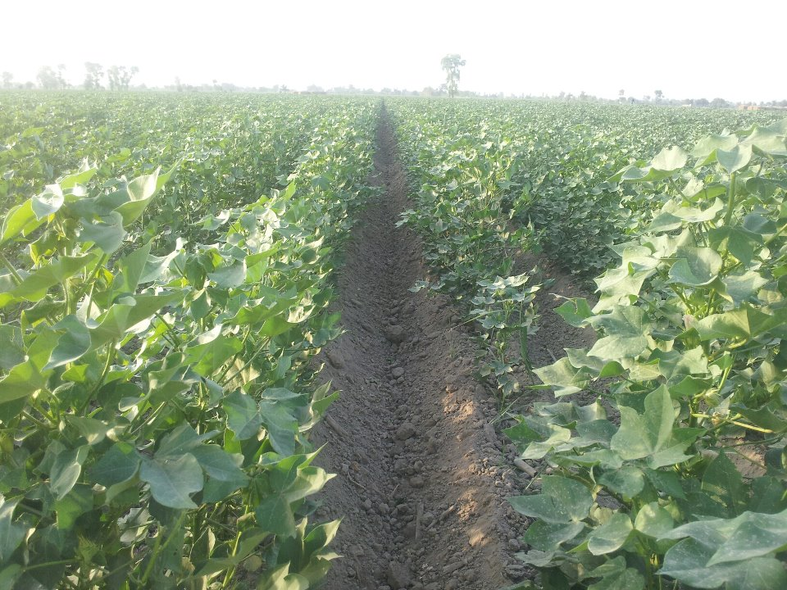
plant population:
Plant population should be optimum for good yield and efficient use of fertilizer,water and pesticides.
March sowing(early):
P x P=12-15 inches,,,,,,,R x R=2ft 6inches
plant population=14000-17500
April sowing:
P x P=9-12 inches,,,,,,,R x R=2ft 6inches
plant population=17500-23000
Late sowing(1-15 may):
P x P=6-9 inches,,,,,,,R x R=2ft 6inches
plant population=23000-35500

Slide 29
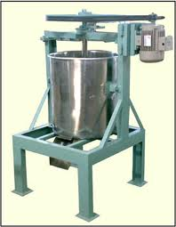
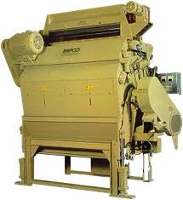
Delinting:
the process of removing the lint is called delinting.
Delinting should be done by treating seed with sulphuric acid.
Ash can also be used if acid is not available.
1 litre sulphuric acid is sufficient for 10kg seed

Slide 30
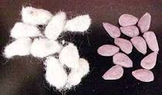
seed treatment:
Treatment of seed should be done with fungicide to prevent seed born diseases.
This will prevent the crop from sucking insects like white fly which transmit CLCuV,during first month.
Imedachloprid 5-10g/kg seed

Slide 31
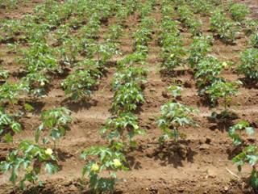
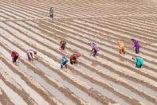
Sowing methods:
Drill sowing:
Ridge sowing:
-mechanical sowing
-hand sowing
Gap filling:
gap filling should be done after 10-15 days of sowing to maintain proper plant population.

Slide 32
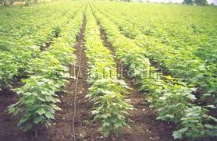
Thinning:
Thinning is done to maintain proper plant to plant distance.
It helps in maintaining optimum plant population.
It also facilitates the agronomic practices like application of fertilizers ,pesticide and hoeing.
Thinning should be done after 20-25 days of germination.

Slide 33
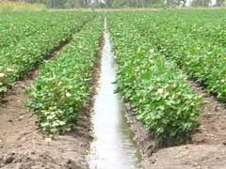
Irrigation:
For line sowing, first irrigation should be done after 30-35 days of sowing and next irrigations should be done at12-15 days interval.
For ridge sowing
first irrigation should be done after 2-3 days of sowing and next irrigations should be done at 6-9 days interval.

Slide 34
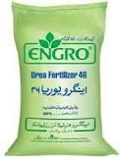
fertilizer application:
Nitrogen fertilizer:
138-161kg/acre or 6-7 bags of urea.
Or 9-11 bags of CAM.
Phosphorous fertilizer:
5 bags of SSP or 2 bags of DAP.
Potassium fertilizer:
37-50kg/acre 0r 1.5-2 bags of potassium sulphate or 1.5 bags of potassium chloride.

Slide 35
PLANT PROTECTION MEASURES
WEEDS CONTROL MEASURES
INSECT CONTROL MEASURES

Slide 36
WEEDS CONTROL METHODS
CULTURAL CONTROL
Inter row cultivation
Hoeing
CHEMICAL CONTROL
Pre-emergence herbicides
Post emergence herbicides

Slide 37
CHEWING TYPE INSECT
SPOTED BOLL WORM
PINK BOLL WORM
AMERICAN BOLL WORM
ARMY WORM
There mode of damage and
management

Slide 38
SUCKING TYPE INSECT
JASSID
APHID
WHITEFLY
There mode of damage and
management

Slide 39
INSECT PEST OF COTTON
There are two types of insect pest
Sucking type insect
Chewing type insect

Slide 40
STORAGE OF COTTON SEED Good judgment should be used in selecting cotton seeds to store. Cotton seed from the cotton harvested in early morning after high dew, cotton harvested soon after a rain or snow or the cotton that have got wet on a trailer should not be stored. Seed can be stored up to 15% moisture control level providing seed 50F* to 60F* temperature.
reduce seed temperature and moisture and minimize mold growth and Insects activity within the seed. Cotton seed require about 80 cubic foot storage space per ton. Following things should kept in mind while storing the seed

Slide 41
Varities BT varieties FH-114 CIM-598 SITARA-009 A-one
Non-BT varieties
BH-167
MIAD-852
CIM-573
SLH-317
These are approved for general cultivation

Slide 42
BT varieties TARZAN-1 NS-141, IR-NIBGE-3 MNH-886
Non-BT varieties
NIBGE -115
FH-941
FH-942

Slide 43
YIELD AND YIELD RELATED PROBLEMS OF COTTON
Yield of cotton:
20 mands per acre

Slide 44
YIELD POTENTIAL:
CRIS 134 =2700 seed cotton kg/ha
CIM482 =3000 Seed cotton kg/ha
MARVI =2500 seed cotton kg/ha
FH900 =3000 seed cotton kg/ha
RH112 =3000 seed cotton kg/ha

Slide 45
YIELD RELATED PROBLEMS OF COTTON
ON FARM PROBLEMS:
LAND PREPARATION:
Cotton is deep rooted crop
It need deeply tilled and well prepared soil for its tap root system to penetrate deep into the soil.
So deep tillage is required for minimizing compaction below the plough layer and for conserving water under rain fed areas.

Slide 46
IRRIGATION:
Cotton is very drought tolerant crop.
Cotton water requirements dependent on environment, the dryer and hotter the environment is, the more water is required by the plant.
In early vegetative period , crop water requirements are low and high during flowering period .Later in growing periods ,the requirements decline.(700-1300mm).

Slide 47
DISEASES:
Disease causes 9.72 percent losses on an average.
Bacterial leaf blight causes defoliation, small bolls and boll rottening.
Fungus Verticillium dahilae ,penetrates into the roots and grows along stem. It grows in cooler temperature and cause 30 percent of yield losses.
Root rot is also present in cotton.

Slide 48
INSECTS:
Insects causes about 15 percent loses.
Red cotton bug,lady bird beetle, red wasp, mealy bug.
Pink bollworm
Cotton aphid, they suck from leaves and secrete honey due which destroy leaves and no photosynthesis. They cause significant loss in yield.

Slide 49
SOIL PROBLEMS:
Water Logging:
Cotton roots grow deep in soil. Water logging block transfer of O2 between roots and soil.
Plant roots may become O2 defficient that they cannot respire.
So root growth and absorption of nutrients decreases.

Slide 50
SOIL SALINITY:
As most of the soil in Pakistan is saline.
As the magnitude of salinity increases, the number of branches decreases in plant .
Yield decreases at different Ece value.
0 percent losses at when Ece is 7.7 mmhos/cm, 10 percent at 9.6, 25 percent at 13, 50 percent at 17 and 100 percent at Ece 27 mmhos/cm.

Slide 51
POST HARVEST LOSSES:
These are about 7-11 percent.
Cotton should be stored after drying it under the sunlight and it should be kept on the floor having sheat spreaded on it.
Pickings collected at different intervals should be kept separate. Mean first picking should be kept separate to second because there is gradual decrease in quality.

