Slide 1
TOPIC: VESICULAR TRAFFICKING AND ENDOMEMBRANE SYSTEM

Slide 2
GENERAL INTRODUCTION:
Vesicles Send or
Vesicular trafficking Communication pathway Receive
Organelles Messages
Secretory pathway
Two Main Pathways Trafficking
Importing pathway
SECRETORY PATHWAY:
Sends Vesicles From Golgi Apparatus Plasma Membrane
Endoplasmic reticulum
Release molecule Extracellular space
Carries molecules Plasma membrane
IMPORTING PATHWAY (DEGRADATION PATHWAY):
Plasma membrane Vesicles originates By membrane invagination Fuse with
Endocytic molecules Which degrades Becomes lysosomes Endosomes

Slide 3
BRIEF INTRODUCTION OF ORGANELLES INVOLVED IN VESICULAR TRAFFICKING
ENDOPLASMIC RETICULUM:
Endoplasmic reticulum Membranous synthesis Transport organelle Extension of nuclear envelope. Endoplasmic reticulum forms SHEET “ER Lumen” (ER cisternal space)
10% of entire cell volume.
Its membrane allows molecules to selectively transferred between lumen and cytoplasm.
It also provides channel between nucleus and the cytoplasm.
Producing
ER has a central role Processing “Biochemical compounds”
Transporting
Use inside and outside of the cell.

Slide 4
CONT…..
Its membrane is the side of production of all transmembrane proteins and lipids
For most of cell organelles including
ER itself Golgi apparatus Lysosomes Endosomes Mitochondria Peroxisomes Secretory vesicles Plasma
membrane.
Almost all of the proteins Exit the cell Those staying in lumen of ER, Golgi apparatus or lysosome
Delivered from endoplasmic reticulum.
ER resident proteins.
Made up of specialized retention signal Made up of specific Sequence of amino acid
Identifies other proteins CHAPERON PROTEIN (BIP)

Slide 5
CONT……
SMOOTH ENDOPLASMIC RETICULUM (FUNCTION):
Also called transitional ER Contain ER exit sites
FUNCTIONS:
Transport vesicles
Carrying newly synthesized proteins and lipids, including
Synthesis of lipids,
Metabolism of carbohydrates,
Detoxification of drugs an poisons.
Enzymes of SER are vital to the synthesis of lipids and steroids
Example: Sex hormones of vertebrates and steroid hormones of adrenal glands
SER performing carbohydrates metabolism cells are abundant in liver cells.

Slide 6
CONT……
ROUGH ENDOPLASMIC RETICULUM (FUNCTION):
Many types of cells export protein produced by ribosomes attached to the rough ER.
The ribosome assemble amino acid into protein units which are carried into RER for further adjustments.
These proteins may be transmembrane proteins, which become embedded in the membrane of endoplasmic reticulum
OR
Water soluble proteins which are able to pass through the membrane into lumen, then those retained proteins are folded into correct three dimensional conformation.
Chemicals such as carbohydrates or sugars are added, then ER either transport the completed protein called Secretory proteins

Slide 7
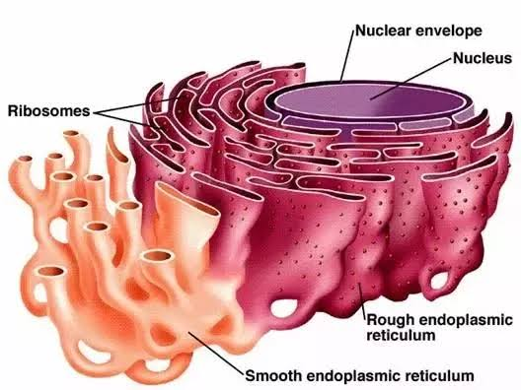
ENDOPLASMIC RETICULUM

Slide 8
GOLGI APPARATUS:
Golgi apparatus Stack of sacs Cisternae.
Main function Protein modification.
Apparatus Receives vesicles From ER Cis-face
Opposite end Modified compounds leave Trans-face Facing the plasma membrane
Where most of the modifies are sent.
Vesicles sent off by ER containing proteins are further altered at Golgi apparatus and then prepared for secretion from the cell or transport to other parts of the cell.
Modification and synthesis of carbohydrate
The Golgi apparatus removes and substitutes various sugar monomers.
In addition to modifying proteins the Golgi also manufactures macromolecules itself.
In plants Golgi apparatus produce pectin and other polysaccharides need by plant structure.
Molecular identification labels or tags are added by Golgi enzymes to help in their transport.
After this, Golgi apparatus sends off its products by budding vesicles from its Trans-face.

Slide 9
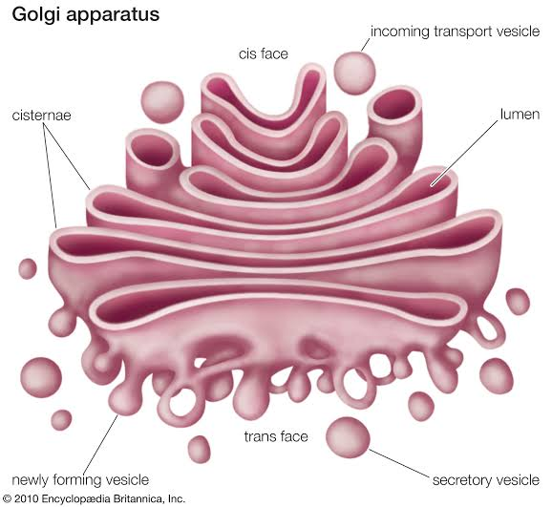
GOLGI APPARATUS

Slide 10
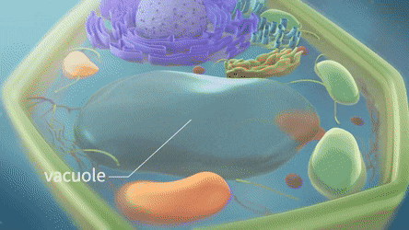
VACUOLES:
These are membrane bound sacs larger then vesicles. In plant cells vacuoles cover 30-90% of total cell volume.

Slide 11
VESICLES:
These are small membrane bound transport unit that can transfer molecules between different compartments.
Endoplasmic reticulum Golgi apparatus 3-Various locations
Clathrin-coated COPI-coated COPII-coated
CLATHRIN-coated:
Transport substances between Golgi apparatus and plasma membrane.
COPI-coated & COPII-coated:
Frequently used between ER & Golgi apparatus. i.e.
COPI coats vesicles transporting from cis-Golgi back to the RER and between Golgi compartments.
This type of transport is called as Retrograde(Backward) transport.
COPII coats vesicles transporting proteins from the RER to the cis-Golgi.

Slide 12
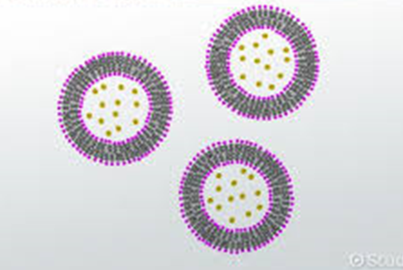
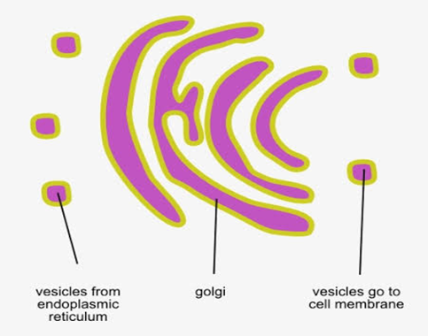
VESICLES
MECHANISM OF TRANSPORT

Slide 13
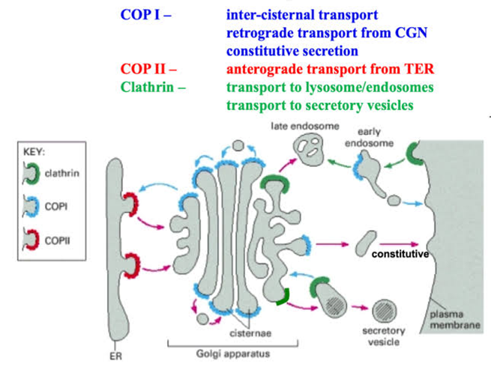
ROLE OF
CLATHRIN
COPI
COPII

Slide 14
The vesicles (60 nm in diameter) are of three types :
Transitional vesicles :
These are small membrane limited vesicles which are thought to form as blebs from the transitional ER to migrate and converge to cis face of Golgi, where they coalesce to form new cisternae.
Secretory vesicles:
These are varied-sized membrane-limited vesicles which discharge from margins of cisternae of Golgi. They, often, occur between the maturing face of Golgi
Clathrin-coated vesicles
These are spherical protuberances, about 50 µm in diameter and with a rough surface. They are found at the periphery of the organelle, usually at the ends of single tubules, and are morphologically quite distinct from the secretory vesicles. The clathrin-coated vesicles are known to play a role in intra-cellular traffic of membranes and of secretory products, i.e., between ER and Golgi, as well as, between GELR region and the endosomal and lysosomal compartments.

Slide 15
The GERL Region :
To the trans face of Golgi Trans-reticular Golgi TGN (trans Golgi-network)
OR
GERL (=Golgi + smooth ER + lysosomal)
Involved in the origin of Primary Lysosomes
+
Melanin granules
TUBULES:
In Golgi apparatus a complex array of associated vesicles and anastomosing tubules (30 to 50 nm diameter) surround the dictyosome and radiate from it. In fact, the peripheral area of dictyosome is fenestrated (lace-like) in structure.

Slide 16
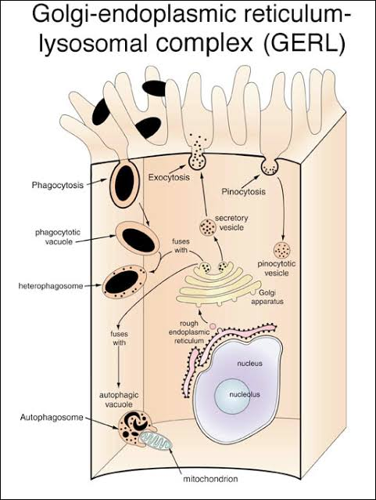
GERL REGION
GOLGI APPARATUS
ENDOPLASMIC RETICULUM
LYSOSOMES

Slide 17
LYSOSOMES:
(Gr. lyso=digestive + soma=body) Tiny membrane-bound Vesicles Intracellular digestion
Biogenesis Hydrolases and Membrane proteins.
Both classes of proteins Synthesized in ER Transported Through the Golgi apparatus
Endolysosome To an intermediate compartment Trans Golgi network
transport vesicle
(coated by clathrin protein)
Lysosomal enzymes Glycoproteins Containing N-linked oligosaccharides that are processed
M6P-receptors Recognized Mannose 6-phosphate (M6P)
(which are transmembrane proteins)
In Trans Golgi network Packaged Budding clathrin-coated vesicles Which quickly lose their coats.

Slide 18
FUNCTIONS OF LYSOSOMES:
The important functions of lysosomes are as follows:
Digestion of large extracellular particles.
The lysosomes digest the food contents of the phagosomes or pinosomes.
Digestion of intracellular substances.
During the starvation, the lysosomes digest the stored food contents, viz., proteins, lipids and carbohydrates (glycogen) of the cytoplasm and supply to the cell necessary amount of energy.
Autolysis
In certain pathological conditions the lysosomes start to digest the various organelles of the cells and this process is known as autolysis or cellular autophagy.
Extracellular digestion.
The lysosomes of certain cells such as sperms discharge their enzymes outside the cell during the process of fertilization. The lysosomal enzymes digest the limiting membranes of the ovum and form penetration.

Slide 19
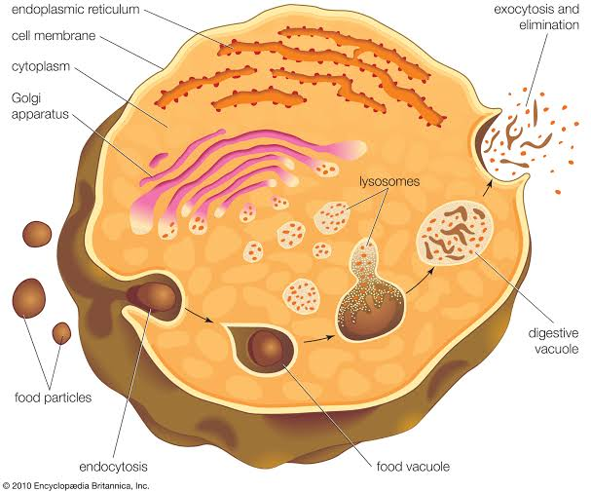
LYSOSOME IN CELL

Slide 20
SECRETORY PATHWAY

Slide 21
Cells routinely import and export large molecules across the plasma membrane. Macromolecules are secreted out from the cell by Exocytosis
Macromolecules are ingested into the cell from outside through Phagocytosis and Endocytosis.
EXOCYTOSIS:
It is also called Emeiocytosis and Cell vomiting.
In all eukaryotic cells, secretory vesicles are continually carrying new plasma membrane and cellular secretions such as proteins, lipids and carbohydrates from the Golgi apparatus to the plasma membrane or to cell exterior by the process of exocytosis.
The proteins to be secreted are synthesized on the rough endoplasmic reticulum (RER).
They pass into the lumen of the ER, glycosidated and are transported to the Golgi apparatus by ER-derived transport vesicles.
In the Golgi apparatus the proteins are:
Modified, Concentrated, Further Glycosidated, Sorted and Finally packaged into Vesicles that pinch off from trans Golgi tubules and migrate to Plasma membrane to fuse with it and release the secretion to cell’s exterior.
Small molecules From the cytosol Vesicles.
Where they are complexed to specific macromolecules (e.g. a network of proteoglycans, in case of histamine)

Slide 23
STEPS IN VESICULAR TRAFFICKING
There are five steps to exocytosis:
• Vesicle trafficking:
In this first step the vesicle containing the waste product or chemical transmitter is transported through the cytoplasm towards the part of the cell from which it will be eliminated.
• Vesicle tethering:
As vesicle approaches the cell membrane, it is secured and pulled towards the part of the cell from which it will be eliminated.
• Vesicle docking:
In this step the vesicle comes in contact with the cell membrane, where it begins to chemically and physically merge with the proteins in the cell membrane.
• Vesicle priming:
In those cells where chemical transmitters are being released, this step involves the chemical preparations for the last step of exocytosis.
• Vesicle fusion:
In this last step, the proteins forming the walls of the vesicles merge with the cell membrane and reach, pushing the vesicle contents (waste products or chemical transmitters) out of the cell. This step is the primary mechanism for the increase in the size of the cell’s plasma membrane.

Slide 25
IMPORTING PATHWAY

Slide 26
ENDOCYTOSIS:
In endocytosis, small regions of the plasma membrane fold inwards or invaginate, until it has formed new intracellular membrane limited vesicles. In eukaryotes, the following two types of endocytosis can occur : pinocytosis and receptor-mediated endocytosis.
PHAGOCYTOSIS:
(Gr., phagein=to eat, kytos=cell or hollow vessel)
The process of ingestion of large-sized solid substances by the cell is known as phagocytosis.
Occurrence of phagocytosis:
The process of phagocytosis occurs in most protozoans and certain cells of multicellular organisms.
In multicellular organisms such as mammals, the phagocytosis occurs very actively in granular leucocytes and in the cells of mesoblastic origin.
The cells of the mesoblastic origin are collectively known as the cells of macrophagic or reticuloendothelial system.
The cells of macrophagic system are histiocytes of the connective tissue, the reticular cells of the hemopoietic organs (bone marrow, lymph nodes and spleen) and the endothelial cells which form the lining of capillary sinusoid of the liver, adrenal gland and hypophysis.
The cells of macrophagic system can ingest bacteria, Protozoa, cell debris or even colloidal particles by the process of phagocytosis.

Slide 27
Process of phagocytosis.
In phagocytosis, first the target particle is bound, to the specific receptors on the cell’s surface Adsorption
Plasma membrane expands along the surface of the particle and eventually engulfs Formed Vesicles Phagosomes
(phagolysosome) Fuse with the pre-existing lysosomes Migrate to the interior of the cell
The food is digested by the hydrolytic enzymes (acid hydrolase) of the lysosomes and the digested food is ultimately diffused to the surrounding cytoplasm.
The undigested food is expelled from the plasma membrane by the process Ephagy or Egestion.
Kinds of phagocytosis.
Ultraphagocytosis or Colloidopexy:
The process in which plasma membrane ingests smaller colloidal particles is known as colloidopexy or ultraphagocytosis, e.g. leucocytes and the macrophagic cells of mammals.
Chromopexy:
When the cell ingests colloidal chromogen particles phagocytotically the process is known as chromopexy, e.g., some mesoblastic cells.

Slide 28
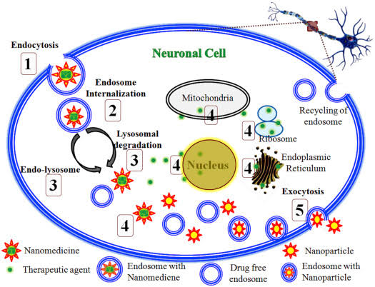

Slide 29
Pinocytosis.:
Pinocytosis (Gr. pinein = to drink ‘cell drinking’) is the non-specific uptake of small droplets of extracellular fluid by endocytic vesicles or pinosomes having diameter of about 0.1 µm to 0.2 µm.
Any material dissolved in the extracellular fluid is internalized in proportion to its concentration in the fluid.
The process of pinocytosis was first of all observed by Edward in Amoeba and by Lewis (1931) in the cultured cells.
The light microscopy has shown that in Amoeba tiny pinocytic channels are continually being formed at the cell surface by invagination of the plasma membrane.
From the inner end of each channel small vacuoles or pinosomes are pinched off, and these move towards the center of the cell, where they fuse with primary lysosomes, to form food vacuoles.
Ultimately, ingested contents are digested, small breakdown products such as sugars and amino acids diffuse to cytosol.

Slide 30
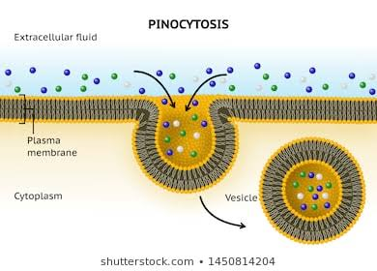
Micropinocytosis:
Electron microscopic observations have been made on the pinocytotic process at sub-cellular or sub-microscopic level in the cells.
The pinocytosis which occurs at submicroscopic level is known as micropinocytosis.

Slide 31
Receptor-mediated endocytosis.
In this type of endocytosis, a specific receptor on the surface of the plasma membrane “recognizes” an extracellular macromolecule and binds with it. The substance bound with the receptor is called the ligand.
Examples of ligands may include:
Viruses, Small proteins, Vitamin B12, Cholesterol containing LDL ( low density lipoprotein), Oligosaccharide etc.
The region of plasma membrane containing the receptor-ligand complex undergoes endocytosis.
The whole process of receptor mediated endocytosis, includes the following events :
Interaction of ligands and cell surface receptors
Formation of coated-pits and coated-vesicles
Functions of coated pits (clathrin dependent)
Fusion of endocytic vesicle and endosome

Slide 33
Functions of coated pits (clathrin dependent):
The ligand-loaded receptors diffuse into these coated-pits.
A coated-pit may accommodate about 1000 receptors of assorted variety.
In fact, coated-pits serve as molecular filters and selective concentrating devices, since, they tend to collect certain receptors and leave others.
They increase the efficiency of internalization of a particular ligand more than 1000-fold and also carry minor components of extracellular fluid.
The life-time of each coated-pit is quite short—within a minute or so of being formed, it invaginates into the cell and pinches off to form the coated-vesicles.
The coat of coated pits and coated vesicles is made up of protein, called clathrin and certain other proteins. A molecule of clathrin is composed of three large polypeptide chains and three smaller polypeptide chains, all of which together form a three-legged structure, called triskelion.
A number of triskelions assemble into a basket-like network of hexagons and pentagons on the cytoplasmic surface of the membranes.

Slide 35
Endosome or Receptosome.
Recently it has been found that in the cells exists a complex set of heterogeneous membrane bound tubes and vesicles, called endosome, which extends from the periphery of the cell to the perinuclear region, where it lies quite close to Golgi apparatus. Thus, endosomes may be of two types:
Peripheral endosomes just beneath the plasma membrane.
Perinuclear or Internal endosomes.
These perinuclear endosomes are converted into endolysosomes and then into lysosomes due to following three activities:
The fusion of transport vesicles from the Golgi apparatus.
Transport vesicles capture a cargo of molecules, e.g., proteins, from the lumen of one compartment as they pinch off from its membrane and then discharge that cargo into another compartment as they fuse with it. Thus, in such vesicular transport, the transported proteins do not cross any membrane and they are transferred from lumen to lumen.
Continuous membrane retrieval.
Increased acidification.

Slide 36
Membrane fusion during exocytosis and endocytosis.
Both exocytosis and endocytosis involve the fusion of initially separate regions of lipid bilayer and occur in at least two steps : first the two bilayers come into close apposition, it is called bilayer adherence, and then they fuse together (This is called bilayer joining). Both of these steps are believed to be mediated by some types of specific proteins, called fusogenic proteins.
MODIFICATIONS NECESSARY FOR TRANSPORT
Invaginations Microvilli Basement Membrane Tight Junctions Desmosomes
(Zonula Occludens)
Basal lamia Reticular layer

Slide 37
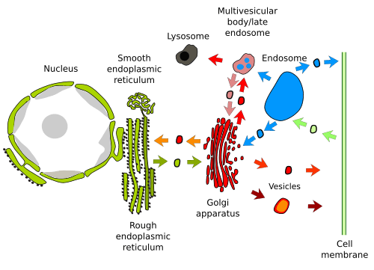
DIAGRAMMATIC MECHANISM OF VESICULAR TRAFFICKING

