Slide 1
Cell And Tissue culture

Slide 2
Definition
Cell and Tissue culture is a method of biological research in which fragments of tissue from an animal or plant are transferred to an artificial environment in which they can continue to survive and function

Slide 3
HISTORY OF PLANT TISSUE CULTURE
Schleiden-Schwann (1838)
cellular theory (Cell is autonomous and totipotent)
Harberlandt (1902)
First attempt of plant tissue culture
White (1939)
Continuously growing callus culture
Ball (1946)
Whole plant developed from shoot tip
Ball (1950)
Organs regenerated on callus
Muir (1954)
Plant from single cell
Cocking (1960)
Protoplast isolation

Slide 4
HISTORY OF PLANT TISSUE CULTURE
Murashige – Skoog (1962)
MS media
Morel (1964)
Clonal propagation of orchids
Guha (1964)
Haploids from pollen
Power (1970)
Fusion of protoplasts
Takebe (1971)
Plants from protoplasts
Larkin (1981)
Somaclonal variation

Slide 5
Plant Cell And Tissue culture

Slide 6
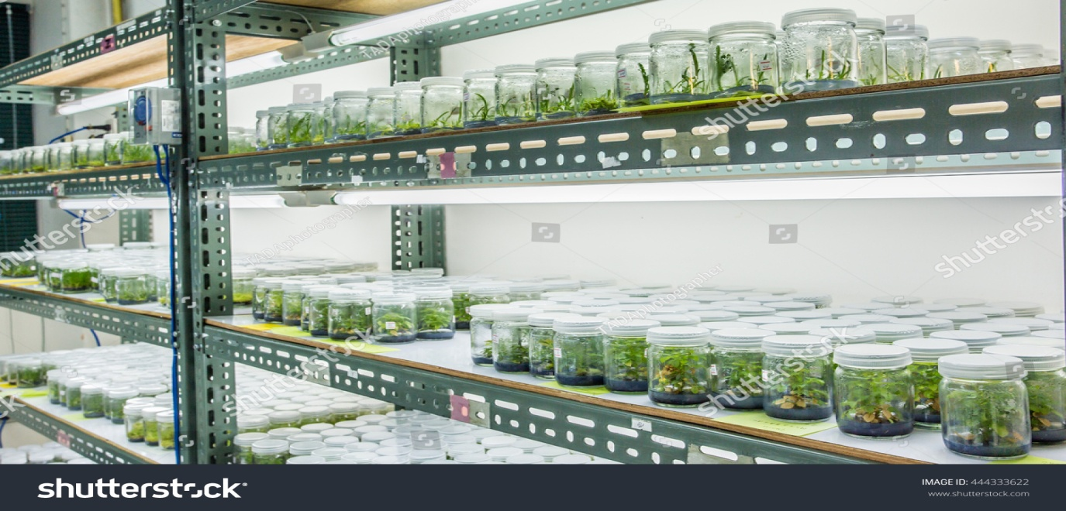
introduction
Plant cell and tissue culture is a process that involves exposing plant tissue to a specific regimen of nutrients, hormones, and light under sterile, in vitro conditions to produce many new plants, each a clone of the original mother plant, over a very short period of time.

Slide 7
Advantages of Plant Tissue Culture
Different techniques in plant tissue culture may offer certain advantages over traditional methods of propagation,
including
The production of exact copies of plants that produce particularly good flowers, fruits, or have other desirable traits.
To quickly produce mature plants.
The production of multiples of plants in the absence of seeds or necessary pollinators to produce seeds.

Slide 8
The regeneration of whole plants from plant cells that have been genetically modified.
The production of plants in sterile containers that allows them to be moved with greatly reduced chances of transmitting diseases, pests, and pathogens.
The production of plants from seeds that otherwise have very low chances of germinating and growing, i.e. orchids and Nepenthes.
To clean particular plants of viral and other infections and to quickly multiply these plants as 'cleaned stock' for horticulture and agriculture.

Slide 9
Totipotent Cells
• They can give rise entire organism
• Ex-plant cells
Pluripotent Cells
These cells can give rise to all types of tissues
Multipotent Cells
• They give rise to a limited range of cells within a tissue type

Slide 10
Three Fundamental Abilities of Plants
Totipotency
the potential or inherent capacity of a plant cell to develop into an entire plant if suitably stimulated.
It implies that all the information necessary for growth and reproduction of the organism is contained in the cell
Dedifferentiation
Capacity of mature cells to return to meristematic condition and development of a new growing point, follow by dedifferentiation which is the ability to reorganize into new organ
Competency
the endogenous potential of a given cells or tissue to develop in a particular way

Slide 11
Setting up of a tissue culture lab
Media preparation room
Aseptic transfer area
Culture room
Analytical room
Acclimatization room

Slide 12
Preparation of plant tissue for tissue culture is performed under aseptic conditions under HEPA filtered air provided by a Laminar flow cabinet.
HEPA is an acronym for high-efficiency particulate air. HEPA is a type of filter that can trap a large number of very small particles that other vacuum cleaners would simply recirculation back into the air of your Laboratory or home.
Thereafter, the tissue is grown in sterile containers, such as Petri dishes or flasks in a growth room with controlled temperature and light intensity.
Living plant materials from the environment are naturally contaminated on their surfaces (and sometimes interiors) with microorganisms, so their surfaces are sterilized in chemical solutions (usually alcohol and sodium or calcium hypochlorite.
Techniques

Slide 13
before suitable samples (known as explants) are taken.
What is explants?
a cell, organ, or piece of tissue which has been transferred from animals or plants to a nutrient medium.
The sterile explants are then usually placed on the surface of a sterile solid culture medium but are sometimes placed directly into a sterile liquid medium, particularly when cell suspension cultures are desired.
Solid and liquid media are generally composed of inorganic salts plus a few organic nutrients, vitamins and plant hormones. Solid media are prepared from liquid media with the addition of a gelling agent, usually purified agar.

Slide 14
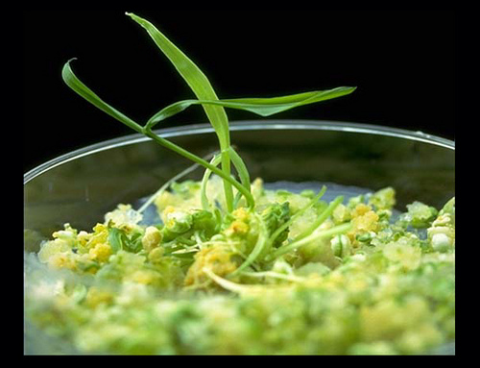
Plant tissue Culture Basics
As cultures grow, pieces are typically sliced off and transferred to new media (subcultured) to allow for growth or to alter the morphology of the culture.

Slide 15
Hormones Affect Plant Differentiation:
Auxin: Stimulates Root Development
Cytokinin: Stimulates Shoot Development
Generally, the ratio of these two hormones can determine plant development:
↑ Auxin ↓Cytokinin = Root Development
↑ Cytokinin ↓Auxin = Shoot Development
Auxin = Cytokinin = Callus Development

Slide 16
Factors Affecting Plant Tissue Culture
Growth Media
Minerals, Growth factors, Carbon source, Hormones
Environmental Factors
Light, Temperature, Photoperiod, Sterility, Media
Ex-plant Source
Usually, the younger, less differentiated the ex-plant, the better for tissue culture
Genetics
Different species show differences in amenability to tissue culture
In many cases, different genotypes within a species will have variable responses to tissue culture

Slide 17
Plant Tissue Culture Applications
The commercial production of plants used as potting, landscape, and florist subjects
To conserve rare or endangered plant species.
To screen cells rather than plants for advantageous characters, e.g. herbicide resistance/tolerance.
Large-scale growth of plant cells in liquid culture in bioreactors for production of valuable compounds, like plant-derived secondary metabolites and recombinant proteins used as biopharmaceuticals.

Slide 18
To cross distantly related species by protoplast fusion and regeneration of the novel hybrid.
To produce clean plant material from stock infected by viruses or other pathogens.
Production of identical sterile hybrid species can be obtained

Slide 19
Define in vitro culture
The technique or process of maintaining or cultivating cells or tissues derived from a living organism in a culture medium
Important features of in vitro techniques
The in vitro works are carried out in a test tube, dish or flask i.e. outside the living organism. Hence in vitro techniques are also referred to as plant tissue culture techniques.
Tissue culture work is confined to plants.
The tissues are grown in suitable nutrient medium.
Tissues are grown outside the parent

Slide 20
Important steps of in vitro culture
In vitro culture technique generally consists of four main steps, they are
Isolation of tissues
Regeneration and callus formation
Embryogenesis
Organogenesis
Isolation of tissues:
Tissues for regeneration can be isolated with the help of sterilized blade from any plant part i.e. leaf, stem, bud etc. The isolated tissues are sterilized and then grew on culture medium. Tissues should be isolated from diseased free portion.

Slide 21
Regeneration and callus formation
Tissues proliferate on the callus medium and give rise to a mass of cells called callus.
Embryogenesis
The process of formation of somatic embryos from the callus is called embryogenesis. Sometimes somatic embryos are not formed somatic buds are formed which germination gives rise to plant.
Organogenesis
The process of differentiation of shoot or root from the somatic embryos is called organogenesis. Sometimes, a complete plant develops directly from the somatic bud. The plants thus obtained are transferred after sometime to pot culture from culture medium

Slide 22
Types of In Vitro Culture
Culture of intact plants (seed and seedling culture)
Embryo culture (immature embryo culture)
Organ culture
1. shoot tip culture
2. root culture
3. leaf culture
4. anther culture
Callus culture
Cell suspension culture
Protoplast culture

Slide 23
what is cell lines
Cell culture is the process by which cells are grown under controlled conditions, generally outside their natural environment. After the cells of interest have been isolated from living tissue, they can subsequently be maintained under carefully controlled conditions.

Slide 25
Primary culture
refers to the stage of the culture after the cells are isolated from the tissue and proliferated under the appropriate conditions until they occupy all of the available substrate (i.e., reach confluence). ... After the first subculture, the primary culture becomes known as a cell line or sub clone.
Secondary cell cultures
When a primary culture is sub-cultured, it becomes secondary culture or cell line. Subculture (or passage) refers to the transfer of cells from one culture vessel to another culture vessel

Slide 26
what is single cell isolation
The basic principle of single cell culture is the isolation of large number of intact living cells and cultures them on a suitable nutrient medium for their requisite growth and development. Single cells can be isolated from a variety of tissue and organ of green plant as well as from callus tissue and cell suspension.
Clonal cell line
A clone is a group of identical cells that share a common ancestry, meaning they are derived from the same cell. Clonality implies the state of a cell or a substance being derived from one source or the other
i.e. GH₃ cells

Slide 27
Immortalised cell line
An immortalised cell line is a population of cells from a multicellular organism which would normally not proliferate indefinitely but, due to mutation, have evaded normal cellular senescence and instead can keep undergoing division. The cells can therefore be grown for prolonged periods in vitro
i.e. HEK293
Transformed cell line
A transformed cell line is a cell line that acquired infinite growth after insertion of viral gene components into the cell's genome

Slide 28
Successive sub-culture
In biology, a successive subculture is a new cell of one parent s made by transferring some or all cells from a previous culture to fresh growth medium. This action is called successive sub-culturing or passaging the cells. Subculture is used to prolong the life and/or expand the number of cells or microorganisms in the culture.
Senescence
Senescence or biological aging is the gradual deterioration of functional characteristics. The word senescence can refer either to cellular senescence or to senescence of the whole organism.

Slide 29
Name of commonly use cell lines
Sf9 insect epithelial cells
CHO
Hep G2
HEK 293
HeLa.

