Slide 1
Problems of Pressure and Density

Slide 2
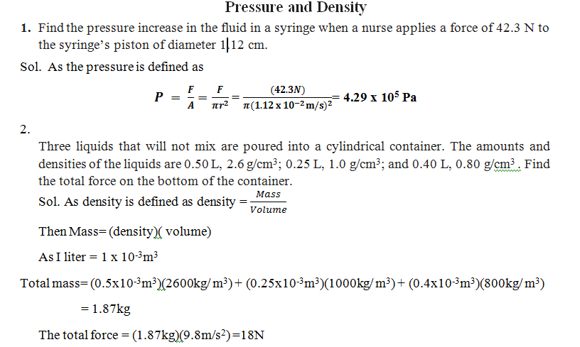

Slide 3
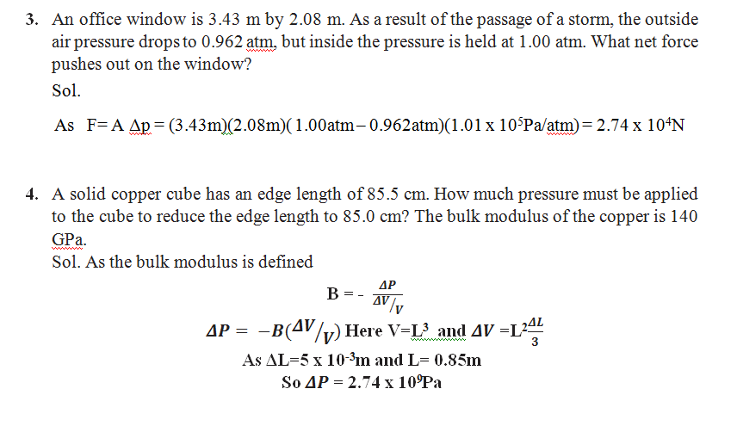

Slide 5
