Slide 1
Chapter 3
Computing and communication resources

Slide 2
Introduction
Computer resources include all the hardware and software and files that you can access over a network
The speed and cost of communications and computer processors impact the use of these resources
As prices continue to drop, the use of computers and communications will keep growing

Slide 3
Hardware
All general-purpose computers have the same types of components:
Processor
Memory
Storage
Input devices
Output devices
Larger computers typically have more and faster components than their microcomputer cousins

Slide 5
Processors
The processor (also called the central processing unit or CPU), controls the calculations and logical comparisons of data
Processors also control and direct the movement of data between different locations within a computer and over a network

Slide 6
Processor Characteristics
Processor Speed is measured by the number of processor cycles per second
Word Size is the measure of the size of the processor’s’ registers, or how many bits may be moved with one cycle of the processor. 32 bits or 64 bits are used as word size these days
A bit is a single value of zero or one
A byte is made of eight bits and each byte can store a single character
Processing power combines word size and processor speed. Improvements in processor circuitry also allows operations (such as addition, comparison of data values, and others) to be performed in fewer cycles

Slide 7
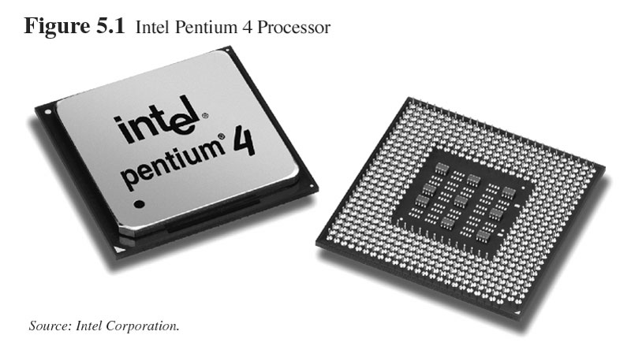
Intel Pentium 4 processor

Slide 8
Memory
Memory, also called primary storage, main memory or random access memory (RAM), refers to the storage area on the computer's circuit board (the “motherboard,” see Figure 5.2)
Microcomputers commonly have 128 to 256 megabytes (MB) of memory while many microcomputers can accommodate 2 gigabytes (2 billion bytes) of memory
Table 5.2 presents a table of byte, megabyte, gigabyte, terabyte, and petabyte conversions
Memory has become more abundant and faster in order to keep up with the more powerful processors
Table 5.3 briefly defines several types of memory

Slide 9
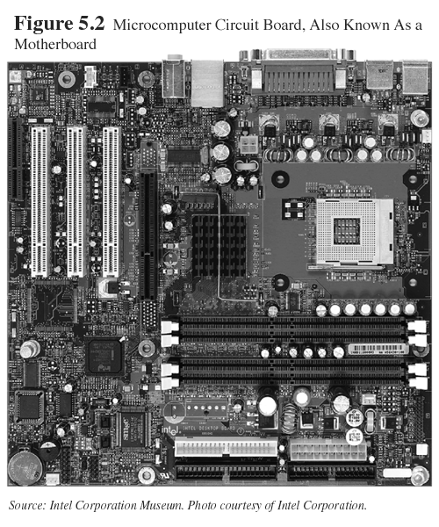

Slide 10
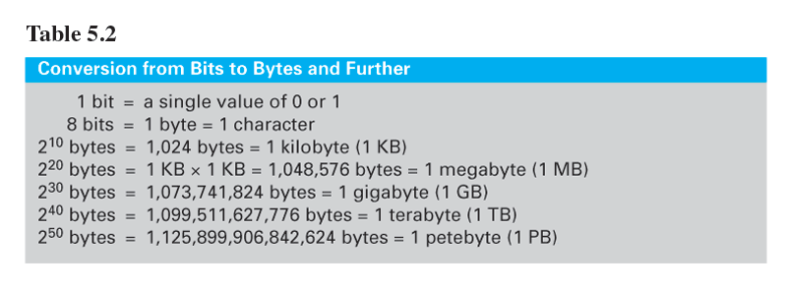

Slide 12
Storage
Storage for computers comes in the form of different media, each having different characteristics that make it better suited for certain tasks
Although the media types vary from large computers to small, the types have similar characteristics
Fixed Storage (=hard drive) refers to storage that is permanently installed in the computer (Figure 5.3)
Removable Storage can be removed from one computer and inserted in another. Table 5.4 lists types of removable disks and their capacities

Slide 13
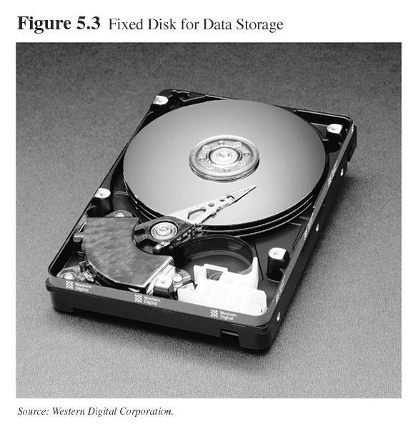

Slide 15
Input Devices
Human captured data refers to input captured by a person typing on a keyboard, clicking a mouse, touching a monitor, speaking into a microphone, or a similar interaction
Figures 5.4, 5.5, and 5.6, depict human-captured input
A bar code on products sold is an example of machine-readable data, that is used by point-of-sale terminals (POS)

Slide 16
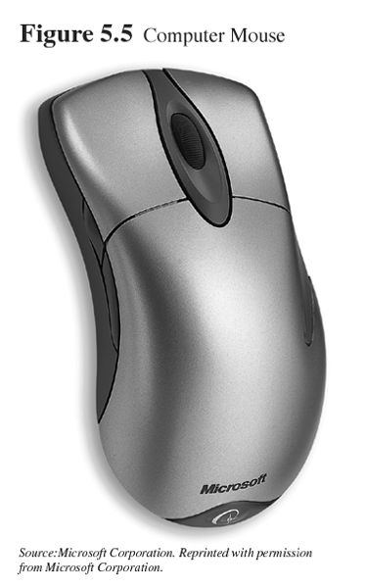
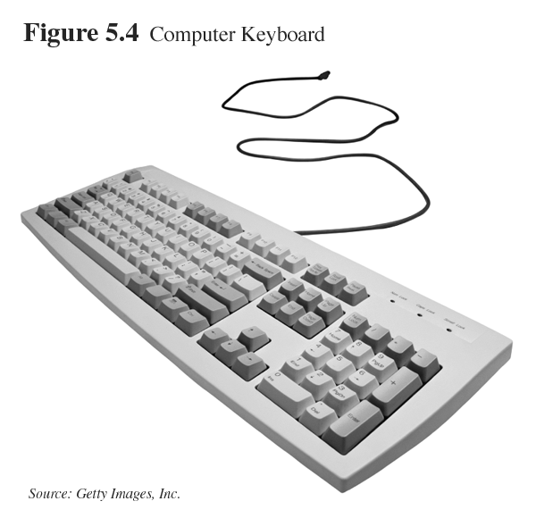
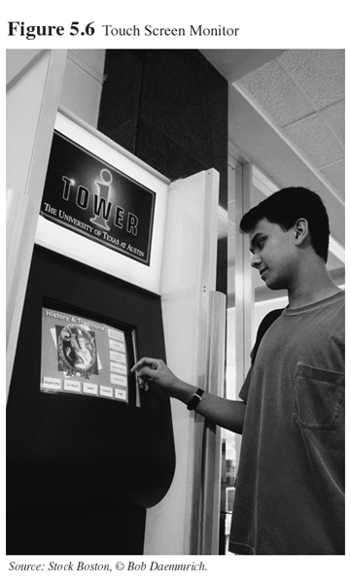

Slide 17
Output Devices and Multimedia
Output Devices
Two of the most familiar output devices are the computer screen, (=a monitor), and a printer
Multimedia
Input and output devices are evolving in the direction of multimedia, or the use of more than a single medium at a time; and also refers to the increased use of graphics and video

Slide 18
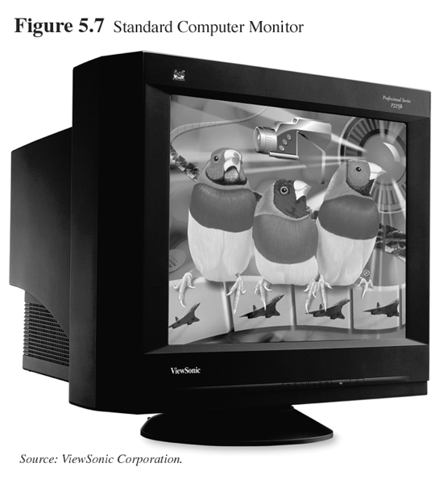
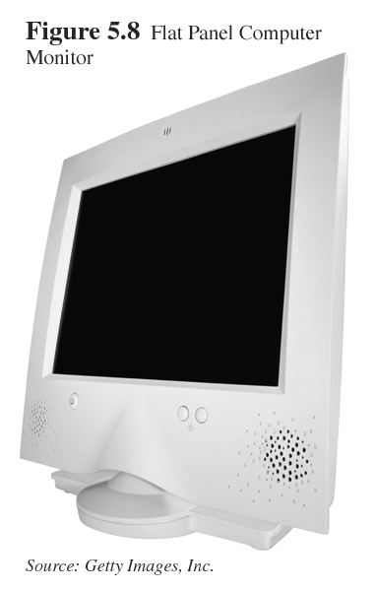

Slide 19
PERSONAL COMPUTING DEVICES
Today, personal computing is becoming associated with portable devices such as:
handheld PCs;
pocket PCs;
tablet PCs;
personal digital assistants (PDAs);
and cell phones with interactive messaging capabilities
Even wearable computing devices like those in Figure 5.9 are also beginning to appear

Slide 20
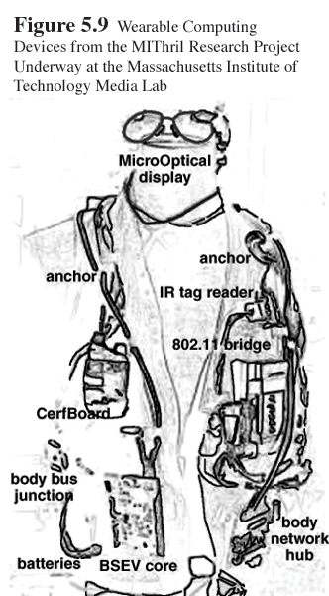

Slide 21
Tablets, Handheld and Pocket PCs
Personal computing devices (Figure 5.10) are rapidly coming together as a single product
Most use a version of Microsoft word processing, presentation, and spreadsheet software
Internet browser software, calendars, e-mail, and other software often also comes with these devices
Their key feature is mobility. Most are now manufactured with wireless network capabilities as well

Slide 22
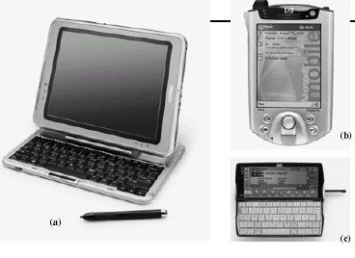
Figure 5.10 Examples of Personal Computing Devices: (a) Compaq Tablet PC-TC100 series; (b) iPAQ Pocket PC-h5450 Series; (c) hp Jornada 728 Handheld PC.

Slide 23
Personal Digital Assistants
Generally called PDAs, these devices are mainly used for personal organization tasks
Calendars, contact lists, and notes are features most people associate with PDAs
Fig. 5.11 shows some of the popular brands
PDAs are pocket size and have battery lives that last days to months without being recharged

Slide 24
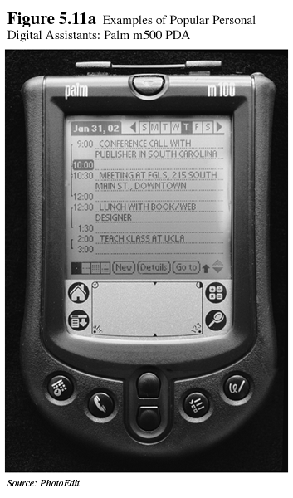
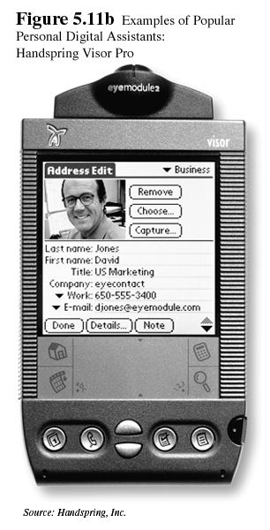
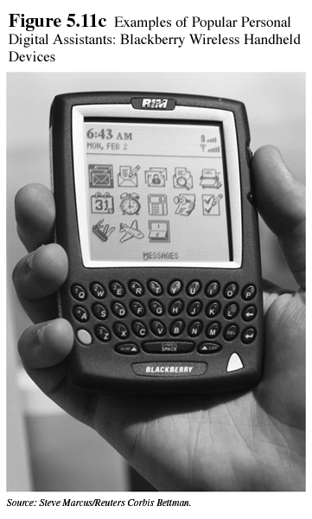

Slide 25
Cell Phones with Interactive Messaging
Cell phone manufacturers are now building an ability to display text messages and small images on their phone’s display screens, blurring the distinction between cell phones and PDAs
Current cell phones still only have a rudimentary computing capacity, however, and their keypad and display screens are limited as input and output devices
Cell phones acting as computer terminals will likely be the next step in the evolution of these devices

Slide 26
SOFTWARE
There are two basic types of software:
System software performs fundamental tasks that all users of a particular computer require
The operating system which manages the computer’s processes, functions as the interface connecting the user, the application software, and the hardware. It is the main form of systems software in use
Application software processes user’s data and can be obtained in a prewritten form or produced in a custom fashion for a particular user

Slide 27
Application Software
In the first generation of computers, programmers would enter a series of 0s and 1s into the computer’s memory to control its operations but this was very time-consuming
Programming languages (such as COBOL, C and C++, Java, and Visual Basic) were developed to provide an easier way to create and run a user application.
3GL were developed in conjunction with database programming applications to further simplify the task of programming.
A fourth generation language (4GL) is one that expresses what is to be done by the computer without explicitly defining how the tasks will take place

Slide 28
Prewritten Application Software
Prewritten application software, off-the-shelf software, is written and produced by suppliers and allows users to utilize software without either hiring programmers or learning how to program themselves
Prewritten software has two very important benefits over custom software:
It’s already written
It’s cheap

Slide 29
Custom Application Software
There are occasions when a business organization has operations that are unique
In such cases, the business may have its own programmers or hire a consulting group to write the application software it needs

Slide 30
The Role of User Friendly Software
Computer software that is simple and intuitive to use is said to be user friendly
This means the application has been carefully engineered to accommodate a wide range of users
Widespread use of computer-based resources is achieved when the application software is designed so that these users can apply their business expertise without special training

Slide 31
COMMUNICATIONS---PUBLIC TELEPHONE SYSTEM
The speed of data transmission between computers that takes place over public telephone systems is often slower than when computers are connected through dedicated networks
The wire making the connections is similar; yet most computer networks operate 100x faster than connections routed through the public telephone system because the protocols (the specification for formatting data to be transferred) were established for voice grade communication when the quality and speed of communication lines did not need to be high

Slide 32
Public Connections
Protocols for the public telephone system were established to meet the minimum criteria of voice transmissions - low grade analog transmissions - and that quality for voice communications is significantly below the needs of computer data transmission
The theoretical limit for telephone modems is 64kbps but because of technical requirements for administering the transmission, telephone modems have a top transmission speed of 56kbps
Data rates for other communications types are listed in Table 5.5

Slide 33
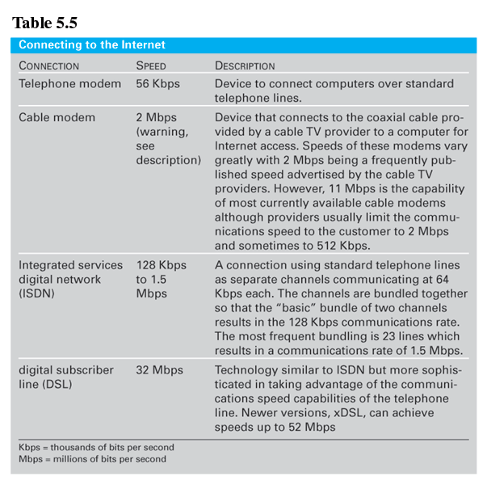

Slide 34
Private Lines
A private (leased or dedicated) line is a circuit that is always open to carry communication traffic
Provided by the common carrier, the telephone company, your organization pays a fixed monthly fee to use the line. The more use the line receives, the smaller the cost is per-unit of data transmitted

Slide 35
Virtual Private Network (VPNs)
VPNs give users the security and speed of a private line along with the low cost of using the Internet
Tunneling software establishes VPN through a set of intermediary locations that host the data while its being transmitted
Tunneling is conceptually similar to establishing a private, secure circuit while the data is being sent

Slide 36
COMMUNICATIONS - NETWORKS
The International Organization for Standardization (www.iso.ch), founded in 1946, established the Open Systems Interconnection (OSI) standard architecture for network connections.
OSI consists of a seven-layer model (Table 5.6) and the levels are detailed so that the exact function for each layer of communication can be plainly defined
Two or more levels may be used by a single piece of communications hardware, while end- to- end communications involve all layers of the model
Common networking devices are listed in Table 5.7.

Slide 39
Protocols for Computer Communication
Computers (“mainframes”) were initially designed to share data with terminals that had no storage or processor and to simply provide a means for entering and displaying data from the computer
In response to the communications limitation, IBM and others began developing communications protocols
An open protocol is a format whose specifications are open to the public and can be used at no cost

Slide 40
Proprietary Protocols
System Network Architecture (SNA), established by IBM as a proprietary protocol in 1974, requires a main host computer that polls other computers connected by the network in a sequence, much like taking turns
If a polled computer has data to send, the data is transferred, otherwise the next computer is polled
IBM was the first to develop a peer-to-peer protocol that allows each computer to act as its own controller, called Token Ring (Figure 5.12)
In token ring, a logical token is passed between computers. The computer with the token is the computer is in control of communications

Slide 41
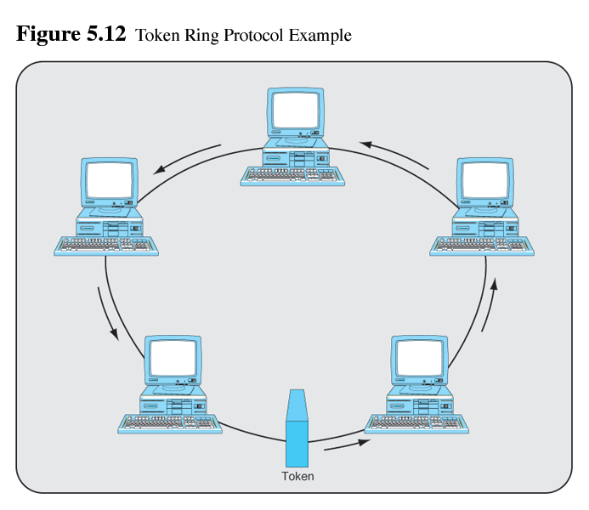

Slide 42
Ethernet
Xerox in cooperation with Intel and Digital Equipment Corporation, developed a different open protocol peer-to-peer communications architecture in the late 1970s called Ethernet
Unlike Token Ring, Ethernet works over a bus, rather than a ring and doesn’t use tokens
Instead, if a computer on the network wishes to send data over the communications medium it simply checks to see if data is currently being transmitted. If not, it sends its message

Slide 43
Packets
For large data transfers, messages need to be broken into smaller pieces so that the message from one computer does not dominate the communications medium
These smaller entities are called packets
The most important packet- switching protocol is the one used by the Internet, Transmission Control Protocol/Internet Protocol (TCP/IP)
TCP/IP handles packetization and also decides how the packets are best routed through the network from source to destination computer

Slide 44
Internet Network Addresses
In order to route packets through the network, each computer handling packets of data must have a unique address
This is called the IP address
IP addresses are made up of a set of four 1-byte numbers, each between 0 to 255, separated by periods
They are often written in dotted decimal notation, such as: 128.64.32.218
The left part of this number represents the number of the network the computer is on, while the right part is the host number of that specific computer

Slide 45
NETWORK TYPES
Understanding the different types of networks is important since plays a different role in a firm's communications strategy.
Different network types can effectively compartmentalize communications
Computers on local area networks are connected using devices called network interface cards (NICs).

Slide 46
Local Area Networks
A local area network (LAN) is a group of computers and other devices (such as printers) that are connected together by a common networking medium
LANs typically join together computers that are in physical proximity, such as in the same room or building
LANs can be connected together using one of three different configurations, called topologies (Figure 5.13)

Slide 47
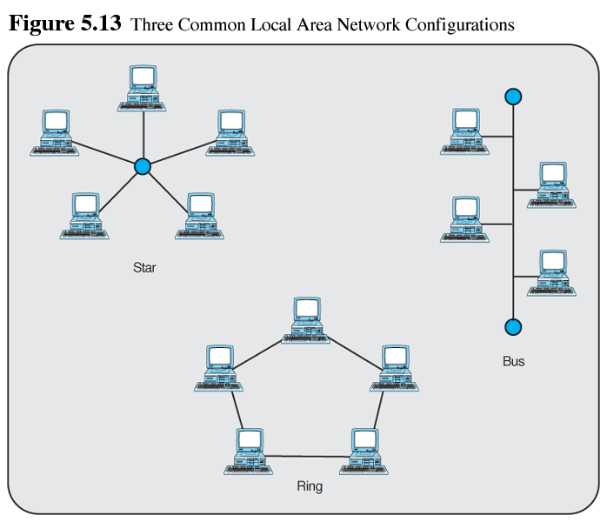

Slide 48
Metropolitan Area Networks and Wide Area Networks
A Metropolitan Area Network (MAN) is one that has a physical distance limit of roughly 30 miles and typically links several buildings of an organization together
Wide Area Networks (WANs) are used to connect computers and other devices when the distance exceeds constraints of LANs and MANs and uses the public telephone system. For practical purposes, WANs have been replaced by the Internet

Slide 49
Internet
The scale of interconnection is the difference between an internet and the Internet
An intranet uses the same network protocols as the Internet but limits accessibility to computer resources to a select group of persons in the organization
When an intranet is expanded to include users outside the firm it is called an extranet
Only trusted customers and business partners are allowed extranet access because this may allow access to proprietary corporate information

Slide 50
CONVERGENCE OF COMPUTING AND COMMUNICATIONS
Computing devices and communications devices are each incorporating features of the other into themselves
Some of the limits to the possibilities of convergence relate to battery life, communication speed and security, size of display and keyboard, and the user's imagination
The convergence process is now well underway, although it will take several years to complete

Slide 51
END OF CHAPTER 5

