Slide 1
Secrets Of The Best Levitation Shots

Slide 2
Levitation is one of the most exciting subjects in trick photography; it has inspired millions of people since its invention in the mid-19th century. The ability to harness the creative aspects of the photographer and combine it with real-life images has resulted in a combined revolution of art and science.

Slide 3
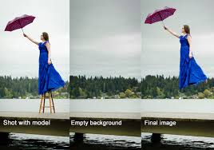

Slide 4
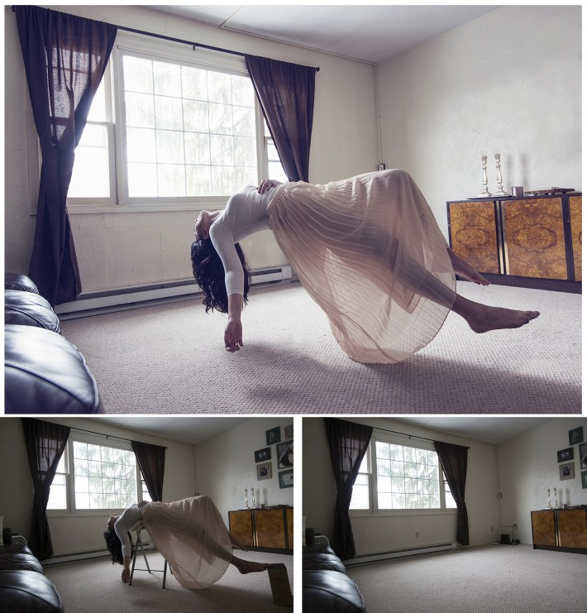

Slide 5
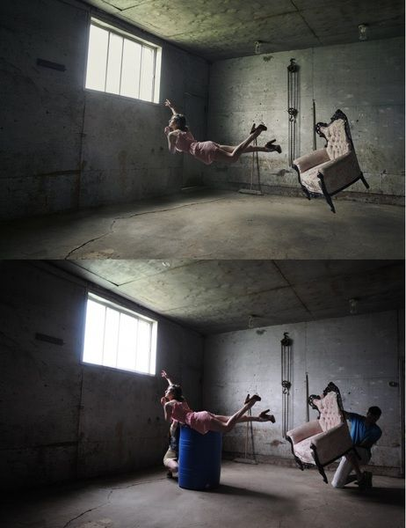

Slide 7
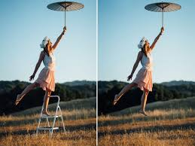

Slide 9
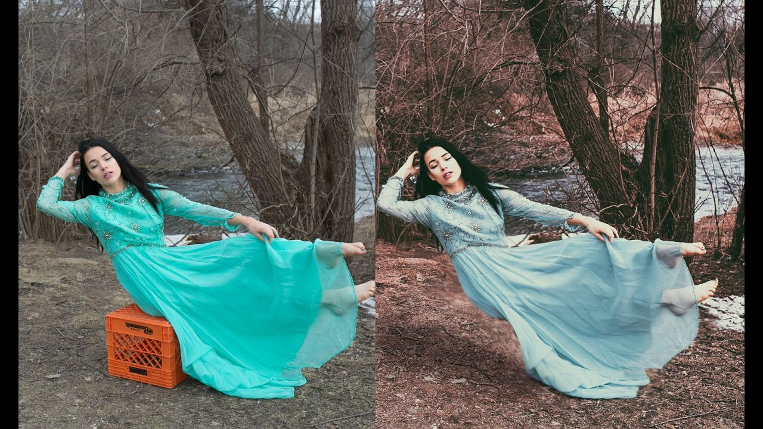

Slide 10
