Slide 1
BASIC TECHNIQUE IN CARDIAC SURGERY & COMMON PROCEDURES
DR ALLAH NAWAZ
MBBS(K.E),FCPS(PAK)
Consultant general & laparoscopic surgeon
Assistant Professor surgery
TSU DHQ Hospital (UOS)

Slide 9
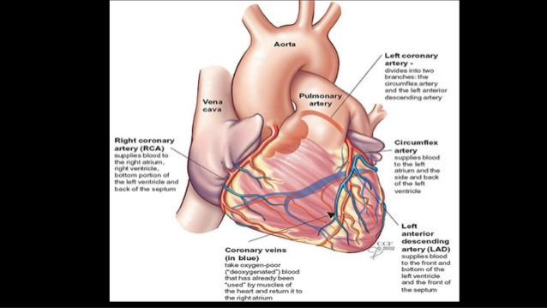

Slide 14
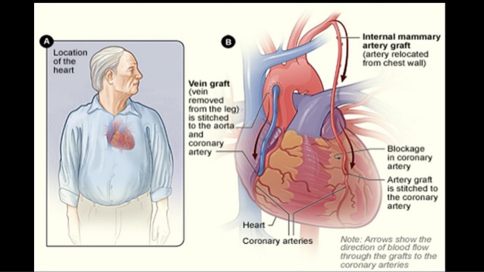

Slide 15
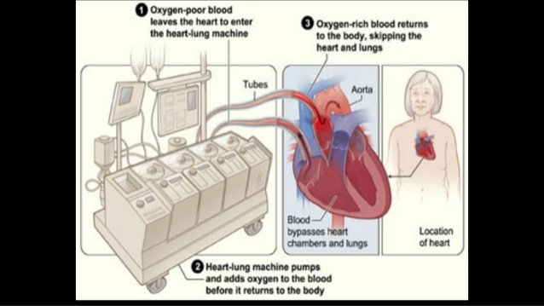

Slide 17
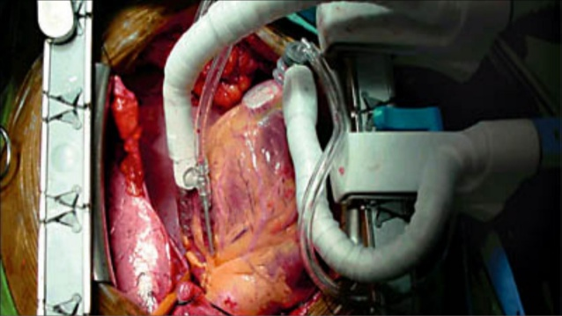

Slide 23
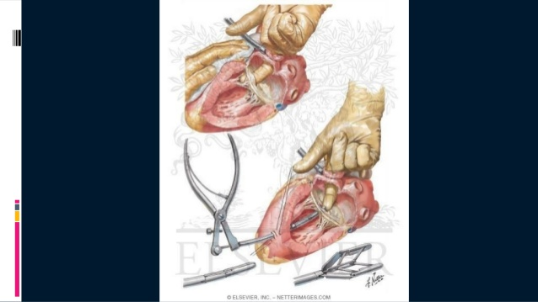

Slide 25
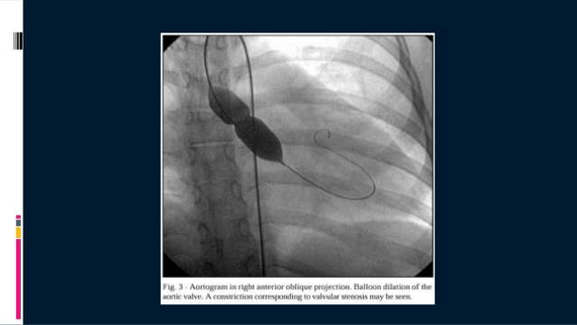

Slide 26
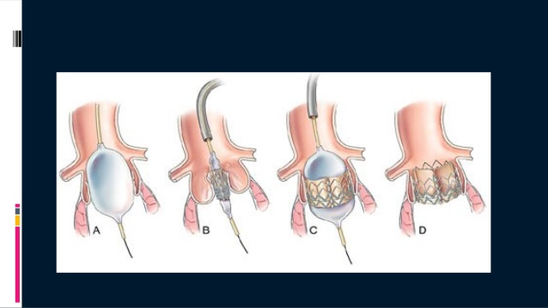

Slide 33
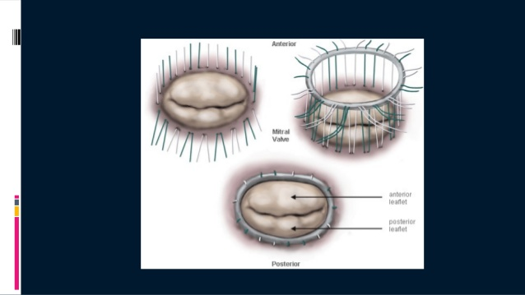

Slide 46
