Slide 1
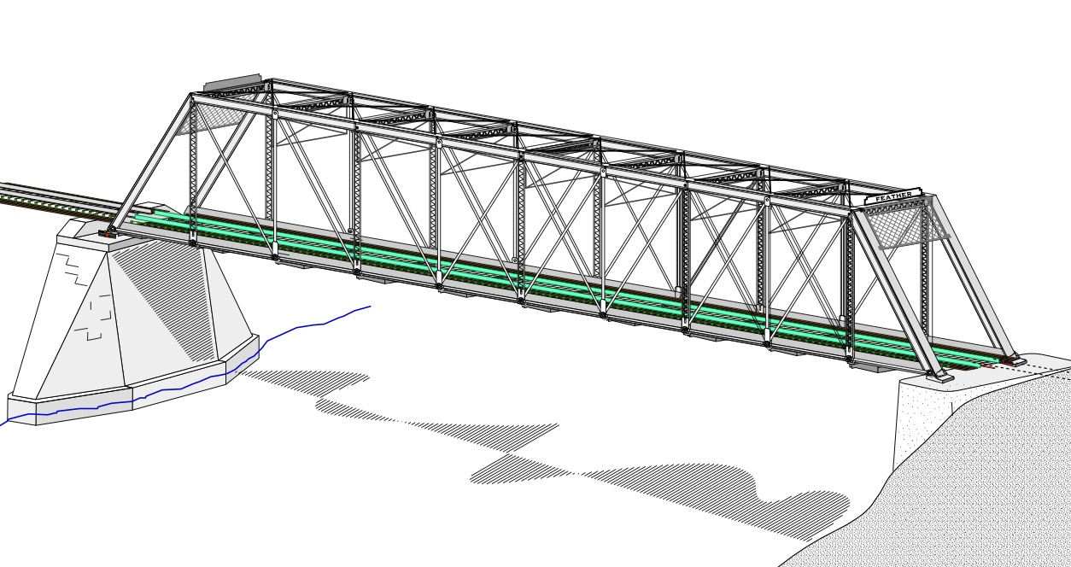
COLLEGE OF ENGINEERING AND TECHNOLOGY UNIVERSITY OF SARGODHA STEEL STRUCTURES (CT-313) (B.S TECHNOLOGY)
LECTURE-22, 23 & 24
COMPRESSION MEMBERS
Engineer Aqeel Ahmed
Lecturer, Civil Engineering Department
CET, UOS, Sargodha
04-12-2020

Slide 2
Compression Members
Structural members that are subjected only to axial compressive forces; the stress can be taken as . Where is considered to be uniform over the entire cross section.
This ideal state is never achieved in reality, however, because some eccentricity of the load is unavoidable.
Bending will result but it can be usually regarded as secondary and can be neglected if the theoretical loading conditions is closely approximated.
Bending can not be neglected if there is a computed bending moment. We consider this situation in “Beam-Columns”.

Slide 3
Compression Members…..
The most common type of compression member occurring in buildings and bridges is the column, whose primary function is to support a vertical loads.
Compression members are also used in trusses and as component of bracing systems.
Smaller compression members not classified as columns are sometimes referred to as struts.

Slide 4
Column Theory
Consider the long, slender compression shown in figure-4.1a.
If the axial load is applied slowly, it will ultimately become larger enough to cause the member to become unstable and assume the shape indicated by dashed line. The member is said to have buckled and the corresponding load is called the Critical Buckling Load.
If the member is stockier, as shown in figure-4.1b, a larger load will be required to the point of instability.
For extremely stocky members, failure may occur by compressive yielding rather than buckling. Prior to failure, the compressive stress P/A will be uniform at any point along the length, whether the failure is by yielding or by buckling.
The load at which buckling occurs, is a function of slenderness, and for very slender members this load could be quite small.

Slide 5
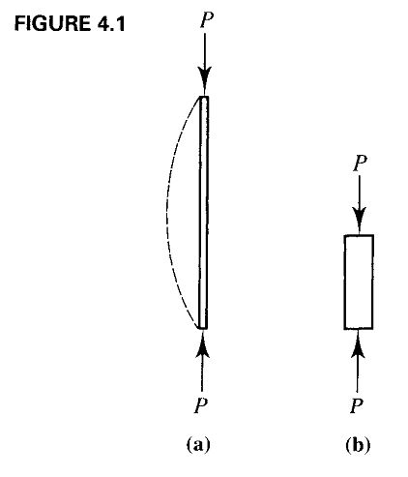

Slide 6
Radius of Gyration
It is defined as the distance from a given axis up to a point where the entire area is assumed to be concentrated.

Slide 7
Column Theory……….
If the member is so slender (we give a precise definition of slenderness shortly) that the stress just before buckling is below the proportional limit – that is the member is still elastic – the critical buckling load is given by:-
E = Modulus of elasticity of material
I = Moment of inertia of the cross-sectional area with respect to the minor principal axis
L = Length of the member between points of support

Slide 8
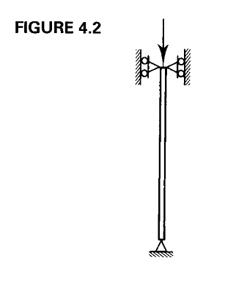
Column Theory……….
For Equation-4.1 to be valid, the member must be elastic and its ends must be free to rotate but not translate laterally.
This end condition is satisfied by hinges or pins as shown in figure-4.2.
This remarkable relation was first formulated by Swiss mathematician Leonhard Euler and published in 1759.
The critical load is sometimes referred to as Euler Load or the Euler buckling load.

Slide 10
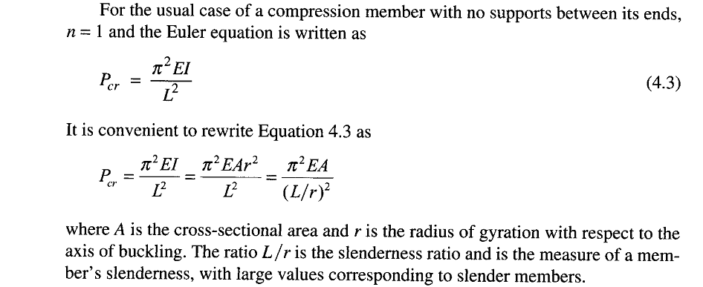
Column Theory……….
The values of n corresponds to different buckling modes ; n=1 represents the first mode, n=2 second mode and so on.
Values of n larger than 1 are not possible unless the compression member is physically restrained from deflecting at the points where the reversal of curvature would occur.

Slide 12
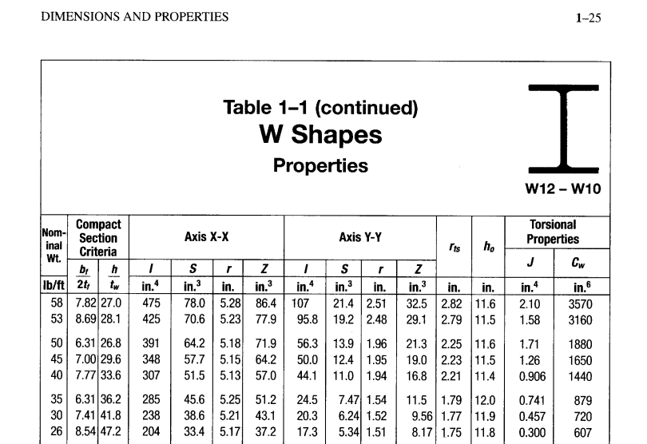

Slide 13
Column Theory……….
If the critical load is divided by the cross-sectional area, the critical buckling stress is obtained by:-
At this compressive stress, buckling will occur about the axis corresponding to r.
Buckling will take place as soon as the load reaches the value given by equation 4.3, and the column will become unstable about the principal axis corresponding to the largest slenderness ratio.
This axis usually is the axis with the smaller moment of inertia.
Thus the moment of inertia and radius of gyration of the cross-section should ordinarily be used in equations 4.3 and 4.4

Slide 14
Early researchers soon found out that Euler’s equation did not give reliable results for stocky, or less slender, compression members.
The reason is that smaller slenderness ratio for members of this type causes a large buckling stress, it can be seen from equation 4.4.
If the stress at which buckling occurs is greater than the proportional limit of the material, the relation between stress and strain is no longer linear and the modulus of elasticity E can no longer be used.
In Example 4.1, the stress at buckling is Pcr/A=278.9/14.6=19.10 Ksi, which is well below the proportional limit of any grade of structural steel.

Slide 15
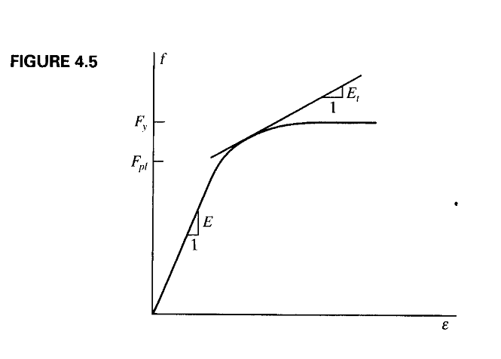

Slide 16
This difficulty was initially resolved by Friedrich Engesser, who proposed in 1889 the use of a variable tangent modulus, E_{t} in equation 4.3.
For a material with a stress-strain curve like the one shown in Figure 4.5, E is not a constant for stresses greater than the proportional limit Fpl.
The tangent modulus E_{t} is defined as the slope of the tangent to the stress-strain curve for values of f between Fpl and Fy. So the equation can be shown as equation 4.5
The equation 4.5 is identical to the Euler equation, except that E_{t} is substituted for E.

Slide 17
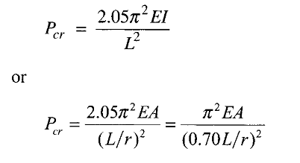
Effective Length
Both the Euler and tangent modulus equations are based on the following assumptions:
1. The Column is perfectly straight with no initial crookedness.
2. The Load is axial, with no eccentricity.
3. The Column is pinned at both ends.
• The first two conditions mean that there is no bending moment in the member before buckling.
For dealing with columns other than pinned end conditions, such as One end pinned and one end fixed as shown in figure-4.7. the Euler equation for this case can be derived as;

Slide 18
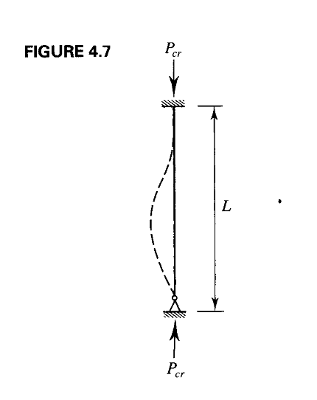
Effective Length…….

Slide 19
Effective Length
For convenience, the equations for buckling load will be written as:
Where KL is the effective length and K is the effective length factor.
The effective length factor for the fixed-pinned compression member is 0.70.
Values of K for these and other cases can be determined with the aid of Table C-C2.2 in the commentary of AISC Specification.

Slide 21
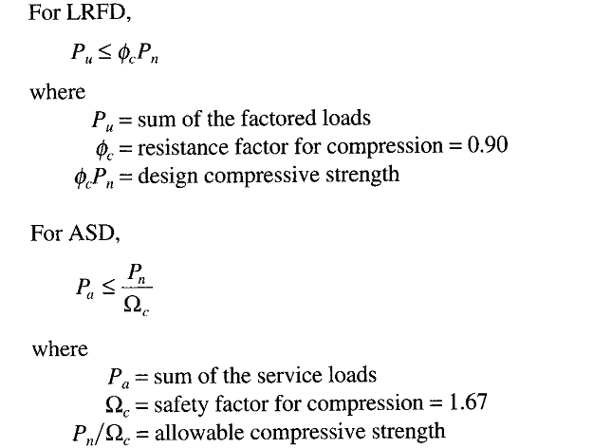
AISC Requirements

Slide 22
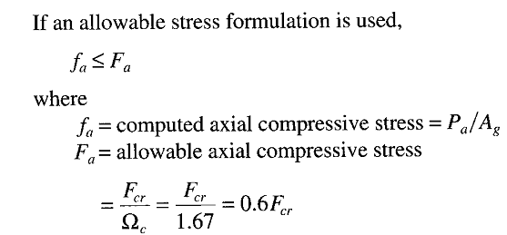
AISC Requirements………

Slide 23
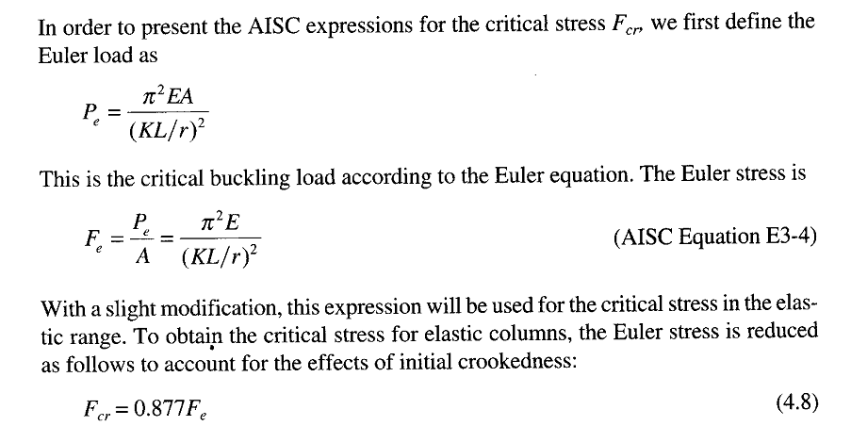
AISC Requirements………

Slide 24
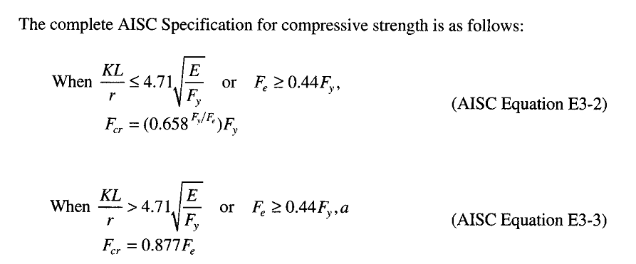
AISC Requirements……..

Slide 25
AISC Requirements……..

Slide 26
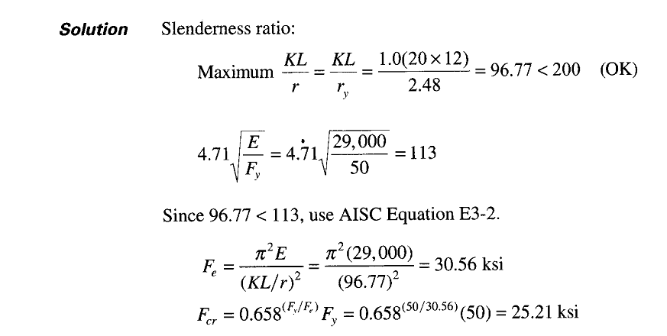

Slide 27
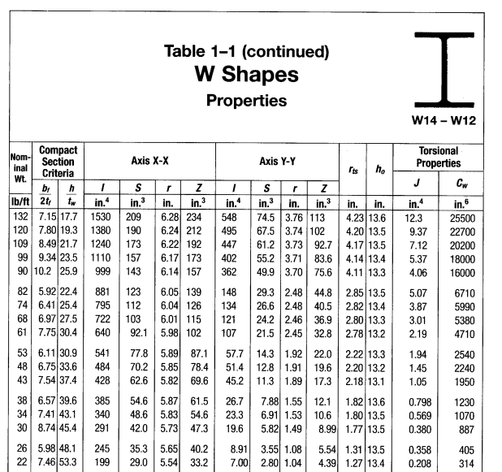

Slide 28
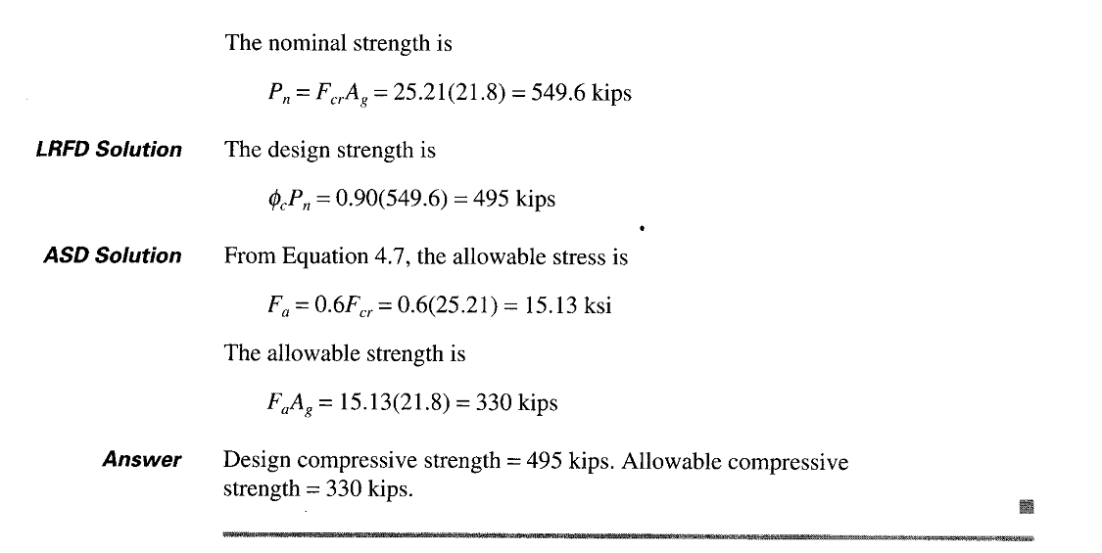

Slide 29
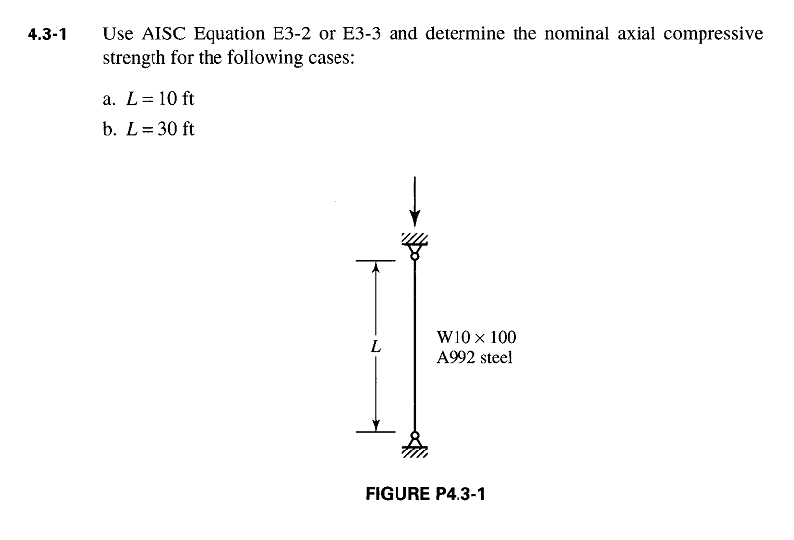

Slide 30
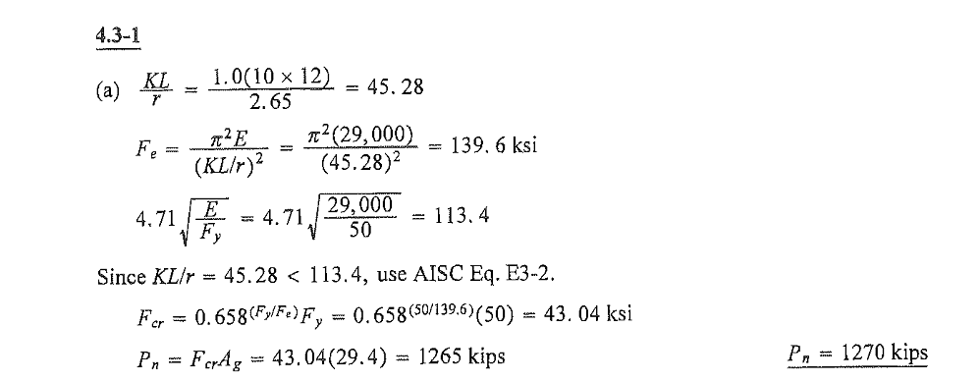

Slide 31
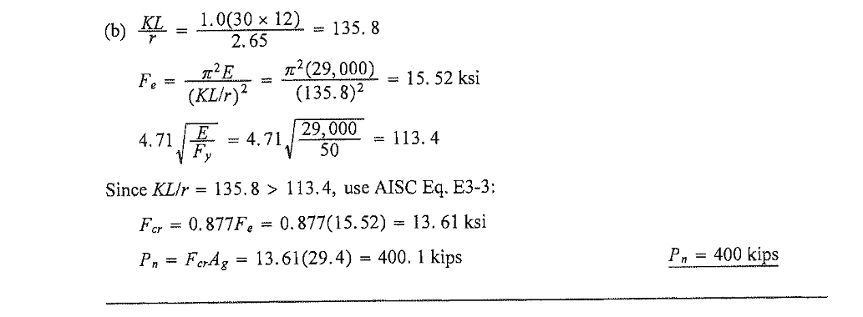

Slide 32
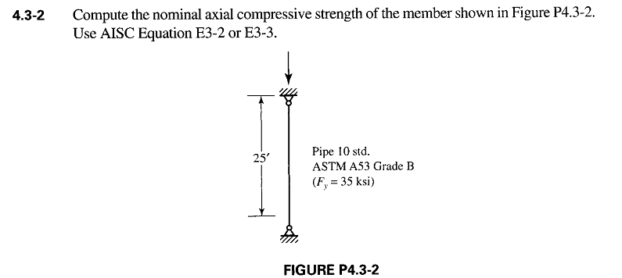

Slide 33
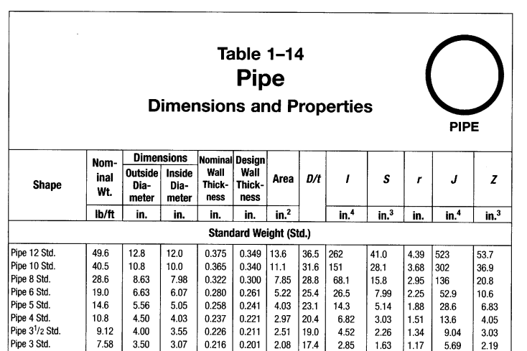

Slide 34
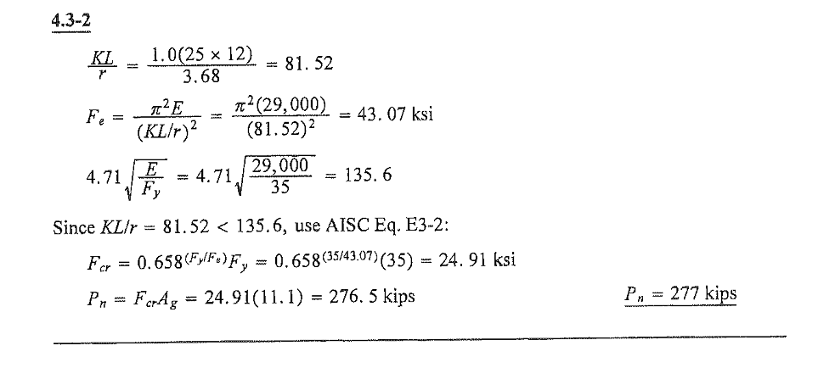

Slide 35
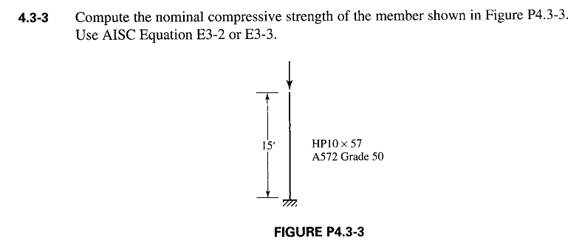

Slide 36
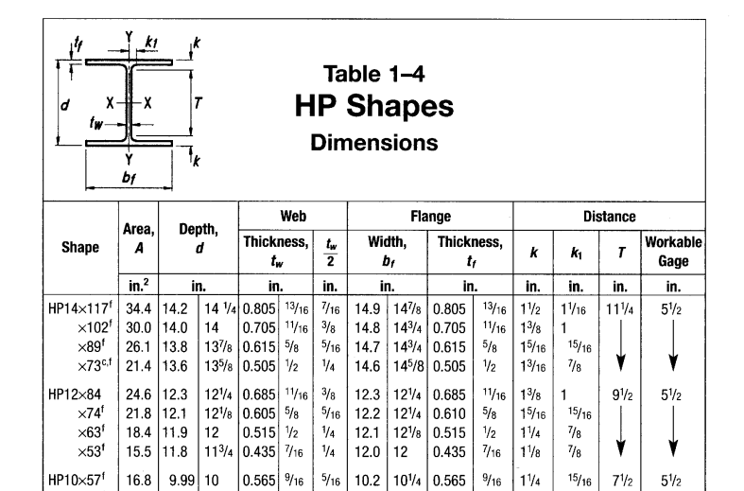

Slide 37
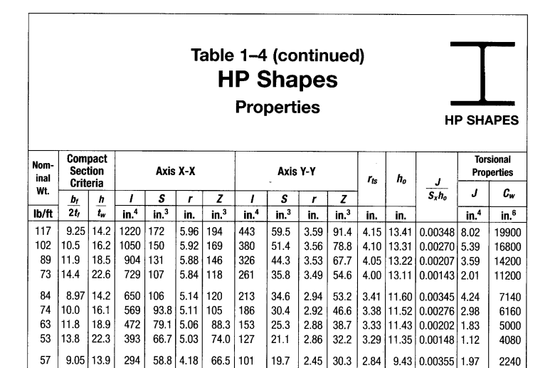

Slide 38
