Slide 1
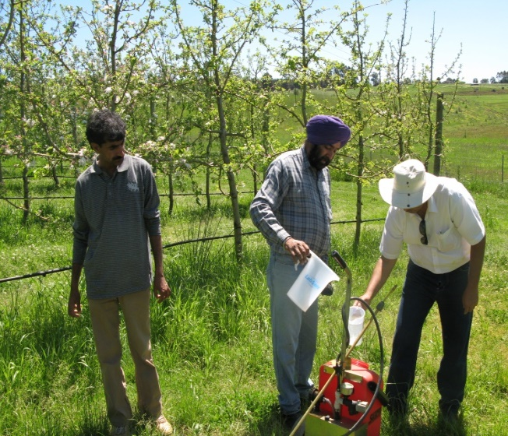
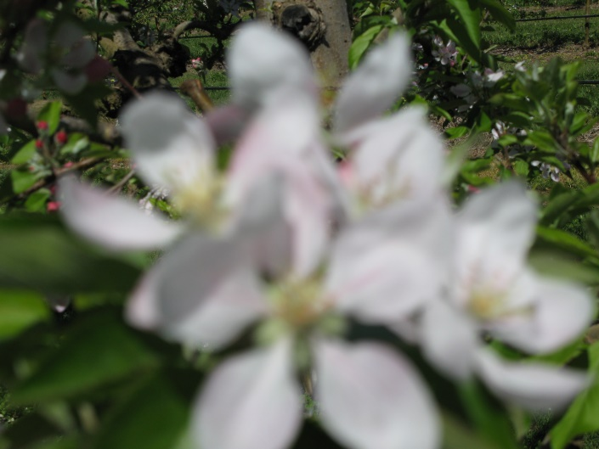
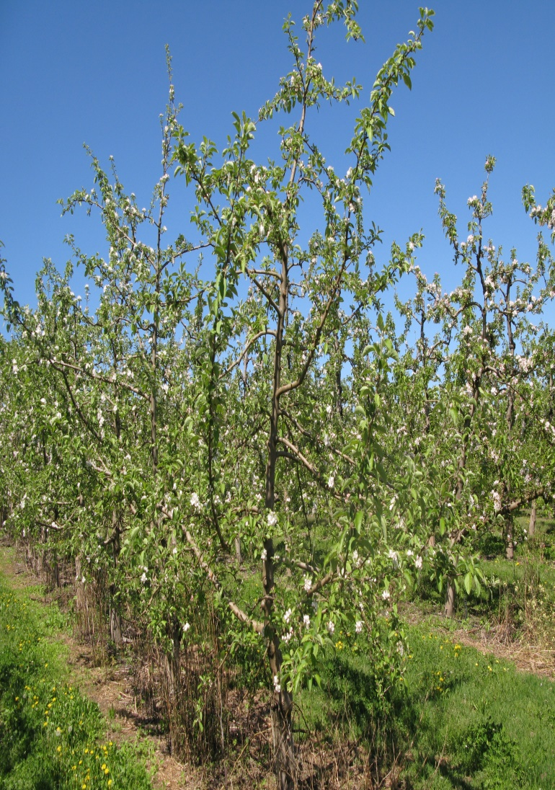
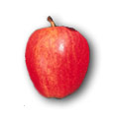
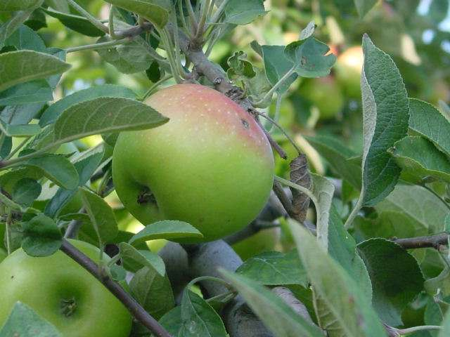
Apple

Slide 2
Apple
Family : Rosaceae
Sub-family: Pomoideae (other member pear and quince)
Botanical Name :
Pyrus : malus
Malus sylvestris
Malus malus

Slide 3
Family: Rosaceae
Sub-family: pomoideae
Pear and quince
The genus pyrus subdivided into
Malus and pyrophorum
Flower is perfect
5 sepal, petals and 5 carpels with 2 ovule
15-20 stamens
Tree is spreading , deciduous carries mixed buds which produced flowers and mostly spur-bearing leaves

Slide 4
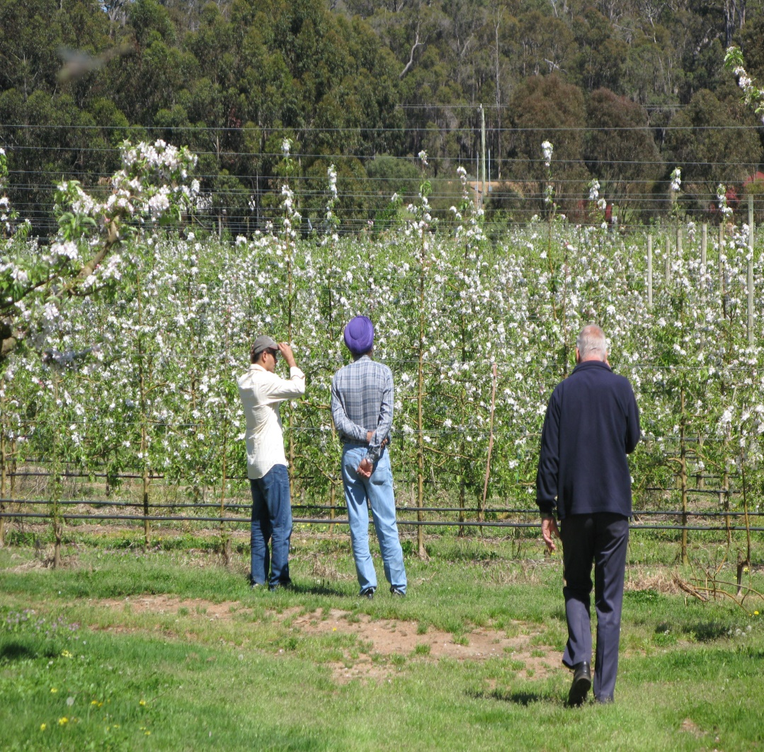
Apple trees
Apple trees can range in size from 6 to 30 feet in height, depending on the variety and type of rootstock (dwarf, semi-dwarf, etc.).

Slide 5
CLIMATE
1.TEMPERATURE
Apple is temperate fruit and generally grown in temperate region.
Apple tree require cool climate for their proper growth and development.
Apple are grown at climate which usually prevails at altitudes of 1700-2500 m
Less altitudes produced less and poor quality fruits

Slide 6
A certain minimum chilling period is needed for fruiting, in its absence the buds may not open or blossoming may be uneven. This chilling process takes place at temperature below 7ºc.
Most of the apple cultivars need to experience such temperature for about 1200 hours in order to achieve and complete and adequate rest while some varieties can manage with as little as 250 hours.

Slide 7
2. MOISTURE AND RAINFALL
Apple can grow in a wide range of rainfall from evenly spread rains of 25 to 37 cm (10-15//) per year to heavy seasonal rain fall of 125 to 175 cm (50-70//).
Where the rain fall is heavy, extensive drainage is required to prevent water logging. A certain minimum soil moisture is necessary for the proper growth and the development of the tree
Growing apples in arid climate will subject to continuous water stress and leads to low cropping capacity.

Slide 8
3. ALTITUDE
In Pakistan the apples can be grown at altitude ranging from 1350 to 2600 m.
The major advantage of planting an apple orchard at relatively lower altitude and in warmer areas is that the fruit is ready for market before the season and hence fetch a better price.
disadvantage is that the orchard will be prone to more insect and disease attacks, because insect and fungi multiply much faster in a warm climate.

Slide 9
5. FROST POCKETS
Site which is prone to frost must be avoided.
Spring frost, can cause very heavy damage to the apple crop.
It can kill or damage the blossoms or prevent the proper fertilization of the blossoms.

Slide 10
6. HAIL ZONES
Certain regions and areas are know to be hail zones which must be avoided while selecting a site for the orchards.
Hail can cause immense damage and there is no insurance against hail in Pakistan.
One heavy hail storm can reduce the value of crop up to 80% and render the entire crop fit only for processing.

Slide 11
WATER RESOURCE
Under normal circumstances, if the apple orchard is located on a site above 1800 m altitude, it requires a little irrigation. However, trees, which are planted at lower elevations or in areas which are prone to draught conditions or planted on sandy soils, may require irrigation.
Similarly dwarfing root stocks like M.9, M. 106,M.4 also prefer adequate moisture.

Slide 12
VARIETAL DEVELOPMENT
5000 to 6000 varieties
1. Golden Delicious 8. Kasmiri
2. Skyspur 9. Kandhari
3. Starking Delicious 10. Amri
4. Anna 11. Kala Kulu
5. Nugget 12. Red delicious
Double Red
labnon
7. Banki.

Slide 13
PLANTING GEOMETRY
Contour/Terrace system
^{Square system}
Distance 6-7 m
Wide spacing

Slide 14
PLANTING SEASONS
Spring
February-March
Autumn
September-October

Slide 15
PROPAGATION OF ROOT STOCK
Sexual Propagation
Crap apple (Pyrus baccata) is propagated through seeds and stooling in( May-June. Seeds are extracted and stored in cool dry place until December)
Seed are sown directly or indirectly
Started germinate in march
Other root stocks are M.1, M.7 & M.9

Slide 16
M.1 :
Outstanding root stock for
nursery performance
Vigorous on dry soil
M7:
Rapidly growing
Semi-dwarf
M9:
Heavy soil and
Dwarfing nature

Slide 17
Raising of Rootstock
Seed
Crab apple:
May and June
December
March
transplanted
Budded there by the next summer

Slide 18
Stooling
Mound layering
2 year old plant cut back to ground during spring
Shoot 10-15 cm hilled up the half the shoot
Process repeated 2 to 3 times until July
When shoots length are 45 cm or more
Many of shoots will produced roots by the following spring
Rooted shoot can be removed from the parent stool in early spring

Slide 20
Propagation of scion cvs
Cleft grafting
Whip or tongue grafting
Ring budding
Shield or “T” Budding
In Murree hills cleft grafting is used

Slide 21
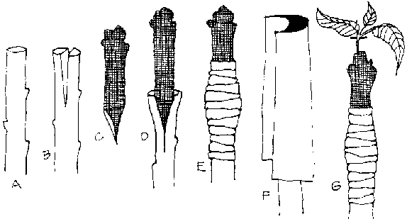
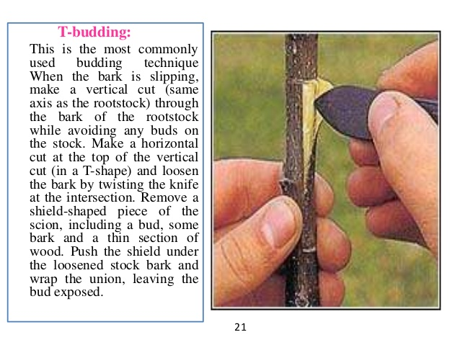
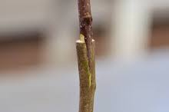

Slide 22
A Fertilizer REQUIREMENTS
Age | F.Y.M. Kg | Urea Kg | SSP Kg | SOP Kg
Pits formation | 20 | - | 2.5 | -
1 years | - | - | - | -
2 years | 10 | 0.25 | - | -
3 years | 10 | 0.33 | - | -
4 years | 15 | 0.50 | 1.50 | -
5 years | 20 | 0.75 | 1.50 | -
6-9 years | 20 | 2.00 | 2.00 | 1.0
10 year | 30 | 2.00 | 3.00 | 1.50
11&above | 40 | 2.50 | 5.00 | 2.00

Slide 23
P PRUNING OF APPLES
Enhances establishment of a strong, well-balanced framework
Mechanically strong, well-balanced framework of branches helps to constitute better management practices.
To insure a balance between vegetative vigor and the fruit fullness.
Improves light penetration and increases the set of interior fruit.
Increases soluble solids contents and improves rind color.

Slide 24
Forces the tree to produce new and productive fruitwood.
To treat of orchards suffering from neglect or injury.
Helpful in the treatment of diseases and recovery of trees.
Benefits spray operations by greater coverage.
Limiting tree height may make picking easier and less expensive.

Slide 25
PROBLEMS

Slide 26
Unfruitful fullness SELECTION OF POLLINIZER
Most apple varieties can not set fruit unless their flowers are cross pollinated with pollen of other compatible varieties. Such varieties are called self unfruitful
The lay out and number of pollinizer is an important part of orchard planning. Without adequate pollinizers the orchards remains unproductive and crop will be poor.
11, 15, 20, 25, 33 % pollinizers are being used in different parts of the world.
In India 25 % pollinizers are being used.

Slide 27
Quality of Pollinizers
The bloom time of the pollinizers and the variety must be the same.
The variety should be diploid.
The age and size of the pollinizers must be the same.
The pollinizers must be regular annual bearer.
The flowers of the pollinizers must be attractive for the bees.

Slide 28
Cross pollination by insect: Agent is honey bee
Suny day, 5000 flowers
rain, Temp lower than 8 ⁰C, Winds
Self pollinated cvs.
Baldwin, Grimes Golden, Rome beauty, cox’s orange and Pippen
Partially self-unfruitful:
Golden delicious, Jonathan, Gravenstein, Red delicious and stayman
Completely self unfruitful:
McIntosh, Gravenstein, red delicious and stayman winesap

Slide 29
HAIL STORMS
In Murree hills late spring frost hail storms are a serious threat for apple which are very common from flowering to harvesting damaging 95% of crop.
By the use of Nylon nets the hail storms affects can be minimized.

Slide 31
Damage by Hail Storms

Slide 32
INSECTS AND PESTS OF APPLE
Apple Lace Bug (Stephanities pyrioides).
Apple woody aphid, (Eriosoma Lanigerum).
Aphids, Aphis (spiraeecola).
San Jose Scale (Quadraspidiotus perniciosus).
Apple codling moth (Cydia Pomonella).
Tent catterpillar ( Malacosoma indicum)
Mite (Cenopalpus pulcher)

Slide 33
Codling moth
Destructive insect
Murree and Quetta
Damage the fruit with no sing on the fruit surface
Larvae burrow through the skin or calyx tube

Slide 34
DISEASES OF APPLE
Ripe rot (Rhizopus arrhizus)
Powdery mildew (Podocphaera leucotricha)
Sooty blotch ( Gloeodes pomigena ).
Apple scab (Venturia inaequalis)
Fire blight (Erwinia amylovora)
Root rot (Phytophothora cactorum)
White root rot (Rosellinia necatrix)

Slide 35
CAUSES OF LOW PRODUCTION
1. Low Organic Matter
2. Saline Soils
3. Uncertain weather conditions during flowering ( Fog, frost, Rains etc.)

Slide 36
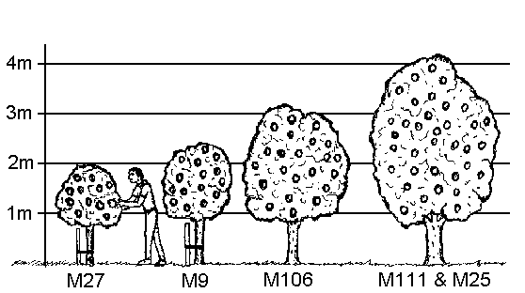
Comparative apple tree sizes using different rootstocks

Slide 37
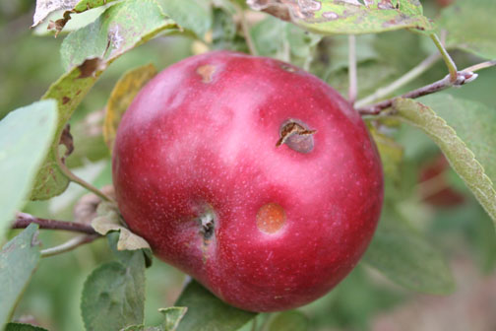
Hail Damage

Slide 38
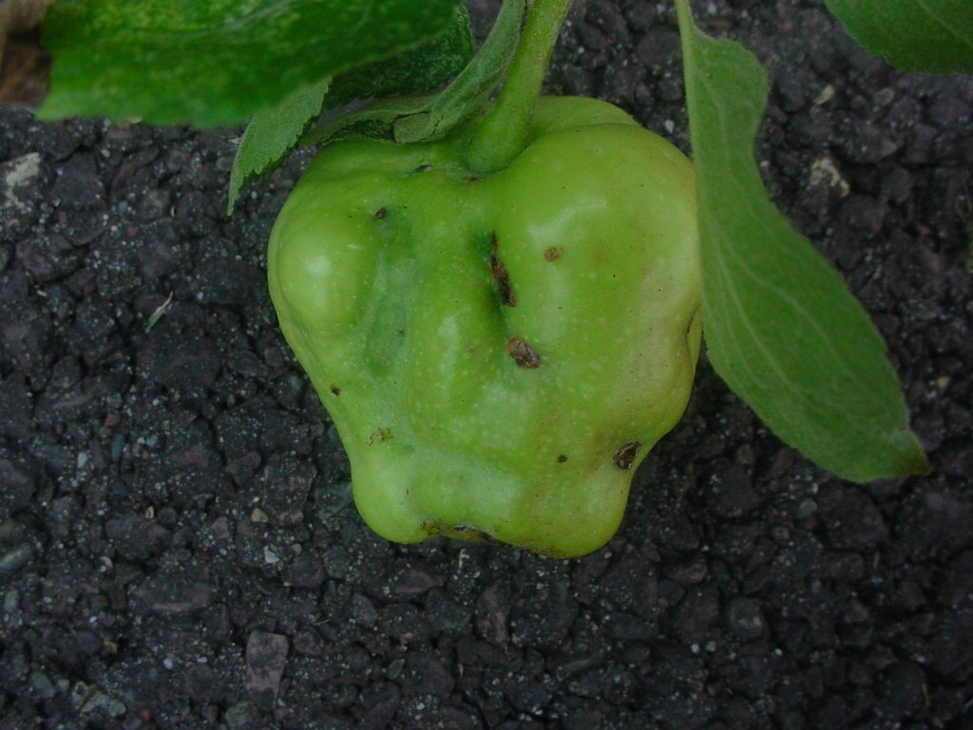
Hail Damage

Slide 39
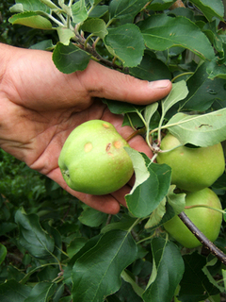

Slide 40
Cultivars 5000 to 6000 varieties
In Quetta Region
Kashmiri, kandhari, Amri, Kulu, Qalat special
In Murree hills
Delicious, Kashmir Amri, Banki, Golden Delicious, Red delicious, Sky Spur
Low chilling varieties
Tropical beauty, Enna, Ein Sheimer

