Slide 1
Defining Social Cognition
Social cognition involves:
The processes involved in perceiving other people and how we come to know about the people in the world around us.
It involves the study of these mental processes that involved in perceiving, remembering, thinking about, and attending to the other people in our social world.
Psychologists are interested in why we attend to certain information about the social world. how this information is stored in memory, and how it is then used to interact with other people.

Slide 2
The Role of Social Cognition
For example, imagine that you are getting ready to go on a blind date. Not only do you worry about the impression and signals that you are sending to the other person, you are also concerned with interpreting the signals given by the other individual. How do you form an impression of this person? What meaning do you read into the other person's behavior?
This is just one example of how social cognition influences a single social interaction, but you can probably think of many more examples from your daily life. We spend a considerable portion of every day interacting with others, which is why an entire branch of psychology formed to help understand how we feel, think and behave in social situations.

Slide 3
The Development of Social Cognition
Developmental psychologist study how social cognition develops over the course of childhood and adolescence. As children grow, they become more aware not only of their own feelings, thoughts, and motives but also of the emotions and mental states of others. As this awareness increases, children become more adept at understanding how others are feeling, knowing how to respond in social situations, engaging in prosocial behaviours , and taking the perspective of others.

Slide 4
Theories of cognation
There are many different theories that look at how social cognition develops, one of the most popular focuses on the work of the psychologist Jean Piaget. According to Piaget, a child's cognitive development goes through a series of stages.
During the earliest stages of development, children are very egocentric. They see the world from their own perspective and struggle to think about how other people may view the world.
As children grow older, children become increasingly adept at perspective-taking and have an increased ability to think about how and why people act the way they do in social situations.

Slide 5
Theory of mind
A theory of mind refers to a person's ability to understand and think about the mental states of other people. It is the emergence of a theory of mind that is critical to being able to consider the thoughts, motives, desires, needs, feelings, and experiences that other people may have. Being able to think about how these mental states can influence how people act is critical to forming social impressions and explaining how and why people do the things that they do.

Slide 6
Cultural Differences in cognation
Social psychologists have also found that there are often important cultural differences in social cognition. When looking at a social situation, any two people may have wildly different interpretations. Each person brings a unique background of experiences, knowledge, social influences, feelings, and cultural variations.
Some researchers have found that there are also collective, cultural influences that can affect how people interpret social situations. The same social behavior in one cultural setting may have a very different meaning and interpretation if it was to take place in another culture. As people interpret behavior, extract meaning from the interaction, and then act based upon their beliefs about the situation, they are then further reinforcing and reproducing the cultural norms that influence their social cognitions.

Slide 7
Meta cognition.
Metacognition is "cognition about cognition", "thinking about thinking", "knowing about knowing", becoming "aware of one's awareness" and higher-order thinking skills.
Metacognition is the awareness of one's thinking and the strategies one is using. It enables students to be more mindful of what they're doing (or learning) and why, and of how the skills they're learning might be used differently in different situations.

Slide 8
Three types of meta cognition.
>Declarative knowledge.
Declarative information is factual and involves knowing the concepts of a given task
>Procedural knowledge.
Procedural knowledge refers to information about how to apply metacognitive strategies.
>Conditional knowledge.
Conditional knowledge refers to knowing when and why to use declarative and procedural knowledge. It allows students to allocate their resources when using strategies. This in turn allows the strategies to become more effective.

Slide 10
Meta cognitive strateges
>Identifying one's own learning style and needs.
>Planning for a task.
>Gathering and organizing materials.
>Arranging a study space and schedule.
>Monitoring mistakes.
>Evaluating task success.
>Evaluating the success of any learning strategy and adjusting.

Slide 11
Meta cognition theories.
Metacognitive theories are theories that integrate one's knowledge about cognition and regulation of cognition. By “theory” we mean a relatively sys- tematic structure of knowledge that can be used to explain and predict a broad range of empirical phenomena

Slide 12
How does metacognition develop?
With greater awareness of how they acquire knowledge, students learn to regulate their behavior to optimize learning. They begin to see how their strengths and weaknesses affect how they perform. The ability to think about one's thinking is what neuroscientists call metacognition.

Slide 13
Regulation of cognition.
>Regulation of cognition refers to metacognitive activities that help control one’s thinking or learning
Three essamtial skills are needed for regulation.
1.Planning.
Planning involves the selection of appropriate strategies and the allocation of resources that affect performance. Examples include making predictions before reading, strategy sequencing, and allocating time or attention selectively before beginning a task (Miller, 1985).

Slide 14
Meta cognition regulation, cont.
2.Monitoring.
Monitoring refers to one’s on-line awareness of comprehension and task performance. The ability to engage in periodic self-testing while learning is a good example.
3.Evaluation.
Evaluation refers to appraising the products and regulatory processes of one’s learning. Typical examples include re-evaluating one’s goals and conclusions

Slide 15
Characteristics of meta cognitive theories.
>One primary characteristic of a metacognitive theory is that it allows an individual to integrate diverse aspects of metacognition within a single framework (cf. Kuhn, 1989).
>Second, metacognitive theories coordinate beliefs or postulates that allow individuals to predict, control, and explain their cognition, the cognition of others, or cognition in general (Flavell, 1992; Montgomery, 1992).

Slide 16
Types of meta cognitive theories.
We propose three different kinds of metacognitive theories: (a) tacit, (b) explicit but informal, and (c) explicit and formal. Henceforth, we refer to these as tacit, informal, and formal metacognitive theories

Slide 17
Tacit theories
Tacit theories are those acquired or constructed without any explicit awareness that one possesses a theory (McCutcheon, 1992).
Incremental Theory.
I An incremental theory in this framework is one in which the child believes that intelligence is malleable and subject to change through other- or self-directed processes.
It is tacit in the sense that many children do not spontaneously report holding a “theory of intelligence” even though they systematically express beliefs consistent with such a theory.

Slide 18
Perhaps the most salient aspect of a tacit metacognitive theory as opposed to an explicit one is that an individual is not readily aware of either the theory itself or evidence that supports or refutes it. Thus, tacit theories are not readily distinguished from, or tested against, relevant data (Kuhn, 1989; Moshman, 1979). To the extent that they remain tacit, metacognitive theories may be persistent even when they are false and maladaptive.

Slide 19
Informal theories.
>Informal theories often are fragmentary in that individuals are aware of some of their beliefs and assumptions regarding a phenomenon, but have not yet constructed an explicit theoretical structure that integrates and justifi es these beliefs.
>Informal theorists may have only a rudimentary awareness of their own metacognitive knowledge.
>Informal theories develop slowly and are affected by a number of social and personal infl uences on theorizing described later in this paper (Kuhn, 1989; Paris and Byrnes, 1989).

Slide 20
Difference.
>One important difference between tacit and informal theorists is that the latter possess some degree of explicit metacognition.
>It seems likely that simple informal theories begin as domain-specifi c entities (Kuhn et al., 1992; Paris and Byrnes, 1989) and gradually are generalized to other domains.
>Increasing the depth and breadth of metacognitive theories over time may allow informal theorists to better understand and direct constructive processes (Flavell et al., 1993; Montgomery, 1992).

Slide 21
Advantages.
>One distinct advantage of an informal metacognitive theory compared to a tacit one is that it enables individuals to reflect purposefully and systematically on their performance and, in turn, to use this information to modify or redirect their future performance and thinking (Kuhn et al., 1992).
>A second advantage of explicit theories is that individuals can begin to distinguish formal from empirical aspects, where the formal aspect refers to the structure and contents of the theory, and the empirical aspect refers to data that the theory attempts to explain (Hergenhahn and Olson, 1993).

Slide 22
A third advantage of explicit theories is that distinguishing the structure of one’s metacognitive theory from evidence that supports or refutes it is a necessary step in the development of more sophisticated theories.
For example,
Reich, Oser, and Valentin (1994) have argued that knowledge about the knowing process develops in a predictable sequence in which individuals fi rst become aware of changes in their beliefs, develop reasons for these changes, and fi nally attempt to explain these changes in terms of a lay theory of mind.

Slide 23
Formal theories.
Formal theories consist of highly systematized accounts of a phenomenon involving explicit theoretical structures such as those encountered in university classes in physics, music, or statistics.
it is unclear what constitutes a formal metacognitive theory of one’s cognition. One possible example of a formal metacognitive theorist is the Good Strategy User as described by Pressley et al. (1987).
The metacognitive knowledge of the Good Strategy User is not only integrated and explicit, but in some individuals (e.g., professional educators) may constitute a formalized theoretical structure involving a set of postulates that can be used to test and evaluate one’s metacognitive knowledge.

Slide 24
formal theorists possess some explicit awareness of the constructive nature of theorizing and engage in purposeful efforts to construct and modify metacognitive theories (Kuhn et al., 1992; Paris and Byrnes, 1989).
ADVANTAGE
One potential advantage of a formal metacognitive theory is that it allows the individual to make informed choices about self-regulatory behaviors. Reich et al. (1994, p. 168) refer to individuals who make such choices as “producers of their own development.”

Slide 25
TWO NECEESSORY SKILLS
One is the ability to clearly distinguish and coordinate the formal and empirical aspects of a theory. Formal theorists understand that the formal and empirical aspects of a theory are conceptually independent of each other even though each can be used to evaluate the adequacy of the other.
>A second skill is the ability to evaluate and interpret the meaning of empirical evidence apart from the formal aspects of one’s theory

Slide 26
SUMMARY.
>We have proposed three types of metacognitive theories and considered how each differs from the others.
>These theories form a naturally occurring hierarchy of knowledge about cognitive and metacognitive processes.
>At one end of this continuum are tacit theories, which provide limited guidance and explanatory power.
>These theories are characterized by loosely systematized knowledge and postulates that are not known consciously by the theorist.

Slide 27
>Informal theories are partially accessible to the theorist and presumably play a greater role in self-regulation. Formal theories provide an explicit framework for understanding and regulating one’s cognition. Moreover, because their formal and empirical aspects are explicitly distinguished, they are more subject than informal theories to purposeful and rigorous evaluation.

Slide 28
Self efficacy
Def: Psychologist Albert Bandura has defined self-efficacy as one's belief in one's ability to succeed in specific situations or accomplish a task. One's sense of self-efficacy can play a major role in how one approaches goals, tasks, and challenges.

Slide 29
Con
Self-Efficacy Theory
Self-efficacy beliefs are an important aspect of human motivation and behavior as well as influence the actions that can affect one's life.
self-efficacy, Bandura (1995) explains that it "refers to beliefs in one's capabilities to organize and execute the courses of action required to manage prospective situations“
Self-efficacy has been thought to be a task-specific version of self-esteem (Lunenburg, 2011)

Slide 30
The basic principle behind Self-Efficacy Theory is that individuals are more likely to engage in activities for which they have high self-efficacy and less likely to engage in those they do not (Van der Bijl & Shortridge-Baggett, 2002)
According to Gecas (2004), people behave in the way that executes their initial beliefs; thus, self-efficacy functions as a self-fulfilling prophecy.
For example, Employee A has high ability and a great deal of experience in creating graphs, but does not have confidence that he can create a high quality graph for an important conference. Employee B has only average ability and only a small amount of experience in creating graphs, yet has great confidence that she can work hard to create a high quality graph for the same conference. Because of Employee A's low self-efficacy for graph creation, he lacks the motivation to create one for the conference and tells his supervisor he cannot complete the task. Employee B, due to her high self-efficacy, is highly motivated, works overtime to learn how to create a high quality graph, presents it during the conference, and earns a promotion.

Slide 31
Self-efficacy has influence over people's ability to learn, their motivation and their performance, as people will often attempt to learn and perform only those task for which they believe they will be successful (Lunenburg, 2011).

Slide 32
Judgments of self-efficacy are generally measured along three basic scales:
Self-efficacy magnitude measures the difficulty level (e.g. easy, moderate, and hard) an individual feels is required to perform a certain task (Van der Bijl & Shortridge-Baggett, 2002). How difficult is my class work? Are the quizzes easy or hard?
Self-efficacy strength refers to the amount of conviction an individual has about performing successfully at diverse levels of difficulty (Van der Bijl & Shortridge-Baggett, 2002). How confident am I that I can excel at my work tasks? How sure am I that I can climb the ladder of success?
Generality of self-efficacy refers to the "degree to which the expectation is generalized across situations (Lunenburg, 2011). How sure am I that what I have learned will apply to my new tasks?

Slide 33
The basic idea behind the Self-Efficacy Theory is that performance and motivation are in part determined by how effective people believe they can be (Bandura, 1982; as cited in Redmond, 2010). The theory is clearly illustrated in the following quote by Mahatma Gandhi
"If I have the belief that I can do it, I shall surely acquire the capacity to do it even if I may not have it at the beginning" - Mahatma Gandhi

Slide 34
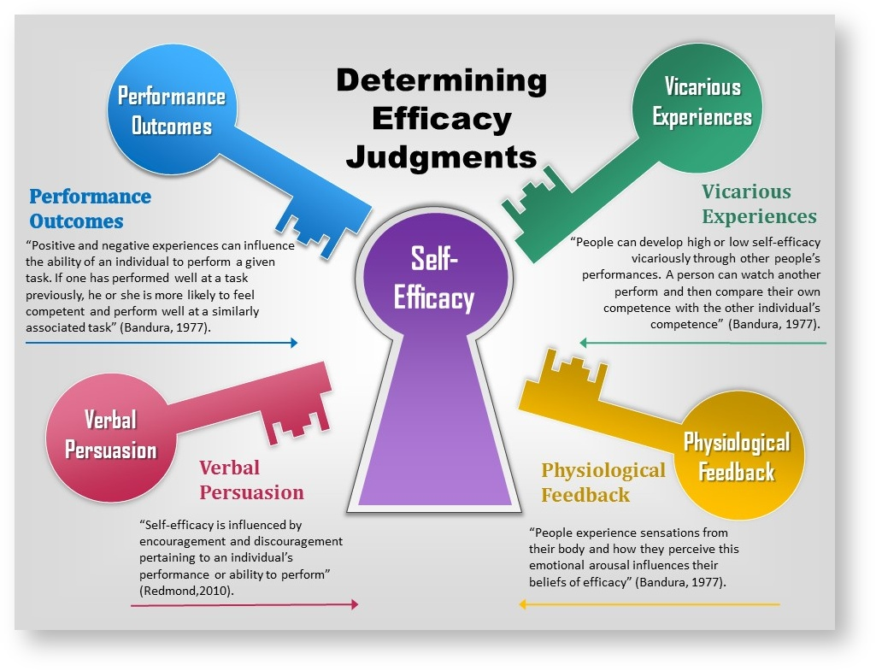

Slide 35
VEI Theory
VIE theory - The expectancy theory, also known as the VIE (expectancy, instrumentality, and valence) theory, is based on the beliefs that an individual’s effort will lead to performance, which in turn, will lead to a specific outcome. Comprehensively, self-efficacy is based on an individual’s belief about their ability to perform specific behaviors. Expectancy theory explores how rewards affect motivation, whereas self-efficacy explores how beliefs about capabilities affect motivation. According to Bandura (1997), “People take action when they hold efficacy beliefs and outcome expectations that make the effort seem worthwhile.

Slide 36
The Role of Social Cognition
For example, imagine that you are getting ready to go on a blind date. Not only do you worry about the impression and signals that you are sending to the other person, you are also concerned with interpreting the signals given by the other individual. How do you form an impression of this person? What meaning do you read into the other person's behavior?
This is just one example of how social cognition influences a single social interaction, but you can probably think of many more examples from your daily life. We spend a considerable portion of every day interacting with others, which is why an entire branch of psychology formed to help understand how we feel, think and behave in social situations.

Slide 37
They expect given actions to produce desired outcomes and believe that they can perform those actions." To successfully achieve the desired outcome, individuals must possess the necessary skills as well as a buoyant self-belief that they are capable of controlling the specific situational factors (Bandura, 1989). People with high self-efficacy are more likely to respond with renewed effort (expectancy) when feedback shows that they are not reaching their goals by developing more successful strategies (Smith, et al., 2005). However, individuals with low self-efficacy, given the same circumstances, may perform poorly because their low self-efficacy impairs their motivation and effort. For example, an employee with high self-efficacy and ability for performing a job, but low self-efficacy for training a new employee will most likely be an inadequate trainer. On the whole, perceived self-efficacy can be distinguished as being competence-based, prospective, and action-related as opposed to related ideas that only share some these elements (Bandura, 1997).

Slide 38
Equity theory
Self-efficacy theory utilizes an important construct of equity theory. Like equity theory, motivation can be influenced by how an individual perceives themselves when compared to another. The difference between the two theories is that equity theory illustrates that an individual's motivation is influenced by the perceived equality of input/output ratios of the comparison-other, where in contrast, self-efficacy theory predicts that an individual's motivation can be influenced by the positive/negative vicarious experiences of the comparison-other. In truth, both theories have been proven to be correct.

Slide 39
Theory of Planned Behavior
According to the Theory of Planned Behavior (TPB; Ajzen, 1991 xClose Ajzen, I. (1991). The theory of planned behavior. Organizational Behavior and Human Decision Processes, 50, 179-211. ), intention is the most proximal predictor of behavior. Cognitions that affect a specific intention are attitudes, subjective norms, and perceived behavioral control (perception about being able to perform a specific behavior). A typical item to assess perceived behavioral control is, "It is easy for me to do xy." Self-efficacy and behavioral control are seen as almost synonymous constructs. However, self-efficacy is more precisely related to one's competence and to future behavior.

Slide 40
the Transtheoretical Model
According to the Transtheoretical Model (TTM; Prochaska, Norcross, Fowler, Follick, & Abrams, 1992 xClose Prochaska, J. O., Norcross, J. C., Fowler, J., Follick, M. J., & Abrams, D. B. (1992). Attendance and outcome in a worksite weight control program: Processes and stages of change as process and predictor variables. Addictive Behaviors, 17, 35-45. ), self-efficacy and perceived positive ("pros") and negative ("cons") outcomes are seen as the main social-cognitive variables that change across the stages. Self-efficacy is typically low in early stages and increases when individuals move on to the later stages. For a critical discussion of this model, see Sutton (2005) xClose Sutton, S. (2005). Stage theories of health behavior. In M. Conner & P. Norman (Eds.), Predicting health behaviors. (2nd ed., pp. 223-275). Maidenhead, England: Open University Press. and West (2005) xClose West, R. (2005). What does it take for a theory to be abandoned? The transtheoretical model of behaviour change as a test case. Addiction, 100, 1048-1050. .

Slide 41
The Health Action Process Approach
The Health Action Process Approach (Schwarzer, 1992 xClose Schwarzer, R. (1992). Self-efficacy in the adoption and maintenance of health behaviors: Theoretical approaches and a new model. In R. Schwarzer (Ed.), Self-efficacy: Thought control of action (pp. 217-243). Washington, DC: Hemisphere. , 2001 xClose Schwarzer, R. (2001). Social-cognitive factors in changing health-related behavior. Current Directions in Psychological Science, 10, 47-51. ) argues for a distinction between (a) preintentional motivation processes that lead to a behavioral intention and (b) post-intentional volition processes that lead to actual health behavior. In the motivation phase, one needs to believe in one's capability to perform a desired action ("I am capable of initiating a healthier diet in spite of temptations"), otherwise one will fail to initiate that action. In the subsequent volition phase, after a person has developed an inclination toward adopting a particular health behavior, the "good intention" has to be transformed into detailed instructions on how to perform the desired action. Self-efficacy influences the processes of planning, taking initiative, maintaining behavior change, and managing relapses (see Luszczynska & Schwarzer, 2003 xClose Luszczynska, A., & Schwarzer, R. (2005). Multidimensional health locus of control: Comments on the construct and its measurement. Journal of Health Psychology, 10, 633-642. ; Marlatt, Baer, & Quigley, 1995 xClose Marlatt, G. A., Baer, J. S., & Quigley, L. A. (1995). Self-efficacy and addictive behavior. In A. Bandura (Ed), Self-efficacy in changing societies (pp. 289-315). New York: Cambridge University Press. ). For a critical discussion, see Sutton (2005)

Slide 42
Self-efficacy reflects confidence in the ability to exert control over one's own motivation, behavior, and social environment. an individual's belief in his or her capacity to execute behaviors necessary to produce specific performance attainments (Bandura, 1977, 1986, 1997)
Self Efficacy.

Slide 43
Self confident clients in intervention programs were less likely to relapse to their previous unhealthy diets (Bagozzi & Edwards, 1998; Brug, Hospers, & Kok, 1997; Fuhrmann & Kuhl, 1998; Gollwitzer & Oettingen, 1998). Adolescents with substance abuse, anxiety, and conduct disorder, diagnostic combinations were found to have significantly lower self-efficacy scores across all the SCQ subscales. Sitharthan, Soames Job, Kavanagh, Sitharthan, and Hough (2003).
Biological perspective .

Slide 44
Nicotine abstinence of self-quitters depends on various demographic, physiological, cognitive and social factors, but only a few factors are common predictors of maintaining abstinence. These are physiological factors, such as lower nicotine dependence, longer duration of previous abstinence, and, as a cognitive factor, high perceived smoking cessation self-efficacy (see Ockene et al., 2000). People with low self efficacy shows higher score on diabetes,high blood pressure, anxiety and depression. (Grossmann, Brink, & Hauser, 1987).

Slide 45
Self efficacy theory is also called social cognition theory or social learning theory. If you are confident of being able to do a any perticular task ,it means you have high self efficacy. People with high self efficacy have more chances of goal acheivement. The higher your self efficacy, the more confidence you have in your ability to succeed a task.
Self efficacy theory .

Slide 46
Low self efficacy high self efficacy fear of failure no fear of failure less confident more confident less successful more successful low coping abilities high coping ability more chances of give up never give up may quit a task keep trying accept failure never accept failur
Difficult situation

Slide 47
This theory states that Specific and difficult goals, with feedback , lead to higher performance motivation. It means the goal has to be specific , you need to be get a target set. for example: you set a target to get 3.7 cgpa , for this you have too pay full concentration on your studies and you have to trust on your abilities as well and difficult means you have to prepare for 4 cgpa then you will get 3.7 cgpa.
Goal setting theory

Slide 48
Energize the person to work harder. Difficulty increase persistance force people to be more effective and efficient.
Benefits of difficult task.
GOAL ACHEIVEMENT

Slide 49
THERE ARE FOUR WAYS TO INCREASE OR DEVELOP A SELF EFFICACY FOR HIGHER GOAL ACHEIVEMENT. 1.ENACTive mastery 2.vicarious modelling 3.verbal persuasion 4.Arousal.
How to develop self efficacy for Goal acheivement .

Slide 50
Most important source of efficacy gaining relevant experience with task or job. “Practice makes perfect”
1.Enactive mastery

Slide 51
Increasing confidence by watching others perform the task. Most effective when observer sees the model to be similar to him or herself. For example: if your friend get higher gpa, it will make you more confident that uh can also get high gpa.
Vicarious modelling.

Slide 52
“someone said so” it means becoming more confident because someone convinces you that you have the skills necessary to be successful. All the motivational speakers that you see use this tectic.
Verbal persuasion.

Slide 53
Arousal leads to an energize state so the person gets psyched up and perform well but it may hurt consequences of long term task.
Arousal.

