Slide 1
Genetic Resources of Pakistan
Genetic resources and conservation
BS Biotechnology (6th Semester)
University of Sargodha

Slide 2
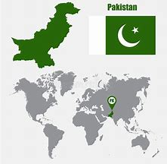
Pakistan
Land area is 79.61 million hector
Located in western end of South Asian subcontinent
Contains the major archeological sites of Indus civilization
Pakistan is located very close to the thee Vavilov center of origins (China, Indian subcontinent and Central Asia)

Slide 3
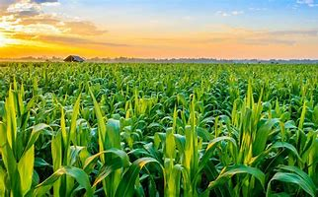
Pakistan: Agriculture
Agriculture is the mainstay of Pakistan’s economy
Agriculture is the main income generating sector contributing about 25% of GDP and 44% of total employment is generated in agriculture
About 67.5% of county’s population living in rural areas is directly and indirectly linked with agriculture for their livelihood.
Rabi (winter) and Kharif (summer) are two crop seasons in Pakistan
Climatically, it is arid and semi-arid. Annual rainfall varies from 50 mm in arid and semi-arid areas to 2000 mm in the moist forests.
The temperature influenced by altitude varies from below freezing in northern mountains during winter to 35 – 50 degree during summer in central and southern plains.

Slide 4
Pakistan: Plant genetic resources
The wide variations in geography, altitude, soil, climate and culture have created a rich plant diversity.
Pakistan is rich in indigenous crop diversity with an estimated 3000 taxa of cultivated plants.
There are around 500 wild relatives of cultivated crops, most of which are found in the Northern Areas of Pakistan.
The old civilizations of Pakistan including Taxila, Harappa and Mohenjodaro domesticated species such as wheat, egg plant, pigeon pea and cucumber.
Northern areas of Pakistan became center of diversity for several nut fruits.
Many wild and local cultivars survived in Pakistan up to the era of the Green revolution.

Slide 5
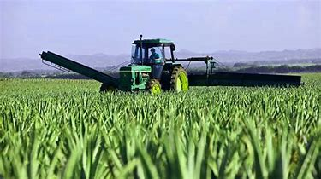
What is Green revolution?
Green revolution started between 1950s to 1960s.
Norman is considered as father of Green revolution and awarded with Nobel prize for saving one billion people from starvation.
Main focus of Green revolution was to promote:
introduction of high yield varieties of wheat, rice and maize in agriculture sector
Use of quality fertilizers to compensate for land deficiencies and to increase per acre yield
Use of pesticides and insecticides

Slide 6
Pakistan: Plant genetic resources
With the introduction of new high yield crop varieties of food and cash crop, expansion of land for cultivation, deforestation and construction of dams posed severe threats to wild and weedy landraces of cultivated crops.
Recognizing the importance of preserving crop genetic diversity, Government of Pakistan started collections of indigenous plant germplasm in the early 1970s. Today there are over 15,600 germplasm accessions from more than 40 different crops maintained by the Plant Genetic Resources Institute(NARC, Islamabad).
Over 50% of the germplasm has been evaluated and presented in respective crop catalogues

Slide 7
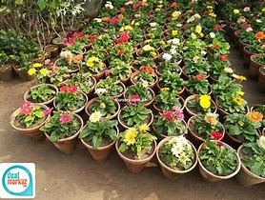
Pakistan: Plant genetic resources
Variety of crops (wheat, rice, maize, barely, sorghum, millet, cotton, brassicas, sunhemp, tobacco, sugarcane, chickpea, mung, mash, lentil, groundnuts, sesame, chilies, onion, garlic, coriander, turmeric)
Various vegetables
Variety of fruits (citrus fruits, mango, banana, grapes, apple, peach, plum, apricot, pomegranate, dates and some nuts)

Slide 8
Domesticated plant resources of Pakistan
Cereals
Wheat is the major food crop of Pakistan grown over an area of 8 million hector. Scattered over a wide range of ecological regions. Presently most of the area is occupied by improved varieties but local land races still exist in Baluchistan and Northern Mountains due to local preferences or non-availability of improved varieties suitable for these areas.
The local land races of wheat and barley are of great importance for quality and their tolerance to drought and salinity.
Rice is the second major crop of Pakistan. It has various varieties like Basmati rice, Chinese black rice, jasmine rice, paella rice, risotto rice, sushi rice etc. Basmati rice of Pakistan is of best quality rice in terms of grain size, aroma, grain length etc.

Slide 9
Domesticated plant resources of Pakistan
Maize is the third major crop of Pakistan. White, yellow and red are most common types of maize grown in Pakistan. White and yellow varieties are preferred by most people.
Food legumes
The area under pulses is 1.48 million hector. It is an important group of food crops providing proteins. Among legumes, the chickpea, lentil mung bean, mash bean, pigeon pea, cow pea, moth bean, broad bean and common bean constitute important gene pools of various legumes.
Oil Seed crops
The main oil seed crops of Pakistan are rape and mustard, sesame, linseed, castor, sunflower, soybean and groundnut. Although the extent of genetic diversity in introduced oil seed crops is low but the indigenous crops express a wide diversity in morphological traits and response to various stresses.

Slide 10
Domesticated plant resources of Pakistan
Fruit plants
A wide range of fruit species like mango, guava, citrus, banana, jujubar (ber), Eugenia (jaman), apple, peach, plum, apricot, grapes and nuts like almond and walnut are grown. These possess wide genetic variability in fruit size, shape, colour, maturity time and quality etc. These fruit species have been diversified through human selection over hundreds of years.
Tree nuts
Walnuts and almonds are cultivated tree nuts of economic importance to local communities. Because these species have small trees and are found in areas where there is extreme drought, they may be valuable as root stock for cultivated almond. Hazelnuts are found in the moist forests of the Kalam Valley, but trees are rare.

Slide 11
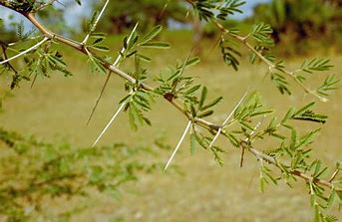
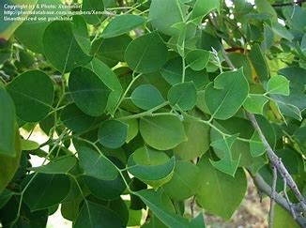
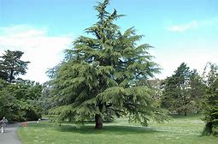
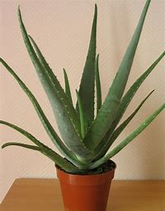
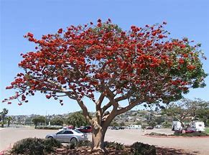
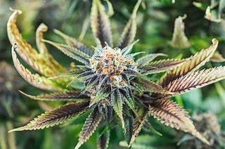
Wild plant resources of Pakistan
Prickly Acacia/Keekar
Deodar Cedar
Dalbergia Sisso/Sheesham tree
Alovera
Marijuana
Corel tree

Slide 12
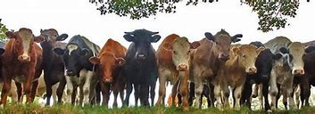
Pakistan: Livestock
11% of Pakistan’s GDP comes from livestock
Livestock also contributes significantly towards national exports and 8.5 – 9.0 % of total exports belong to this sector
Livestock is raised by more than 6.5 million small and landless families in the rural areas constituting their main livelihood source
The demand for livestock products is increasing due to population growth, urbanization and economic development in the country

Slide 13
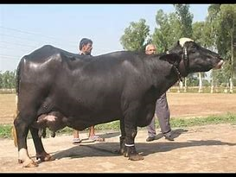
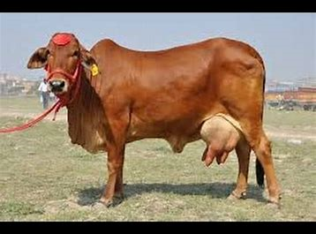
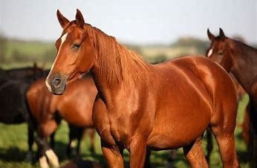
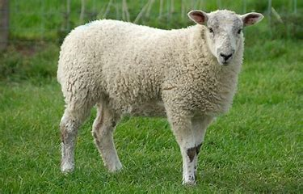
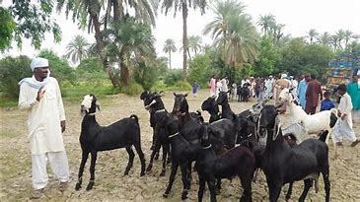
Pakistan: Domestic animals
Buffalo (Nili-Ravi, Kundi, Azi-Kheli)
Cattle (Sahiwal, Red Sindhi, Cholistani, Achai)
Sheep (Lohi, Kajli, Damani, Balkhi, Baluchi)
Goat (Beetal, Dera Din, Panah, Nachi, Teddy)
Horse (Baluchi)
Camel (Bagri, Marecha, Brela, Pahari)

Slide 14
Buffalo
Nili-Ravi
The hometract of the Nili-Ravi buffalo includes Lahore, Sheikhupura, Faisalabad, Okara, Sahiwal, Pakpattan and Vehari districts of Central Punjab; and Multan and parts of Bahawalpur and Bahawalnagar districts of southern Punjab. However, because of their well-recognized dairy qualities, these animals are now found all over the country. Males attain maturity at the age of 30 months, and females at 36 months. Milk yield is 1800-2500 litres per lactation (322 days) with 6.5% butter fat. Males may be used for draught purposes, especially for preparing land for paddy cultivation and are a good source of beef.
Kundi
Kundhi buffaloes are found throughout Sindh, particularly on both sides of the Indus river. The average age at maturity is 30 months in males and 36 months in females. Adult males weigh 500-600 kg, and females 300-400 kg. The milk yield per lactation is 1700-2200 litres with over 6.5% butter fat.

Slide 15
Buffalo
Azi-Kheli
These buffaloes are mainly found in Khwaza Khella and Madyan areas of Swat. Azi-Khelies have been named after a local tribe ‘Aziz Khell’. Colour variation in Azi-Kheli is quite pronounced, varying from complete albino animals to piebald to even black. Milk yield per lactation is about 1800 litres. Azi‑Kheli buffaloes are generally docile.

Slide 16
Cattle
Sahiwal
Sahiwal cattle lives in parts of districts Sahiwal, Okara, Pakpattan, Multan, and Faisalabad in Punjab. The breed is named after Sahiwal district, which is part of its hometract. This is tick resistant breed because its skin naturally keeps on shivering . Milk yield is 1500-2200 litres per lactation with a fat content of 4.5 %. Sahiwal are in great demand in several Asian and African countries. They have also been exported to Australia.
Red Sindhi
The Red Sindhi breed originates from a mountainous region called `Mahal Kohistan’, spread over parts of Karachi, Thattha and Dadu districts in Sindh. Red Sindhi animals are hardy and adapt very well to stressful environments. Milk yield per lactation varies from 1200 to 2000 litres.

Slide 17
Cattle
Cholistani
Cholistan tract (a desert area) and adjoining colonized areas of Bahawalnagar, Bahawalpur, and Rahimyar Khan districts. Males are a good source of beef and may be used as draught animals. milk yield varying from 1200 to 1800 litres/lactation.
Achai
A small-sized breed found in KPK province. Males are reasonably agile and are used for light draft work. Well-fed males serve as good beef animals, especially for sacrificial purposes. Docility is one of the recognized characteristics of Achai animals, even children can comfortably handle them. They are an asset for hilly terrain of the KPK province under resource limited subsistence production set up.

Slide 18
Other domestic animals
The Dog: Of all the domestic animals, the dog is perhaps the most well-known for its qualities of obedience, intelligence and watchfulness and its quick power of smell.
Donkey, Mules and asses are also domesticates sources of Pakistan. These are mainly used for transportation.

Slide 19
Uses of Domestic Animals
Domestic animals are reared for several purposes. The most important of them are kept for agricultural purposes, milk and its by-products, transportation and other purposes.
1. Fertilizing the fields: Domestic animals also yield dung and farmyard manure, which are so necessary for fertilizing the fields.
2. Agricultural purposes: We use cattle for many agricultural purposes such as the drawing of ploughs and carts, lifting of water from the wells, carrying of loads, crushing of cane and seed, threshing of grain, and to the performance of such other forms of productive activities. For agricultural purposes, bullock and buffalo are the most important.
3. Milking: Cow, goat, sheep, and buffalo are kept mainly for milking.
4. Wool: Goat and sheep also yield wool.
5. Transportation: Horses, ponies, asses, mules, camels, sometimes also elephants, were old means of transport

Slide 20
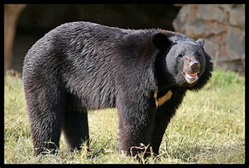
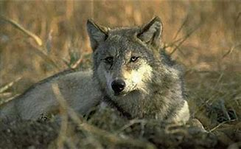
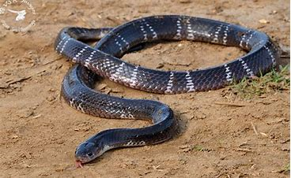
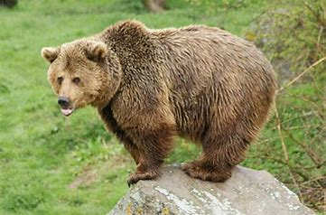
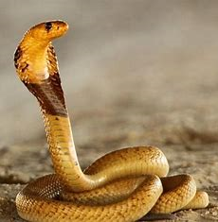
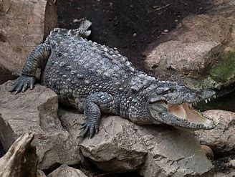
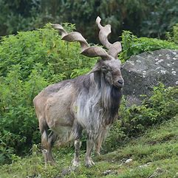
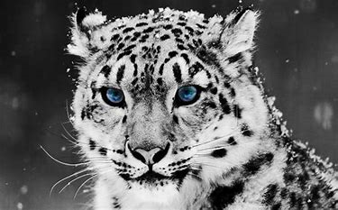
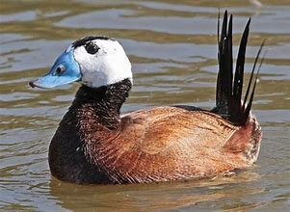
Pakistan: Wild animals
Fishing cat
Asiatic Black Bear
Grey Wolf
Sind Krait
Himalayan Brown Bear
Mugger Crocodile
Asiatic Cobra
Alpine Markhors
Snow Leopard
White head duck

