Slide 2
Advanced Production Technology Of Apricot Fruit

Slide 3
Introduction:
Botanical Name : Pirunus armeniaca
Family : Rosaceae
Chromosome No : 2n=16
Type of Fruit : Stone Fruit
Type of Pollination : Self pollination
Rate of Respiration : Climacteric
Production : 128382 Tonnes
Propagation : Asexually(Grafting)
Advance Technology : Tissue Culture
Transport and Storage :1-2 weeks at 0°C

Slide 4
Introduction:
The origin of apricot is China.
It is one of the most important stone fruit.
Delicious, Attractive and Nutritious fruit.
Rich source of vitamin A.
Drought tolerant, Salt tolerant, hardy and less susceptible to pest and diseases.
Highly Perishable fruit.

Slide 5
Benefits and Uses Of Apricot

Slide 8
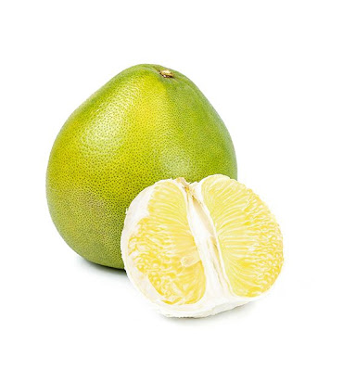
Largest Apricot Producing Country:
Country | Production(Tonn)
Turkey | 795,768
Iran | 460,000
Uzbekistan | 365,000
Algeria | 269,308
Italy | 247,146
Pakistan | 176289
France | 189,711

Slide 9
Varieties of Apricot Fruit in Pakistan:
Name of Variety | Fruit Color
Castle Brigh | Orange Yellow
Sarbaghal | Whitish
Narai | Light Yellow
Gold cort | Yellow to light orange
Badami | Yellow to light orange
NJA-13 | Orange Yellow
Habi | Light Yellow to greenish

Slide 11
Climatic Requirements:
Temperate Fruit.
300-2000 m Elevation.
Chilling Requirement 300-900hrs, below 7°C for fruiting.
Rainfall 100cm, well distributed through out the year.
Summer temperapture 16.6-32.2°C.
For Flowering temperature is 5-6°C
Long Cool region develop excellent quality.

Slide 12
Soil Requirement:
Deep fertile, well drained loamy soils are readily suitable.
Hardy Crop.
PH 6-6.8
Subsoil free from Hard Pan.
Poor Soil with high PH is not suitable..

Slide 13
Manures and Fertilizer:
Age Of Plant | Fertilizer |  |  | FYM
 | N | P | K
1st Year | 50 | 25 | 25
2nd Year | 100 | 50 | 50
3rd Year | 200 | 100 | 100
4th Year | 300 | 150 | 150
5th Year or Above | 400 | 200 | 200

Slide 14
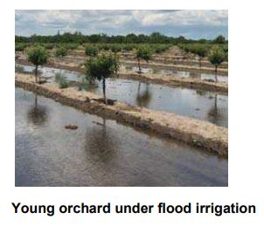
Irrigation:
Can be grown as a rain fed crop.
Irrigation is essential during initial years and during critical stage.
Pit hardening stage (April-june).

Slide 16
Grafting

Slide 21
Yield and Storage
Yield:
A 5 year-old tree may provide 67.59 kg fresh fruits.
Economical life span 30-40 years.
Storage:
Fruits are highly perishable.
Fruits harvested at optimum maturity can be stored for a week at 5°C and 85 % Relative humidity.

Slide 23
Major diseases and insects and their control
Diseases | Insects
Brown rot | Aphids
Botrytis blight or gray mold | Peach twig borer
Bacterial Canker | Peachtree borer
Phytophthora root and crown rot | Scale insects

Slide 24
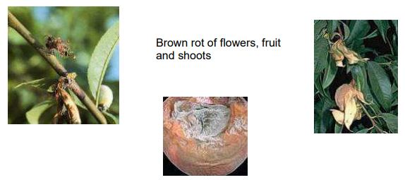
Major diseases and insects and their control
Brown rot:
Brown rot is a major disease that can infect the blossoms, fruit, spurs (flower and fruit bearing twigs), and small branches.
Rain during the pre-bloom and bloom period can lead to flower infection and crop loss.
Typical disease symptoms are blossom and twig blight, cankers, and fruit rot.

Slide 25
Major diseases and insects and their control
Management:
Applications of copper-containing fungicides at pink bud stage can help avoid serious losses.
Do not apply copper compounds after bloom; after bloom use noncopper-containing fungicides.
Prune trees to allow good ventilation. Avoid wetting blossoms, foliage, and fruit.

Slide 26
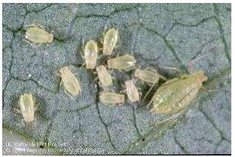
Major diseases and insects and their control
Aphids:
large populations cause curling, yellowing, and distortion of leaves and stunting of shoots.
; they can also produce large quantities of a sticky exudate known as honeydew.
which often turns black with the growth of a sooty mold fungus that can damage fruit.
Management:
Catch infestations early

