Slide 1
Ordinal Approach Or
Indifference Curve Analysis

Slide 2
This approach to consumer behavior is based on consumer preferences. Human satisfaction is psychological phenomenon which cannot be measured in monetary terms.
Ordinal concept based on ordering of preferences compared with Marshall’s approach of cardinality.
It is possible for a consumer to tell whether a commodity is more or less or equally useful when compare to another.
For example, a consumer may not be able to say that ice cream gives 5 utils and chocolate gives 10 utils. But he can specify whether chocolate gives more or less utility than ice-cream.

Slide 3
Indifference curve
An indifference curve is the locus of points- particular combinations or bundles of goods- which yield the same utility (level of satisfaction) to the consumer, so that he is indifferent as to the particular combination he consumes.
In other words, an indifference curve is a graph showing combination of two goods that give the equal satisfaction and utility to consumer. Each point on an indifference curve indicates that a consumer is indifferent
U = F(X, Y) = K

Slide 4
Assumptions of an indifference curve:
1.Rational consumers.
2.Two commodities
3.Utility is ordinal
4.Diminishing marginal rate of substitution
5.Total utility of the consumer depends on the quantities of the commodities consumed.
6.Consistency and transitivity of choice

Slide 5
1. Rational Consumers:
It is assumed that consumers are rational in making decisions from their expenditures on consumer goods. Consumer aims as maximizing his total satisfaction given his income and prices of goods and services that he consumes.
2. Two commodities:
There are 2 commodities, commodity X and commodity Y.
3. Utility is Ordinal:
Utility can not be measured cardinally. The consumer can rank the basket of goods according to the satisfaction or utility of each basket. Consumer is able to order his preference for different basket of goods.
4. Diminishing marginal rate of substitution
The rate at which Good Y is exchanged for Good X is called MRS. If consumer wants to have more and more units of good x he has to forgo some units of good y. The MRS of Good X for Good Y diminishes as more and more of Good X is substituted for Good Y. In other words, as the consumer has more and more of good X he is prepared to give up less and less of Good Y.

Slide 6
5. Total utility of the consumer depends on the quantities of the commodities consumed.
6 .Consistency and transitivity of choice:
Consistency:
Consumer is consistent in his behavior during a period of time. If consumer prefer combination of good A to combination of good B, he than remain consistent in his choice.
If A > B than B ≯ A
Transitivity:
This principle states that if bundle A is preferred to B, and B is preferred to C, then it must be true that bundle A is preferred to C.

Slide 7
INDIFFERENCE Schedule Of Commodity X And Y
Combination | Commodity X | Commodity Y | MRS | Total Utility
A | 1 | 14 | 0 | U
B | 2 | 9 | 5 | U
C | 3 | 6 | 3 | U
D | 4 | 4 | 2 | U
E | 5 | 3 | 1 | U

Slide 8
△Y
△X

Slide 9
U = f(x, y)
The equation of IC is: U = f(x, y) = k
Where k is constant
All combinations of X and Y below the curve are inferior to those combinations on or above the curve.
All combinations of X and Y above the curve are preferable to consumer.

Slide 10
Marginal Rate of Substitution
The Slope of indifference curve is called MRS.
The marginal rate of substitution (MRS) can be defined as how many units of good x have to be given up in order to gain an extra unit of good y, while keeping the same level of utility.
Formula:
MRS x,y = $\frac{\text{△}\text{y}}{\text{△}\text{x}}$
or
MRS y,x = $\frac{\text{△}x}{\text{△}y}$

Slide 11
Marginal Rate of Substitution
MRS x, y = △y/ △x
Point A → B = 9 – 14 / 2 -1 = - 5 / 1 = -5
Point B → C = 6 - 9 / 3 - 2 = - 3 / 1 = -3
Point C→ D = 4 -6 / 4 - 3 = - 2 / 1 = -2
Point D→ E = 3 -4 / 5 - 4 = - 1 / 1 = -1
The rate at which the consumer substitutes Good X for Good Y is greater at the beginning. But, as he continues the substitution process, the rate of substitution begins to fall.

Slide 12
Properties of an indifference curve:
Negative downward slope
Higher Indifference curves represent higher levels of satisfaction.
Indifference curve does not intersect.
Convex to the origin.

Slide 13
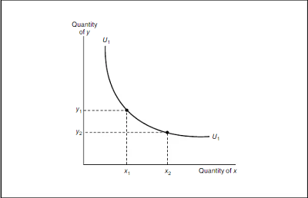
1. Negative Downward Slope
It slopes downward because as the consumer increases the consumption of X commodity, he has to give up certain units of Y commodity in order to maintain the same level of satisfaction.

Slide 14
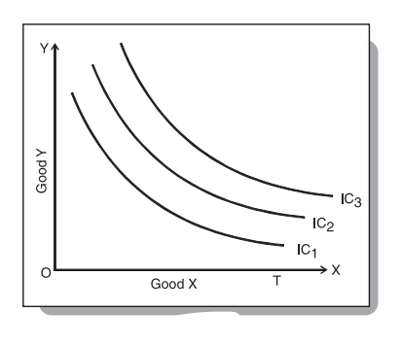
2. Higher Indifference curves represent higher levels of satisfaction.
The combination of goods which lies on a higher IC will be preferred by the consumer to the combination which lies on a lower IC.
In the diagram there are 3 Indifference curves. IC1, IC2, IC3, which represents different levels of satisfaction. The IC3 shows greater amount of satisfaction and it contains more of both goods than IC2 and IC1. [IC3 > IC2 > IC!]

Slide 15
C
B
A

Slide 16
3. Indifference curve does not intersect.
In the diagram 2 ICs are showing cutting each other at point A, The combinations presented by point B and A gives equal satisfaction to consumer because both lie on the same IC2. similarly the combinations presented by point C and A gives equal satisfaction to consumer consumer because of points lie on same IC1.
IF combination B = combination A
And Combination C = combination A
Than
Combination C = Combination B in term of satisfaction.
But it cannot be possible because combination B lies on IC2 which contains more good X..
We therefore conclude that ICs cannot intersect each other.

Slide 17
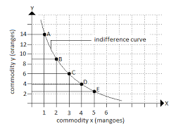
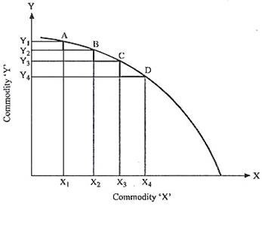
IC are Convex to the origin.
IC are convex to origin (bowed inward). It means that as the consumer substitutes commodity X for commodity Y, the MRS diminishes of X for Y along an IC.
Concavity of the indifference curves implies that the marginal rate of substitution of X for y increases when more of X is substituted for Y.
Convex IC
Concave IC

Slide 18
Budget Line
A budget line is a straight line that slopes downwards and consists of all the possible combinations of the two goods which a consumer can buy at a given market price by allocating all his/her income.
All those combinations which are within the reach of the consumer will lie on the budget line.
A Budget line separates what is affordable from what is not affordable.
Budget line slopes downwards as more of one good can be bought by decreasing some units of the other good.

Slide 19
Equation of the budget line
Px Qx + Py Qy = M
Where, Px is the price of goods X; Qx is the quantity of goods X; Py is the price of goods Y; Qy is the quantity of goods Y; M is the income of the consumer

Slide 20
Budget Schedule when Income is 50
COMBINATION | MANGOES (10/-PER MANGO) | ORANGES (5/-PER ORANGE) | BUDGET ALOCATION
A | 0 | 10 | 10*0+5*10=50
B | 1 | 8 | 10*1 +5*8 = 50
C | 2 | 6 | 10*2 +5*6 = 50
D | 3 | 4 | 10*3 +5*4 = 50
E | 4 | 2 | 10*4 +5*2 = 50
F | 5 | 0 | 10*5 + 5*0 = 50

Slide 21
ORANGES
MANGOES

Slide 22
We now know that Consumer must purchase at some point along the budget line, depending on his preferences. Note that any point within the budget line is feasible.
Consumer can spend less than 50, but this is not optimal as he can still buy more goods. Since Mangoes and Oranges are the only two goods, there is no ability in this model for Consumer’s to save.
This means that not spending his full budget is essentially wasted income.
On the other hand, any point beyond the budget line is not feasible. If Consumer only has 50, he cannot spend more than that.
O
R
A
N
G
E
S
Mangoes

Slide 23
Slope of Budget Line.
Slope of Budget line is = -$\frac{Price of Oranges}{Price of Mangoes}$
We know, the slope of a curve is calculated as a change in variable on the vertical or Y-axis divided by change in variable on the horizontal or X-axis. In the example of Mangoes and Oranges, slope of the budget line will be number of units of Oranges, that the consumer is willing to sacrifice for an additional unit of Mango.

Slide 24
Conditions of Consumer’s Equilibrium
Budget line should be tangent to the indifference curve.
At the point of equilibrium, slope of the budget line = slope of the indifference curve.
Indifference curve should be convex to the point of origin.

Slide 25
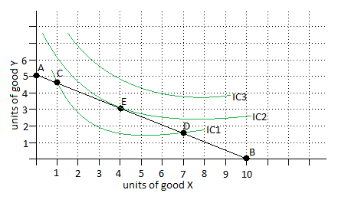
1. Budget line should be tangent to the indifference curve
Consumer’s equilibrium is based on the assumption that the income of a consumer is constant and that he spends his entire income on purchasing two goods whose prices are given.
In the given diagram, we can see IC1, IC2 and IC3 are three different indifference curves and AB is a budget line.
The consumer can purchase combinations C or D but these will not yield him maximum satisfaction as they lie on lower indifference curve.
Thus, the consumer will be in equilibrium (achieve maximum satisfaction at any given level of income) where the budget line is tangent to the indifference curve, i.e. at point E on IC2.

Slide 26
2. The slope on indifference curve = slope of the budget line.
the consumer to be in equilibrium and get the maximum possible satisfaction is only at a point where the price line is a tangent to the highest possible indifference curve from below.
At tangency point E, the consumer’s substitution ratio(MRSx,y) is equal to price ratio P_{x} / P_{y}. It implies that at point E, what the consumer is willing to pay is equal to what he actually pays. So the equilibrium condition is at the point E which is:
MRS xy = $\frac{Px}{Py}$
The equilibrium conditions given above states that the rate at which the individual is willing to substitute commodity X for commodity Y must equal the ratio at which he can substitute X for Y in the market at a given price.

Slide 27
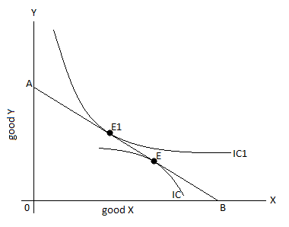
3. IC should be convex to the origin
It means that marginal substitution rate between X and Y (MRS_{XY}) should be diminishing. If indifference curve is concave and not convex to the origin, then it will not be the point of equilibrium.
AB is a budget line tangent to IC curve at point E. At point E, marginal rate of substitution is increasing instead of diminishing. It means, by moving left or right of point E, a consumer can obtain higher amount of either good X or good Y. Thus point E is not an equilibrium point

