Slide 1
LIFE SPAN DEVELOPEMENT

Slide 2
It is life long ,multi dimensional ,multi directional ,plastic ,multidisciplinary and contextual that involves maintenance, growth and regulation of loss. The development occur through socio-cultural, individual and biological factors.
Development is life long
There is no endpoint of development.

Slide 3
Development is multidimensional;
How body, mind ,emotions and relationships are changing and effecting each other. The development consisted of cognitive, emotional and biological and within each dimension there are many components such as attention, memory, abstract thinking ,speed of processing information and social intelligence.

Slide 4
Multidirectional
Some dimensions or components of dimensions expand and some shrink such as acquiring the one language can decrease the capacity to acquire second language.
Development is plastic
It means capacity for change .for example can an individual can improve his skills at any age. Research prove that skills can be improved through training but in old age the change is little.

Slide 5
IT IS Multidisciplinary
All researchers belonging to different fields of science are interested in unlocking the mysteries of development.
CONTEXTUAL
WE study development from different context including families, school, countries, and how much they are influenced by historic ,and cultural factors. Individuals are changing being in the changing world. There are three types of influences.
Normative age graded influence( similar age effects)
Normative history graded influence(common to people belonging to the particular generation such as shared experiences .
Non-normative or highly individualized life events ( these are not common to all individuals such as death of parent .

Slide 6
Development involves growth, maintenance and regulation of loss.
Mastery of the life often involves conflicts and competition among three goals of human development. which are growth, maintenance and regulation of loss. Because these all things changes with life.
Development is co-construction of biology, culture and the individual
Development involves the working of all these factors. For example the brain shapes culture, but it is also shaped by culture and life experiences.

Slide 7
Periods of development
Prenatal period
Infancy from birth to 24 months
Early childhood (2 to 5)
Middle and late childhood (6 to 11)
Adolescence (teen age )
Early adulthood
Middle adulthood
Late adulthood

Slide 8
Developmental issues
Nature and nurture
Stability and change
Continuity and discontinuity
Evaluating the developmental issues
Theories of development(Freud, Erikson, Piaget, social cognitive theory of Bandura, ecological theory)
Research methods such as cross sectional and longitudinal ,cohort effects that are due to person time and area of birth, CROSS SECTIONAL STUDIES CAN SHOW IT)
And

Slide 9
Stage Basic Conflict Important Events Outcome Infancy (birth to 18 months) Trust vs. Mistrust Feeding Children develop a sense of trust when caregivers provide reliabilty, care, and affection. A lack of this will lead to mistrust.
Early Childhood (2 to 3 years) Autonomy vs. Shame and Doubt Toilet Training Children need to develop a sense of personal control over physical skills and a sense of independence. Success leads to feelings of autonomy, failure results in feelings of shame and doubt.

Slide 10
reschool (3 to 5 years) Initiative vs. Guilt Exploration Children need to begin asserting control and power over the environment. Success in this stage leads to a sense of purpose. Children who try to exert too much power experience disapproval, resulting in a sense of guilt.
School Age (6 to 11 years) Industry vs. Inferiority School Children need to cope with new social and academic demands. Success leads to a sense of competence, while failure results in feelings of inferiority.

Slide 11
Adolescence (12 to 18 years) Identity vs. Role Confusion Social Relationships Teens need to develop a sense of self and personal identity. Success leads to an ability to stay true to yourself, while failure leads to role confusion and a weak sense of self. Young Adulthood (19 to 40 years) Intimacy vs. Isolation Relationships Young adults need to form intimate, loving relationships with other people. Success leads to strong relationships, while failure results in loneliness and isolation.

Slide 12
Middle Adulthood (40 to 65 years) Generativity vs. Stagnation Work and Parenthood Adults need to create or nurture things that will outlast them, often by having children or creating a positive change that benefits other people. Success leads to feelings of usefulness and accomplishment, while failure results in shallow involvement in the world.
Maturity(65 to death) Ego Integrity vs. Despair Reflection on Life Older adults need to look back on life and feel a sense of fulfillment. Success at this stage leads to feelings of wisdom, while failure results in regret, bitterness, and despair.

Slide 13
Sensory Motor Stage
(Birth - 2yrs)
Pre-operational Stage
(2yrs-7yrs)
Concrete Operational Stage
(7yrs-11yrs)
Formal Operations Stage
(11yrs-16yrs)

Slide 14
The sensorimotor stage can be divided into six separate substages that are characterized by the development of a new skill. The Preoperational Stage This stage is characterized by an increase in playing and pretending. Characteristics of this stage include egocentrism and difficulty understanding conservation. The Concrete Operational Stage During this stage, children begin thinking logically about concrete events, but have difficulty understanding abstract or hypothetical concepts. The Formal Operational Stage During this stage of cognitive development, skills such as logical thought, deductive reasoning, and systematic planning begin to emerge.

Slide 15
Sensorimotor Stage
0-2 yrs During this first stage, children learn entirely through the movements they make and the sensations that result. They learn: that they exist separately from the objects and people around them
that they can cause things to happen
that things continue to exist even when they can't see them
Preoperational Stage
2-7 yrs Once children acquire language, they are able to use symbols (such as words or pictures) to represent objects. Their thinking is still very egocentric though -- they assume that everyone else sees things from the same viewpoint as they do.They are able to understand concepts like counting, classifying according to similarity, and past-present-future but generally they are still focused primarily on the present and on the concrete, rather than the abstract.

Slide 16
oncrete Operational Stage
7-11 yrs At this stage, children are able to see things from different points of view and to imagine events that occur outside their own lives. Some organized, logical thought processes are now evident and they are able to: order objects by size, color gradient, etc.
understand that if 3 + 4 = 7 then 7 - 4 = 3
understand that a red square can belong to both the 'red' category and the 'square' category
understand that a short wide cup can hold the same amount of liquid as a tall thin cup
However, thinking still tends to be tied to concrete reality
Formal Operational Stage
11+ yrs Around the onset of puberty, children are able to reason in much more abstract ways and to test hypotheses using systematic logic. There is a much greater focus on possibilities and on ideological issues.

Slide 17
pproximate Ages Freud's Stages of Psychosexual Development Erikson's Stages of Psychosocial Development
Birth to 1 year Oral Stage
A child's primary source of pleasure is through the mouth, via sucking, eating and tasting.
1-3 years Anal Stage
Children gain a sense of mastery and competence by controlling bladder and bowel movements.

Slide 18
3-6 years Phallic Stage
The libido's energy is focused on the genitals. Children begin to identify with their same-sex parent.
7-11 year Latent Period
The libido's energy is suppressed and children are focused on other activities such as school, friends and hobbies.

Slide 19
Adolescence Genital Stage
Children begin to explore romantic relationships.
Adulthood According to Freud, the genital stage lasts throughout adulthood. He believed the goal is to develop a balance between all areas of life.

Slide 20
VYGOTSKY’S SOCIOCULTURAL THEORY
According to him the children can actively construct their knowledge. More than Piaget he gave importance to the social interaction and culture in cognitive development. It is socio-cultural cognitive theory that how cognitive development is influenced by the social and cultural interaction.
ACCODING TO him the learning occur by using the inventions of society such as memory strategies, computer and language.

Slide 21
Information processing
According to this theory the individuals manipulate, monitor and strategize the information.
This theory doesn't describe the development in stages according to this theory the development is gradual increase in information processing.
Robert Seigler proposed that when children perceive ,encode, represent ,store and retrieve information than they are thinking.
According to him learning the good strategies is very important for information processing.

Slide 22
Behavioural and social learning theories
Operant conditioning and
Bandura social learning (the environment, cognition and behaviour are key factors in development)
Bandura emphasized the cognitive processes that are linked with environment and behaviour.
More focused on observational learning such as modelling and imitation.
According to him three elements are important and involved in the learning and development such as behavior,person cognition and environment.
The thinking that a person can control his success is example of his cognitive factor.

Slide 23
ETHOLOGICAL THEORY
Biology role is important that the evolution play an important role. According to this theory there are specific time when the certain experiences have great influences on the life.
Offspring following their parents and learn by the process of imprinting .IT IS rapid innate learning that involves attachment to first moving object seen. According to Lorenz the imprinting need to take place at certain, very early in the life or else it will not take place. This time is called critical period. According to Bowlby this time is infancy when attachment occurs. Which is very important for developing the social relations.(concept of attachment in early life negative or positive )

Slide 24
Ecological theory
It emphasise the environmental factors.
Bronfenbrener .according to him development is influenced by several environmental systems.
Five systems
Micro
Meso
Exo
Macro
Chrono

Slide 25
Micro setting in which individual live. These include person’s family ,peers, school, and neighbour. In it their is direct interaction with social agents such as neighbours and family.
Mesosystem : involves the relationship between microsystems or connections between context. For example the relation of family experiences and school experiences. School experiences to religious experiences. Such as the parents who rejected their children can also have difficulty in developing good relations with children.

Slide 26
Exosystem :it involves the link between a socil settings in which the individual does not have an active role and the individual's immediate context.
For example father and child experiences at home can be influenced by mother’s experiences at work. For example mother receive promotion that requires more travel it can create conflict at home.

Slide 27
Macrosystem :culture in which an individual lives.
Choronosystem: patterns of environmental events and transitions events in life. For example divorce.
Always use electical approach

Slide 28
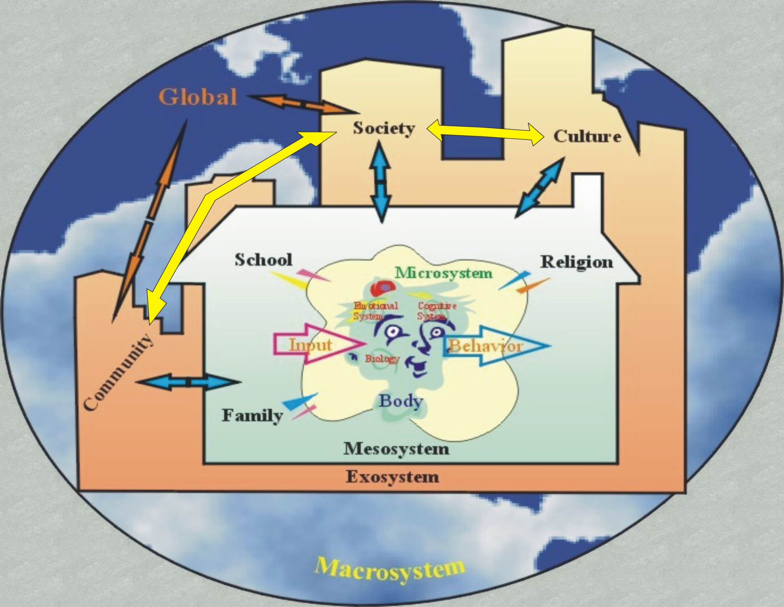

Slide 29
Chromosomal abnormalities
,Sometime when gamete is formed the male and female ovum do not have their normal set of 23 chromosomes.FOR EXAMPLE
Down Syndrome
Round face ,flattened skull, an extra folds of skin over eyelids, a protruding tongue, retradation of motor or mental abilities.
Due to extra 21 chromosome
Cause not known but the heath of male sperm and female egg involved.

Slide 30
Present in once 700 live births.
Women age between 16 -34 less chances.
Sex linked chromosomal abnormalities
These are due to presence of extra Y or X CHORMOSOME or absence of X chromosome.
Klinefelter syndrome
Genetic disorder in which the males have extra X chromosome making them XXY instead of XY.
Undeveloped testes
Enlarged breasts
Tall
Once in every 600 live male birth

Slide 31
Fragile X syndrome
Due to abnormality in X chromosome ,which often become stiff or some time break.
Lead to mental disability, mental retardation, learning difficulty, short attention span.
Recent study shows that boys have poor memory and planning.
More common in males
Because in female s the TWO X compensate each other.

Slide 32
Turner syndorme
IT IS chromosomal disorder inwhich wither an X chromosome is missing ,making XO instaed of XX.
Females have short stature
Webbed neck
Infertile and difficulty in mathematics
Verbal ability is good
Occur in 1 every 2500

Slide 33
XYY
Male have extra Y chromosome
In males cause aggression and violence
But crimes rate is not high as compared XY

Slide 34
GENE LINKED ABNORMALITIES
The abnormalities can be due to harmful genes.
Phenylketonureia
Cant metabolize the enzyme phenylalanine an amino acid.
Results from recessive gene
Can easily dected and treated through diet which prevent the accumulation of phenylalanine

Slide 35
If not treated than cause mental retardation and hyperactivity.
Sickle cell anemia
The genetic disorder that affects the red blood cells and occur most often in people of africa.
Genetic disorder lead to impairment of red blood cells.
The recessive gene cause red blood to become hooked shaped and cant receive adequate oxygen causing the anemia and than death. Babies are affected and research is under process.

Slide 36
BIOLOGICAL BEGNINGS

Slide 37
NARURAL SELECTION AND ADAPTIVE BEHAVIOR
Natural selection is process by which those individuals or species that are best adapted are the ones that survive and reproduce.
Darwin gave the concept of natural selection and published a book origin of species.
Lot of generation produce and than reproduce further but some die and which survive their characters pass to next generation.

Slide 38
Adaptive behaviour
All organisms should show adaptive behaviour.
The best adapted organism reproduce, promote the behaviour is natural environment by living in suitable climate.
Over many generations the gradual modifications occur, that further bring the modification in whole population.

Slide 39
Terms
Chromosome
DNA
GENE (Unit of inheritance, direct cells to reproduce and play important role in the production of protein).
Total chromosomes 46 in 23 pairs expect in sperm and eggs.
These cells(chromosomes ) reproduce by the process of duplication. Than two new cells form. Than new cells containing exact same DNA and 23 pairs of chromosomes.

Slide 40
Meiosis
It is different type of cell division.
Female produce eggs and male produce sperms. During meiosis, cell of testes or ovaries duplicates its chromosomes and form four cells each of which has half of parental genetic material.
And at the end of meiosis each egg or sperm has 23 unpaired chromosomes.

Slide 41
Fertilization
The fusion of egg and sperm to create single cell is called zygote.
In zygote there are 23 unpaired chromosomes from egg and 23 chromosome from sperms.
Genes are from the parents cells having the features of both. for hairs, eyes etc.
Genotype: genetic makeup
Phenotype: physical and psychological characters which are observable.

Slide 42
Chromosomal abnormalities
Sometimes, the males sperms and female ovum do not have their normal set of 23 chromosomes.
Down Syndrome : has round face, flattened skull,extra fold of skin over eye lids,proruding tongue,short limbs,mental and motor retardation.
Due to the presence of extra chromosome on 21 pair of chromosome.
Mother between 16 to 34 have less chances to give birth to abnormal child.
Reason is unknown

Slide 43
Sex linked chromosomal abnormalities
Klinefelter
Males have extra X chromosomes ,XXY instead of XY.
Have undeveloped testes, enlarged breast, tall

Slide 44
Fragile X syndrome
Abnormality is X chromosome
Mentally abnormal ,learning disability,a short attention span.
In boys cognitive disability, problem in memory and planning.
More common in males because females has two X chromosome so the one neglects the affect of other chromosome.

Slide 45
Turner Syndrome
More common in females where one X chromosome is missing or the part of X chromosome is deleted.
Females are short in stature, and webbed neck.
Infertile and having difficulty in mathematics.

Slide 46
XYY SYNDROME
Male has extra y chromosome
Aggression and violence
But not in high ratio on criminal behaviour.

Slide 47
Gene linked abnormalities
Phenylketonuria
It is genetic problem in which individual cant metabolize phenylalanine, an amino acid.
Due to recessive gene
It can easily be detected and can be treated by diet that prevent the excess accumulation of phenylinanine.
if untreated can lead toward mental retardation and hyperactivity.

Slide 48
Sickle –cell anaemia
Impairing of body red blood cells.
That body cells that carry oxygen to the body become disk shaped.
Recessive gene
So that the cells cant receive accurate amount of oxygen and cant transfer it appropritely to the body.
Can cause early death

