Slide 1
IT-4545 Introduction to Mobile Computing Fall 2020

Slide 2
Course Information
Books
Programming Mobile Devices: An Introduction for Practitioners by TommiMikkonen, Wiley; 1st Edition (March 19, 2007). ISBN-10: 0470057386.
Professional Mobile Application Development by Jeff McWherter& Scott Gowell, Wrox; 1st Edition (September 4, 2012). ISBN-10: 1118203909

Slide 3
Introduction
“Mobile computing systems are computing systems that may be easily moved physically and whose computing capabilities may be used while they are being moved”.
Examples are
laptops, personal digital assistants (PDAs), and mobile phones

Slide 4
Aspects Of Mobile Computing
Systems are
small size
mobile nature of their use
wireless network connectivity
power sources
functionalities that are particularly suited

Slide 5
A Brief History of Mobile Computing
Notes:
- Abacus (500 B.B. was small size and portable) -> Calculator (evolves into modern technology mobile computing) because of their use and portability.
- Networking two or more computers together requires some medium that allows the signals to be exchanged among them.

Slide 6
Wireless Mobile or Mobile Wireless?
wireless communications and mobile computing
Mobile computing devices need not be wireless.
Wireless communication systems are type of communication system
four pieces to the mobile problem:
mobile user, mobile device, mobile application, and mobile network
Dimensions of mobility:
The set of properties that distinguishes the mobile computing system from stationary computing system

Slide 7
Dimensions of Mobile Computing
Location awareness
Network connectivity quality of service (QOS)
Limited device capabilities
Limited power supply
Support for a wide variety of user interfaces
Platform proliferation
Active transactions
Notes:
Tools that allow us to qualify our problem of building mobile software applications and mobile computing systems.

Slide 8
Dimensions of Mobile Computing

Slide 9
Location
A mobile device is not always at the same place: Its location is constantly changing.
Location aware app and systems have Challenges .
localization and location sensitivity
Localization is ability of the architecture of the mobile application to accommodate logic that allows the selection of different business logic, level of work flow, and interfaces based on a given set of location information commonly referred to as locales. e.g., P.O.S or e-commerce web application
different taxation rules

Slide 10
Location
Location sensitivity is the ability of the device and the software application to first obtain location information while being used and then to take advantage of this location information in offering features and functionality.
location-sensing technologies (triangulation, proximity, and scene analysis)
Triangulation is calculation of the location of a point that lies in the middle of three other points whose exact locations are known.

Slide 11
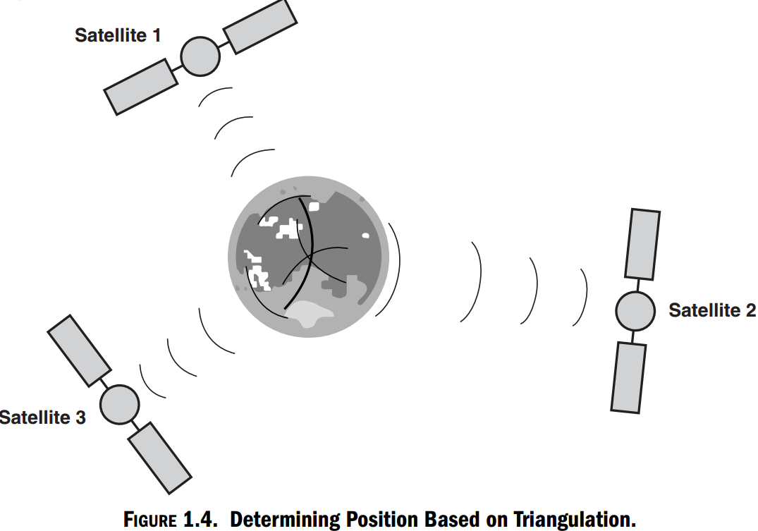
Location: Triangulation

Slide 12
Location
Proximity-based methods measure the relative position of the unknown point to some known point.
Scene analysis relies on image processing and topographical techniques to calculate the location of the unknown point based on a view of the unknown point from a known point.
The most well known location sensing system today is GPS. GPS-enabled devices can obtain latitude and longitude with accuracy of about 1–5 m.

Slide 13
Quality of Service
Mobility means loss of network connectivity reliability.
Physical conditions can significantly affect the quality of service (QOS)
E.g. bad weather, solar flares, and a variety of other climate-related conditions
Mobile applications have to know how to continue to operate even after they are disconnected from the network or while they connect and disconnect from the network
E.g. User traveling in train downloading affect
Mobile applications should know how to stop working when the application suddenly disconnects from the network and then resume working when it connects again.

Slide 14
Limited Device Storage and CPU
physical size limits; volatile storage, nonvolatile storage, and CPU
smaller is nearly always better
physical boundaries on the size of transistors
heat produced by the transistors
number of transistors on a microchip
So, the constraint on how we develop mobile applications
Mobile applications must be designed to optimize the use of data storage and processing power

Slide 15
Limited Power Supply
limited power supply
must be balanced with the processing power, storage, and size constraints
power supply has a direct or an indirect effect on everything
For example, the brighter the display
power management functionality is built into the operating system
making the right choice of platform and configure it properly

Slide 16
Varying User Interfaces
Stationary computers efficiently operate interfaces with keyboard, mouse, and monitor
Alternative interfaces for mobile devices are voice user interfaces, smaller displays, stylus and other pointing devices, touch-screen displays, and miniature keyboards.
Cumbersome to interact while driving or on the move.
designers and implementers need to understand necessity of finding the best user interface(s)
Next computing revolution in interfaces

Slide 17
Varying User Interfaces
User interfaces are difficult to design and implement for the following reasons
Designers have difficulties learning the user’s tasks.
The tasks and domains are complex.
A balance must be achieved among the many different design aspects, such as standards, graphic design, technical writing, internationalization, performance, multiple levels of detail, social factors, and implementation time.
The existing theories and guidelines are not sufficient.
Iterative design is difficult.
There are real-time requirements for handling input events.
It is difficult to test user interface software.
Today’s languages do not provide support for user interfaces.
Programmers report an added difficulty of modularization of user interface software.

Slide 18
Platform Proliferation
Low cost, small size mobile devices rage manufacturing
Gives rise to proliferation of devices and platforms in market
Platform proliferation has very significant implications on the architecture, design, and development of mobile applications.
For example, it is not wise to write a voice-driven phone book application that runs only on one type of platform.
The software architects and developers should be focused on user’s requirements such as, support of multiple platforms.

Slide 19
Active Transactions
active transactions as those transactions initiated by the system.
Active transactions may be synchronous or asynchronous.
All active transactions are initiated by the system.
Synchronous transactions are time dependent

Slide 20
Active Transactions
Synchronous active transactions properties:
The transaction is initiated by the system, and during the same transaction, the user is given an opportunity, for a finite period of time, to respond to the action initiated by the system.
Synchronous active transactions require a timely response from the user.
The interactions between the system and the user work in a sequential and serial manner during a synchronous transaction.
Synchronous active transactions are established between the system and a single user.

Slide 21
Architecture Of Mobile Software Applications
After gathering requirements require such a high-level plan.
basic prevalent application architectures are, N-Tier, client–server, mobile agent, and peer-to-peer
software architecture to be a particular high-level abstraction of the system and how its components collaborate.
architectural patterns; these are patterns that are recognizable once they are used prevalently in some architectures.
Not fully established design patterns, architectural patterns, or even architectures

Slide 22
