Slide 1
The Project Planning Phase
By: saba ashraf
Noon business school, university of sargodha

Slide 2
Outline
What is a plan?
Standard components of planning phase
The breakdown of work
Tree diagram and outline format
8/80 Rule
Organizing the WBS
Five step to creating WBS
Identifying dependencies
Lead time and lag time
WBS identifiers
Defining the deliverables

Slide 3
Outline
Difference between internal and external deliverable
Difference between project deliverables and process deliverables
Refining WBS
Some other sources to get better understanding of WBS

Slide 4
The plan is a roadmap for your project that helps you guide the work from start to finish.

Slide 5
Standard Components
Project plans contain three standard components;
Project plans contain three standard components;
Work Breakdown Structure (WBS)
The Schedule
The Budget

Slide 6
The Breakdown of Work
A WBS is a hierarchal chart used to organize the project’s activities into related areas.
In a WBS, a project breaks down into following levels:
The total project
Major deliverables
Milestones that summarize the completion of an important set of activities or the completion of an important event in a project such as a subproject.
Major activities
Work packages

Slide 7
The WBS and Your Project
The WB should be able to help you do following:
Identify the major parts of the project so all the work needed to be done is clearly indicated.
Organize the work in the most logical sequence so the work packages can be efficiently scheduled.
Identify the work schedules you need to assign to various team members.
Identify the resources so you can develop a budget.
Communicate the work to be done in a clear-cut way so the team members clearly understand their jobs.
Organize related work packages using logical milestones.

Slide 8
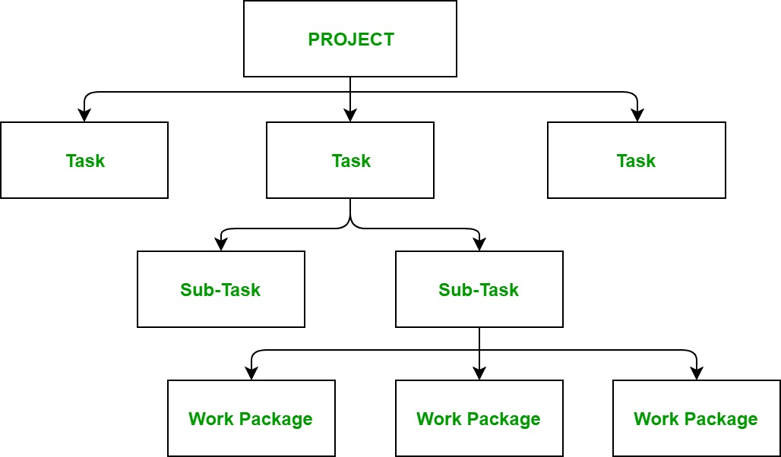

Slide 9
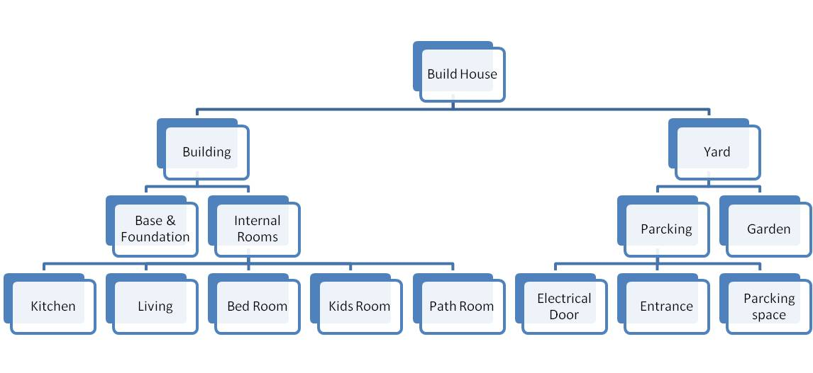
WBS of a House Project

Slide 10
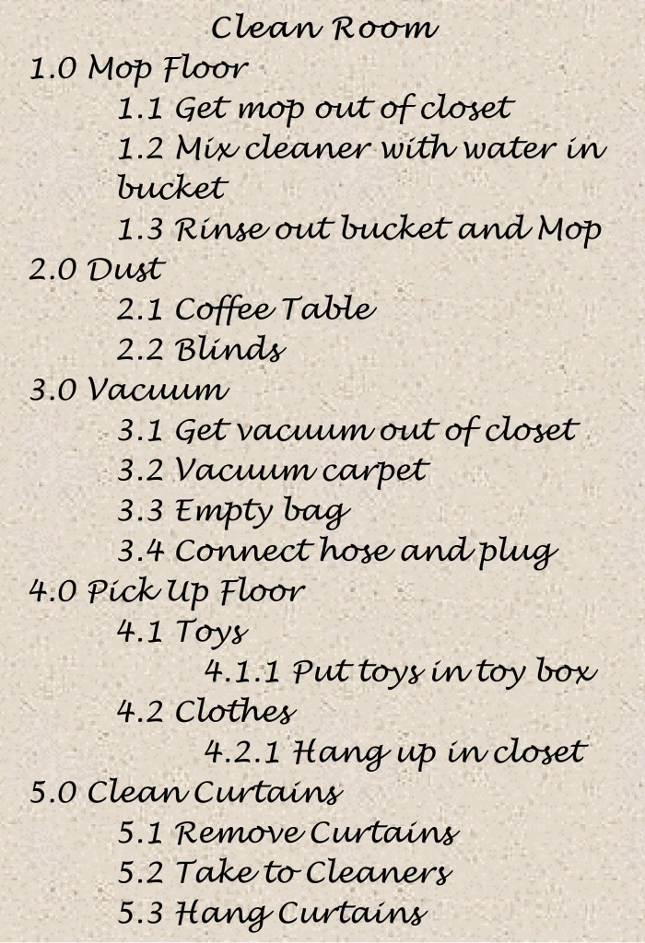
WBS Outline Method

Slide 11
Outline Format For The House Project
Outline Format:
1. Build House
1.1. Main Building
1.1.1. Building Rooms
1.1.1.1. Work package
1.1.1.2. Work package
1.1.1.3. Work package
1.1.2. Base & Foundation
1.2. Yard
1.2.1. Parking
1.2.1.1. Electrical door
1.2.1.2. Entrance

Slide 12
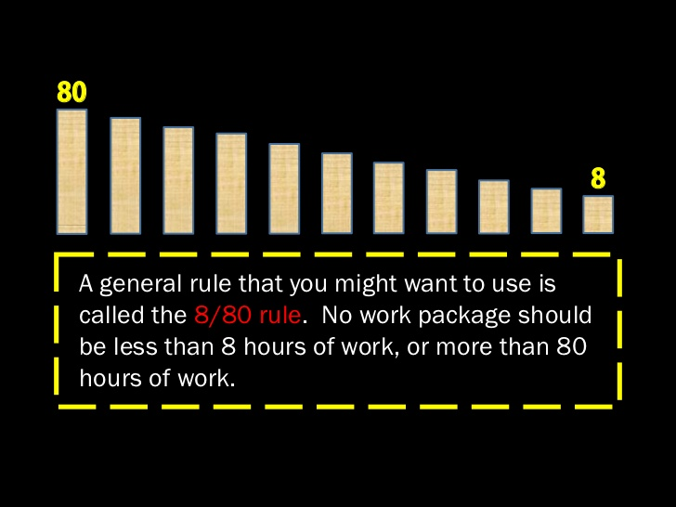
8/80 Rule

Slide 13
Organizing the WBS
There is no hard and fast rule for organizing the WBS. You could base your organization on any of the following
Phase of the project. Decide what is required in each phase of the project.
Organizational structure. In a clearly divided organization or a cooperating set of separate divisions, you can establish the WBS according to the reporting structure.
Physical location. If you are working with separate facilities, it might take sense to build the WBS based on the geographical locations instead of people.
System and subsystem. If there is clear demarcation between several aspects of a project, assemble the WBS to reflect this.

Slide 14
Five steps to the WBS
Break the work into independent work packages that you can sequence, assign, schedule, and monitor.
Define the work packages at a level of detail appropriate for the length and complexity of the project.
Integrate the work packages into a total system with a beginning and an end.
Present the work packages in a format you can easily communicate to people assigned to complete them during the project.
Verify that completion of work packages will result in attainment of project goals and objectives.

Slide 15
Identifying dependencies
A dependency is a logical relationship between tasks and activities.
FINISH-TO-START: the most common dependency that occurs when you complete one task to start the next one.
FINISH-TO-FINISH: in this situation, one task must finish before the other can finish.
START-TO-START: one task must start so the other task can start.
START-TO-FINISH: This is very rare dependency, but it does happen occasionally.

Slide 16
Finish-to-start
Finish-to-start
A
A
A must finish before B can start.
A must finish before B can finish
B
B
B
Start-to-Start
Start-to-finish
A
A
A must start before B can start
A must start before B can finish.
B
B

Slide 17
Lead Time and Lag Time
You apply lead and lag after you sequence activities and identify the dependencies.
LEAD TIME:
“Lead time is the amount of time whereby a successor activity can be advanced with respect to a predecessor activity.”
Put simply, when the first activity is still running when the second activity starts, it is Lead. Lead Time is the overlap between the first and second activities.
EXAMPLE:
You are constructing a two-floor building. You have two activities in sequence; i.e., electrical work and painting.
However, as you complete the electrical work on the ground floor, you start painting it while the electrical work on the first floor continues.
We commonly use Lead with Finish to Start relationships. In this dependency, the predecessor activity must finish before the successor activity starts.

Slide 18
Lag Time
“A lag time is the amount of time whereby a successor activity is required to be delayed with respect to a predecessor activity.”
Put simply, when the first activity completes and there is a delay before the second activity starts, this is called Lag. The delay is known as Lag Time.
Lag Time is the delay between the first and second activities.
EXAMPLE:
Suppose you have to paint a room. The first activity is applying the primer coating, and then you will do the final painting. However, you must let the primer dry before applying the paint.

Slide 19
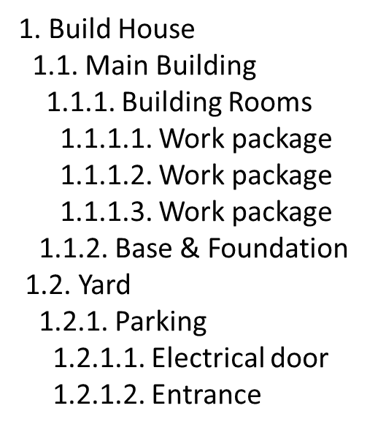
Unique WBS Identifiers
Each component of a WBS is assigned a unique identifier. Collectively, these unique identifiers are known as the code of accounts or code.

Slide 20
Making sure you have identified all the work
Identify work so you can asses the overall amount of work there is and sequence it in the most logical fashion.
A list of activities can be short and simple or long and detailed, depending on the size and goals of the project.
Do not sequence the task or estimate time and budget during WBS definition phase.
Have members of your project team help in developing the WBS.

Slide 21
Defining the Deliverables in the Work Package
All the required work deliverables should be considered while starting to build WBS that could be any drawing, design, documents, and schematics.
But first, lets clear the concept of ‘Deliverables’
What you can call a ‘Project Deliverable’?
A specific output generated by the work done on the tasks related to the project in question.
However, not every or task completed can be considered as a deliverable.
WHY?
There’s a specific criterion to fall under the category of deliverables.

Slide 22
Specific criterion for project deliverables.
The output in the question must be well within the scope of the project.
All of the stakeholders whether internal or external must agree to it
It must not a mistake or a fluke, it must be achieved through deliberate work
If should play an important role in the project’s development

Slide 23
Example
For example, if you belong to a creative agency, you must achieve a dozen goals per day, but you can’t count all of these goals as “deliverables”, because they were neither critical for the progress of the project nor did you spend weeks and weeks of deliberate work on them.
Still, it doesn’t mean that a deliverable has to be a very big entity like creating a building, it can even be a simple bicycle or even a document per se. You just have to remember while creating deliverables, that it has to have a significant value for the project and hard work spent on it, to count it as a deliverable.

Slide 24
Deliverables within a deliverable
Deliverables can also be stacked on top of each other. One deliverable can even have many deliverables of its own. For example, your primary deliverable is to create a website for your client but to achieve that goal, you need to create a website mockup and a wireframe, which are two separate deliverables on which the primary is dependent.

Slide 25
Difference Between External and Internal Deliverables.
External Deliverables
Internal deliverables
Any task or deliverable that is specifically performed to fulfill a client’s order or to attain more business from them is an external deliverable
External deliverables generate revenue.
For example, creating a website as a project
Any task or deliverable that is not a part of a business activity performed with a client is an internal deliverable
Internal deliverables are required to run the business.
For example, keeping accounts or creating corporate documents.

Slide 26
Project Deliverables vs. Process Deliverables
Project deliverables
Process deliverables
Project deliverables are huge client-related accomplishments that make or break the company.
Process deliverables the path on which you get to create those important project deliverables

Slide 27
Tips to manage project deliverables
Before you start your work, first you have to define all of the deliverables. This is because if you add the deliverables during the development phase, it will drastically change the budget and scope of the project
While gathering the required information about the deliverables, you would have to be extremely thorough. Why? Because when you’ll have the complete information about the deliverable, you will be able to persuade the stakeholders to accept your terms easily
Find out whether the deliverable you’re working on is supposed to be internal or external

Slide 28
The objective of the project needs to be properly decomposed in order to reveal the critical deliverables. But make sure that you get approval on every deliverable by the stakeholders before starting to work on it
Divide the development of each deliverable in different phases. This will help you in tracking them easily
Use a project management software to properly track and manage your project deliverables
There are a lot of process deliverables as standard in the market. Whenever convenient, use those to achieve your goals

Slide 29
Deliverables in the work package
A deliverable should be clearly stated
All work within the same work package should occur within a sequential time frame.
A work package should include only related work elements.

Slide 30
Refining the WBS
As the project progresses, you gather more information and learn more which should allow you to refine your project.
This refinement is referred to as Progressive Elaboration.
Continuously improving the plan as more information becomes available as the project continuous.

Slide 31
Some sources to get better understanding.
https://expertprogrammanagement.com/2010/03/wbs-work-breakdown-structures-everything-you-need-to-know/
https://www.teamgantt.com/blog/how-to-estimate-projects-accurately-using-a-work-breakdown-structure

