Slide 1
Data Encryption Standard
􀂄We focus now on the most widely used symmetric cipher: DES
􀂉DES has been replaced by AES as a standard
􀂉We will use DES to illustrate the principles of modern symmetric ciphers
􀂄Adopted in 1977 by the National Bureau of Standards (US), nowadays NIST
􀂄Originates from an IBM project from late 1960s led by Feistel
􀂉Project ended in 1971 with the development of LUCIFER (key 128 bits)
􀂉LUCIFER was then refined with the help of NSA to produce DES (key 56 bits)
􀂉Immediate criticism: the reduction in key length was enormous and the internal details of the design were (and remained) classified information
􀂉1994: DES is reaffirmed as a standard for 5 more years
􀂉1999: DES should only be used for legacy systems and 3DES shouldreplace it

Slide 2
Conventional Encryption Algorithms
Data Encryption Standard (DES)
The most widely used encryption scheme
The algorithm is reffered to the Data Encryption Algorithm (DEA)
DES is a block cipher
The plaintext is processed in 64-bit blocks
The key is 56-bits in length

Slide 3
DES encryption scheme
􀂄The plaintext (64 bits) passes through an initial permutation IP(on 64 bits)
􀂄Then follow 16 identical rounds –in each round a different sub key is used; each sub key is generated from the key
􀂄After round 16, swap the left half with the right half
􀂄Apply the inverse of the initial permutation IP⁻¹(on 64 bits)

Slide 5
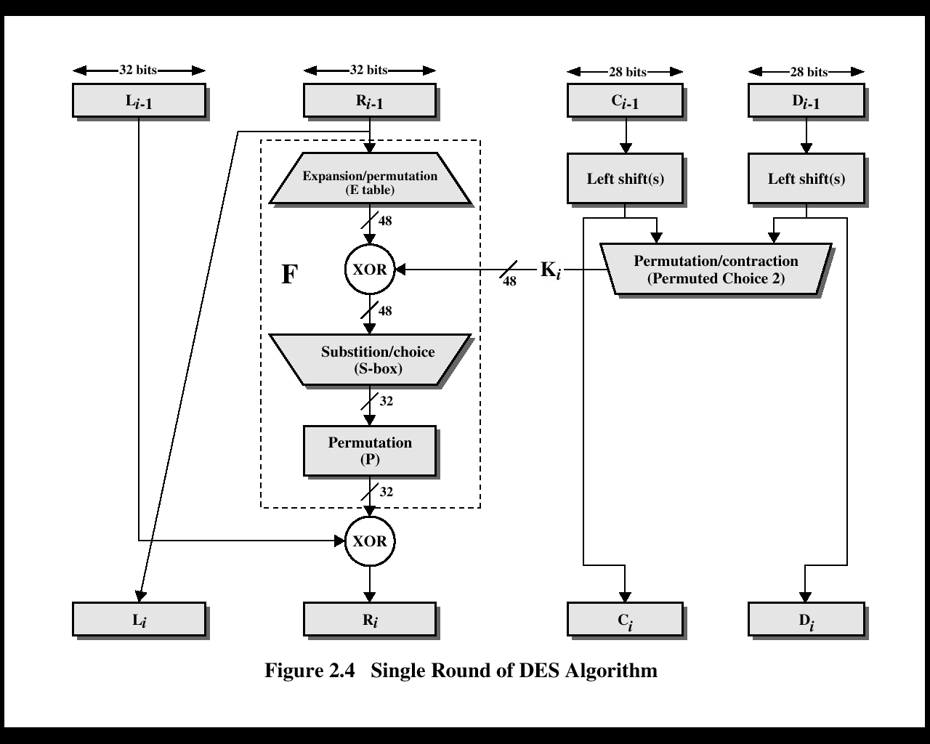

Slide 6
Sub key generation
Before round 1 of DES, they key is permuted according to a table labeled Permuted Choice One –the resulting 56-bit key is split into its two 28-bit halves labeled C0and D0􀂄
In each round, Ci-1 and Di-1 are separately subjected to a circular left shift of one or two bits according to the table on the next slide –the shifted values will be input to next round􀂄
The shifted values serve as input to Permuted Choice Two which produces a 48-bit output: the sub key of the current round

Slide 7
Example of DES
M = 0123456789ABCDEF
M = 0000 0001 0010 0011 0100 0101 0110 0111 1000 1001 1010 1011 1100 1101 1110 1111
K = 133457799BBCDFF1
K = 00010011 00110100 01010111 01111001 10011011 10111100 11011111 11110001

Slide 8
Step 1: Create 16 sub keys, each of which is 48-bits long.
In the general scheme of DES is shown that a 64-bit key is used –the bits of the key are numbered from 1 to 64. 􀂄
The algorithm ignores every 8, 16, 24, 32, 40, 48, 56, and 64 bit –thus, the key for DES is effectively 56-bit long

Slide 10
Sub keys cont’d
Example: From the original 64-bit key
K = 00010011 00110100 01010111 01111001 10011011 10111100 11011111 11110001
we get the 56-bit permutation
K+ = 1111000 0110011 0010101 0101111 0101010 1011001 1001111 0001111
Next, split this key into left and right halves, C0 and D0, where each half has 28 bits.

Slide 11
Example: From the permuted key K+, we get C0 = 1111000 0110011 0010101 0101111 D0 = 0101010 1011001 1001111 0001111 C1 = 1110000110011001010101011111 D1 = 1010101011001100111100011110 C2 = 1100001100110010101010111111 D2 = 0101010110011001111000111101 C3 = 0000110011001010101011111111 D3 = 0101011001100111100011110101 C4 = 0011001100101010101111111100 D4 = 0101100110011110001111010101 C5 = 1100110010101010111111110000 D5 = 0110011001111000111101010101 C6 = 0011001010101011111111000011 D6 = 1001100111100011110101010101 C7 = 1100101010101111111100001100 D7 = 0110011110001111010101010110 … ……….

Slide 12
Sub key contd
We now form the keys Kn, for 1<=n<=16, by applying the following permutation table to each of the concatenated pairs CnDn. Each pair has 56 bits, but PC-2 only uses 48 of these
Example: For the first key we have C1D1 = 1110000 1100110 0101010 1011111 1010101 0110011 0011110 0011110
which, after we apply the permutation PC-2, becomes
K1 = 000110 110000 001011 101111 111111 000111 000001 110010

Slide 13
Sub key gnerated
For the other keys we have
K2 = 011110 011010 111011 011001 110110 111100 100111 100101 K3 = 010101 011111 110010 001010 010000 101100 111110 011001 K4 = 011100 101010 110111 010110 110110 110011 010100 011101 K5 = 011111 001110 110000 000111 111010 110101 001110 101000 K6 = 011000 111010 010100 111110 010100 000111 101100 101111 K7 = 111011 001000 010010 110111 111101 100001 100010 111100 K8 = 111101 111000 101000 111010 110000 010011 101111 111011 K9 = 111000 001101 101111 101011 111011 011110 011110 000001 K10 = 101100 011111 001101 000111 101110 100100 011001 001111 K11 = 001000 010101 111111 010011 110111 101101 001110 000110 K12 = 011101 010111 000111 110101 100101 000110 011111 101001 K13 = 100101 111100 010111 010001 111110 101011 101001 000001 K14 = 010111 110100 001110 110111 111100 101110 011100 111010 K15 = 101111 111001 000110 001101 001111 010011 111100 001010 K16 = 110010 110011 110110 001011 000011 100001 011111 110101

Slide 14
Step 2: Encode each 64-bit block of data
M = 0123456789ABCDEF
M = 0000 0001 0010 0011 0100 0101 0110 0111 1000 1001 1010 1011 1100 1101 1110 1111
There is an initial permutation IP of the 64 bits of the message data M. This rearranges the bits according to the following table
Example: Applying the initial permutation to the block of text M, given previously, we get
M = 0000 0001 0010 0011 0100 0101 0110 0111 1000 1001 1010 1011 1100 1101 1110 1111 IP = 1100 1100 0000 0000 1100 1100 1111 1111 1111 0000 1010 1010 1111 0000 1010 1010

Slide 15
Step 2 contd
Next divide the permuted block IP into a left half L0 of 32 bits, and a right half R0 of 32 bits.
Example: From IP, we get L0 and R0
L0 = 1100 1100 0000 0000 1100 1100 1111 1111 R0 = 1111 0000 1010 1010 1111 0000 1010 1010
for 1<=n<=16, using a function f which operates on two blocks--a data block of 32 bits and a key Kn of 48 bits--to produce a block of 32 bits. Let + denote XOR addition, Then for n going from 1 to 16 we calculate
Ln = Rn-1 Rn = Ln-1 + f(Rn-1,Kn)
Example: For n = 1, we have
K1 = 000110 110000 001011 101111 111111 000111 000001 110010 L1 = R0 = 1111 0000 1010 1010 1111 0000 1010 1010 R1 = L0 + f(R0,K1)

Slide 16
Step 2 contd
To calculate f, we first expand each block Rn-1 from 32 bits to 48 bits. This is done by using a selection table
Example: We calculate E(R0) from R0 as follows:
R0 = 1111 0000 1010 1010 1111 0000 1010 1010 E(R0) = 011110 100001 010101 010101 011110 100001 010101 010101
Note that each block of 4 original bits has been expanded to a block of 6 output bits

Slide 17
Step 2 contd
Next in the f calculation, we XOR the output E(Rn-1) with the key Kn:
Kn + E(Rn-1).
Example: For K1 , E(R0), we have
K1 = 000110 110000 001011 101111 111111 000111 000001 110010 E(R0) = 011110 100001 010101 010101 011110 100001 010101 010101 K1+E(R0) = 011000 010001 011110 111010 100001 100110 010100 100111
We have not yet finished calculating the function f . To this point we have expanded Rn-1 from 32 bits to 48 bits, using the selection table, and XORed the result with the key Kn . We now have 48 bits, or eight groups of six bits.

Slide 18
Step 2 contd
with each group of six bits: we use them as addresses in tables called "S boxes"
Write the previous result, which is 48 bits, in the form:
Kn + E(Rn-1) =B1B2B3B4B5B6B7B8,
where each Bi is a group of six bits. We now calculate
S1(B1)S2(B2)S3(B3)S4(B4)S5(B5)S6(B6)S7(B7)S8(B8)

Slide 19
S-boxes
Example: consider the input 011001 to S-box S1􀂄
The row is 011001:01(i.e. 1)􀂄
The column is 011001: 1100 (i.e. 12)􀂄
The value in the selected cell is 9􀂄Output is 1001
Example: For the first round, we obtain as the output of the eight S boxes:
K1 + E(R0) = 011000 010001 011110 111010 100001 100110 010100 100111.
S1(B1)S2(B2)S3(B3)S4(B4)S5(B5)S6(B6)S7(B7)S8(B8) = 0101 1100 1000 0010 1011 0101 1001 0111

Slide 20
Step 2 contd
The final stage in the calculation of f is to do a permutation P of the S-box output to obtain the final value of f:
f = P(S1(B1)S2(B2)...S8(B8))
P yields a 32-bit output from a 32-bit input by permuting the bits of the input block
Example: From the output of the eight S boxes:
S1(B1)S2(B2)S3(B3)S4(B4)S5(B5)S6(B6)S7(B7)S8(B8) = 0101 1100 1000 0010 1011 0101 1001 0111 we get f = 0010 0011 0100 1010 1010 1001 1011 1011
R1 = L0 + f(R0 , K1 ) = 1100 1100 0000 0000 1100 1100 1111 1111 + 0010 0011 0100 1010 1010 1001 1011 1011 = 1110 1111 0100 1010 0110 0101 0100 0100

Slide 21
Step 2 contd
We then reverse the order of the two blocks into the 64-bit block R16L16
and apply a final permutation IP-1 as defined by the following table:

Slide 22
Step 2 contd
Example: If we process all 16 blocks using the method defined previously, we get, on the 16th round,
L16 = 0100 0011 0100 0010 0011 0010 0011 0100 R16 = 0000 1010 0100 1100 1101 1001 1001 0101
We reverse the order of these two blocks and apply the final permutation to
R16L16 = 00001010 01001100 11011001 10010101 01000011 01000010 00110010 00110100
IP-1 = 10000101 11101000 00010011 01010100 00001111 00001010 10110100 00000101
which in hexadecimal format is
85E813540F0AB405.

Slide 23
Strength of DES
􀂄Two main concerns with DES: the length of the key and the nature of the algorithm
􀂄The key is rather short: 56 bits –
􀂉In average, only half of the keys have to be tried to break the system
􀂉In principle it should take long time to break the system
􀂉Things are quicker with dedicated hardware: 1998 –a special machine was built for less than 250 000 $ breaking DES in less than 3 days, 2006 –estimates are that a hardware costing around 20.000$ may break DES within a day

Slide 24
Strength of DES
Nature of the algorithm
􀂄There has always been a concern about the design of DES, especially about the design of S-boxes –perhaps they have been designed in such a way as to ensure a trapdoor to the algorithm –break it without having to search for the key
􀂉The design criteria for the S-boxes (and for the rest of the algorithm) have been classified information and NSA was involved in the design
􀂉Many regularities and unexpected behavior of the S-boxes have been reported
􀂉On the other hand, changing the S-boxes slightly seems to weaken the algorithm
􀂉No fatal weaknesses in the S-boxes have been (publicly) reported so far

Slide 25
Analysis of DES
􀂄Avalanche effect: this is a desirable property of any encryption algorithm
􀂉A small change (even 1 bit) in the plaintext should produce significant change in the ciphertext
􀂄Example: consider two blocks of 64 zeros and in the second block rewrite 1 on the first position. Encrypt them both with DES: depending on the key, the result may have 34 different bits!
􀂉A small change (even 1 bit) in the key should produce significant change in the ciphertext
􀂄Example: a change of one bit in the DES key may produce 35 different bits in the encryption of the same plaintext

Slide 26
Most important symmetric ciphers currently in use
Triple DES
􀂉RC5
􀂉RC4
􀂉Blowfish (read from the book or other reference)

Slide 27
Replacing DES
􀂄DES is vulnerable nowadays to a brute-force attack
􀂄It is replaced as a standard by AES
􀂄There has been interest to provide another algorithm during the transition to AES
􀂄Also interest to preserve the existing investment in software and hardware, increasing the security
􀂄Solution: 2 DES

Slide 28
Obvious solution: double DES
􀂄Use two keys K1, K2 and encrypt the text using the two keys
C=EK2(EK1(P))
􀂄To decrypt simply use DES decryption twice
P=DK1(DK2(C))
􀂄The scheme involves now a key of 112 bits which should make it much more secure than DES, at least in principle

Slide 29
Meet-in-the-middle attack
The meet-in-the-middle attack targets block cipher cryptographic functions
Main observation: if C=EK2(EK1(P)), then
X=EK1(P)=DK2(C)
􀂄Assume we have two pairs of plaintext-ciphertext (of only one byte each!)
􀂄Given a known pair (P,C) attack as follows:
􀂉Encrypt P for all 2^56possible keys K1
􀂉Store the results in a table and sort the table by the values of X
􀂉Decrypt C using all possible 2^56possible keys K2
􀂄For each decryption check the result in the table
􀂄In case of match, either we have the answer, or a false positive
􀂄Test the two keys with the second pair of plaintext-ciphertext: if they match, the correct keys were found

Slide 30
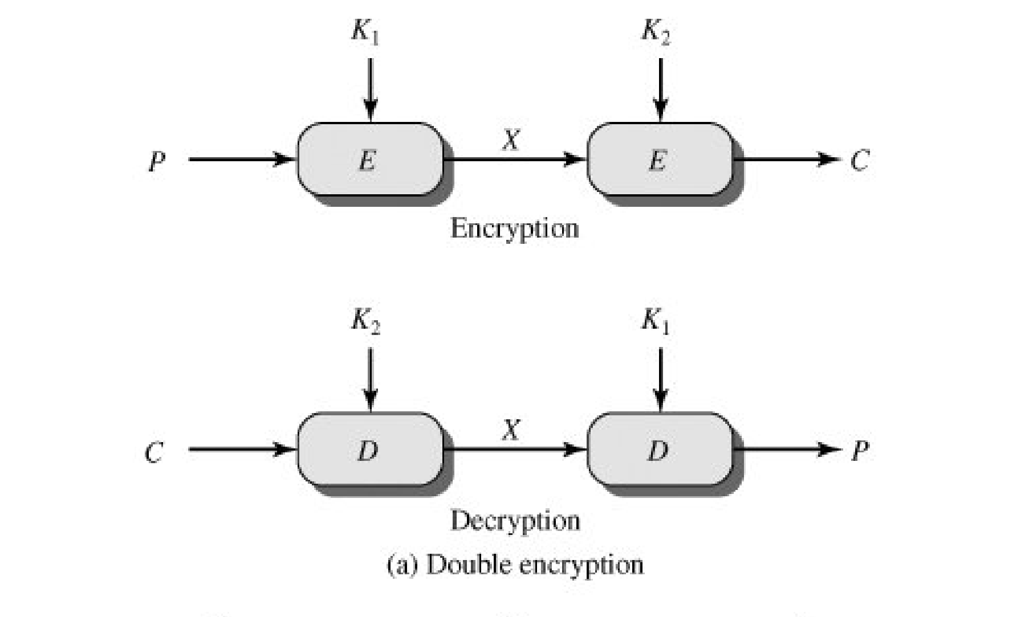

Slide 31
Triple DES
use three stages of encryption with three different keys
C=EK3(EK2(EK1(P)))
􀂉Drawback: keys is now 168 bits which makes it slower
􀂉Alternative: 3DES with 2 keys: K3=K1
􀂄Another alternative: instead of three encryptions, use 2 encryptions and one decryption

Slide 32
Triple DES
Use three keys and three executions of the DES algorithm (encrypt-decrypt-encrypt)
C = ciphertext
P = Plaintext
EK[X] = encryption of X using key K
DK[Y] = decryption of Y using key K
C = EK3[DK2[EK1[P]]]

Slide 33
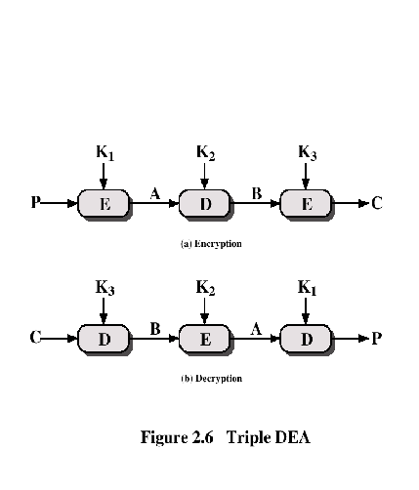
Triple DEA

Slide 34
Assignment
Ciphertext: 11101011
Key: 1011100110
Find Plaintext?

