Slide 1
Types of legs

Slide 2
Cursorial
Saltatorial
Raptorial
Fossorial
Natatorial
Clinging
Silk secreting
Antennae cleaner
Pollen collecting
Basket like

Slide 3
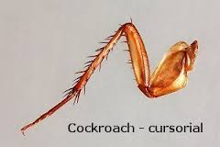
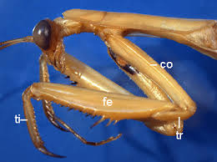
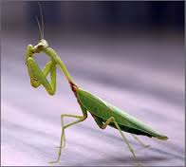
Cursorial (ambulatory or waling legs)
Femur normal
e.g., metaleg of cockroach
Saltatorial (Leaping or jumping)
Femur contain powerful muscle
E.g., metaleg of grasshopper
Raptorial (catching or grasping)
Coxa long
Femur long and thick
Have double row of spines
Have groove
Tibia shorter, spiny
Fit into the groove of femur
E.g., proleg of mantid

Slide 4
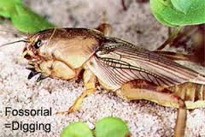
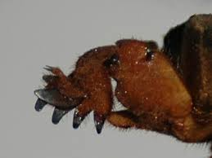
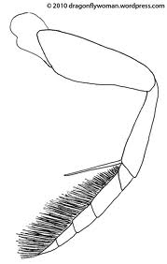
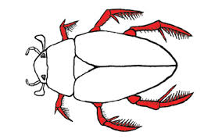
Fossorial (digging)
Parts reduced and strong for digging
Tibia has finger-like projection
Tarsus has 3-finger like processes
which are seen below those of tibia
E.g., proleg of mole cricket
Natatorial (swimming)
All parts are flattened
Tarsus has long hair
E.g., metaleg of giant water bug,
water beetle

Slide 5
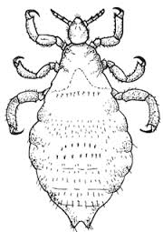
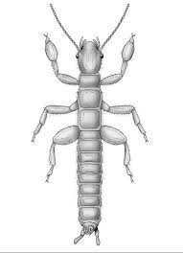
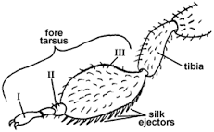
Clinging
Tibia has small process at its apex
Tarsus 1-segmented and bear claw that fit against tibial process for clinging to hair of host
E.g., louse
Silk secreting
1st segment of fore-tarsus swollen and contains silk glands
E.g., proleg of female webspinner

Slide 6
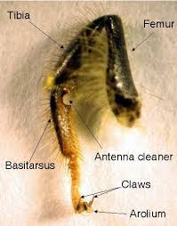
Antennae cleaner
Long spur at the apex of tibia
Semicircular notch on proximal end of tarsus (contain fine hair)
Antennae drawn through this for cleaning
E.g., proleg of honey bee

Slide 7
Pollen collecting
Tibia dilated
Outer surface smooth, bordered on each side with a fringe of long curved hair, which is called corbicula or pollen basket
Row of hair on distal end of tibia, called pecten or pollen rake
Basistarsus (1st seg of tarsus) has transverse row of short, stiff hair on its inner surface called Scopa or pollen comb or pollen brush
E.g., metaleg of worker honey bee

Slide 8
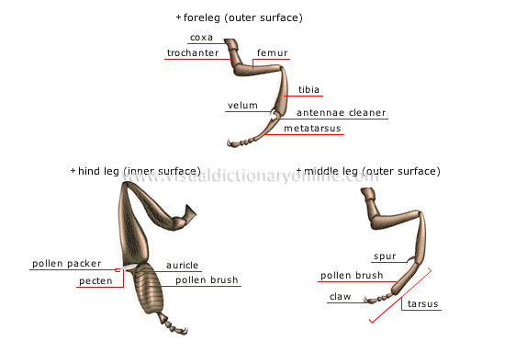
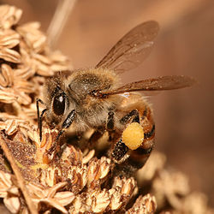
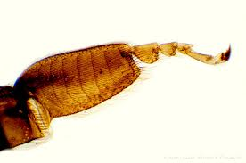
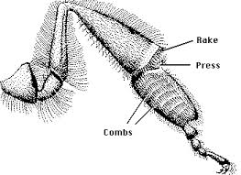
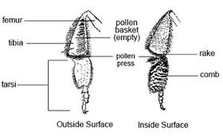

Slide 9
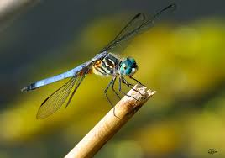
Basket-like
During flight, all legs come together to form a basket below mouth for catching and eating insects
E.g., dragonfly, damselfly

Slide 11
To be considered
http://www.entomology.umn.edu/cues/4015/morpology/

Slide 12
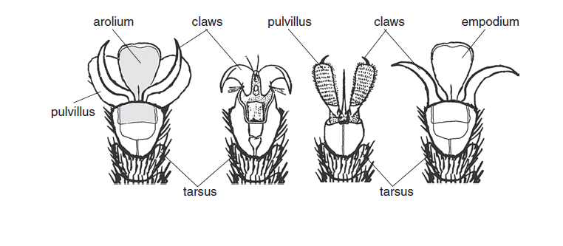

Slide 13
Arolium, Empodium, Pulvilli
The tarsus of insects usually consists of several small joints, the last of which generally carries a pair of terminal claws. The last tarsal segment may be extended between the claws to form a pad-like organ - the arolium. Some Diptera (true flies) have two additional pads - the pulvilli (singular: pulvillus) - lying below the claws on either side of the arolium , although in most flies, including the common housefly and its relatives, the arolium is replaced by a stout central bristle - the empodium. In many insects, the other tarsal segments also have ventral pulvillus-like organs, called plantulae. These various structures - the arolium, pulvilli and plantulae - produce a sticky secretion and act like ‘suction-pads’, enabling the insect to climb smooth or steep surfaces. This is the secret of the fly’s ability to walk up-side-down on the ceiling!

Slide 14
Pulvilli are lobes or padds that are located between the tarsal claws of many insects. The pads have adhesive properties, including the use of an adhesive fluid, and this helps the insect stick to the surface on which it is standing.
Between the pulvilli there is often a spine called the empodium.

Slide 15
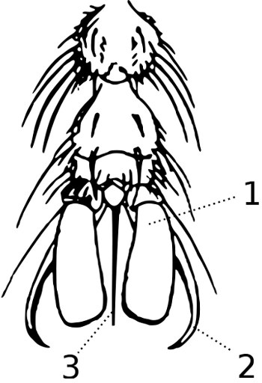
Pulvillus (Pulvilli)
Claw
Empodium
Leg of house fly

Slide 18
The diving beetle's leg is used to swim; the flea beetle's to jump; the hog louse's to clutch the host's skin; themole cricket's to dig; the ichneumon fly's to run; the honeybee's to carry food; the mantis' to catch prey.

