Slide 1
Non- Metallic Poison
Phosphorus Poisoning.

Slide 2
Physical Appearance
:
there are two varieties of phosphorus Red and Yellow
Red Phosphorus:
Amorphous
Non Luminas
Relatively Non toxic
Radish Brown Powder has no taste or smell and non poisonous
it is inert unless contaminated with the white form

Slide 3
Yellow Phosphorus :
Crystalline and highly toxic
Translucent and waxy
Luminous in the dark
Gives off dense white fumes of phosphate and phosphoric acid when exposed to atmosphere.

Slide 4
the fumes glow with pale yellow color called phosphorescence
it has garlicky odor and highly volatile.
It ignites at room temperature hence must be constantly stored under water

Slide 7
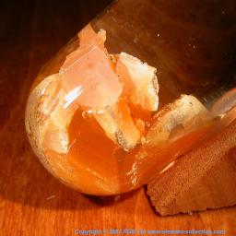

Slide 9
Uses :
Military purpose, Rescue flares , fire works , rodenticide and insecticide
Red type is used on the side of match boxes , ignited by rubbing against the side of match box covered with thin layer of phosphorus and powdered glass

Slide 10
Mechanism of action:
Phosphorus is a protoplasmic poison. It affects cellular metabolism. Under such anaerobic conditions, the metabolism of cells may still proceed but will be considerably diminished.
because lack of energy. Fat accumulates in the cells leading to fatty change. This is called Necrobiosis.

Slide 13
Fatal dose:
usually 1 mg/kg body weight is fatal.
Fatal period:
death may occur by collapse is fatal. It ranges from 60 to 120mg.

Slide 14
Sign and symptoms:
Fulminate poisoning: results from massive intake of phosphorus. The dominant clinical phenomenon. Death occurs in 12 to 48 hrs
Acute poisoning:
This results from moderate dose of phosphorus(0.1 to 1 gm). The clinical manifestations include two phases.

Slide 15
Primary symptoms:
these occur within 2 to 6 hrs. they are primarily due to the local irritative action of phosphorus on the GI tract. They include following.
Intense thirst
Garlic like taste in mouth
Burning in the mouth
Followed by nausea

Slide 16
The vomitus and stools have a garlic or sulphurous odor and are luminous
Contact with skin produces
Primary stage may last for 1 – 2 days
Remission are also common with bouts

Slide 17
secondary symptoms:
these appear after 2- 6 days and are due to the absorption of phosphorus and its action.
Jaundice and abdominal distention due to enlargement and necrosis of liver.
In early stages there is liver enlargement due to fatty degeneration.

Slide 18
Purpura and epistaxis develop due to hypoprothrombinemia
Skin shows purpuric sots
Pregnant woman abort with alarming flooding of blood
Priapism is frequent

Slide 19
Treatment:
1- Demulcents are contraindicated as they increase the absorption
2- gastric lavage: with 0.5% sol. Of KMnO4
3- KMnO4 is chemical antidote
4 -The bowl must be emptied by a brisk purgative
5 - dil. Sol. Of CuSO4 an be used

Slide 20
Liquid paraffin can be given as it retards absorption
Calcium gluconate i/v if blood calcium is decreased.
Sod. Bicarbonate to maintain alkali reserve
Iv saline to combat shock
Iv dextrose to prevent liver failure

Slide 21
Vitamin B complex, vitamin K and C are necessary
Peritoneal or hemodialysis may be needed if kidney failure sets in.
Skin burns should be washed thoroughly with 1%CuSO4 sol. Or 1% sodium bicarbonate soln.

Slide 22
Postmortem Appearance:
These differ according to whether death takes with in the first 24 hrs. or after the lapse of few days. The findings are that irritant poison consisting of:
Erosion of the mucous membrane of pharynx and intestines

Slide 23
Cloudy swelling of the liver and kidney may be other findings
The body emits smell of garlic
If death occurs after 24 hours the appearance shows the following findings

Slide 24
External
Body may be emaciated and has smell of garlic
Jaundice and hemorrhages under the skin and various natural orrifices of the body
Internally
Fatty degeneration in viscera especially liver (necrobiosis)
Hemorrhages in viscera stomach and intestine.

Slide 25
The mucus memberane of the stomach and intestine will be yellowish or grayish white, softened inflamed or eroded.
The stomach and intestine contents will be of garlicky & luminous in the dark.
Fatty degeneration of heart muscles, voluntary muscles and kidneys

Slide 26
Sub- endocardial hemorrhages are usually evident in left ventricle.
The blood may appear tarry and its coaguability will be diminished.
The viscera preserved in saturated sol of common salt and not in spirit.

Slide 27
CHRONIC POISONING
Common among workers in match factories ( containing white P).
Poisoning now a days is due to the inhalation of fumes over a long periods of time. The vapor gain access to the jaws through carious tooth, where the micro organism already present.

Slide 28
Symptoms:
Osteomyelitis of jaw bones with multiple sinuses discharging foul smelling pus.
The initial symptoms are toothache
Later on swelling of jaw, loosening of teeth and necrosis of gums.
Eventually bone get sequestered in the mandible. This is known as phossy Jaw.

Slide 29
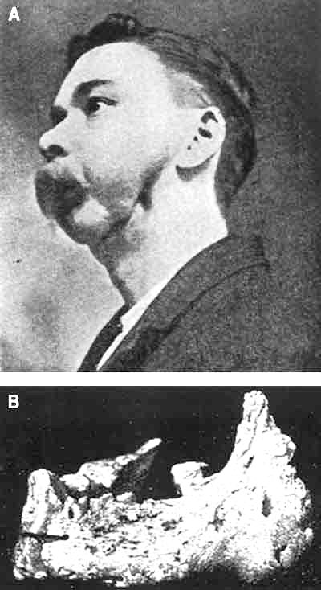

Slide 30
Systemic manifestations,
anorexia, weakness, joint pains, hepatic damage etc . Are also present.

Slide 31
Treatment
Regular examination of teeth of workers
Periodic X-rays of upper and lower jaw for early detection of bone caries.
Surgical excision of sequestered bone is advised.

Slide 32
M/L Importance.
Accidental
In children via fire works, rat pastes. Quacks to procure abortion.
Suicidal
By eating rat pastes, soak several matches in water and then drink it.
Homicidal
Not common due to smell. Rat paste can be used and mimic acute liver disease death occurs in few days.

Slide 33
Arson
P wrapped in wet rag placed on the thatched roof of a house. It ignites resulting in conflagration. Insurance frauds committed this way.
It can be detected in putrefied bodies as well.
P occurs in various foods as well as tissues and body fluids in the form of phosphates. Its presence in the body in elementary form are essential to confirm its poisoning.

