Slide 1
Spinal Cord Injury Management

Slide 2
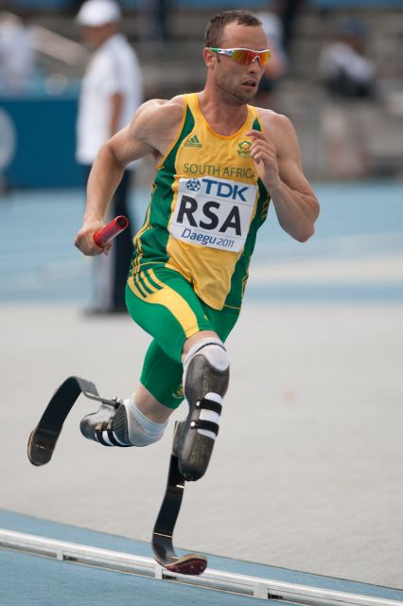
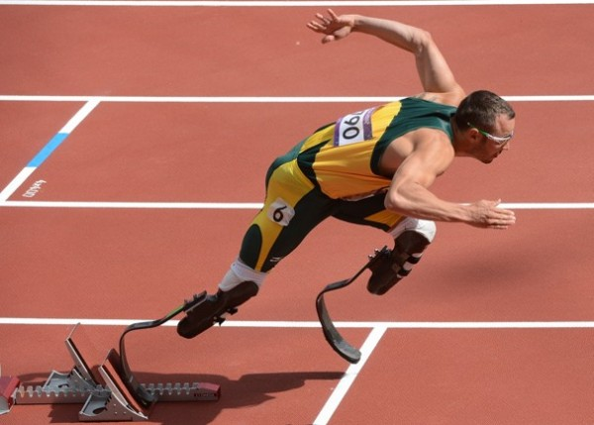
You are not disabled by the disabilities you have.
You are able by the abilities you have.”
– Oscar Pistorius.

Slide 3
Outline
Transfer and bed mobility of people with lower limb paralysis
C6 Tetraplegia
Thoracic Paraplegia

Slide 4
C6
Triceps ????(answer:- no triceps are not intact)
Mobility task
Sitting unsupported
Rolling
Moving from lying to sitting
Transferring

Slide 5
Sitting Unsupported
Integral part in
Dressing and transfer
Reaching and grasping
Sitting balance good……. mobility less
Sitting balance challenge more mobility
Normal reaching trunk and leg muscle activity …..proprioception…..anticipatory postural …..feedback……
SCI no proprioception ..no leg activity…..different strategies

Slide 6
Upper limb strategies
Stabilize the trunk
LD, SA and pect
C6 High level of independence than C5
Normal muscle in reaching sideways
Trunk and neck opposite side bend
Center of mass
SCI …… abduct other limb to counterbalance COM
Front …other arm backward and neck extend

Slide 7
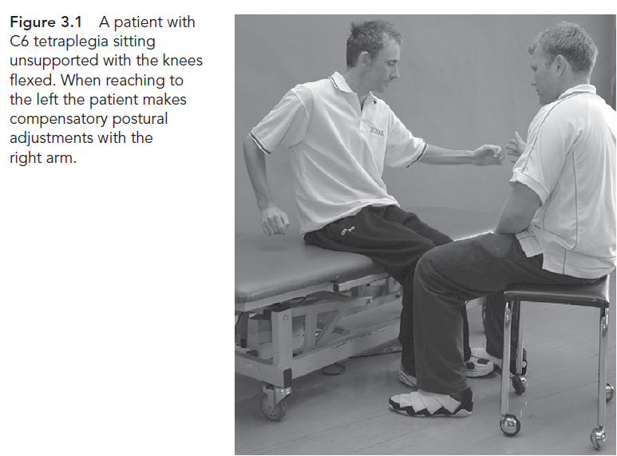

Slide 8
Compensatory postural adjustments not spontaneous
C-6 has high Fall risk b/c of triceps paralysis.
Triceps
Hand and wrist muscle
With practice compensation occur

Slide 9
Sitting with knee extended
Greater passive stretch when knee extend
Produces hip extensor torque….prevent falling forward
Extensibility of hip joint
Role of hamstring in sideways fall??? (No role of hamstring in side ways fall).
Knee flexed no passive tension
Sitting over side of bed
Surfaces ,(there are some surfaces on which sitting is too difficult).

Slide 10
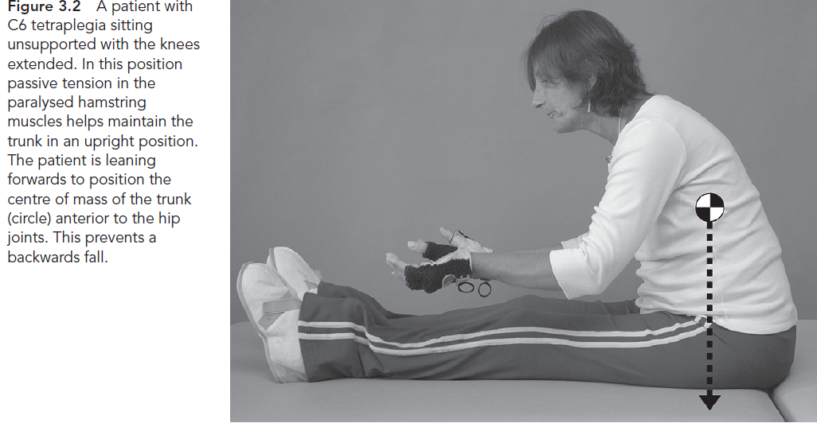

Slide 12
Rolling
Dress and change position
Pre requisite for sitting
Normal
Leading arm …trunk and legs
SCI…..head and upper limb rolls
Rapidly swinging the arm
Angular momentum
Ankle crossed …head lift….
Triceps….shoulder external rotated …..

Slide 13
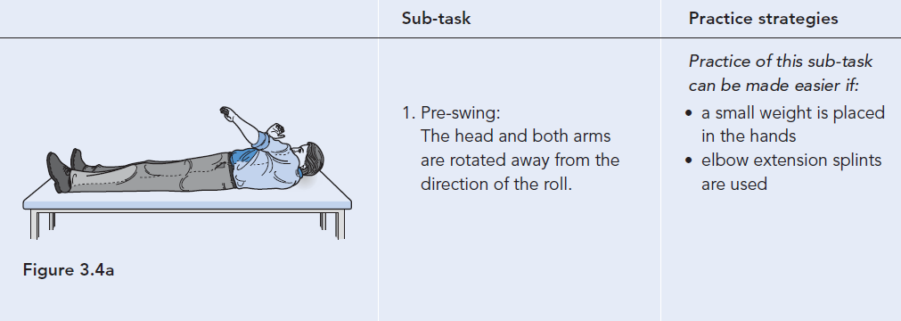

Slide 14
Lying to long sitting
Dressing and transferring
Two option lying to sitting
One approach
From lying to sitting
C6 side lying position and walking one or both elbows around the body
Other option
Lying to sitting position

Slide 15
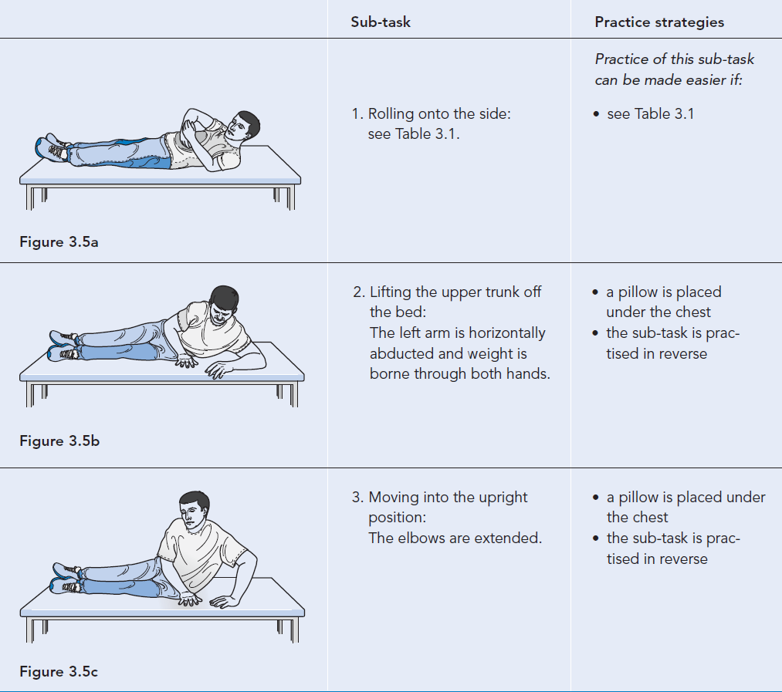
Paraplegic

Slide 16
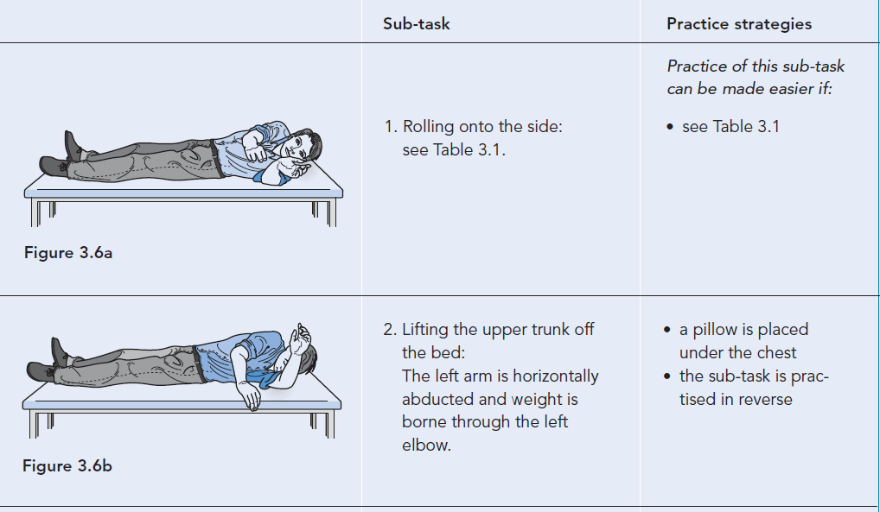
C6

Slide 17
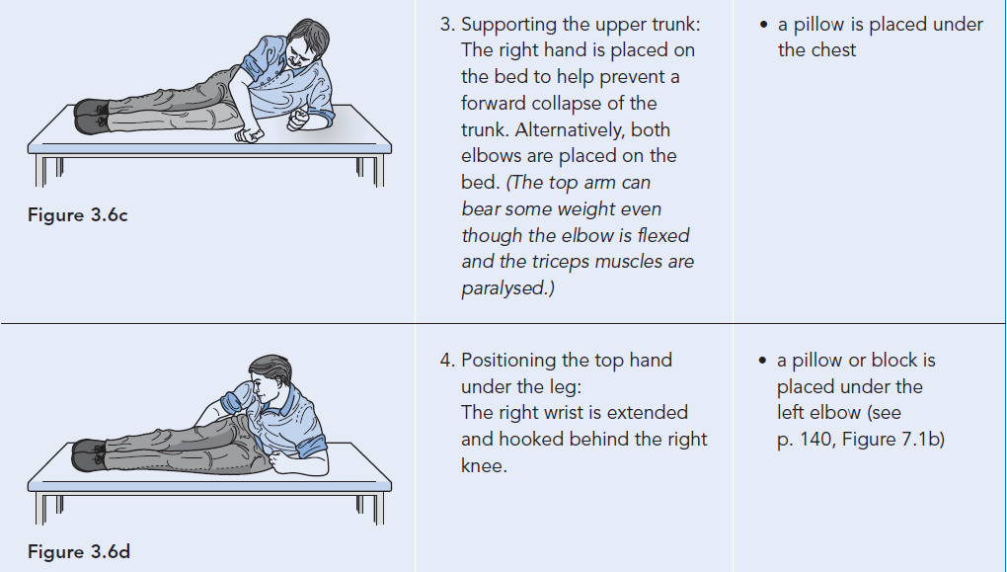

Slide 18
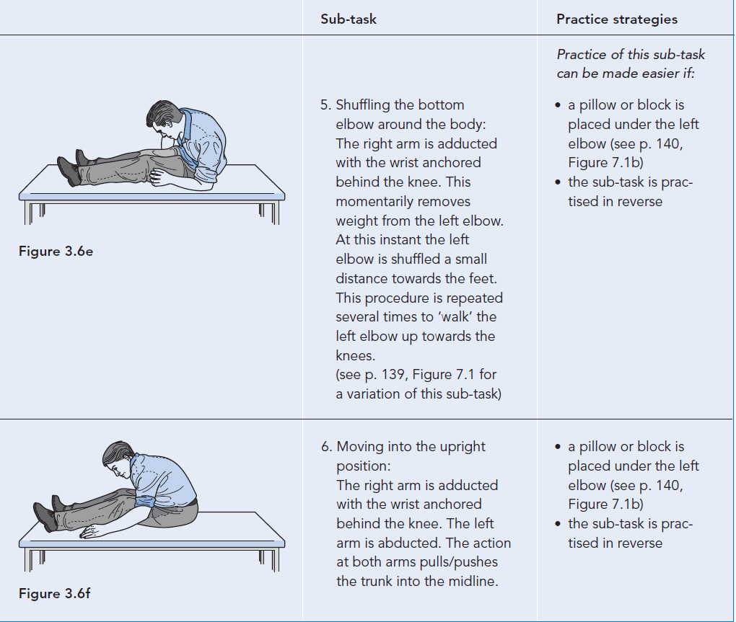

Slide 19
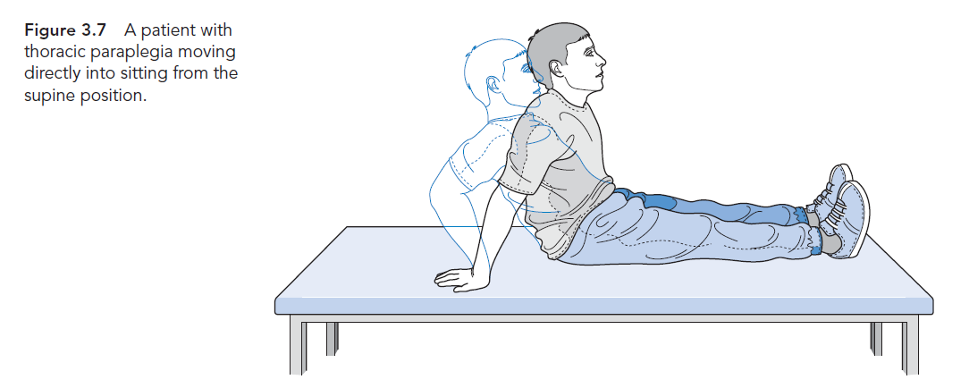

Slide 20
Vertical lift
Relieve pressure, transfer etc
Long sitting and sitting on WC
Which is easy position for lift and why
Three components
Elbow extension
Shoulder depression
Shoulder flexion
Controlled by LD, PECT, ant.Deltiod and lower trapezius
GH joint stabilized in adduction and depressed

Slide 21
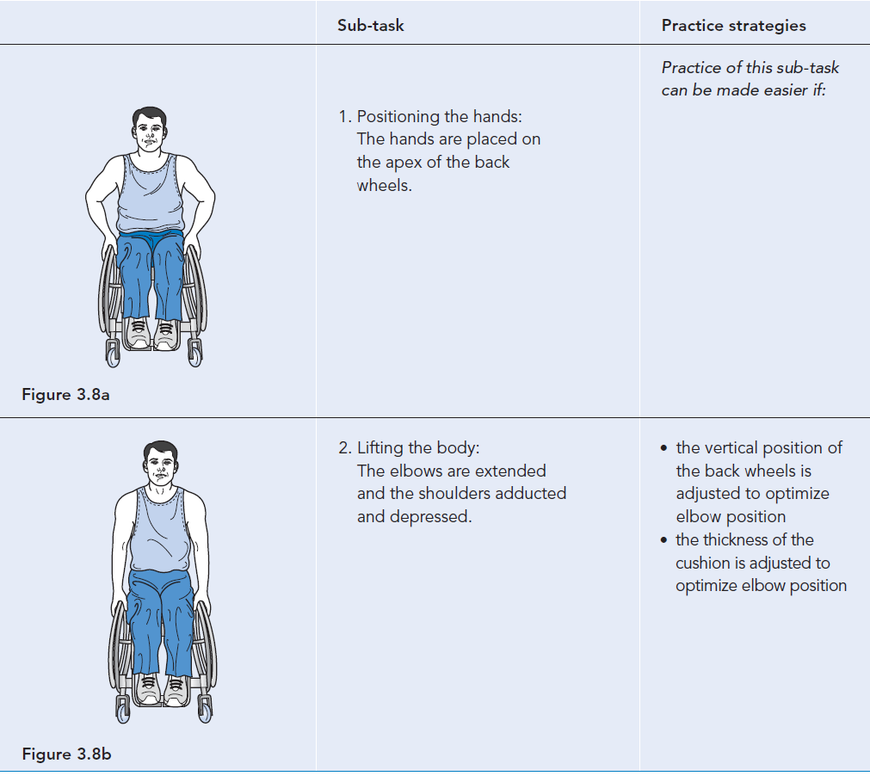

Slide 22
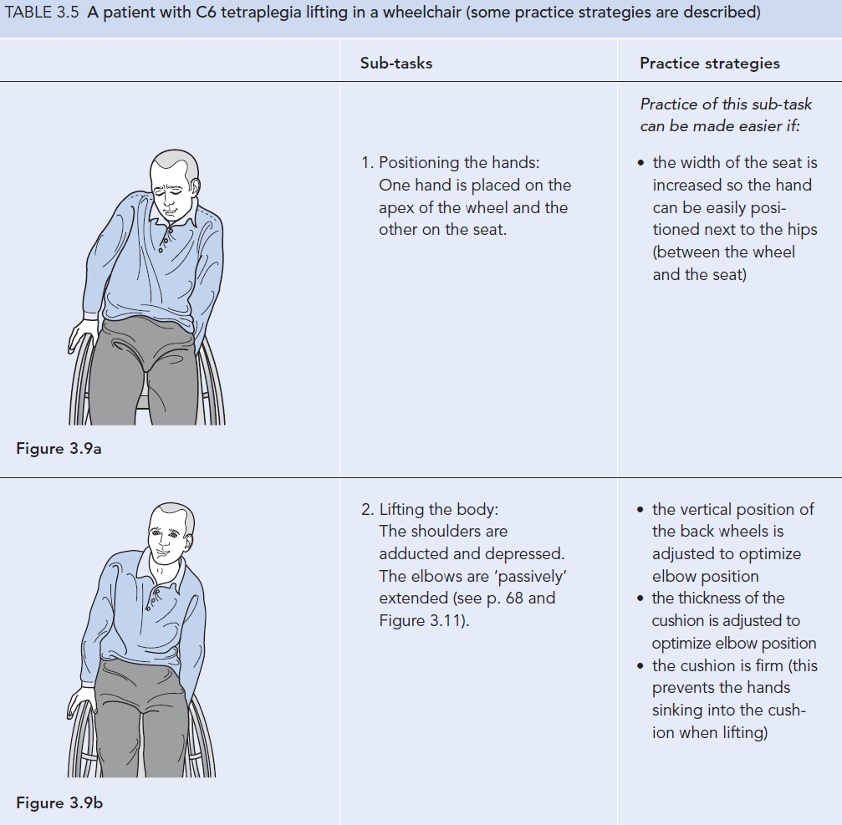

Slide 23
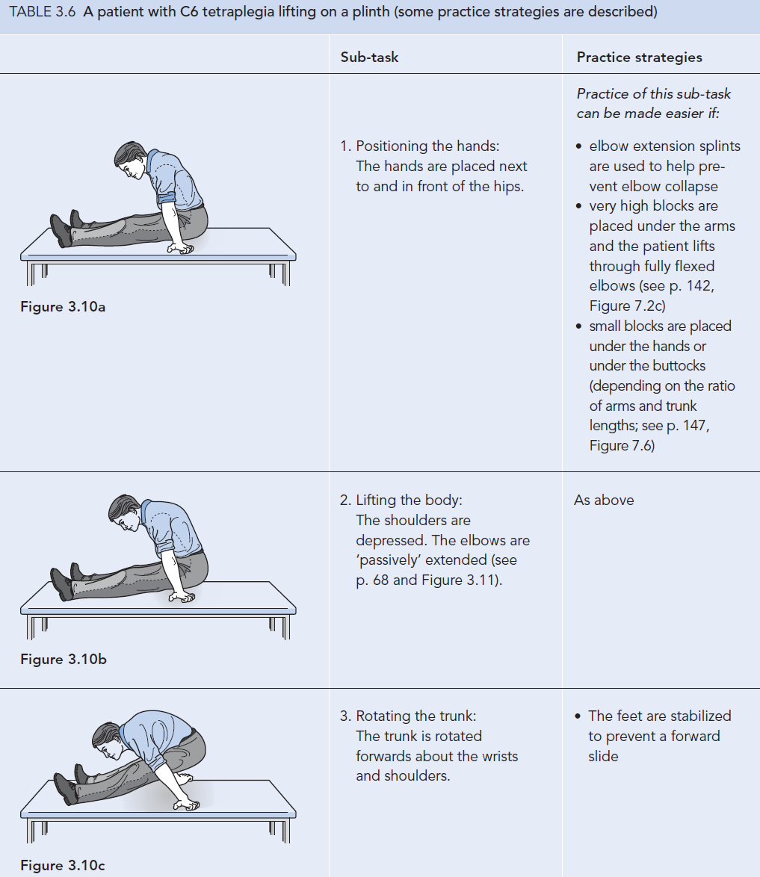

Slide 24
