Slide 1
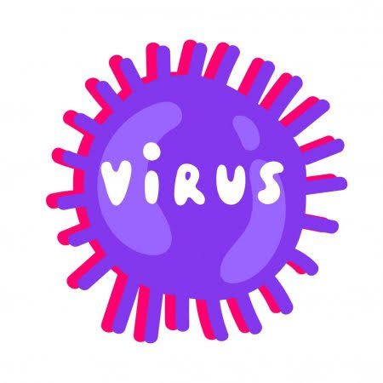
Virus biology

Slide 2
virology
The branch of science that deals with viruses and viral disease is called virology.
Virus:
Viruses are acellular obligate intracellular parasite.
OR
Any of large group of submicroscopic infectious agents that are usually regarded as between living and non living extremely complex molecules , that capable of growth and multiplication only in living cell and cause diseases in living organisms.
(Merriam webster)

Slide 3
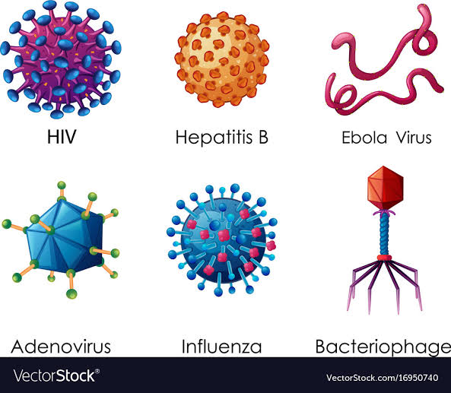

Slide 4
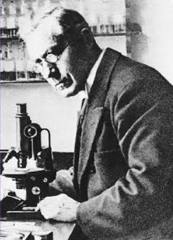
Discovery of viruses:
Beijerinck (1897) coined the Latin name ‘virus’ meaning poison..
He studied filtered plant juices and found they caused healthy plants to become sick.
Edward Jenner (1796) developed a smallpox vaccine using milder cowpox viruses.
Deadly viruses are said to be virulent.
Smallpox has been eradicated in the world today.

Slide 5
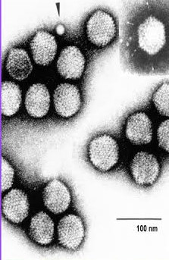
Viewing viruses:
Viruses are smaller than the smallest cell.
Viruses could not be seen until the electron microscope was invented in 20th century.
Viruses measured in nanometers.
Size of some viruses are following:
Poxvirus 250nm
Herpes simplex 150nm
Rabies 125nm
HIV 110nm
Influenza 100nm
Adenovirus 75nm
T2 bacteriophage 65nm
Poliomyelitis 30nm
Yellow fever 22nm

Slide 6
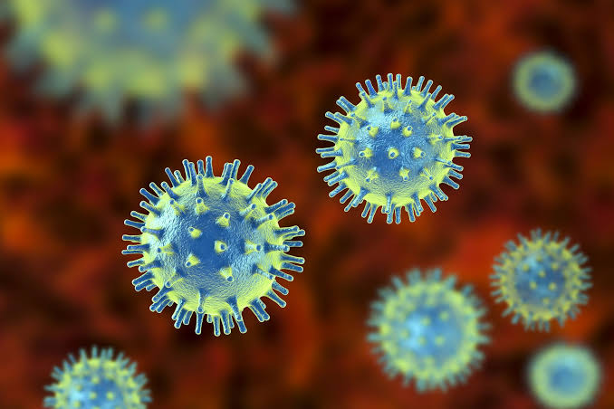
Properties of viruses:
Viruses are not cells, do not have nuclei or mitochondria or ribosomes or other cellular components.
Viruses replicate or multiply. Viruses do not grow.
Viruses replicate or multiply only within living cells.
Viruses are obligate intracellular parasite.
Viruses are acellular.
It use the metabolic machinery of host.
They are inert.
It contain nucleic acid either DNA or RNA.
It can mutate.
It can grow.

Slide 7
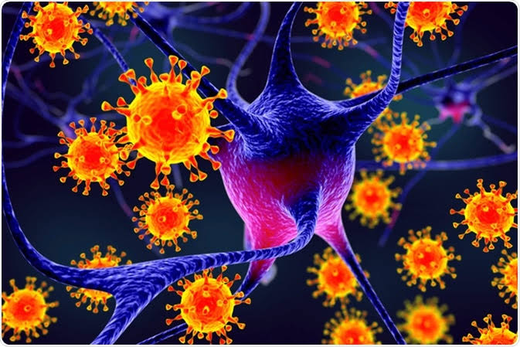
Contin…
Viruses have a host range. That is, viruses infect specific cells or tissues of specific hosts, or specific bacteria, or specific plants.
Viral specificity refers to the specific kinds of cells a virus can infect. It is regulated by the specificities of attachment, penetration and replication of the virus.
They are obligate.
They are intracellular parasite.
They pass from filter paper.
They are non reactive.
It do not have its own metabolic machinery.
They cannot able to make energy.

Slide 8
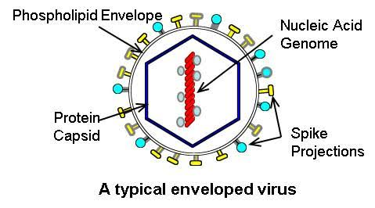
Components of viruses:
Viruses are composed of a nucleic acid, RNA or DNA - never both.
All viruses have a protein coat or shell that surrounds and protects the nucleic acid core.
Some viruses have a lipid envelope or membrane surrounding a nucleocapsid core. The source of the envelope is from the membranes of the host cell.
Some viruses package enzymes - e.g. RNA dependent-RNA polymerase or other enzymes.
Capsid (outer protein covering of virus)
Capsomere (capsid made up of protein subunits)
Envelope (lipid layer present outside the capsid)
Peplomers (outside envelope hair like projections present)

Slide 9
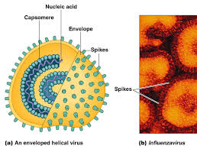
Spikes are also called peplomers.
Protomers are subunit of capsomeres.

Slide 10
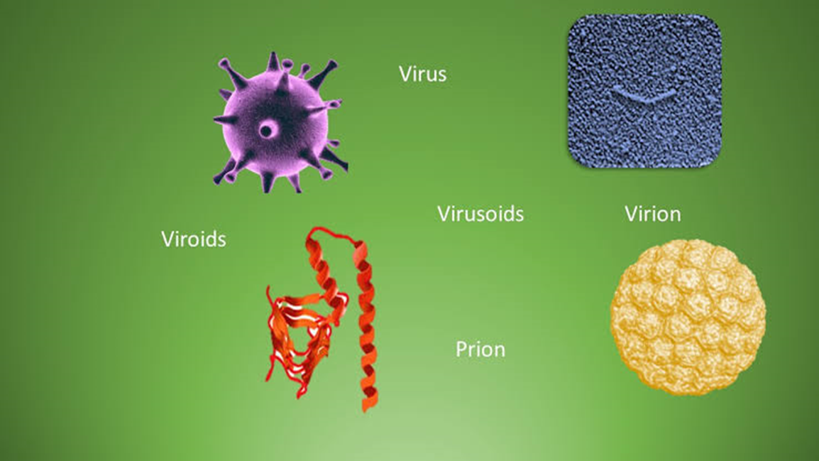
Virion:
Complete infectious agent of virus is called virion.
Viroid:
When virus only contain nucleic acid called viroid.
Prions:
When virus contain only protein coat called prions.
Nucleocapsid:
Combination of nucleic acid and protein coat that surround the genome of virus called nucleocapsid.

Slide 11
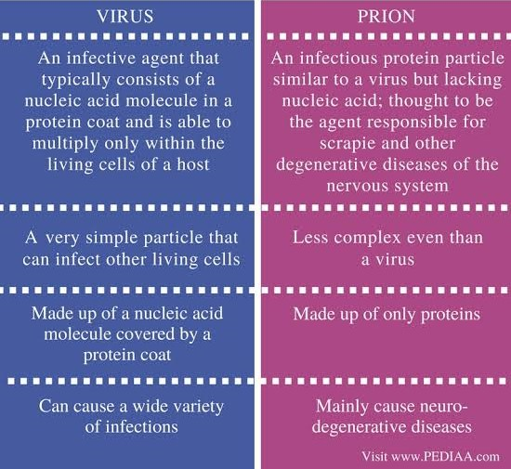

Slide 12
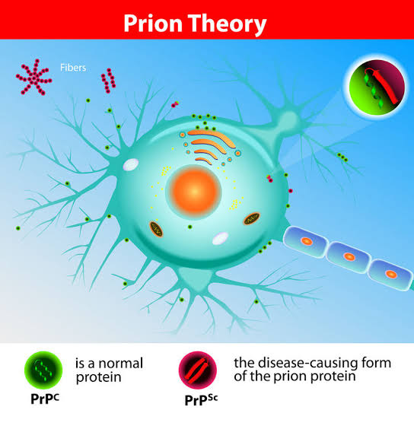
Prions are ‘infectious proteins.’
They are normal body proteins that get converted into the alternate configuration by contact with other prion proteins.
They have no DNA and RNA.
The main protein involved in human and mammalian prion diseases is called PrP.
PrP = Platelet rich plasma

Slide 13
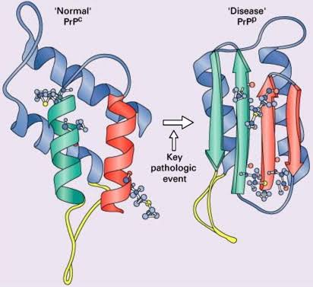

Slide 15
Symmetry of viruses:
Helical:
Hollow tube like. e.g. Tobacco mosaic virus.
Icosahedral:
Nearly spherical e.g. Rotavirus.
Envelope:
Envelope is develop outside the virus body. E.g. HIV and influenza.
Polyhedral:
Have five fold axis and is a common arrangement of the heads of bacteriophages.

Slide 16
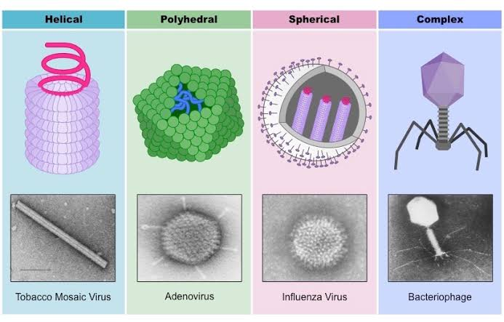

Slide 17
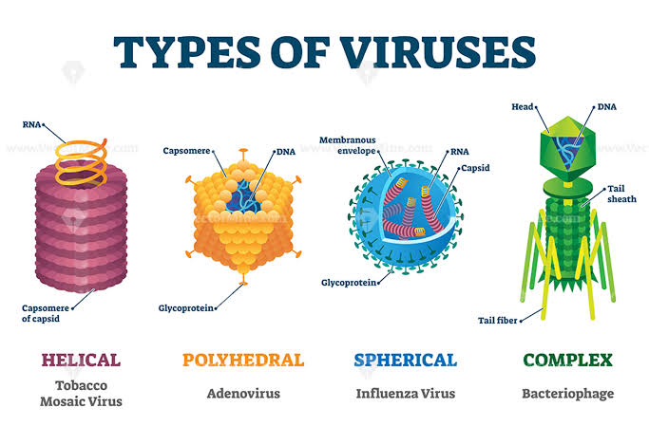

Slide 18
Taxonomic structure:
The ending of taxonomic structure of classification of virus is;
Order (-virales)
Family (-viridae)
Sub -family (-virinae)
Genus (-virus)
Species (-virus)

Slide 19
Types of viruses:
Animal viruses:
Viruses cause infection in animal cells. For example parvovirus, corona virus etc.
Plant viruses:
They are pathogens of plants.
They spread from plant to plant through vectors. For example tobacco mosaic virus.
Bacteriophage:
Viruses cause infection in bacteria and other microscopic agents.
For example T4 phage etc.

Slide 20
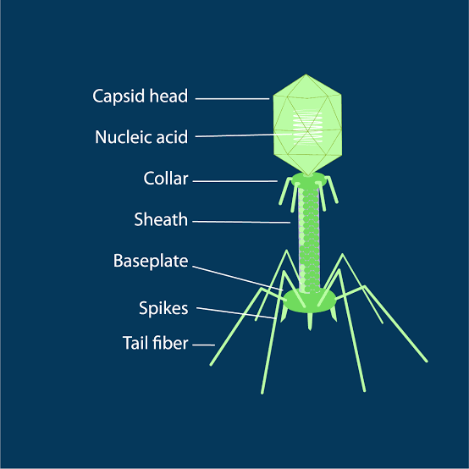
Structure of bacteriophage.

Slide 21
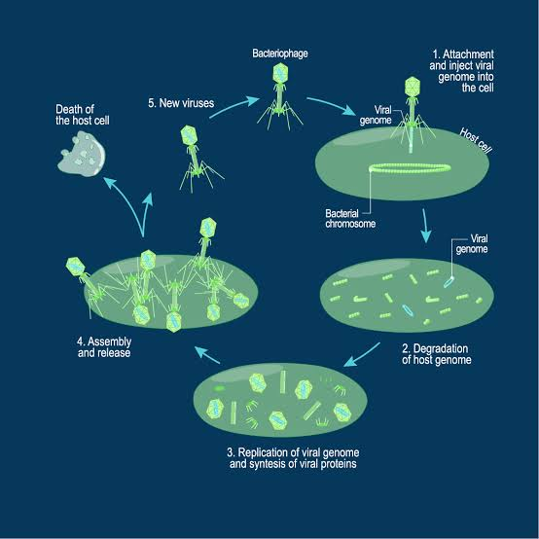

Slide 23
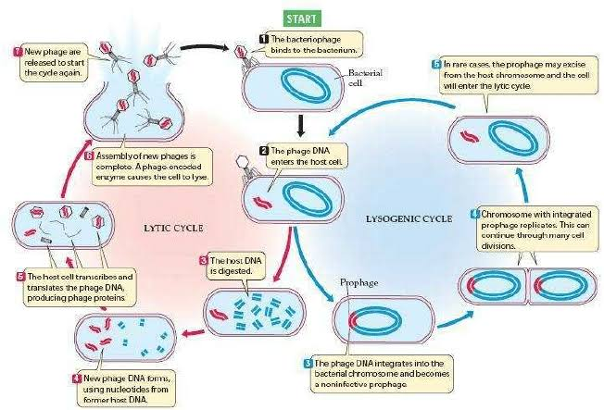

Slide 24
Thank you

