Slide 1
Rejuvenating Avocado Orchards
Replanting

Slide 2
Introduction
Growers should rejuvenate their avocado orchards for the following reasons:
Yield decrease: Tree weakening, low density planting (old density), tree death.
The avocado variety is no longer profitable.
Climate change: Frost where never before, drought.
Increased costs
When the problem is severe, pruning or stumping is not enough to rejuvenate our orchard. In these cases, the only option is to replace trees to recovery productive potential.
Replanting the orchard involve tree removal, remove the trunks and the main roots, soil preparation and make new ridges.

Slide 3
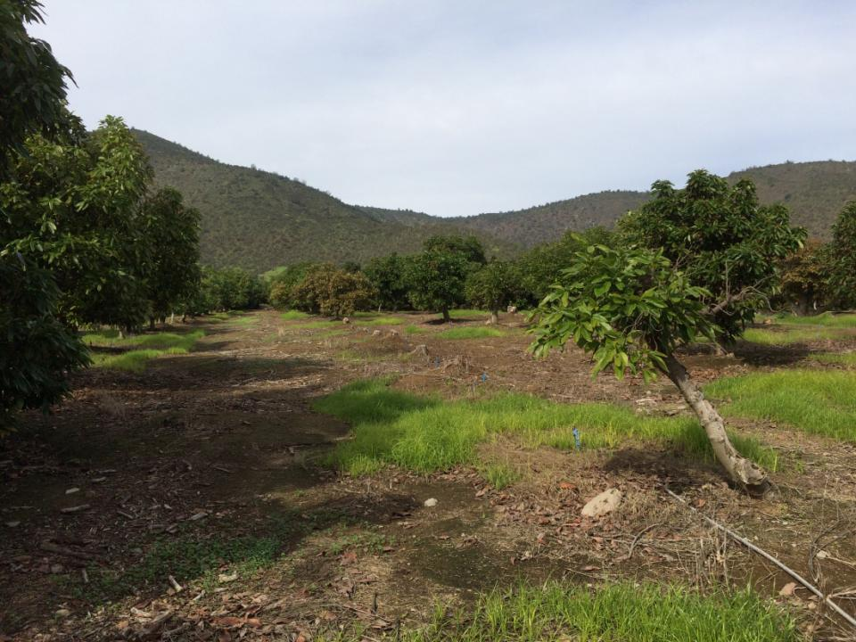
When this situation is observed, pruning or stumping are not an option. There are not only dead – missed trees, but also very weak ones.

Slide 4
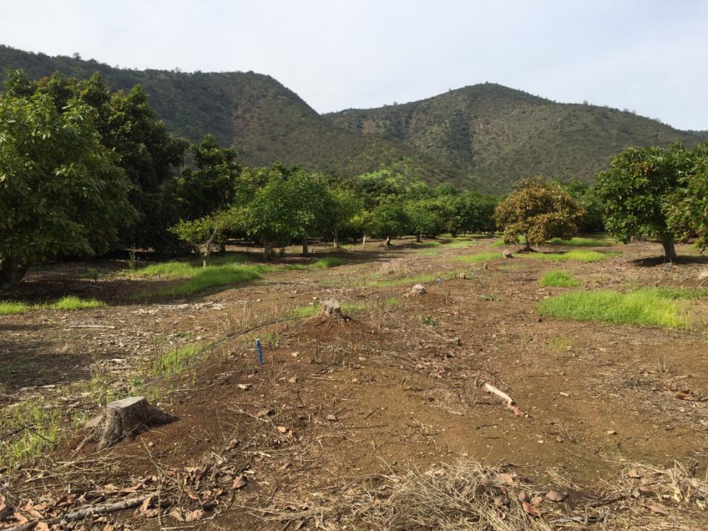

Slide 5
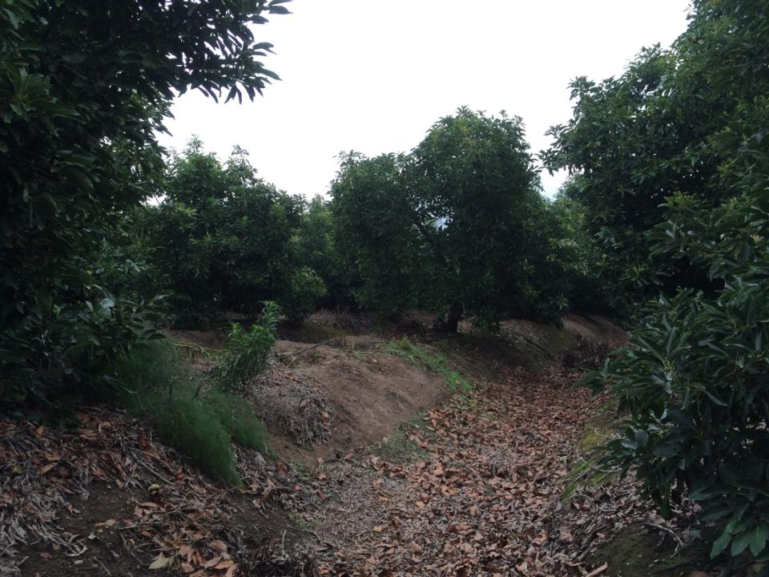
When tree death is high with a low density planting, it is impossible to recover the lost space, replanting is the better choice.
When 20% of the trees die, our productive potential (yield) loss 20% as well.
If the remaining trees (80%) is already weak or overcrowded the yields are low and take serious actions is required.

Slide 6
REPLANTING
Replanting inside the orchard
Only when:
Planting density allow a high productive potential.
When the trees are healthy and vigorous.
When tree death it not greater than 10%.
Replanting whole orchard or block
Only when:
Planting density is low (old). Less than 300 trees/hectare.
When the trees are weak, low vigor, root rot.
When over 10-15% of the trees are death.
4. When change variety or rootstock is required.

Slide 7
Replanting avocado trees in Chile was based in soil fumigation for many years, previous soil prep and the use of seedlings rootstock.
The restriction of soil fumigants (Methyl Bromide) usage, along with the clonal avocado rootstock, has led to replant avocado orchards without soil fumigation.
The major problems of avocado orchards replanting in Chile are:
High level of Phytophthora cinnamomi colonies in soil.
Soil compaction limiting root development causing root asphyxia.
Depletion mineral and biological fertility in soil.

Slide 8
Replanting whole orchard or block
It is the only way to rejuvenate an old and weak avocado orchard. Low density planting limit the productive potential.
The replant does not necessarily have to be done in whole orchard, but it is possible to replant the oldest or weakest
block in the first place.
For example, strategically define to replant 10% of the orchard every year.
Clonal rootstock allow to start a new orchard with more uniformity, high vigor, and high productive potential.

Slide 9
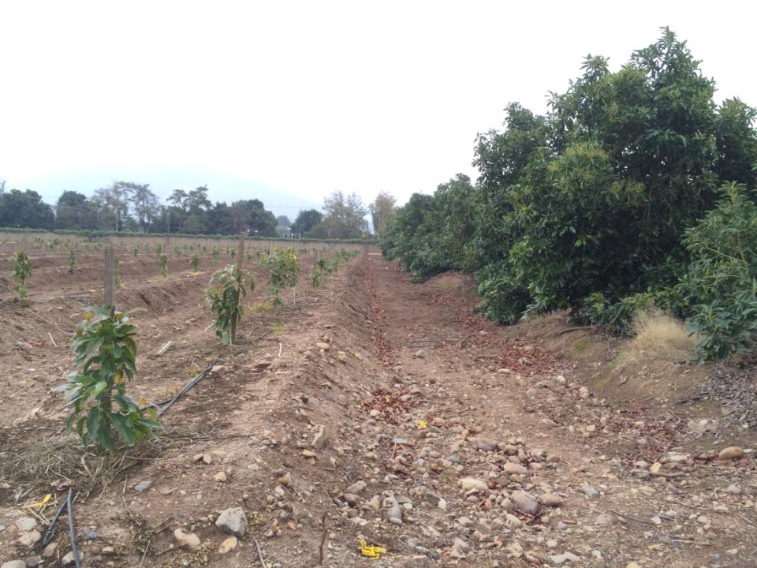
This old orchard (almost 30 years old) started a replanting program in Spring 2015

Slide 10
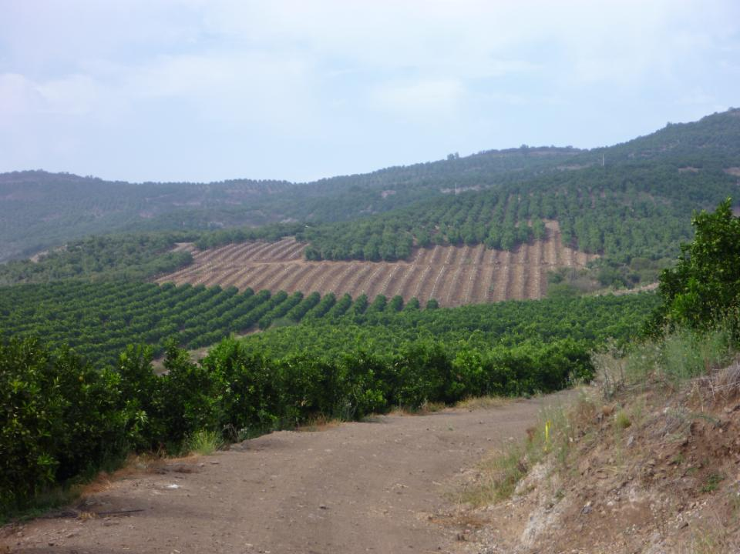
Even replanting younger orchards (seedlings rootstock) that have failed in heavy soils.

Slide 11
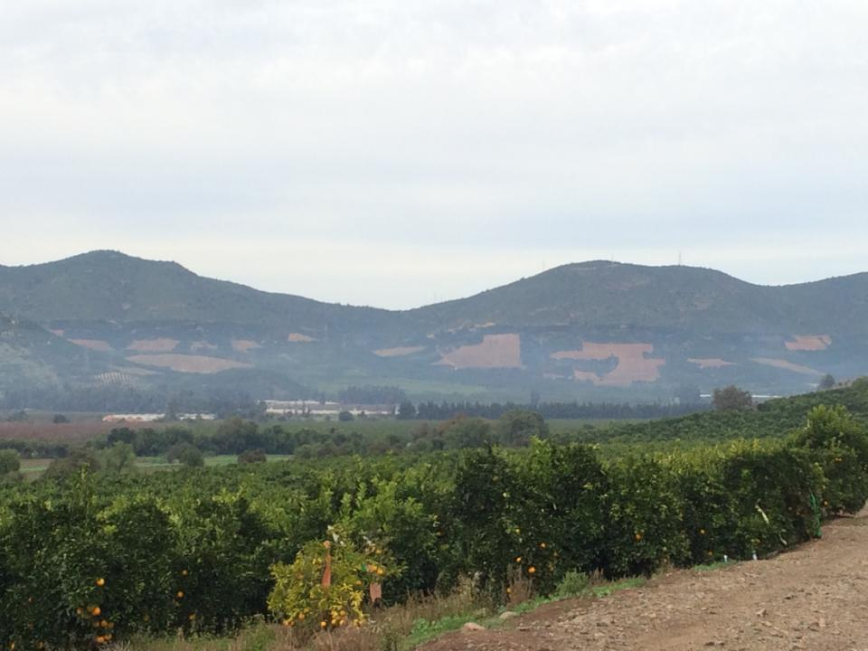
Big decisions are made when the yields are low!!!

Slide 12
Planting avocado clonal rootstock:
Irrigate the soil previous to planting. Irrigate the plants before take them to the field.
Keep plants vertical and never place them in direct sun light. Never pull or take the plants from the stem!
Dig a hole as deep and wide as the plant bag.
Remove the bag by hand very careful. Avoid using knives to prevent root damage (cuts).
Put the plant in the hole at the same level of the ground. Locate the more leafy area to the strongest sunlight (west). Replanting inside the orchard put the plant at least 1ft above the ground (a little mount).
Fill the hole with soil pushing gently to remove air bags. Check that the plant never stays below ground level.
Put organic matter (mulch) around the plant to improve root development conditions.
Irrigate deep (4hrs at least) to remove all the air bags.

Slide 13
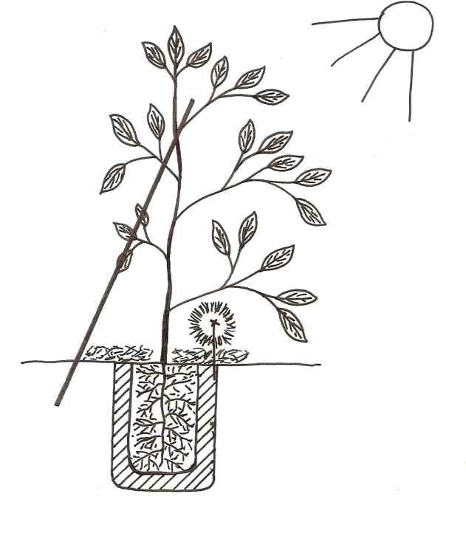
Wind
Scheme of planting avocado clonal rootstock in a new orchard.
Always is advisable to paint in white the stem to avoid sun burn.

Slide 14
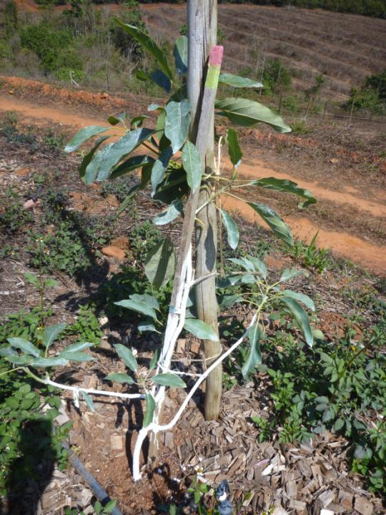
Avocado chip wood is very good for mulching

Slide 15
The organic mulch in avocado clonal new orchard is essential right after planting.
Clonal rootstock haven’t main deep roots as seedling rootstocks. All their roots are lateral and superficial.
These lateral roots must be very cared in first months after planting, and organic mulching gives stable humidity in soil and keep an ideal organic environment for root development, keeping a stable soil temperature.
Also, it is advisable to put covers to avoid rodents damage.

Slide 16
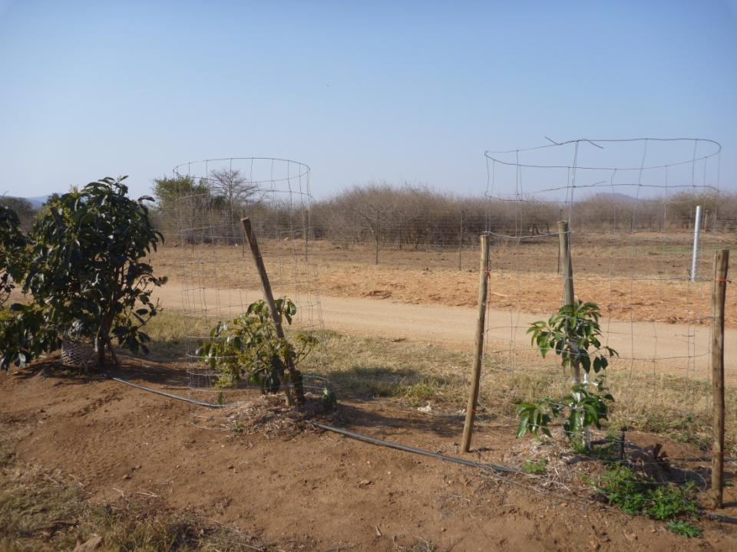
In South Africa they need to protect against Kudus and Impalas

Slide 17
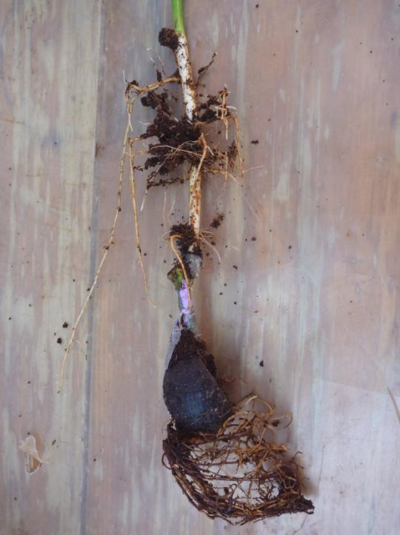
Clonal rootstock roots
Clonal rootstock scion grafted
Metal ring
Nurse seedling plant
Nurse seed (Esther)

Slide 18
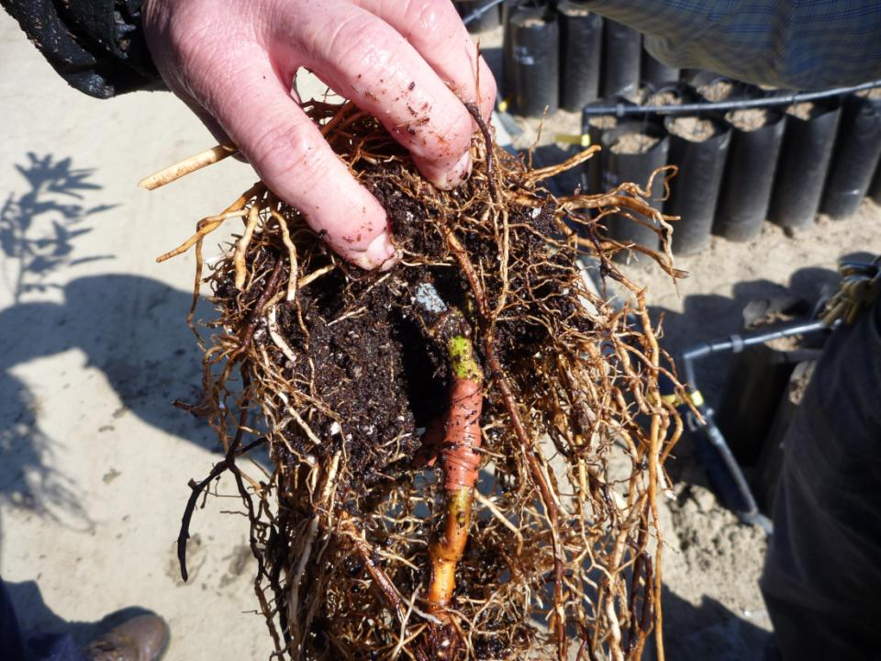

Slide 19
When a whole block (or orchard) is replanted, good soil preparation is required.
Over time the soil suffers a natural compaction, caused by:
Weight of plants and crop.
Water (irrigation and rains).
Machinery (tractors).
People harvesting, pruning...
Lost of organic matter in soil.
Lost of chemical structure in soil: Decrease of Calcium, increase Sodium.
All this factor decrease soil porosity and increase soil density. New avocado plants are unable to develop roots
under these conditions.
It should be considered that good soil prep will make for long term effects, and it should be done as best as possible.

Slide 20
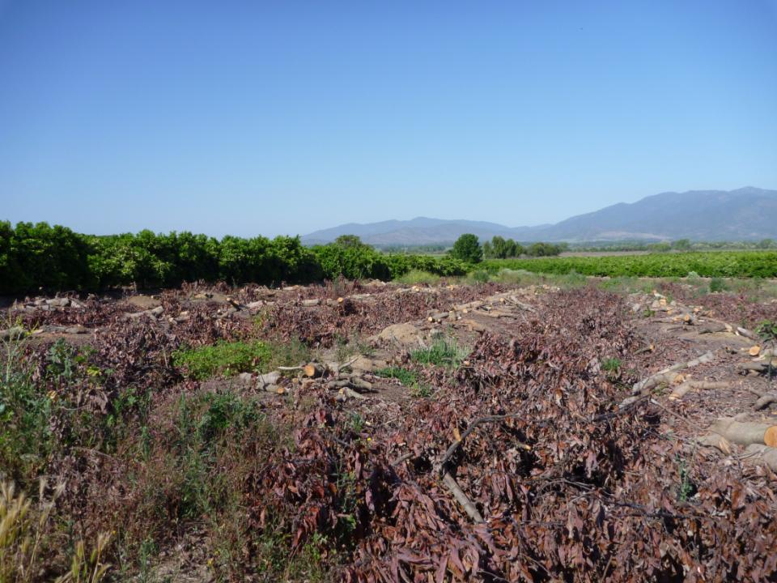
Once the old trees are cut and all the trunks and main roots are removed, the soil prep begins.

Slide 21
Soil Preparation Steps:
Big machinery able to break the soil 3.2 – 4ft deep.
The compacted soil must be broken, but not turned over. Deep high density clay layers can’t be put on top.

Slide 22
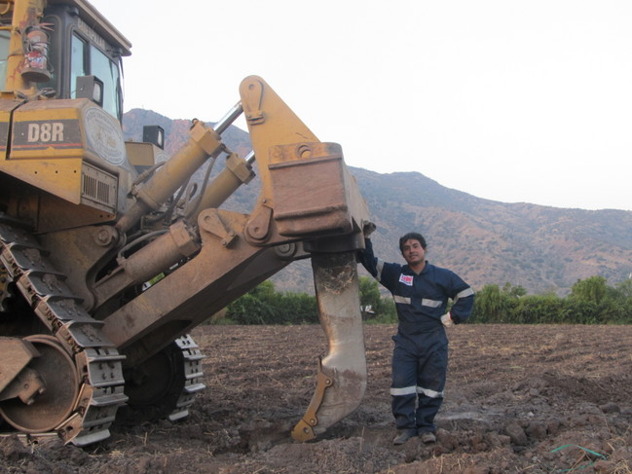
Once the ridges are destroyed, heavy D8 or D9 with a strong sting have to break the soil to loosen it.
5.5 – 6ft

Slide 23
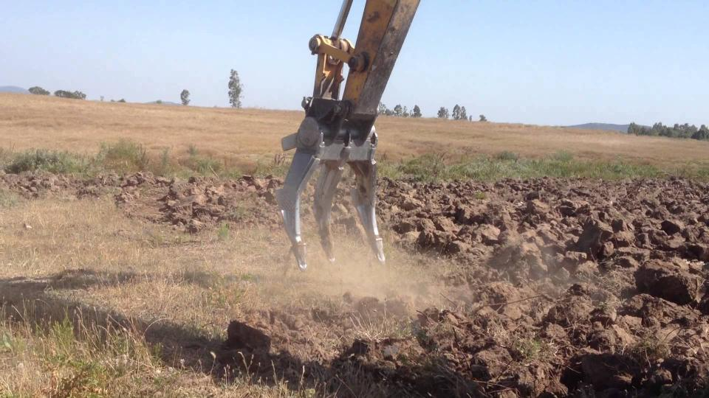
The claw machine breaks the soil very good with a low compaction problems. Now, it is widely used in Chile instead of D8.

Slide 24
Soil Preparation Steps:
Big machinery able to break the soil 3.2 – 4ft deep.
The compacted soil must be broken, but not turned over. Deep high density clay layers can’t be put on top.
In sandy loam soils with medium compaction the claw machine works very good. But in clay heavy compacted soil D8 or D9 works better.
For D8 the distance between the cuts should not exceed 2/3 of the effective deep penetration. For example, if the sting has 5ft long the cuts in the ground should be made every 3.33ft.
The ground has to be cut in one way and then in diagonal (45°).
It is more convenient to work in dry soil than wet soil (avoid soil lumps).

Slide 25
Claw machine works in reverse over planting line (avoid compaction). The claw has to work in 8ft wide over planting line.
The rest of the ground can be prep by plow, only when Claw machine is used.
If the soil is not enough fluffy after claw and plow, harrows can be used.
Previous ridges, it is very advisable to apply gypsum and organic matter (compost) to improve chemical and biological fertility.

Slide 26
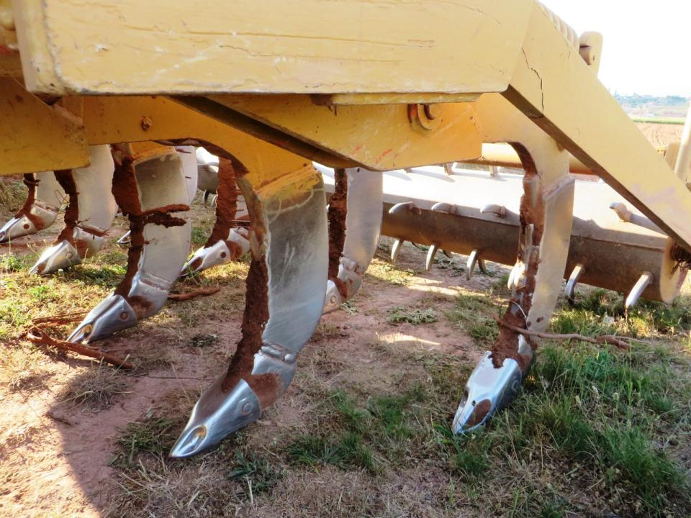

Slide 27
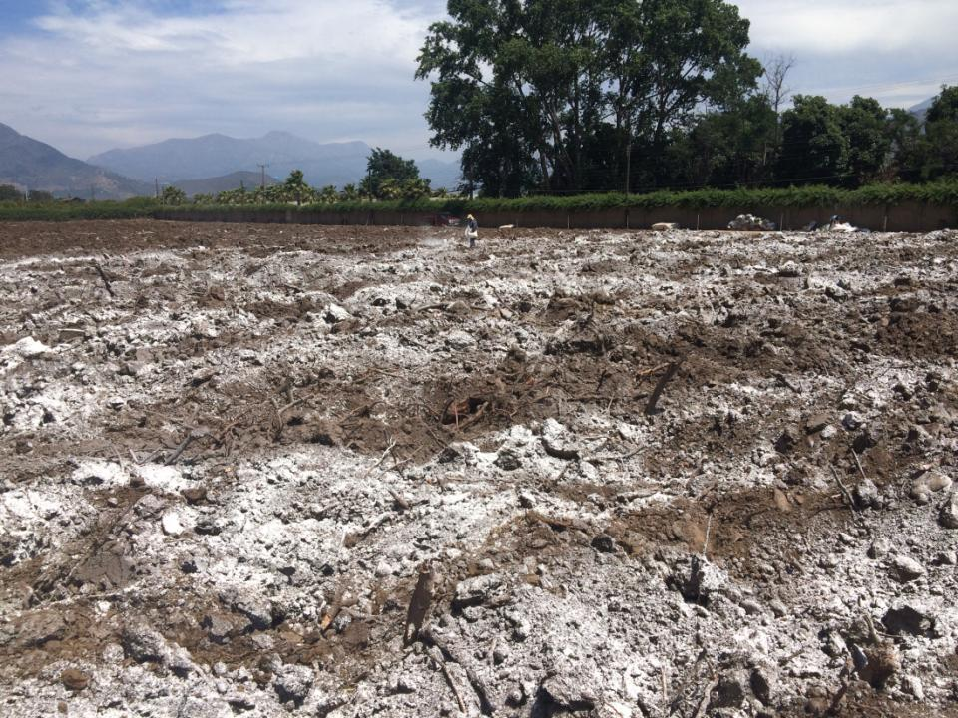
Gypsum: 4ton/hectare at least concentrated over planting lines
Organic Matter: 30m3/hectare (composted manure) concentrated over planting lines

Slide 28
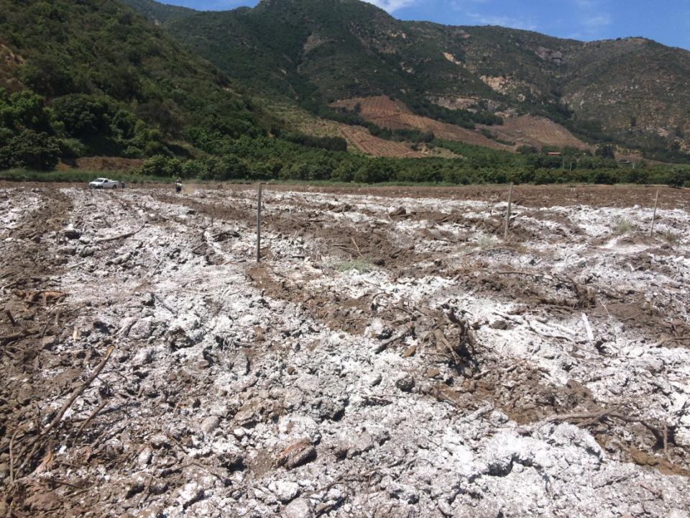

Slide 29
Ridges
Objective: Increase useful soil for the trees. Also, ridges give a loose soil to fast root growth in new plants.
Ridges must be flat in the upper surface (top), because the irrigation system works better this way. We need that water goes into the soil, not run off by sides.
Wide in the upper surface must be at least 3ft, could be wider depend of irrigation system (microsprinkler needs more space compare with drip irrigation).

Slide 30
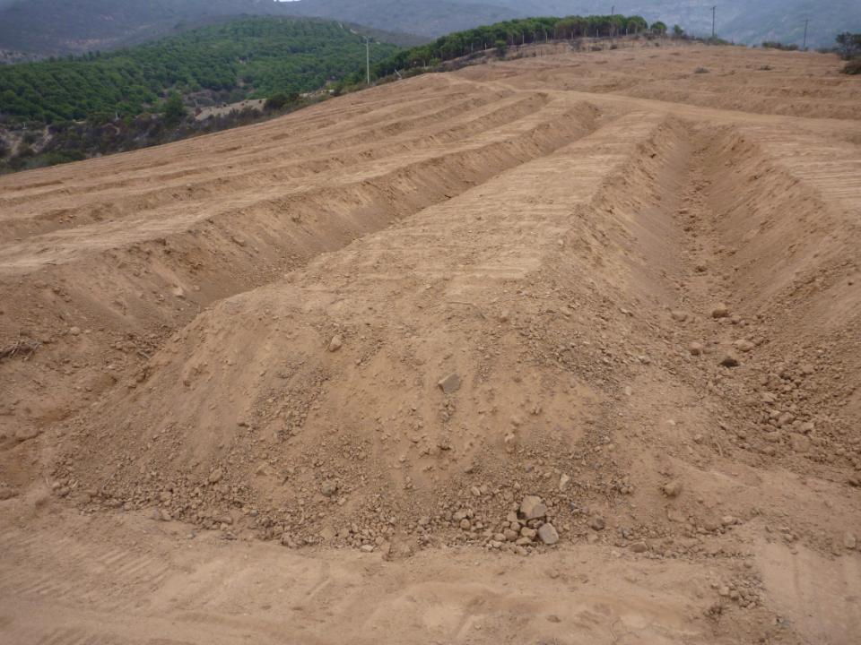
At least 3ft wide on top
At least 3ft high
Wide at the base 8ft

Slide 31
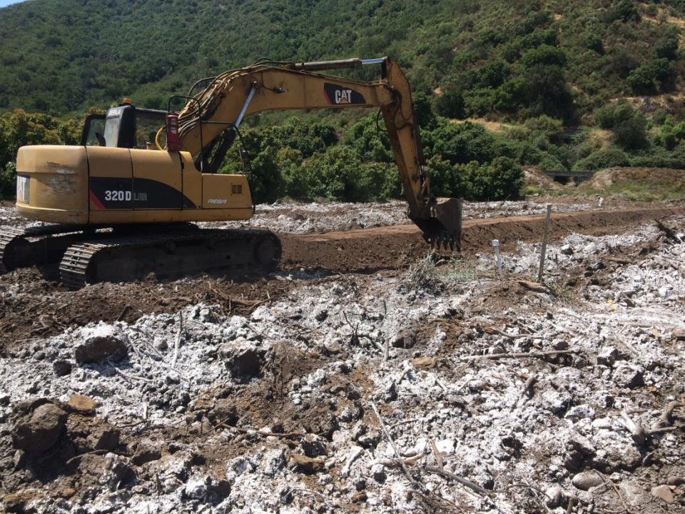
When ridges are made gypsum and organic matter must be mixed with the soil. Be very careful to not mix with deep heavy clay (high compacted) layers.

Slide 32
Soil prep is a essential step in the new project, which must be strictly well programmed and done.
Mistakes made in this stage could affect productive potential in the whole orchard life, and can’t be corrected easily when trees are adult.
It is the only moment to correct and fix compaction problems and improve soil depth.
Not only is a physical prep, but also chemical and biological improvement.

Slide 33
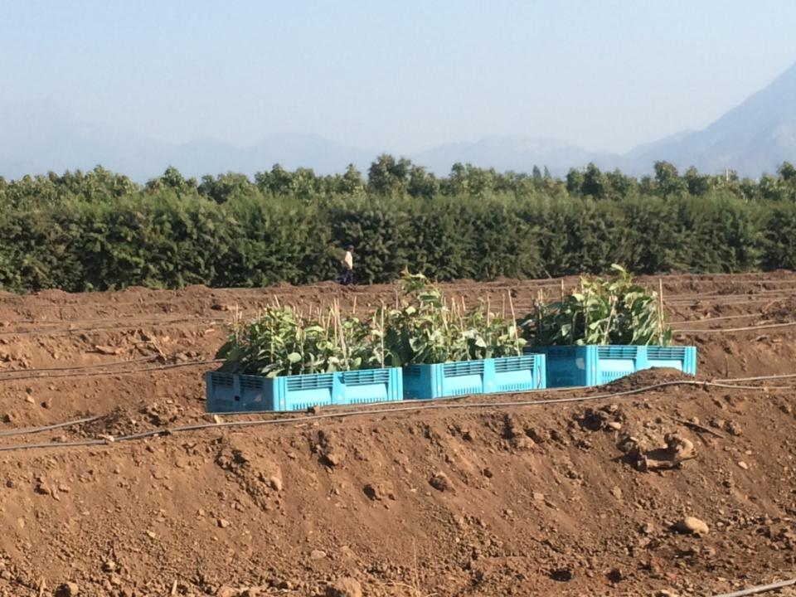
When ridges are made and the irrigation is ready, plants are carried to the field

Slide 34
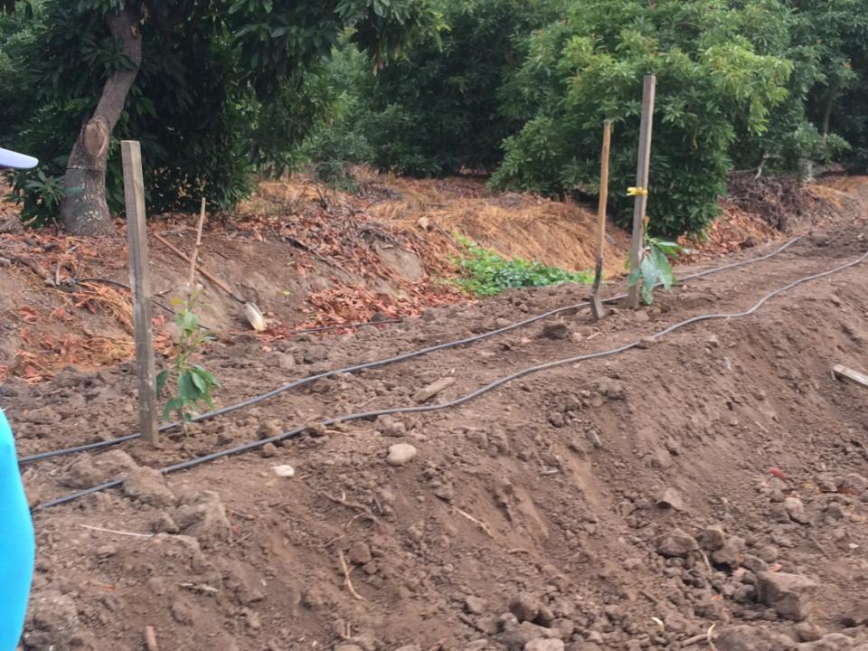
Right after planting the trees, a strong tutor should be installed to avoid to prevent fall down (remember, clonal rootstock doesn’t have deep main roots).

Slide 35
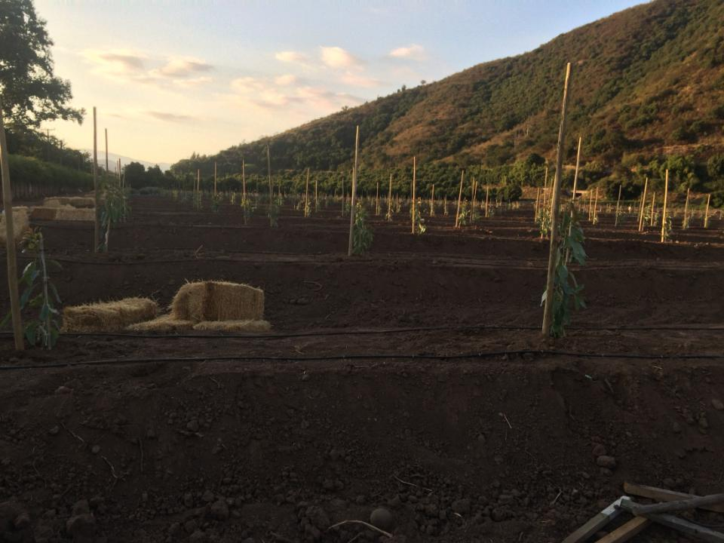
The tutor has to be strong with wood treatment to avoid rot. It has to be buried 3ft to support the trees for at least 3-4 years.

Slide 36
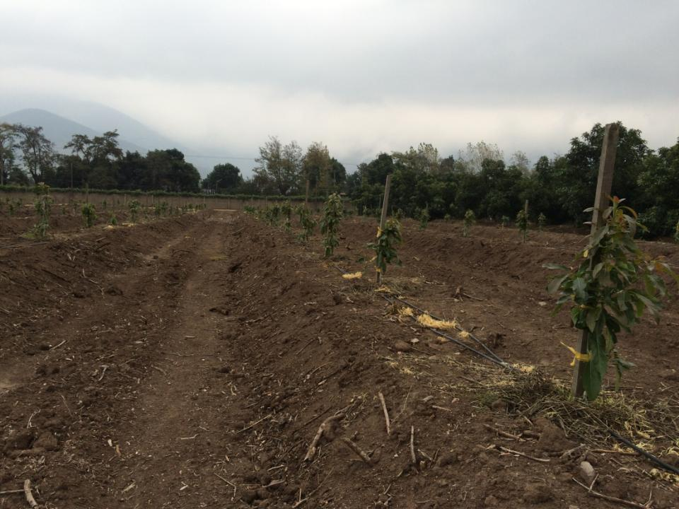
Note the chaff mulch, not a good idea because a major weed problem had a few month after planting!

Slide 37
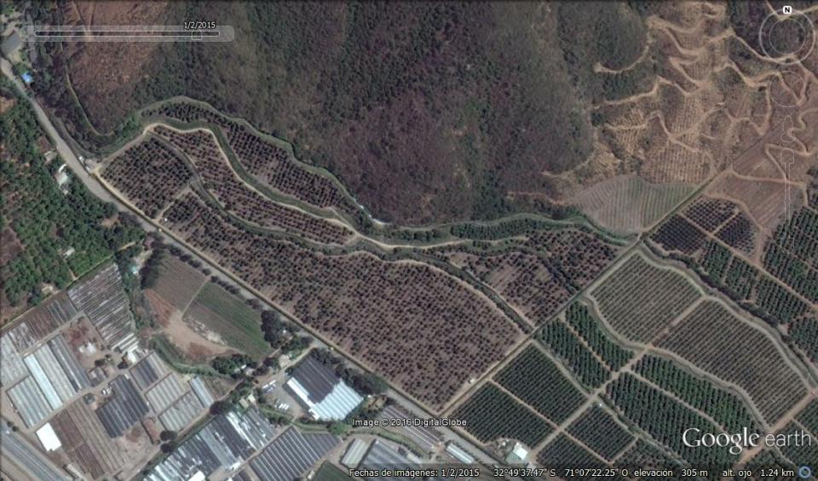
Summer 2015
30 years old avocado orchard. Note the big amount of death trees.

Slide 38
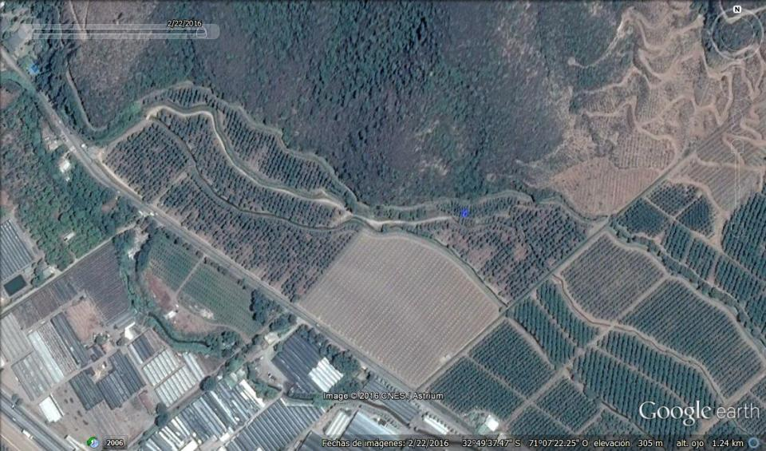
Summer 2016
About 3 hectares were replanted in Spring 2015. We will wait to have the first harvest to replant other big block.

Slide 39
Density planting in clonal rootstock orchards
Higher vigor plants with clonal rootstocks forces to low density planting to gain more space. In other words, it is not advisable to plant a high density orchard with these rootstocks.
Normally, when replanting with clonal rootstock the planting density is around 416 to 833 plants per hectare.
Anyway, climatic conditions of the site (early or late harvest zone) influences the decision.
PGR usage in these rootstocks is still in development. But the primary results are very promising and without a doubt will be a great help to increase density planting.
Finally, the price of the plant with clonal rootstock influence in the density final decision. Are very expensive!!!.

Slide 40
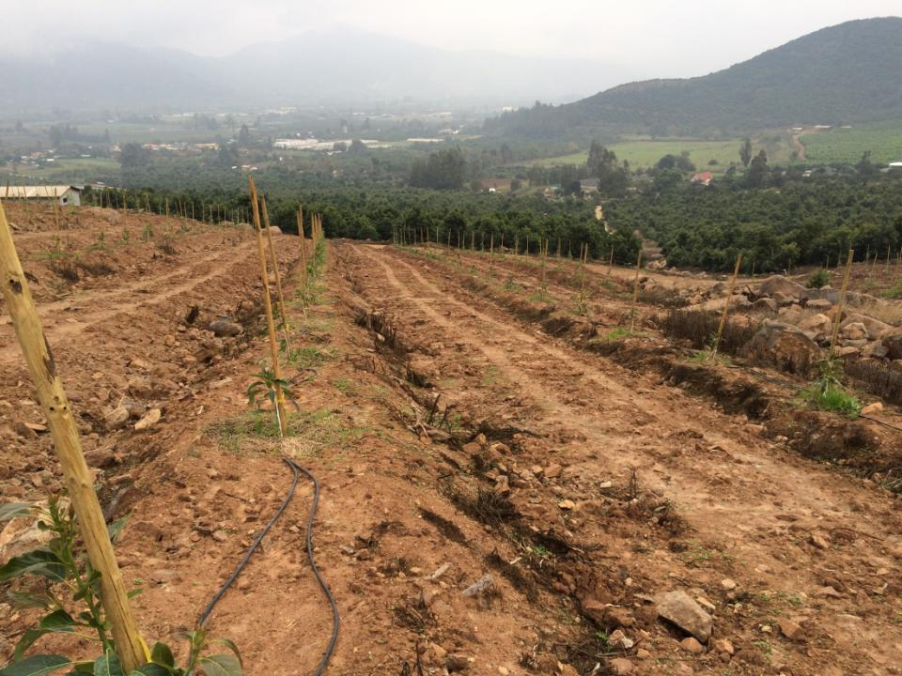
During the first time, this block was thought to be replanted with seedling rootstock in a high density orchard (9ft x 9ft). But finally was replanted with clonal rootstock (Duke 7) 18ft x 9ft, removing the extra ridges.

Slide 41
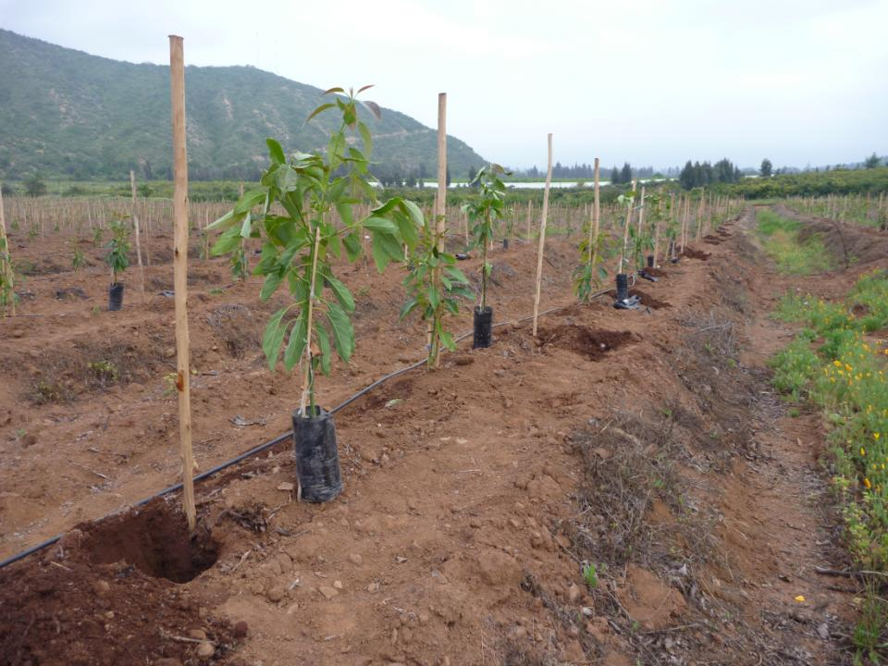
Clonal rootstock
Seedling rootstock
This orchard was replanted (18ft x 6ft) in Spring 2012 planting clonal rootstock (Dusa and Duke 7) alternate with seedling rootstock (Reed). The idea was to increase yields in the first 3 harvests. Then, the seedling rootstock plant will be removed.

Slide 42
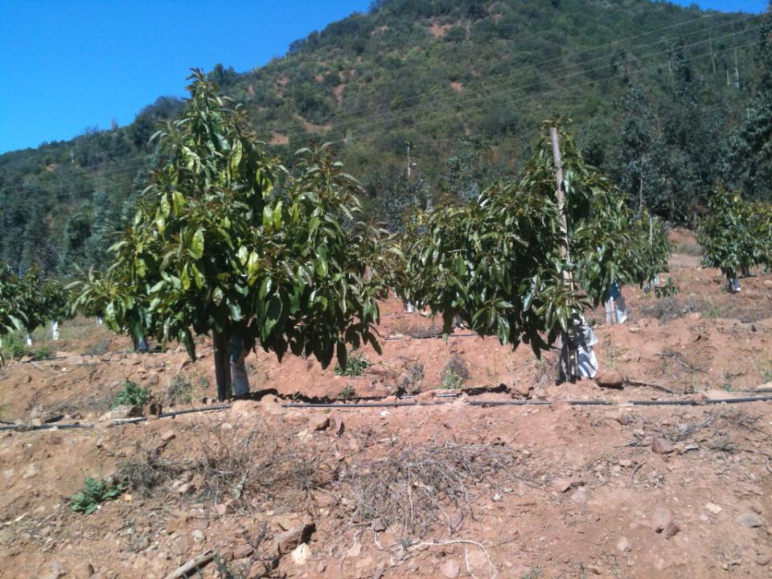
Clonal Rootstock
Seedling Rootstock
Spring 2013, first bloom

Slide 43
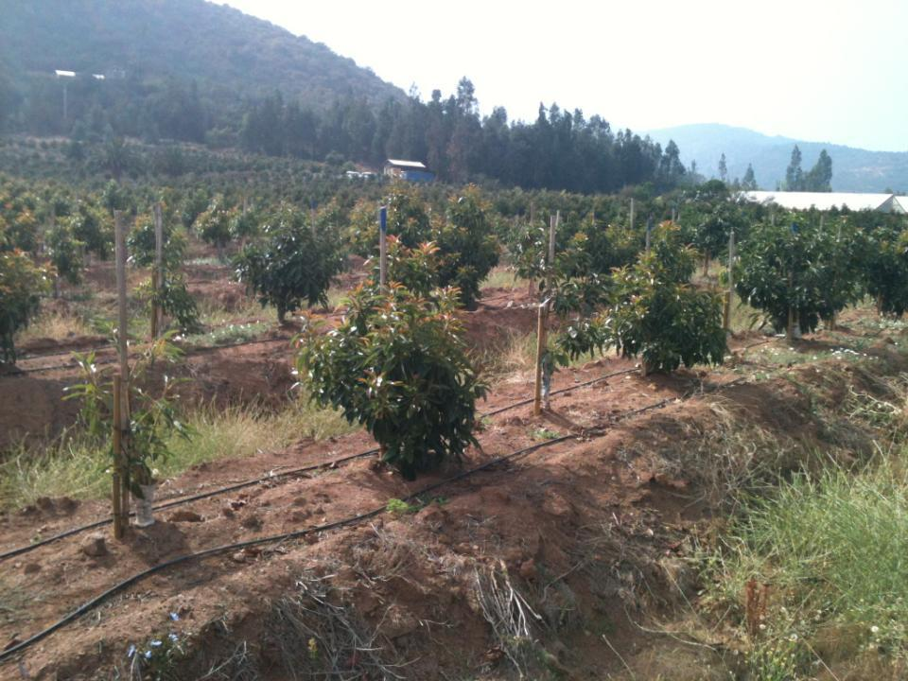
Clonal Rootstock
Seedling Rootstock
Spring 2013, first bloom

Slide 44
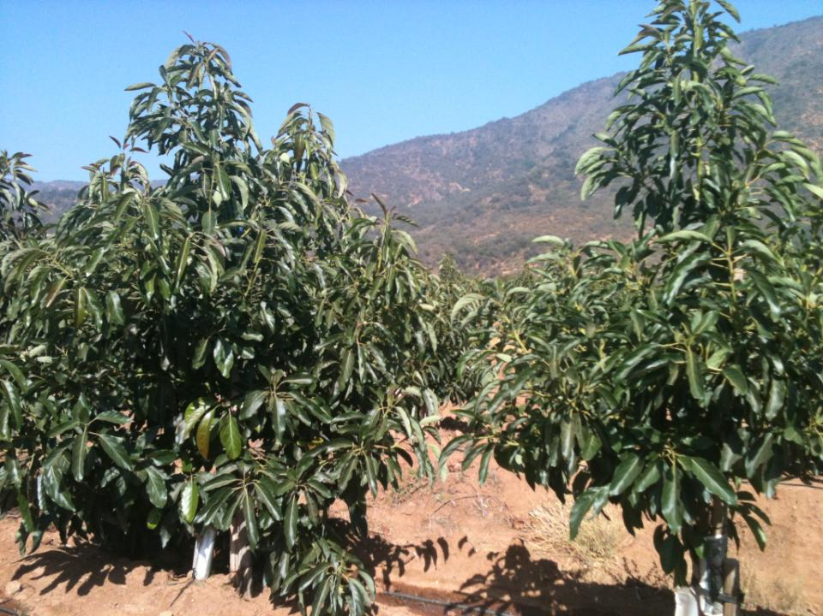
Clonal Rootstock
Seedling Rootstock
Spring 2015: Second harvest around 18ton/hectare. We had the third bloom (Spring 2015) that will give the last crop (Spring 2016), and right after harvest the seedlings rootstock plants will be removed. And the orchard will remain 18 x 12ft only with clonal rootstock.
Spring 2014, first harvest around 12ton/hectare. Second bloom.

Slide 45
Replanting costs per hectare (555 plants/hectare)
Trunks and canopies removal: U$440
Soil prep (flat ground): U$1.030
Clonal rootstocks plants: U$7.345
Planting: U$245
Organic matter: U$330
Irrigation adjusts (no new one): U$220
Tutors: U$980
Other (freight, protectors, planting design): U$ 410
TOTAL: U$11.000.-

Slide 46
2. Replanting inside the orchard
It is not an easy labor and require high attention. The new plants will be irrigated and fertilized in the same way than
adult trees.
Clonal rootstocks has shown successful under these conditions, tolerating very good adverse soil and water conditions.
It should be considered that soil can’t be prepared completely, and large amounts of water will irrigate a little plant in a
compacted soil. Also, light penetration is not as good as we would like, give a very bad conditions for the new plant.
That’s why these replant need all our attention!!.

Slide 47
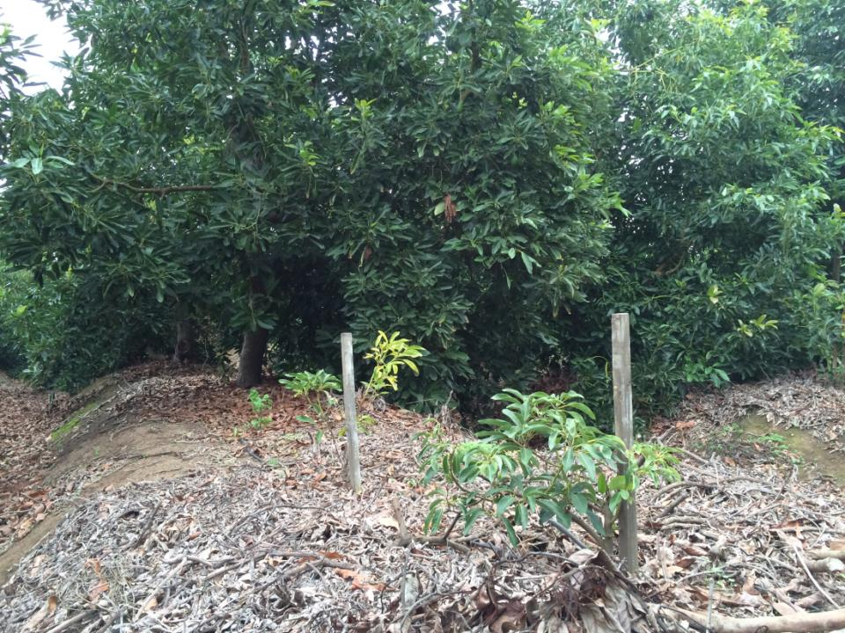
Seedling rootstock normally fail because:
1. High level of Phytophthora cinnamomi colonies in soil.
2. High compaction soil.
3. Big amount of water (from irrigation) causing root asphyxia.

Slide 48
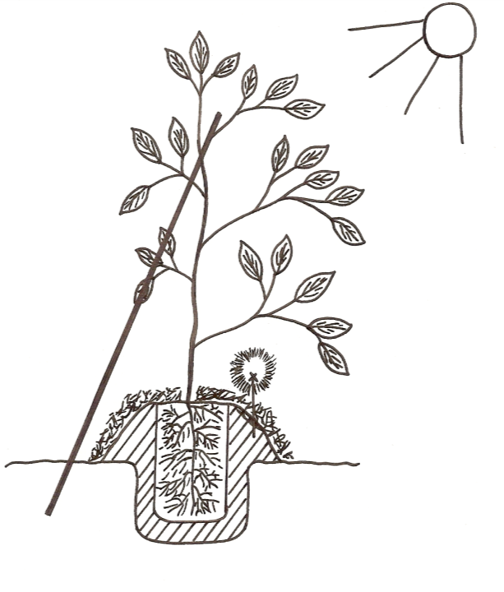
Wind
Scheme of planting avocado clonal rootstock inside the orchard.
This mount is essential to help water drainage and avoid root asphyxia – Root Rot

Slide 49
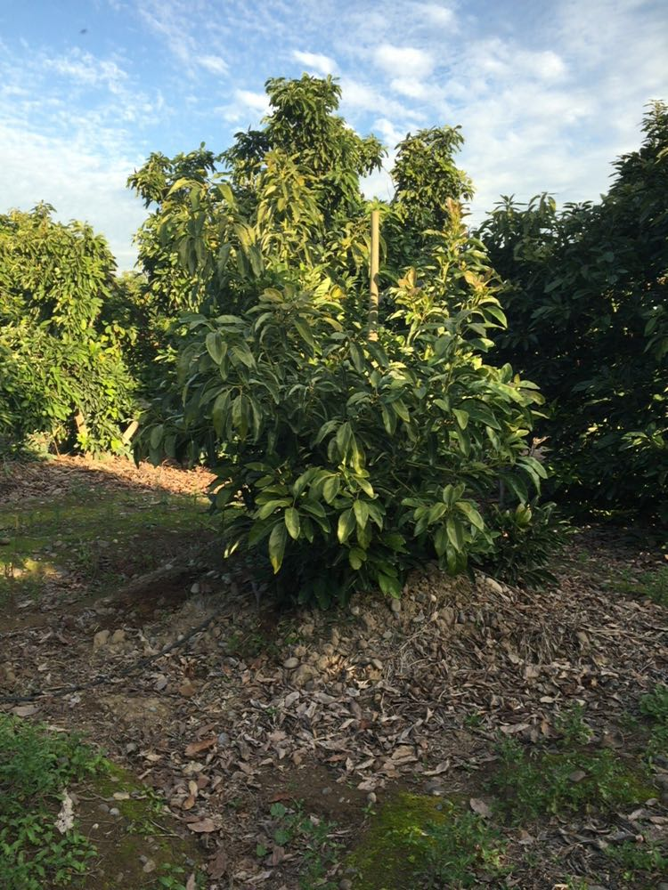
Replanted 2014

Slide 50
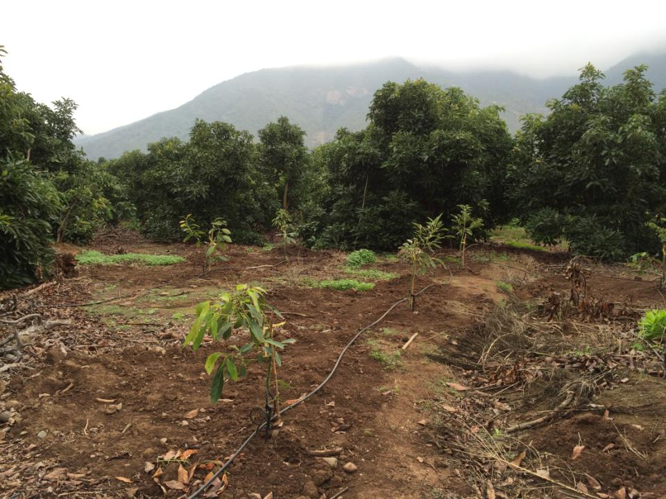
In this orchard, the big tree are healthy, vigorous and very productive.

Slide 51
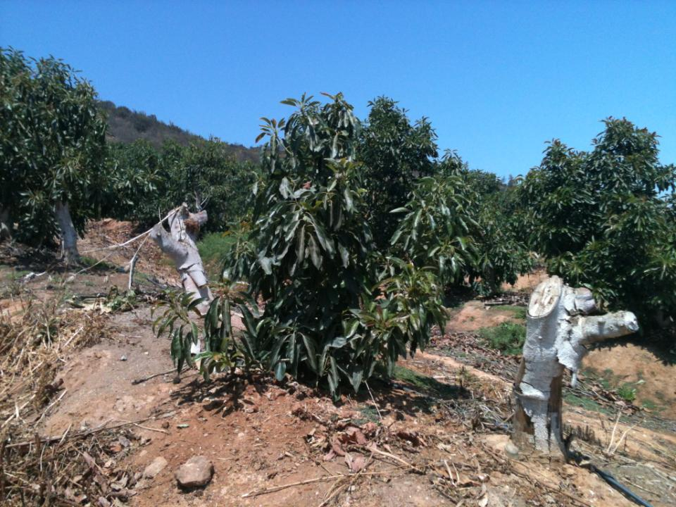
These replant were successful (Duke 7) planted in 2014 between two dead Hass tree. Normally, for two dead trees we replant one clonal rootstock plant.

Slide 52
FINAL CONCLUSIONS – Message to take home…
Over time the avocado trees grow old inevitably, but we can keep our canopies young under a pruning program. This branch renewal pruning program must be executed every year.
Also: Phosphates treatments (Injection, Foliar Sprays); a good fertigation program to keep high vigor trees; Organic – Calcium soil amendments to avoid heavy compaction problems help to keep a healthy and strong roots system. Any rejuvenating strategy depends on healthy roots!
When the orchard yield decreases under financial level, take actions quickly without hesitation.
These actions are directed to rejuvenate productively the canopies:
Branch renewal pruning
Whole orchard or blocks stumping
Replant whole orchard
Replant inside the orchard

Slide 53
Thank you very much for your attention

